Slide 1
Back health

Slide 2
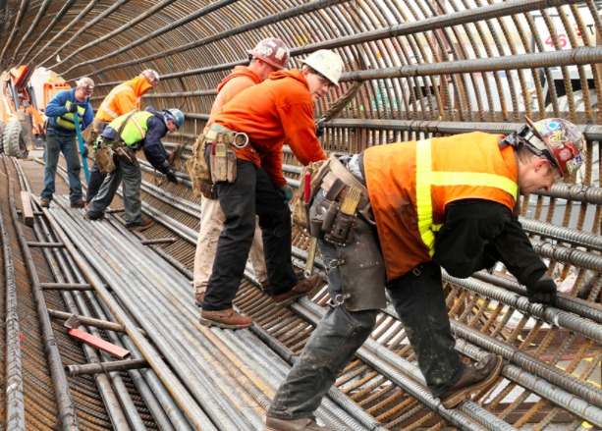
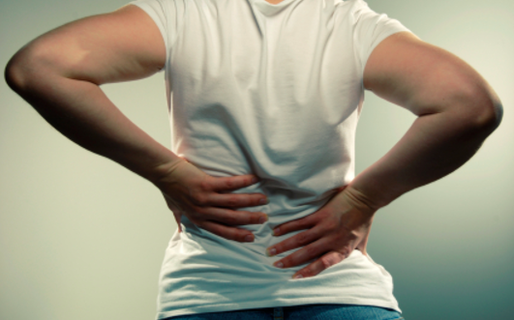
Stresses on the Back
Many occupations place stress on our back
Construction, nursing, factory, office job, etc
Force – placing too much force on your back could injure your back
Lifting something too heavy or improperly
Repetition/overuse – repetitive movements that involves your spine such as twisting could injure your back
Inactivity – sitting at a desk all day with poor posture could negatively impact your back
Notes:
http://www.mayoclinic.org/healthy-lifestyle/adult-health/in-depth/back-pain/art-20044526
Sitting forces the weight of the top half of your body onto a small section of your lower back, stressing the muscles, tendons, and ligaments that support your spine.

Slide 3
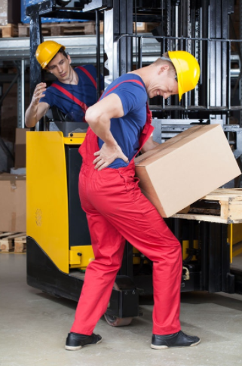
Back Pain Symptoms
May be sharp or dull pain
Comes and goes
Pain may worsen when standing, sitting, walking, bending
Notes:
http://www.mayoclinic.org/healthy-lifestyle/adult-health/in-depth/back-pain/art-20044526

Slide 4
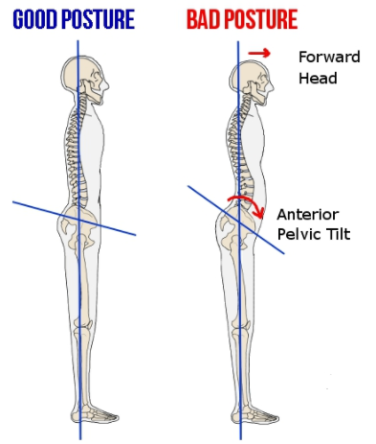
Muscle Imbalances
Muscle imbalances = using a muscle group a lot more than the opposing muscle group
Using certain muscles and neglecting others
Mostly caused by too much sitting
Can cause pain and joint injuries
Body will compensate for muscle imbalances
E.g. Curving of spine and tilting of pelvis
Notes:
https://experiencelife.com/article/office-imbalance/
Office work → hip flexors and chest muscles are shortened and active while glutes and upper back muscles are stretched and inactive
Therefore, tight hip flexors and weak glutes → pelvis is shifted forward and lower back has to compensate
Overuse of chest muscles results in poor posture
Weak upper back and shoulder muscles can cause shoulder pain

Slide 5
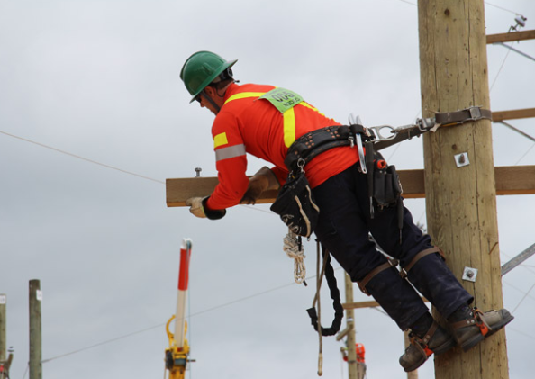
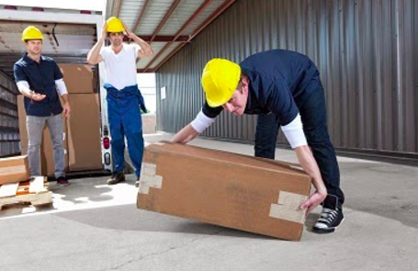
High Physical Requirements at Work
Some jobs require you to lift heavy things
Involves many physical movements like twisting, walking, sudden movement, repetitive lifting of awkwardly shaped objects, whole body vibration, and more
Straining back muscles and may tear a ligament that attaches one vertebrae to another
Repetitive movements puts stress on muscles, tendons, and joints which increases the force on your spine
Pre-work warm ups, finding ways to de-stress, lift safely, & take frequent breaks
Strengthening back, shoulder, and hip muscles
Notes:
http://elcosh.org/document/1648/d000560/preventing-muskuloskeletal-disorders-in-construction-workers.html
If object too big, and you have to bend from waist, the stress on your back is 3 times greater than if you lift from a straight back
Lifting an object that is far away from your body places more stress on your lower back than if the object is closer to you
Lifting above shoulder height places stress on upper back
Twisting/bending WHILE lifting puts more stress on spine
Frequent lifting also puts stress on the discs, tendons and ligaments of the back
Reaching upward causes you to arch your back which increases stress on lower spine
Carrying object with one shoulder, arm, hand, or hip places more stress on one side of the body
Personal safety depends on your endurance
Muscle strength and flexibility can help you to do tasks more efficiently
Pre-work warm ups to increase circulation and decrease changes of injury
Exercise and activity keeps spinal muscles strong
Maintaining healthy weight avoids compression
https://www.ccohs.ca/oshanswers/ergonomics/inj_prev.html
List of more specific ways of back injury prevention (lots are about changing the organization of work flow, training, and education)

Slide 6
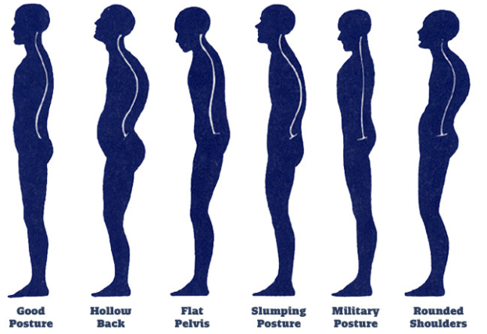
Why Back Health is Important
Leads to a better posture
Better posture helps to:
Improve circulation and digestion
Improve nerve conduction
Improve quality of respiration
Increase your energy
Decrease risk of injury
Decrease risk of depression
Notes:
http://greatist.com/health/ultimate-guide-good-posture
http://www.kansaschirofoundation.org/goodposture-article.html
Good posture places less stress on your body
Vital organs can function optimally when they’re in the right position
Organs are in natural position without compression
https://www.fastcompany.com/3041688/body-week/the-surprising-and-powerful-links-between-posture-and-mood
“sitting in a collapsed, helpless position makes it easier for negative thoughts and memories to appear while sitting in an upright, powerful position makes it easier to have empowering thoughts and memories”

Slide 7
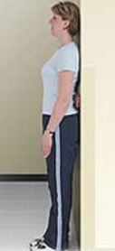
How to Check Your Postural Alignment
Heels against the wall
Buttocks against the wall
Upper back against the wall with back of shoulders touching
Arms falling laterally (not protracted at the shoulder)
Crest of skull against the wall
Abdominal wall contracted (core should be engaged)

Slide 8
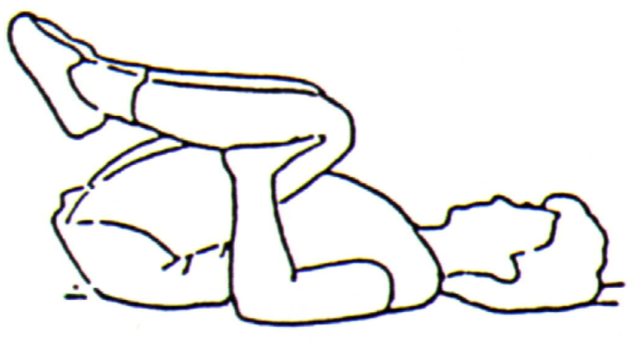
Exercises and Stretches - Back
Lie on your back and bring your knees to your chest. Gently roll from side to side.
Lie on your stomach with your legs together and straight, arms straight, and extended above your head. Keep your head/neck in neutral position. Keeping limbs straight (but not locked), simultaneously lift your arms and legs toward ceiling to form a gentle curve within your body. Hold for a slow 30 counts. Do not hold your breath.

Slide 9
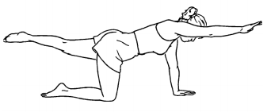
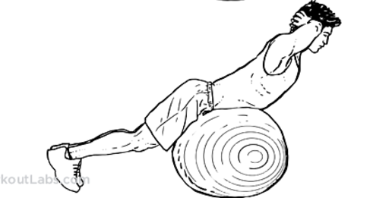
Exercises and Stretches - Back
Place your hands directly under your shoulder with your knees directly under your hips. Simultaneously extend your left arm and right leg while maintaining a flat back and facing downward. Hold for 3 seconds, and repeat with opposite arm and leg. Alternate back and forth for 10-15 repetitions.
Place yourself on a ball so that your abdominals and hips are on it. Keep your toes firm on the ground. Place your hands by your ears or across your chest and then raise your torso up, level with your body. Hold this position for 1-3 seconds. Return back to starting position and repeat 12 – 15 times.

Slide 10
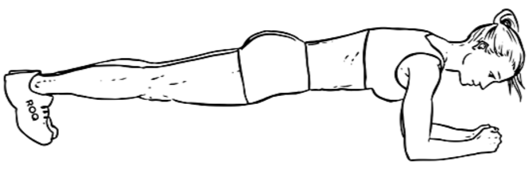
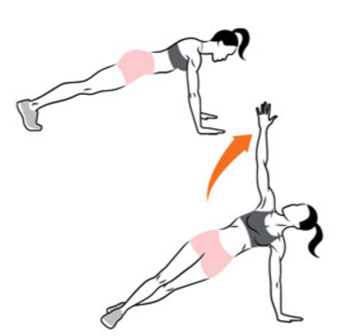
Exercises and Stretches - Back
Position yourself onto your hands and knees. Plant your forearms on the floor and lift up your legs until your body is a straight line – keep your abdominals tight. Try and hold this position for 30 seconds.
Position yourself onto your hands and knees. Plant your forearms on the floor and lift up your legs until your body is a straight line – keep your abdominals tight. Open up your right side of your body by lifting your arm to reach the ceiling while having your left hand and feet planted on the floor. Lower back down to plank position, then twist to your left side, holding your left arm up. Repeat for 20 seconds, making sure you stay in plank position for a beat before switching sides. Rest on all fours for 10 seconds.

Slide 11
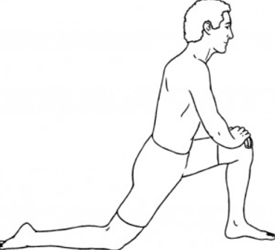
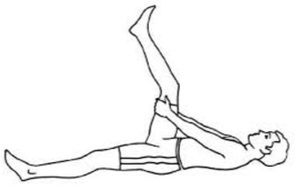
Exercises and Stretches - Hip
Position yourself in a forward lunge with your left leg bent at 90 degrees and your right knee on the ground. Contract your abs and your glutes as you slightly tilt your pelvis. To increase the stretch, reach your right arm up and lean away from the side you are stretching. Hold for up to 2 minutes. Repeat on other side.
Lie on your back on the floor and bend one leg while placing your hand behind the knee. Slowly raise the knee perpendicular to the ground. Extend lower part of leg you are stretching until you feel a stretch on your hamstrings. Hold stretch for 30 seconds and repeat 3 times, then switch leg.

Slide 12
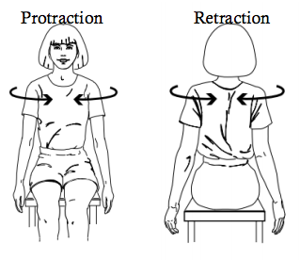
Exercises and Stretches - Shoulder
Protraction – internally rotate your shoulders to take your scapula away from your spine and return to neutral position. Repeat 10 times.
Retraction – externally rotate your shoulders to take your scapula closer to your spine and return to neutral position. Repeat 10 times.

Slide 13
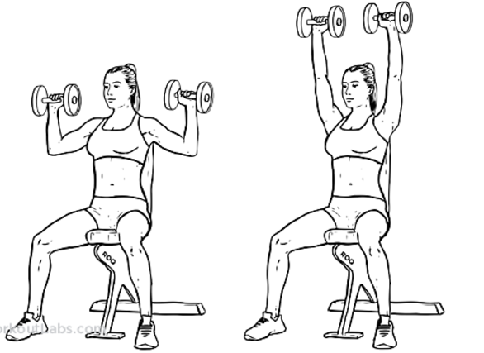
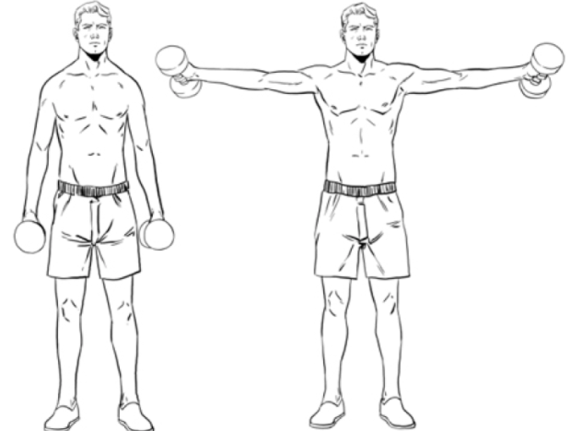
Exercises and Stretches - Shoulder
Position dumbbells to each side of shoulders with elbows below wrists. Press dumbbells upward until arms are extended overhead. Lower to sides of shoulders and repeat 15 times.
Grasp dumbbells with elbows slightly bent. Bend over slightly with hips and knees bent slightly. Raise upper arms to sides until elbows are shoulder height. Maintain elbows' height above or equal to wrists. Lower and repeat. Maintain slight bend through elbows (10° to 30° angle) throughout movement. At top of movement, elbows (not necessarily dumbbells) should be directly lateral to shoulders since elbows are slightly bent forward. Repeat 15 times.

Slide 14
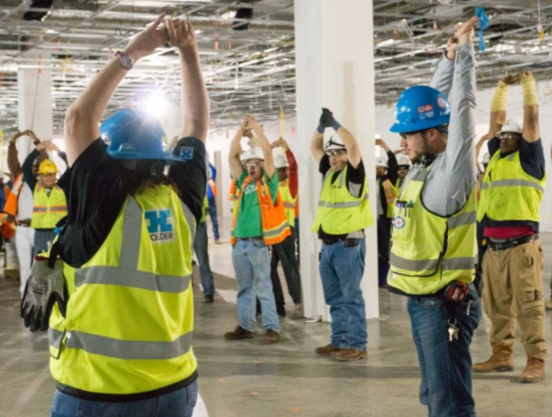
Remember to:
Take breaks and walk around to increase blood flow
Stretch frequently
When sitting at desk, place both feet on the ground
Maintain a healthy weight
Eat healthily
Use proper lifting techniques
Tighten stomach and use legs while lifting
Be smoke-free
Use a swiss-ball instead of a regular chair if possible
Notes:
- Lifting → bend at knees and keep your back straight

Slide 15
Questions and Concerns?
Connect with your wellness coach!

