Slide 1

September 16, 2015
Employee Wellness Solutions Network
DOCS 1950161
Tobacco Use in the Workplace
Insert picture

Slide 2
Key Topics
Learn how you can use screening, brief intervention and referral to treatment (SBIRT) to support employees to reduce and quit tobacco use
Receive tools and resources to help you effectively provide with your employees

Slide 3
Outline
Tobacco and Addiction
Screening, Brief Intervention, Referral and to Treatment (SBIRT) known as 5As
Medications
Ecigarettes
Questions and Answers

Slide 4
Why People Smoke?
Addiction
Dependence
Influences
Physiological
Social
Psychological

Slide 5
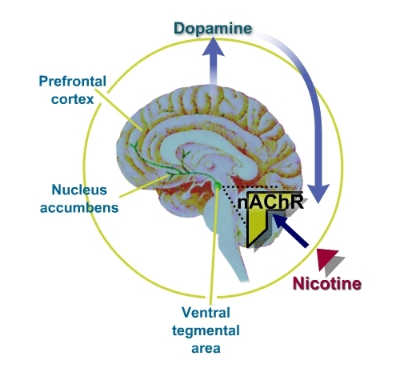
Addiction
Smoking sends nicotine to the brain within a few seconds
Nicotine increases the levels of dopamine in the brain

Slide 6
Tobacco
Cigarettes are “exquisite nicotine delivery
devices”
Highly potent: just 1 mg of nicotine does the trick
Nicotine has a very short half life: 120 minutes
Its addictive effects are similar to cocaine, heroin and amphetamines

Slide 7
Quitting Smoking
Spontaneous quit rate is 2-3%
95% of unaided attempts to quit end in failure
Brief advice (1-3 minutes) from a healthcare provider can increase quit rates by an additional 1-3%
Quit rates increase with intensity of advice
The highest quit rates are achieved using a combination of counseling (cognitive behavioral therapy, motivational interviewing) and pharmacotherapy supports

Slide 8
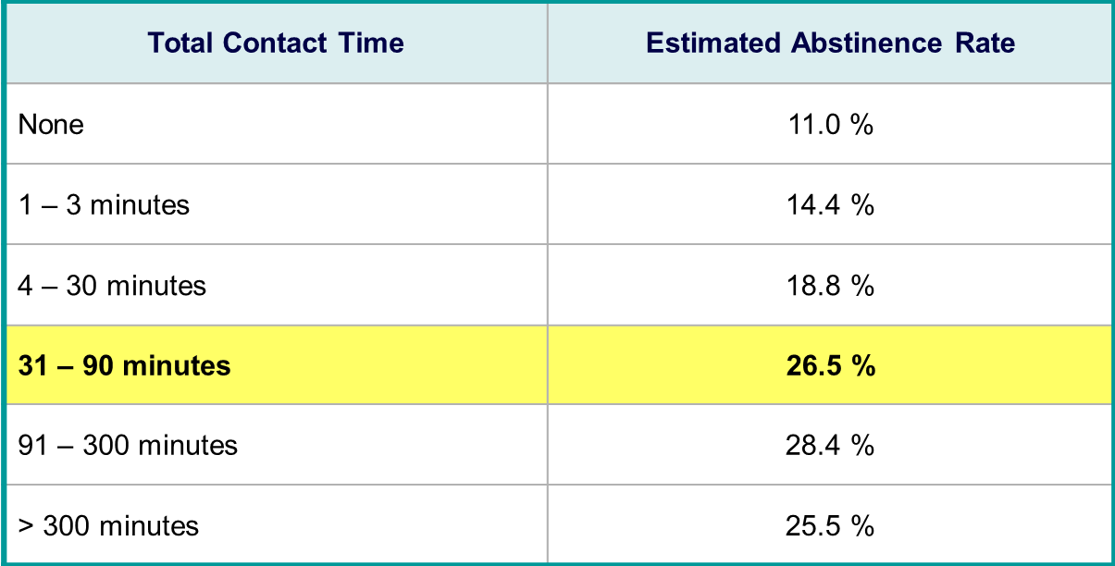
Effective Amount of Contact Time

Slide 9
Quitting Smoking
Repeated interventions are often
required:
Smoking is a chronic addiction that may require repeated intervention over many years
Smokers make several attempts to quit
(average 7-10) before they finally achieve long-term, smoke-free status

Slide 10

Why implement SBIRT (5As)?
Evidence based best practice
Efficient and cost effective
Increases the number of people who make a quit smoking attempt and improves the methods and strategies they use

Slide 11

Motivational Interviewing
It is not what you do to people it is what you do with people
"There is something in human nature that resists being coerced and told what to do. Ironically, it is in acknowledging the other's right and freedom not to change that sometimes makes change possible" (Rollnick S, Miller WR, Butler CC 2008)
Notes:
(Rollnick S, Miller WR, Butler CC – Motivational Interviewing in Health Care: Helping Patients Change Behaviour 2008)

Slide 12
Tobacco SBIRT
5As
ASK
ADVISE
ASSESS
ASSIST
ARRANGE

Slide 13

Ask
Screening
"Have you used any tobacco products in the past six months?"
Type(s) of tobacco used
Duration of use
Amounts used

Slide 14
Advise
Brief Intervention
In a clear, strong, and personalized manner - ADVISE every patient who uses tobacco products to quit
  Clear
  Strong
  Personalized
  As your healthcare provider, quitting smoking is the most important thing you can do to protect your health now and in the future

Slide 15
Assess
Screening
ASSESS Tobacco Users Readiness to Quit
"Are you ready to make a quit attempt at this time?"
"Have you thought about quitting in the next 30 days?"
"Given everything going on in your life right now, how important is quitting for you?
Number and duration of previous quit attempts
Level of Nicotine Addiction?

Slide 16
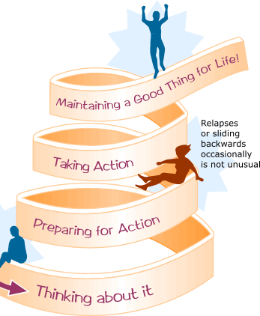
Assess
ASSESS the patient's willingness to quit or cut down
Readiness Ruler

Slide 17
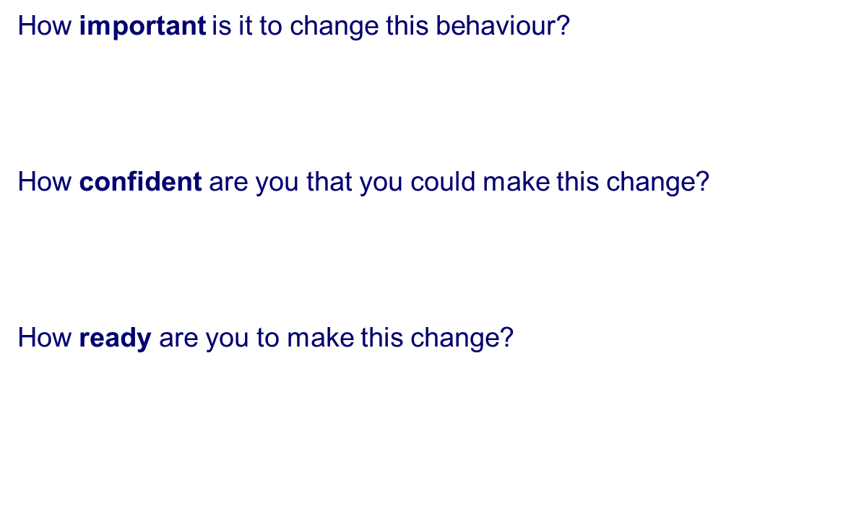

Readiness Ruler
0 1 2 3 4 5 6 7 8 9 10
0 1 2 3 4 5 6 7 8 9 10
0 1 2 3 4 5 6 7 8 9 10

Slide 18
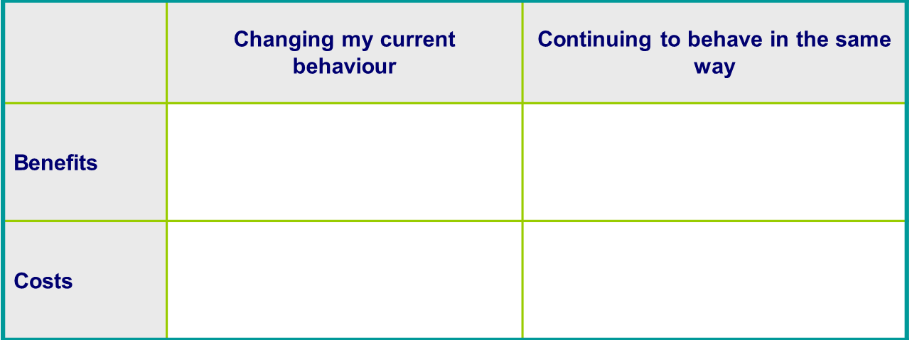
Decision to Change Worksheet

Slide 19

Assist
Brief Intervention
Help the client make a quit plan
  Set a quit date
  Identify triggers and strategies to cope
  Build your toolbox
  Identify supports
  Discuss stop smoking medications

Slide 20
Understanding why you smoke?
When do they smoke?
What a) situations
b) feelings
c) times of day
d) make them want to smoke?
Discuss “triggers” to smoke

Slide 21
Relationship with Smoking
Personal relationship with cigarettes
Describe cigarettes as friend or lover. Quitting is like "losing a friend"
Can experience sense of loss when quitting
Help reframe this thinking… abusive friend
or lover
Acknowledge these emotions

Slide 22
Tracking tools
Tracking sheets / Self-monitoring
  Increase awareness of smoking behaviour
  Identify triggers, challenges
  Suggest which cigarettes will be easy and which will be more difficult
  Begins to break the automatic smoking behaviour and possibly reduces the number of cigarettes smoked

Slide 23
How will you cope with urges?
  Try the 4 Ds
    Distract yourself - do something different
    Deep breathing
    Drink water or fruit juice
    Delay and delay again - the urge will pass

Slide 24
What is in your Toolbox?
Straws
Stress ball
Picture
List of reasons to quit
Sunflower seeds in shell
Sugar free chewing gum or candy
Deck of cards
"junk drawer"
Phone apps
Fresh fruits and veggies
Music
Elastics
Crossword puzzle, doodle pad, Sudoku
Healthy snacks
Water bottle
Support partner
Think about things you like to do?
reward system planned

Slide 25
Other Factors to Consider
Exploring client’s living, work and social environment is critical
Partner smoking is a strong predictor of relapse
We know workplace bans help to reduce the overall smoking rate
Encouraging clients to make all of their environments smoke-free – no safe level of SHS

Slide 26
Cutting Down
Cutting Down
Removing a certain amount of cigarettes a week/day
Track your smoking using a tracking sheet – remove cigarettes that you can do without first
  Not smoking in certain places
  Increase the amount of time between cigarettes using a timer or watch
  Substitute nicotine replacement therapy such as gum, lozenge or inhaler for every couple or every other cigarette

Slide 27
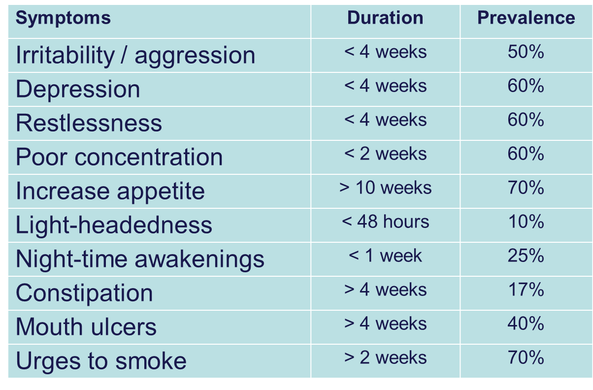
Withdrawal Symptoms

Slide 28
Pharmacotherapy
  If client is interested in medications, refer to physician/pharmacist or provide information
  How much do they know about what is available?
  What are the pros and cons of pharmacotherapy?
  Who will help monitor this part of the quit plan?

Slide 29
Nicotine Replacement Therapy
 | Key Instructions: | Common Side Effects:
Nicotine Gum | “Chew, Chew, Park” | Upset stomach from swallowing nicotine
Nicotine Lozenge | Suck on it to moisten, then park. Don’t chew
Nicotine Inhaler | Inhale gently, hold vapours in mouth (do not inhale) | Dry or irritated throat
Nicotine Mouth Spray | 1-2 sprays in mouth, avoiding lips. Don’t inhale while spraying or swallow immediately | Hiccups, tingling on lips

Slide 30
Patch1
Nicotine Patch
24 hour continuous dose of nicotine
Varying strengths (7-21 mg/day)
Usually used for 8-12 weeks
May experience headache or nausea
May cause sleep disturbance or nightmares
  Take off the patch before bed if this occurs
May cause skin irritation
  Reaction to the adhesive
  Talk to your pharmacist about medicated creams that may help (aloe, OTC hydrocortisone, anti itch cream)

Slide 31
Patch
Nicotine Patch
Remove old patch
Apply to clean dry different area of skin (upper body)
Touch only small corner of adhesive (sticky back of the patch)
Rub patch after application
Wash hands in water after application – don’t use soap
Fold in half (sticky parts together) and discard old patch out of reach of children, animals
Do not use lotion, moisturizing soap where you intend to apply the patch
If patch doesn’t stick well: Clean area with alcohol wipe and use use medical tape

Slide 32
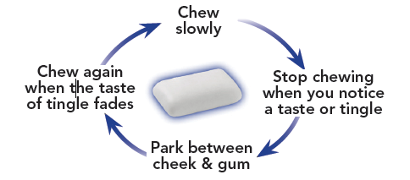
Gum
Nicotine Gum
Provides the body with nicotine over 20-30 mins.
2 & 4 mg doses
Must be able to chew gum (i.e. no dentures)
Do not chew like regular gum
Only use one piece at a time
Works in 10 minutes
Can be used to reduce then quit
Nicotine is absorbed by chewing and then “parking” the gum between the teeth and the cheek

Slide 33
lozenge
Nicotine Lozenge
Do not chew lozenge or swallow saliva
Moisten lozenge in mouth
Move from side to side, for about 1 minute per side until the lozenge is completely gone
Works in 7-10 minutes
Available in doses of 1, 2 and 4 mg
Use approx. 1 per hour, or as needed
Possible side effects:
  mouth irritation, sore jaw, hiccups, heartburn, flatulence, nausea

Slide 34

Inhaler
Nicotine Inhaler
Small tube-shaped mouthpiece
Delivers nicotine by "puffing" NOT inhaling
Nicotine is absorbed in the mouth, cheeks, throat
Satisfies the sensory habitual hand to mouth motion
Single cartridge lasts for approx. 80-400 puffs or 20 minutes of continuous puffing (max. 12 cartridges/day)
One cartridge contains 10mg nicotine, 1 mg menthol
Possible side effects:
  Throat & mouth irritation, initial cough, headache, nausea, indigestion

Slide 35

mist
Nicotine Quickmist Spray
Spray 1-2 times/hour in mouth avoiding lips
Avoid inhaling spray
Works in 1 minute

Slide 36
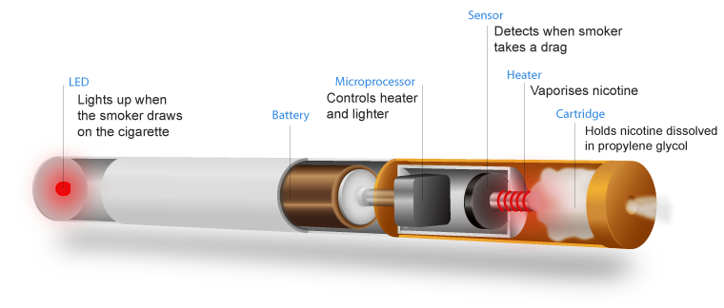
mist
E Cigarettes
Retrieved April 8, 2014 from http://www.viaecigs.com/wp/wp-content/uploads/2013/08/e-cig-diagram.png

Slide 37
Eliquid
E Liquid
E-liquid is vaporized by the e-cigarette and inhaled into the lungs by the user
E-liquid usually contains:
  Propylene glycol (~95%)
  Nicotine of varying amounts (some claim to be nicotine free)
  Flavouring and colouring agents
  Other impurities and additives

Slide 38
Efficacy as a Cessation Aid
Efficacy as Cessation Aid
Few randomized controlled trials
Limited to small studies with weak scientific designs
Some preliminary evidence to suggest that:
  Effective at reducing cravings (with or without nicotine)
  Can deliver relatively high levels of nicotine (self-titrate)
Inconclusive, require more rigorous studies
Major issue – lack of regulation of e-liquids and e-cigarette devices make it difficult to determine nicotine dosing

Slide 39
Potential Health Effects
Potential Health Effects
E-cigarettes are less harmful than cigarettes (no combustion)
Need to determine safety of use, especially long-term use
The FDA found a number of impurities in e-liquid cartridges including polycyclic aromatic hydrocarbons and tobacco-specific nitrosamines, which are carcinogenic (1)
A study evaluating the vapor from 12 brands of e-cigarettes found potentially toxic and carcinogenic substances, but at levels much lower than those found in cigarette smoke (2)
Common side effects include: mouth and throat irritation, and dry cough

Slide 40
Prescription Medications:ZYBAN
Zyban (Buproprion)
Reduces withdrawal symptoms, cravings and urge to smoke
Prescribed by your doctor
Start taking one week before you quit
Shown to double ones chances of quitting
Can be used in combination with nicotine replacement
Treatment lasts 7 to 12 weeks

Slide 41
Prescription Medication:CHAMPIX
Specifically designed for smoking cessation
Must be prescribed by a physician
Cannot combine with NRT
Treatment lasts ~12 weeks

Slide 42
Arrange
Referral to Treatment
ARRANGE for follow-up with yourself or programs/services in your practice
Other forms of quit support such as:
  Telephone - Smoker’s Helpline 1-877-513-5333, On-line www.smokershelpline.ca
  Primary care provider
  Individual or group supports in the community

Slide 43
Health Benefits
What does your employee benefit package cover for smoking cessation treatment?
  Employee Assistance Program
  Medication coverage and amounts
  Flex funds or other ways to access medications

Slide 44
Putting it all together: 5As in 3 minutes
https://www.youtube.com/watch?v=yzWfgjXsgr4&feature=related

Slide 45
Opportunities
STOP on the Road Workshops (Smoking Treatment for Ontario Patients)
Eligible participants will
    Attend a 3 hour workshop
    Receive 5 weeks of NRT patch FREE
MATCH STUDY
Medication Aids for Tobacco Cessation and Health (MATCH)
Provides 12 weeks of medication at no cost

Slide 46
Additional Training
Fundamentals of Tobacco Intervention
  Wednesday October 28th, full day training in Cambridge
Centre for Addiction and Mental Health – Training Enhancement in Applied Cessation Counseling and Health (T.E.A.C.H)
https://www.nicotinedependenceclinic.com/English/teach/Pages/Courses/Online-Courses.aspx

Slide 47
Follow Up: Relapse Prevention
Most common in first 1-2 weeks – schedule follow-up accordingly
Trigger situations plan
  Continue identifying triggers, stressful situations
  Continue self-monitoring
Pharmacotherapy instructions and appropriate dosing
Reset quit/reduce date if needed
Congratulate your client for coming back and/or for progress to date
Weight control
Physical activity
Social supports
Can be one session or several sessions

Slide 48
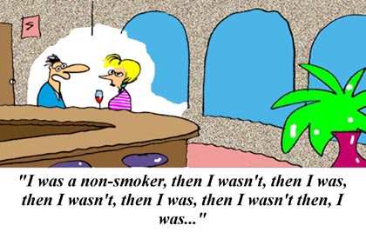
Don't Quit Quitting
Don' Quit Quitting
Quitting smoking takes time. It’s a process, and every time you try to quit, you get closer to making it.

Slide 49

Wrap up

Slide 50
Thank You
Karen Haughey, RN, BScN, MSc
Public Health Nurse, Tobacco and Cancer Prevention
Region of Waterloo Public Health and Emergency Services, Healthy Living Division
150 Main Street, 3rd floor
Cambridge, ON., N1R 6P9
Phone: 519-575-4400 ext. 3438
e-mail: khaughey@regionofwaterloo.ca

