Slide 1
Employee Wellness Program
www.EWSNetwork.com
Notes:
Rules
Talk about the last 2 years

Slide 2
Founded in October 2003 in London, ON
Clients in over 110 locations and in over 60 cities
Over 30 wellness consultants
Network of strategic affiliates
Average client engagement is >80%.
Recognition
Winner - 2015 KW Chamber of Commerce Health and Wellness
Winner - 2014 Benefits Canada Health & Wellness Program of the Year Award
Winner - 2014 Benefits Canada Engagement Award
Finalist - 2014 Benefits Canada Communication Award
Finalist - 2014 Benefits Canada Strategic Partnership Award
Finalist - 2013 Benefits Health and Wellness Program of the Year Award
Finalist - 2013 Benefits Canada Strategic Partnership Award
Finalist - 2012 Benefits Health and Wellness Program of the Year Award
Winner - 2012 Benefits Canada Strategic Partnership Award
Winner - 2011 Benefits Canada Health & Wellness Program of the Year Award
www.EWSNetwork.com

Slide 3
Wellness is a Natural Progression Over Time
Readiness to Change
Pre-contemplators
Contemplators
Preparation
Action
Maintenance
People are Unique
Goals
Amount of Information
Level of Information
Time frame
Topic
Therefore employee wellness can not be a “catch all” program.
www.EWSNetwork.com
Notes:
Internal programs tend to cater to the healthy

Slide 4
Why is
EWSNetwork
Different
www.EWSNetwork.com

Slide 5
Onsite
Engagement
Outreach
Encouragement
www.EWSNetwork.com

Slide 6
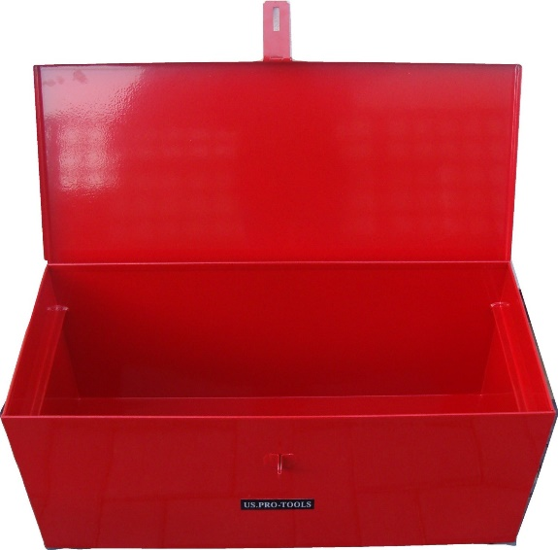
The EWSNetwork Toolbox
Virtual
Mental Health
Group & Awareness
Individual
www.EWSNetwork.com

Slide 7
Retain EWSNetwork
Consultations
Majority of hours
1hr
1hr
1hr
1hr
1hr
1hr
Seminars
1hr
1hr
1hr
Walk Arounds
Admin Programs
Challenges
Newsletters
Posters, Kiosks
E-campaigns
Analysis & Reporting
Group X
Health Fairs
www.EWSNetwork.com

Slide 8
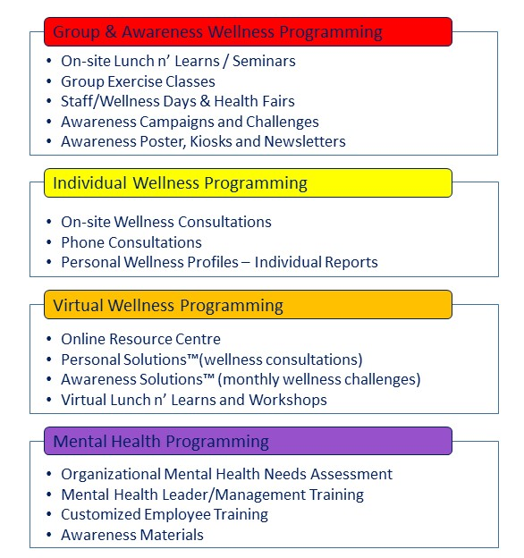
Group & Awareness
www.EWSNetwork.com

Slide 9
Individual
www.EWSNetwork.com

Slide 10
Virtual
www.EWSNetwork.com

Slide 11
Mental Health
www.EWSNetwork.com

Slide 12
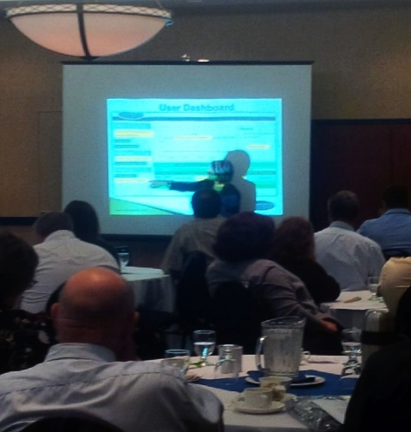
Wellness Program Roll-out
Optional Management Pre-launch
Opportunity to inform management about program components and how they can help with its success.
www.EWSNetwork.com

Slide 13
Wellness Program Roll-out
Optional Management Pre-launch
Opportunity to inform management about program components and how they can help with its success.
Program Launch
Explanation of new benefit/program.
Group/Awareness programs may be implemented in the upcoming months
Introduction of wellness consulting team
Consultation Sign-up
www.EWSNetwork.com

Slide 14
EWSNetwork Consultants
Qualified/Certified Fitness and Nutrition Wellness Consultants
Monthly Training Calls with Consultant Manager
EWSNetwork System Trained
Quarterly EWSNetwork Team Training Webinars
www.EWSNetwork.com

Slide 15
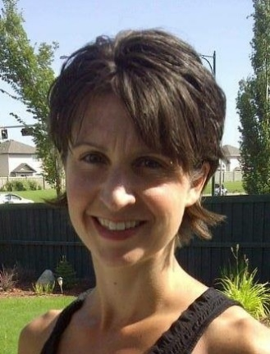
Edmonton Wellness Consulting Team
Kendra
Devan
Erin
Brandy
Amanda
www.EWSNetwork.com

Slide 16
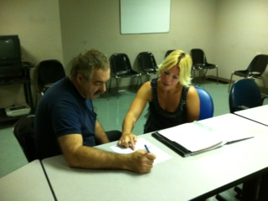
Wellness Coaching/Consultations
30 minute one-on-one confidential appointments with a wellness consultant
Desired turn-around is 4-5 weeks
Trust, rapport, accountability, motivation, on-going support
Nutrition, fitness, stress, sleep, lifestyle behaviour change
www.EWSNetwork.com

Slide 17
Wellness Coaching/Consultations
Traditional Personal Training Relationship
30 minute one-on-one confidential appointments with a wellness consultant
Desired turn-around is 4-5 weeks
Trust, rapport, accountability, motivation, on-going support
Nutrition, fitness, stress, sleep, lifestyle behaviour change
www.EWSNetwork.com

Slide 18
Wellness Coaching/Consultations
Corporate Wellness
30 minute one-on-one confidential appointments with a wellness consultant
Desired turn-around is 4-5 weeks
Trust, rapport, accountability, motivation, on-going support
Nutrition, fitness, stress, sleep, lifestyle behaviour change
www.EWSNetwork.com

Slide 19
Wellness Program Roll-out
Optional Management Pre-launch
Opportunity to inform management about program components and how they can help with its success.
Program Launch
Explanation of new benefit/program.
Group/Awareness programs may be implemented in the upcoming months
Introduction of wellness consulting team
Consultation Sign-up
Wellness Committee Sign-up
www.EWSNetwork.com

Slide 20
The EWSNetwork
“Wellness Champion”
Certification Program
www.EWSNetwork.com

Slide 21
Wellness Program Roll-out
Optional Management Pre-launch
Opportunity to inform management about program components and how they can help with its success.
Program Launch
Explanation of new benefit/program.
Group/Awareness programs may be implemented in the upcoming months
Introduction of wellness consulting team
Consultation Sign-up
Wellness Committee Sign-up
Launch Health Risk Assessment
Employee benefits and company benefit
www.EWSNetwork.com

Slide 22
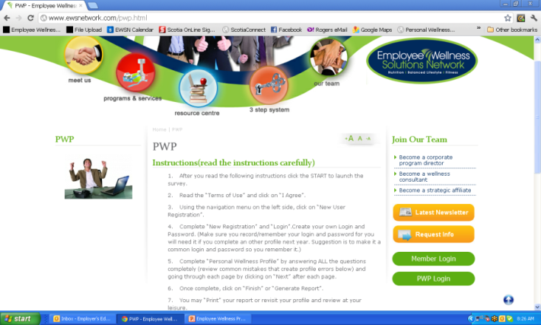
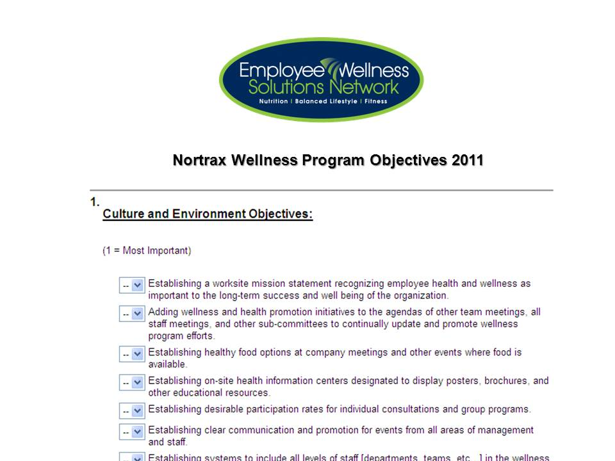
30-Day Analysis
Health Risk Assessment
Metrics Analysis
Drug Classification
# Health Claims
$ Health Claims
… and more
Objectives Surveys & Strategic Planning
Consultation Analysis
Analysis of the First 30-days of
One-on-One Consultations
www.EWSNetwork.com

Slide 23
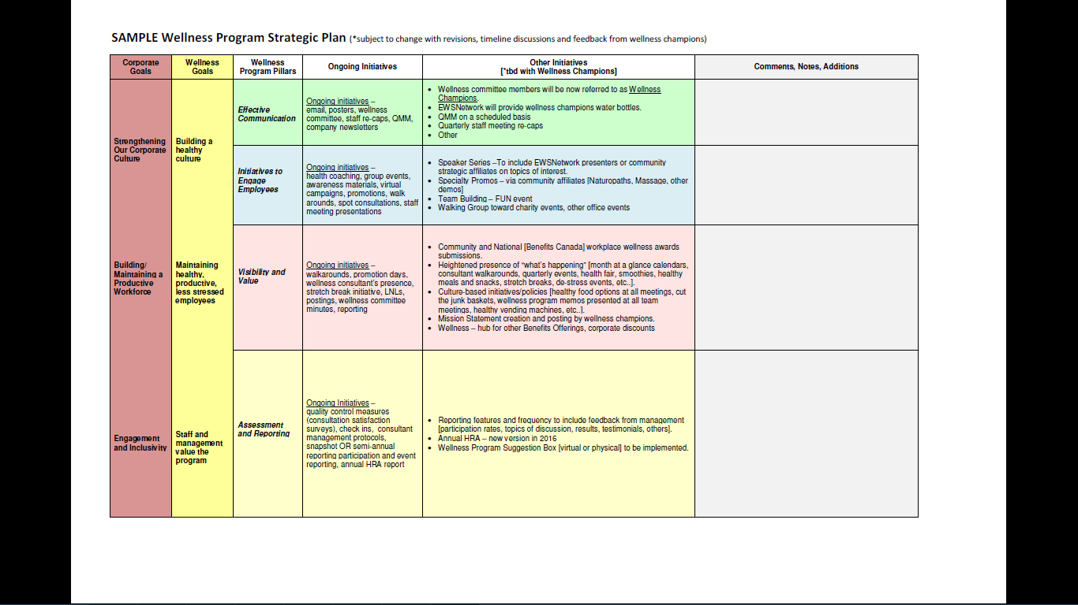
Wellness Program Strategic Plan

Slide 24
Wellness Program Strategic Plan
Corporate Goals

Slide 25
Wellness Program Strategic Plan
Wellness Goals

Slide 26
Wellness Program Strategic Plan
Custom Wellness Initiatives
Report Card
Communication, Engagement,
Visibility, Assessment/Reporting

Slide 27
Customized Programming
Company ABC Jan-June 2014 At-A-Glance [subject to change as per wellness committee, needs and interests] PWP Focus [weight management, improved fitness, nutrition, heart health, stress]
Initiative | Jan | Feb | March | Apr | May | June
Consultations | One-on-One Consultations – on-site
Individual | NEW Virtual Online Profile, Wellness Tracking, Calendar of Events
PWP |  |  |  |  |  | June
Exercise Class/Series |  |  |  | Walking routes/groups; site specific Yoga/morning stretching
Lunch n’ Learns/Webinars | Healthy Weights | Healthy Weights | It’s In You to Move (coincide with site visit)
Workshop
Group Challenge [team] |  |  | Healthy Potluck at each site |  | Pedometer Challenge
Virtual Challenge [team] | Portal and Challenge
Newsletter | Ongoing Monthly Newsletter and Personal Challenge
Kiosk / Poster Display | A Healthy Weight for You |  |  | It’s in You to MOVE
POD Posters | ongoing
BPOS Sleeve Posters | ongoing
Email/On-site/Pay-Stub Campaign | Healthy Weights | Healthy Weights |  | Taking Breaks | Step Into Summer
Walk Around |  | Healthy Snacking with almonds |  | Desk Stretches |  | PWP Instructions
Promo Day | Healthy Eating Yogurt Parfaits – month tba
Wellness Challenge [Individual] |  |  | Low GI Foods |  | Step Check IC
Virtual Challenge [individual] | Individual Challenge
Health Fair | Fall 2014
Corporate Reporting |  |  | Q1 Report |  |  | PWP & Q2 Report
Componen
t
s
Programs

Slide 28
Online and Virtual Components
Employee Portal
Virtual Challenges
EWSNetwork Reporting
www.EWSNetwork.com

Slide 29
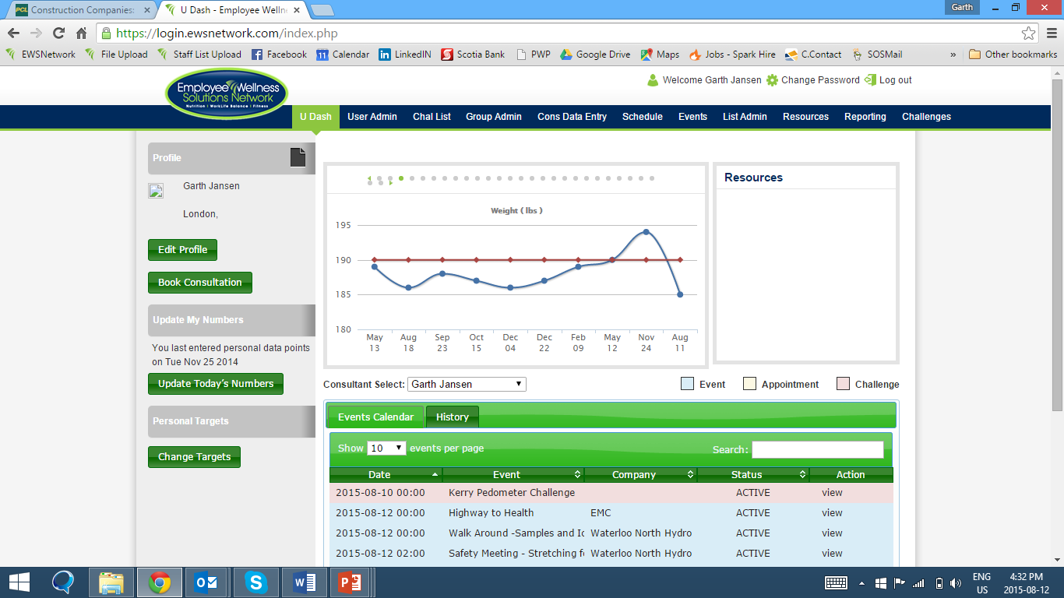
Employee Portal
Follow Your Progress
Book Consultation
Key Resources
Enter Your Numbers
Enter Your Targets
See and Register for Events
www.EWSNetwork.com

Slide 30
Online and Virtual Components
Employee Portal
Virtual Challenges
EWSNetwork Reporting
www.EWSNetwork.com

Slide 31
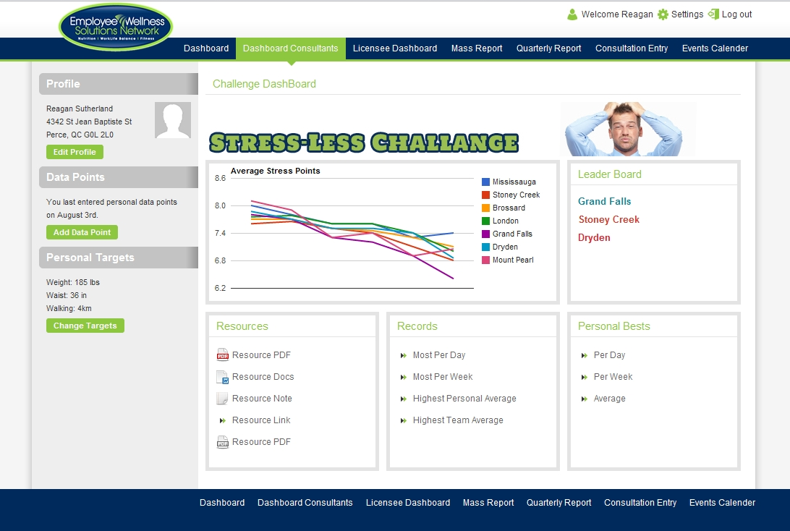
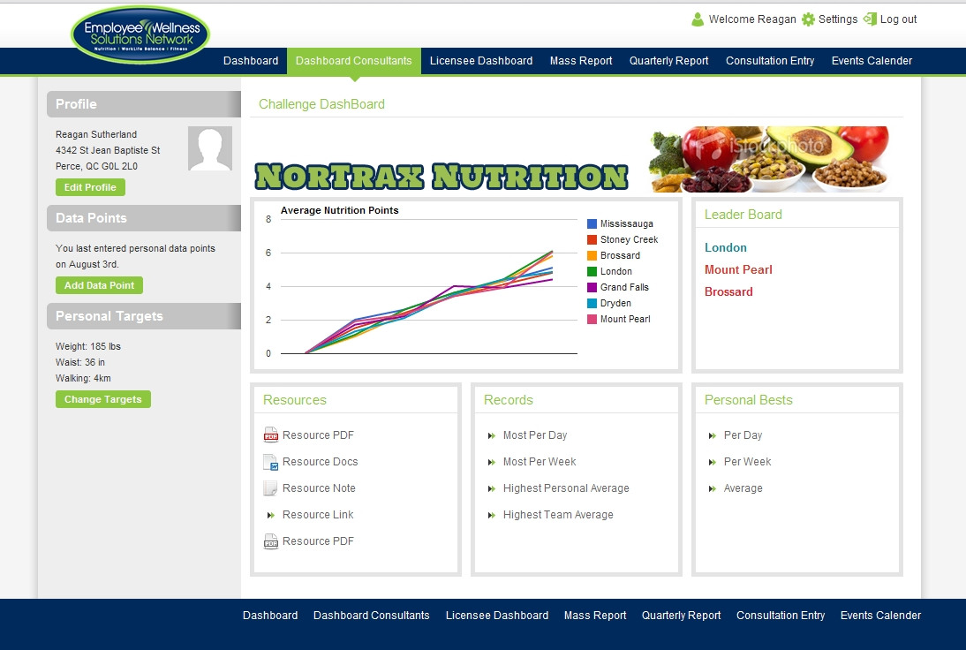
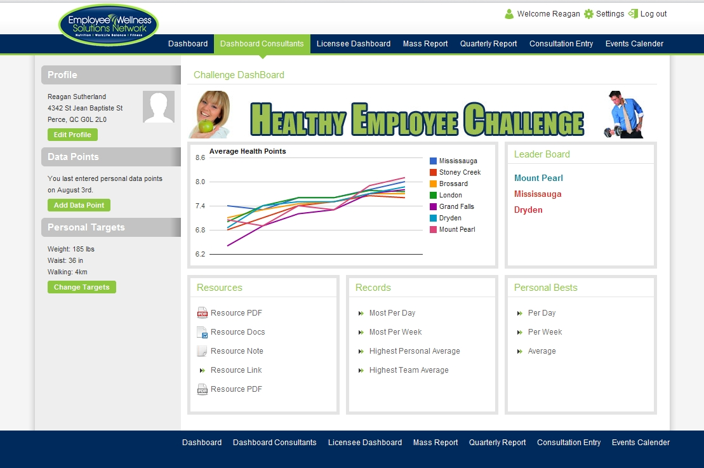
Virtual Challenges
www.EWSNetwork.com
Notes:
Virtual programming – tba as per wellness committee, etc..
ON YOUR USER DASHBOARD, YOU’LL SEE A VIRTUAL CHALLENGE TAB WHEN WE LAUNCH A VIRTUAL CHALLENGE

Slide 32
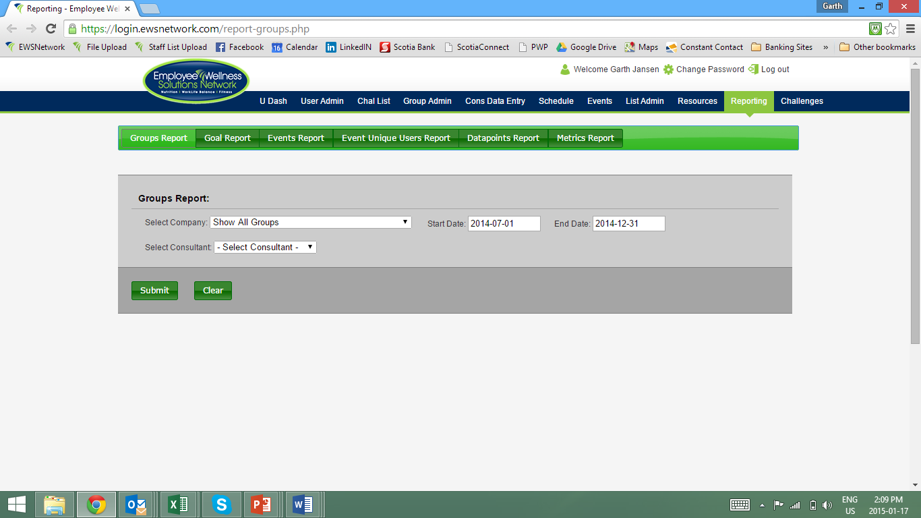
Online and Virtual Components
Employee Portal
Virtual Challenges
EWSNetwork Reporting
HRA Report
Consultation Report - bookings/attendance rates and unique users
Consultation Unique User Report
Program Reconciliation Report
Event Unique Users Report
Event Report
Individual Data Trending
Metrics Report
www.EWSNetwork.com

Slide 33
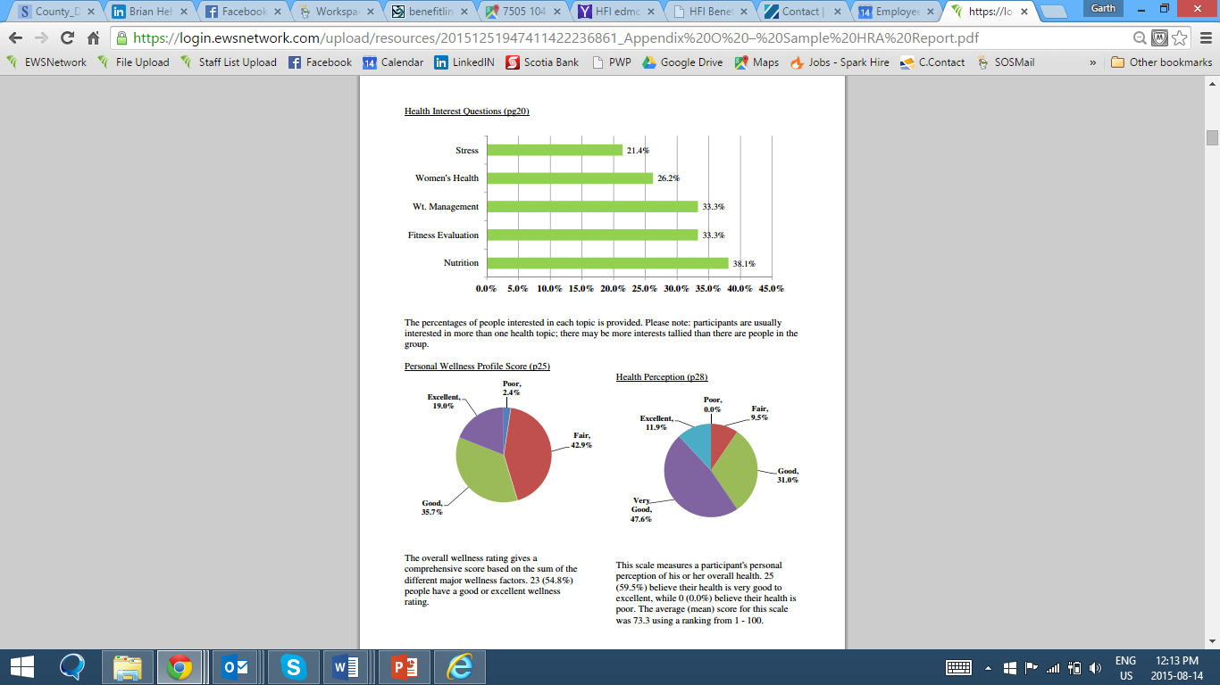
Health Risk Assessment Report
www.EWSNetwork.com

Slide 34
Consultation Report
Bookings | 120 |  | Hours for Events (hrs) | 21
% Booked | 96.00% |  | Hours Used from Events (hrs) | 23
 |  |  | Reconciliation (hrs) | 2
Attended | 114
% Attended | 95.00% |  | Unique Users in Company | 40
Hours of Attended Apts | 57 |  | Percentage of Company | 55.56%
 |  |  | Avg Appts per user per timeframe | 2.85
Cancelled or No-Show | 15 |  | Users who entered >1 datapoints | 20
% Cancelled | 12.50%
 |  |  | 1x | 11
Cancellations or No-Show Rebooked | 10 |  | 2x | 8
% Cancellations Rebooked | 8.33% |  | 3x | 8
 |  |  | 4x | 7
Actual Cancelled or No-Show Apts | 5 |  | 5x | 2
% Actual Cancelled or No-Show Appts | 4.17% |  | 6x | 3
 |  |  | 7x | 1
www.EWSNetwork.com

Slide 35
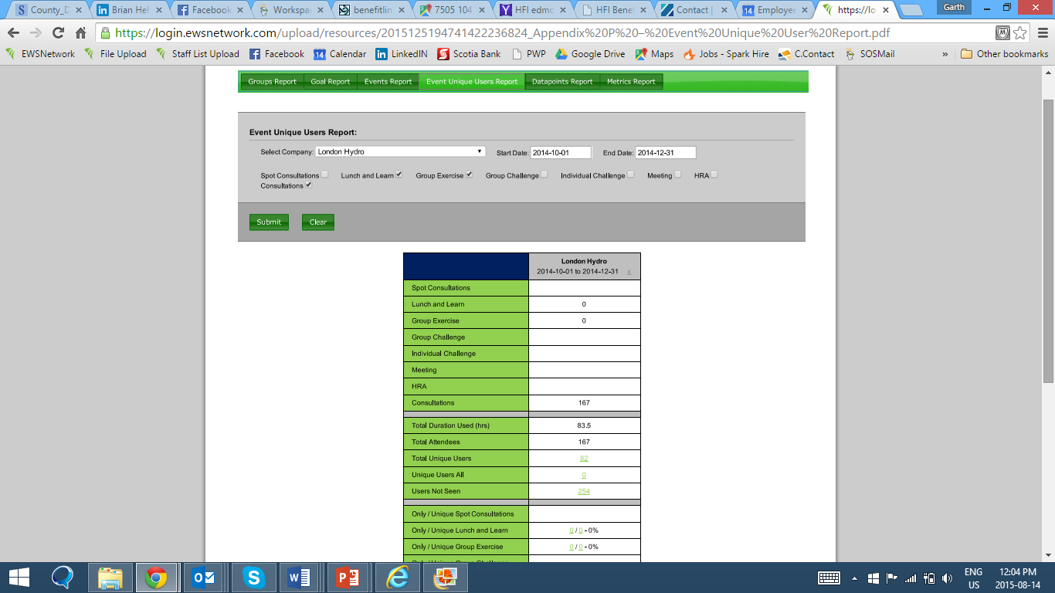
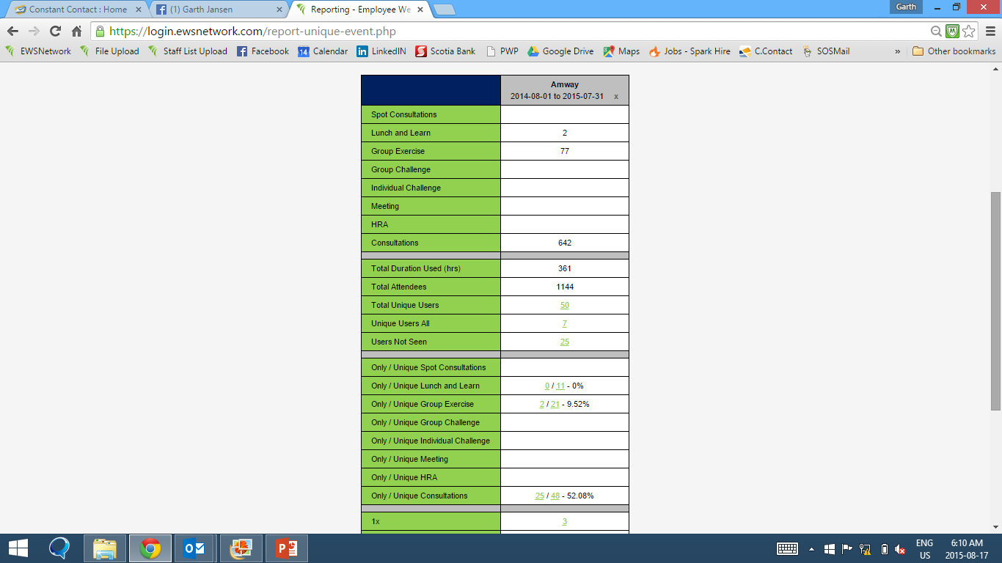
Event Unique User Report
Company ABC
www.EWSNetwork.com

Slide 36
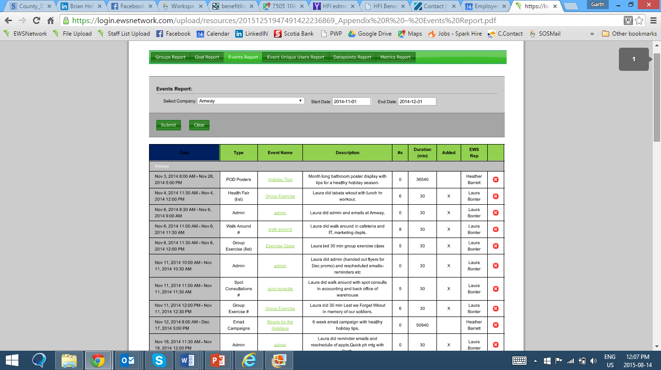
Event Report
www.EWSNetwork.com

Slide 37
Individual Data Trend Report
Category | Participants | Total Change | Total Average Change | Average % Change
Weight (lbs) | 29 | 207.1 | 7.14 | -0.31
Exercise (x/wk) | 3 | 1 | 0.33 | 0.11
Fruits & Veggie (srv) | 4 | 9 | 2.25 | 0.58
Bicep (in) | 11 | 12.23 | 1.11 | 0.1
Chest (in) | 13 | -4.14 | -0.32 | -0.01
Abdominals (in) | 13 | 3.93 | 0.3 | 0.01
Waist (in) | 13 | -8.07 | -0.62 | -0.02
Hip (in) | 13 | -2.01 | -0.15 | 0
Thigh (in) | 12 | 1.84 | 0.15 | 0.01
Total Inches | 3.78
Sleep Hours (hrs) | 6 | -1.5 | -0.25 | -0.02
Stress Score (1 - 10) | 4 | 2.5 | 0.63 | 0.19
www.EWSNetwork.com

Slide 38
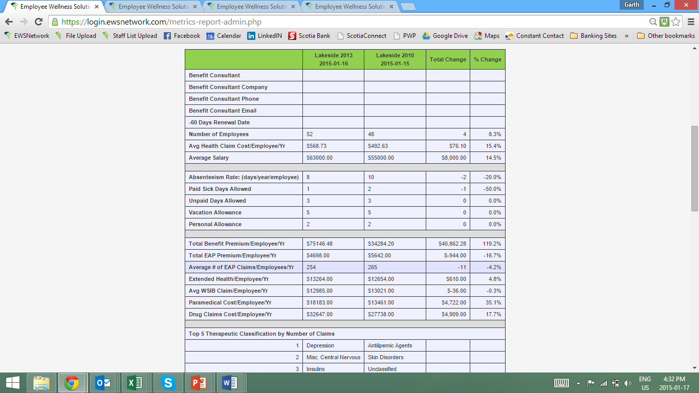
Metrics Report
2015
2018

Slide 39
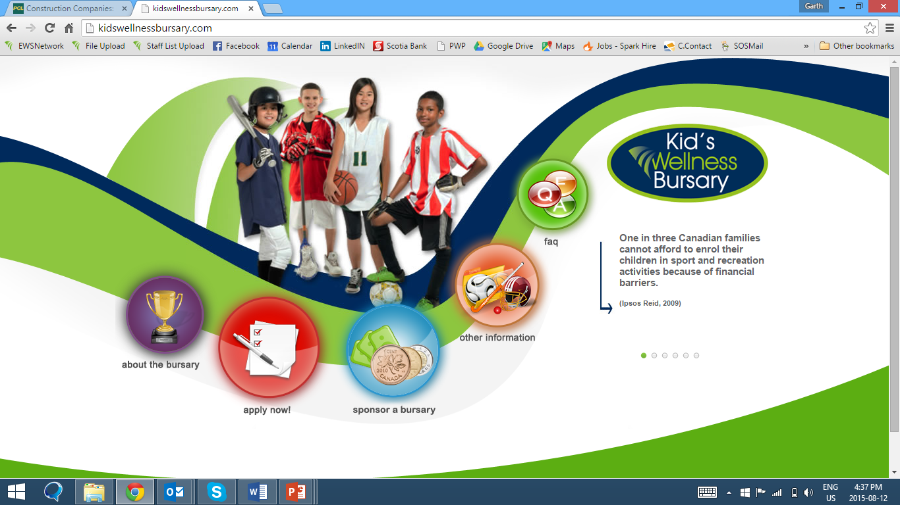
Kid’s Wellness Bursary
www.EWSNetwork.com

Slide 40
Questions??? Thank you.
Garth Jansen, President, Employee Wellness Solutions Network
www.EWSNetwork.com I garth@EWSNetwork.com I 519.860.0502

Slide 41
Importance of Reporting
Snapshot Report | https://login.ewsnetwork.com/upload/resources/2015125194881422236888_Appendix%20U%20%E2%80%93%20Sample%20Progression%20Report.pdf
Progression Report | https://login.ewsnetwork.com/upload/resources/20151251947381422236858_Appendix%20T%20%E2%80%93%20%20Sample%20Snapshot%20Report.pdf
EWSNetwork Trend and Metrics Analysis | https://login.ewsnetwork.com/upload/resources/20157241446281437767188_EWSNetwork%20Group%20Trend%20Analysis%20-%20claims,%20drugs,%20risks.pdf
HRA Report | https://login.ewsnetwork.com/upload/resources/20151251947411422236861_Appendix%20O%20%E2%80%93%20Sample%20HRA%20Report.pdf
Event Unique Users Report | https://login.ewsnetwork.com/upload/resources/2015125194741422236824_Appendix%20P%20%E2%80%93%20Event%20Unique%20User%20Report.pdf
Event Reporting | https://login.ewsnetwork.com/upload/resources/20151251947491422236869_Appendix%20R%20%E2%80%93%20Events%20Report.pdf
Consultation User Report | https://login.ewsnetwork.com/upload/resources/2015125194771422236827_Appendix%20Q%E2%80%93%20Group%20Report.pdf
Metrics Collection Form | https://login.ewsnetwork.com/upload/resources/20151251946141422236774_Appendix%20Ii%20%E2%80%93%20Metrics%20Collection%20Form.pdf
Data Trending Report | https://login.ewsnetwork.com/upload/resources/20151251947191422236839_Appendix%20S%20%E2%80%93%20Data%20Trending%20Report.pdf
www.EWSNetwork.com

