Slide 1
Employee Wellness Program
www.EWSNetwork.com
Notes:
Rules
Talk about the last 2 years

Slide 2
EWSNetwork
EWSNetwork was founded in October 2003
Clients in over 110 locations and in over 60 cities
Over 25 wellness consultants and many more strategic affiliates
Average client engagement for onsite programs is >80%.
Benefits Canada
Winner - 2015 KW Chamber of Commerce Health and Wellness in the Workplace Award
Winner - 2014 Benefits Health and Wellness Program of the Year Award
Winner - 2014 Benefits Canada Engagement Award
Finalist - 2014 Benefits Canada Communication Award
Finalist - 2014 Benefits Canada Strategic Partnership Award
Finalist - 2013 Benefits Health and Wellness Program of the Year Award
Finalist - 2013 Benefits Canada Strategic Partnership Award
Finalist - 2012 Benefits Health and Wellness Program of the Year Award
Winner - 2012 Benefits Canada Strategic Partnership Award
Winner - 2011 Benefits Canada Health and Wellness Program of the Year Award
www.EWSNetwork.com

Slide 3
Onsite
Engagement
Outreach
Encouragement
www.EWSNetwork.com

Slide 4
Benefits and Objectives
The right thing to do
Part of an overall strategic plan
Improve the health and wellness of employees
Improve the culture of the workplace
Decrease the costs of health benefits
Decrease STD/LTD and Workmen’s Comp
Improve productivity and decrease absenteeism
Retention / Attraction
Marketing
Return on Investment
Wellness programs save about 1.5 to 1.7 days in absenteeism per worker over 12 months, or an estimated $251 per employee per year in savings.
Sun Life-Ivey Canadian Wellness ROI study meta-analysis, 2012
For every $1.00 spent on wellness programs:
Medical costs fall by about $3.27
Absenteeism costs fall by about $2.73
Harvard University - Health Affairs, February 2010 USD
www.EWSNetwork.com

Slide 5
Claims Cost Distribution “Disease Costs, Prevention Saves”
20% of employees generate 80% of the costs.
Healthy/ At-Risk High Risk Early Active
Low Risk Symptoms Disease
That means, 80% of employees generate only 20% of the costs.
www.EWSNetwork.com

Slide 6
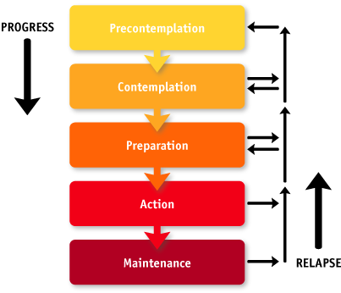
Readiness to Change
Area for Positive Impact and Change
Where Most Companies Spend Their Time
www.EWSNetwork.com
Notes:
Internal programs tend to cater to the healthy

Slide 7
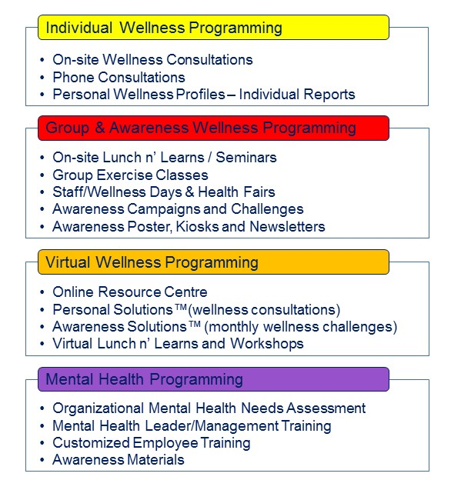
Well Designed, Custom Wellness Strategy Links Components Together Giving the Greatest Opportunity for Success
Virtual
Mental Health
Group & Awareness
Individual
www.EWSNetwork.com

Slide 8
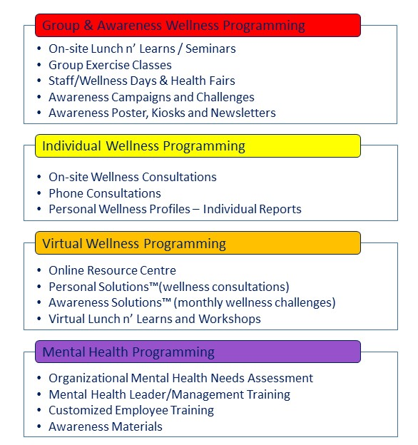
Group & Awareness
www.EWSNetwork.com

Slide 9
Individual
www.EWSNetwork.com

Slide 10
Virtual
www.EWSNetwork.com

Slide 11
Mental Health
www.EWSNetwork.com

Slide 12
Work with EWSNetwork and their wellness toolbox to build a custom program for your organization
Consultations
Majority of hours
1hr
1hr
1hr
1hr
1hr
1hr
Seminars
1hr
1hr
1hr
Walk Arounds
Admin Programs
Challenges
Newsletters
Posters, Kiosks
E-campaigns
Analysis & Reporting
Group X
Health Fairs
www.EWSNetwork.com

Slide 13
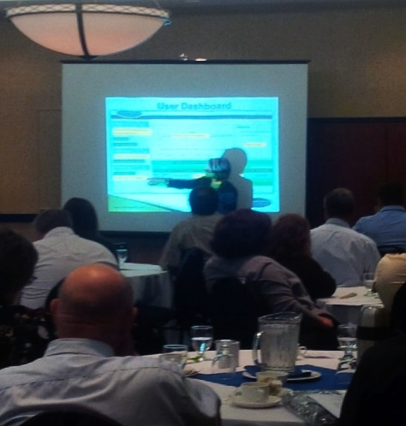
Program Launch
Market the Launch
Posters, emails, flyers, paystub drops, announcements, memos, intranet and any other mode that is applicable.
Launch Presentation
Onsite or virtually, an EWSNetwork representative presents the various components of the new employee benefit and introduces the certified wellness consultants who will be working with the organization.
Consultation Sign-up
Wellness Committee Sign-up
The Health Risk Assessment
Consultations Begin the
following week
www.EWSNetwork.com

Slide 14
Health Risk Assessment
Employee Benefits – Personal Wellness Profile
Private registration, immediate results highlighting participants’ wellness scores, health ages and recommended health actions.
Annually, employees will receive a comparative report.
Employer Benefits – HRA Trend Report
Summary and Program Suggestions/Productivity and Economic Benefits Report (using company specific income and medical values)
Annually, organizations receive a comparative report.
www.EWSNetwork.com/pwp
www.EWSNetwork.com

Slide 15
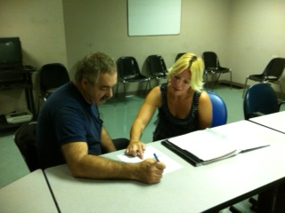
One-on-One Health / Wellness Coaching
30 minute one-on-one confidential appointments with a wellness consultant
Desired turn-around is 4-5 weeks.
Trust, rapport, accountability, motivation, on-going support
Nutrition, fitness, stress, sleep, lifestyle behaviour change
www.EWSNetwork.com

Slide 16
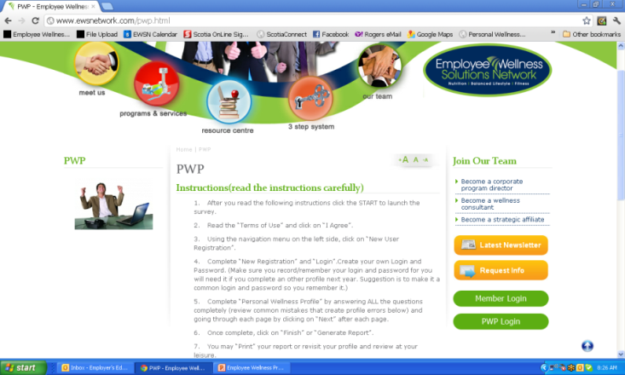
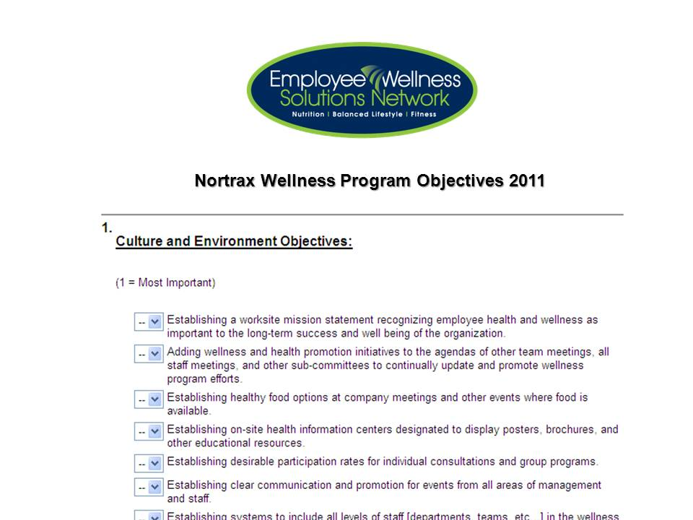
First 30 days Analysis
Objectives Surveys & Strategic Planning
Health Risk Assessment
Consultation Analysis
Metrics Analysis
Analysis of the First 30-days of
One-on-One Consultations
Drug Classification
# Health Claims
$ Health Claims
… and more
www.EWSNetwork.com

Slide 17
Custom Year at a Glance
Company ABC Jan-June 2014 At-A-Glance [subject to change as per wellness committee, needs and interests] PWP Focus [weight management, improved fitness, nutrition, heart health, stress]
Initiative | Jan | Feb | March | Apr | May | June
Consultations | One-on-One Consultations – on-site
Individual | NEW Virtual Online Profile, Wellness Tracking, Calendar of Events
PWP |  |  |  |  |  | June
Exercise Class/Series |  |  |  | Walking routes/groups; site specific Yoga/morning stretching
Lunch n’ Learns/Webinars | Healthy Weights | Healthy Weights | It’s In You to Move (coincide with site visit)
Workshop
Group Challenge [team] |  |  | Healthy Potluck at each site |  | Pedometer Challenge
Virtual Challenge [team] | Portal and Challenge
Newsletter | Ongoing Monthly Newsletter and Personal Challenge
Kiosk / Poster Display | A Healthy Weight for You |  |  | It’s in You to MOVE
POD Posters | ongoing
BPOS Sleeve Posters | ongoing
Email/On-site/Pay-Stub Campaign | Healthy Weights | Healthy Weights |  | Taking Breaks | Step Into Summer
Walk Around |  | Healthy Snacking with almonds |  | Desk Stretches |  | PWP Instructions
Promo Day | Healthy Eating Yogurt Parfaits – month tba
Wellness Challenge [Individual] |  |  | Low GI Foods |  | Step Check IC
Virtual Challenge [individual] | Individual Challenge
Health Fair | Fall 2014
Corporate Reporting |  |  | Q1 Report |  |  | PWP & Q2 Report
Componen
t
s
Programs

Slide 18
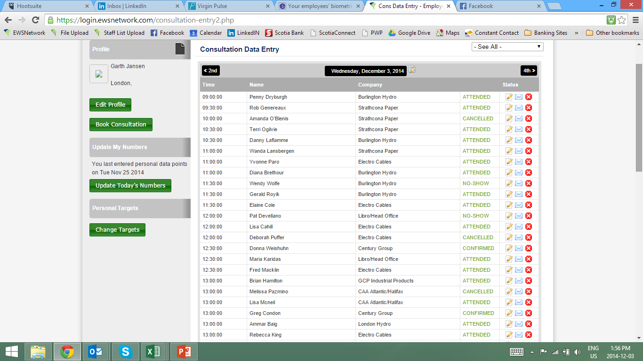
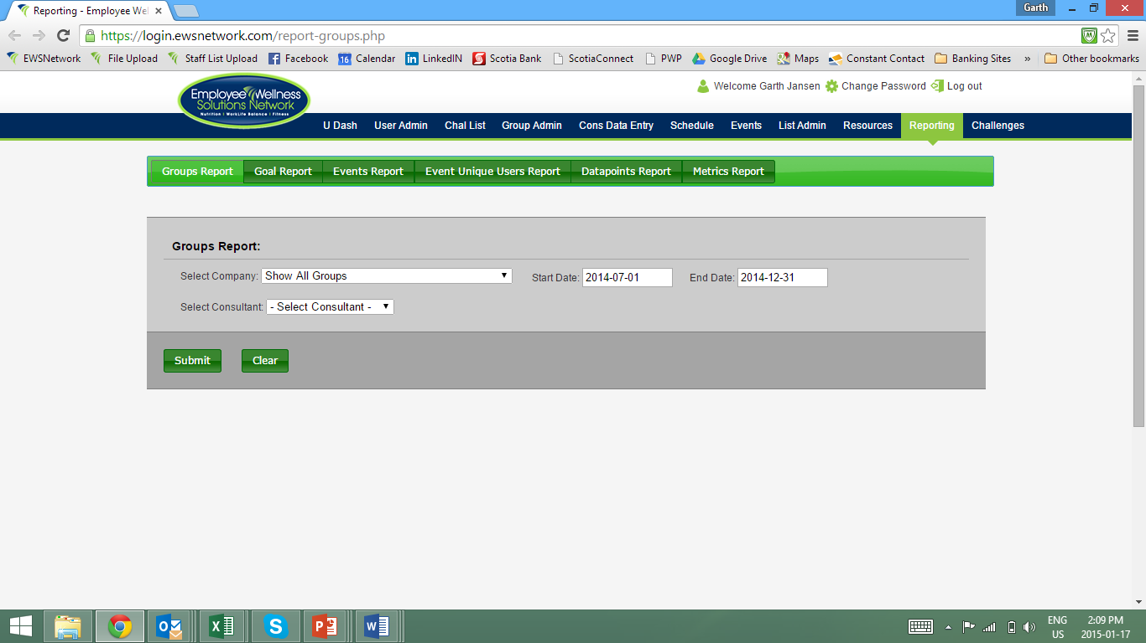
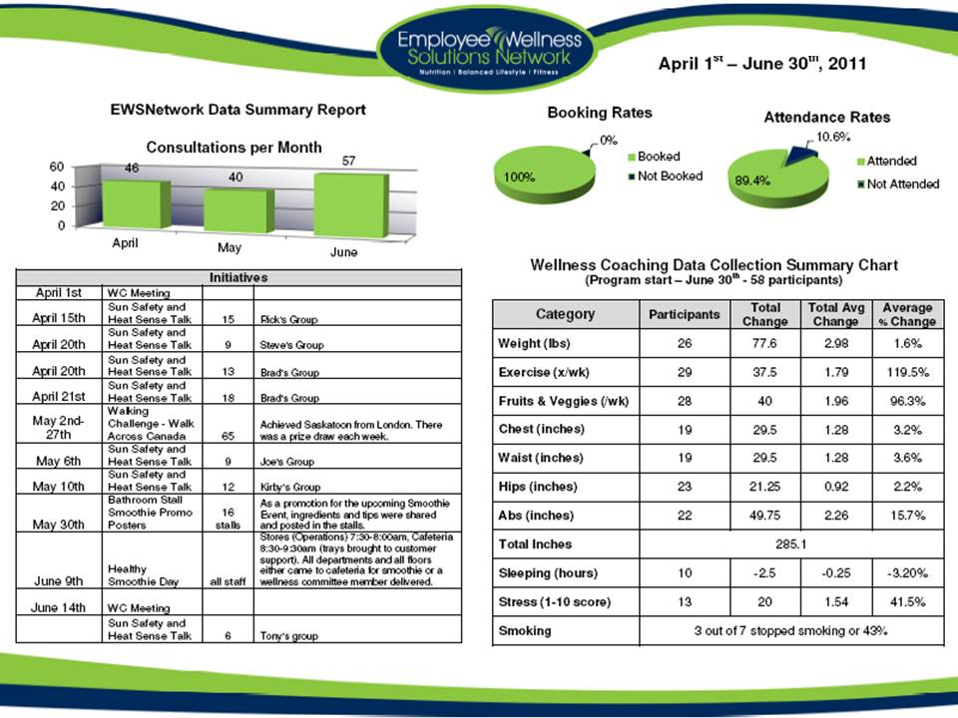
Reporting slides
Administrative Abilities
Do one with data points, notes, homework, etc
Snapshot, Progression and Annual Reporting
Consultation bookings & attendance rates
Unique users for consultations
Unique users for various event types
Participation in various events
Reconciliation for program hours to serviced hours
Individual data trending
Metrics trends are followed from year to year

Slide 19
Importance of Reporting Group Report
Bookings | 120 |  | Hours for Events (hrs) | 21
% Booked | 96.00% |  | Hours Used from Events (hrs) | 23
 |  |  | Reconciliation (hrs) | 2
Attended | 114
% Attended | 95.00% |  | Unique Users in Company | 40
Hours of Attended Apts | 57 |  | Percentage of Company | 55.56%
 |  |  | Avg Appts per user per timeframe | 2.85
Cancelled or No-Show | 15 |  | Users who entered >1 datapoints | 20
% Cancelled | 12.50%
 |  |  | 1x | 11
Cancellations or No-Show Rebooked | 10 |  | 2x | 8
% Cancellations Rebooked | 8.33% |  | 3x | 8
 |  |  | 4x | 7
Actual Cancelled or No-Show Apts | 5 |  | 5x | 2
% Actual Cancelled or No-Show Appts | 4.17% |  | 6x | 3
 |  |  | 7x | 1
www.EWSNetwork.com

Slide 20
Importance of Reporting Individual Data Trend Report
Category | Participants | Total Change | Total Average Change | Average % Change
Weight (lbs) | 29 | 207.1 | 7.14 | -0.31
Exercise (x/wk) | 3 | 1 | 0.33 | 0.11
Fruits & Veggie (srv) | 4 | 9 | 2.25 | 0.58
Bicep (in) | 11 | 12.23 | 1.11 | 0.1
Chest (in) | 13 | -4.14 | -0.32 | -0.01
Abdominals (in) | 13 | 3.93 | 0.3 | 0.01
Waist (in) | 13 | -8.07 | -0.62 | -0.02
Hip (in) | 13 | -2.01 | -0.15 | 0
Thigh (in) | 12 | 1.84 | 0.15 | 0.01
Total Inches | 3.78
Sleep Hours (hrs) | 6 | -1.5 | -0.25 | -0.02
Stress Score (1 - 10) | 4 | 2.5 | 0.63 | 0.19
www.EWSNetwork.com

Slide 21
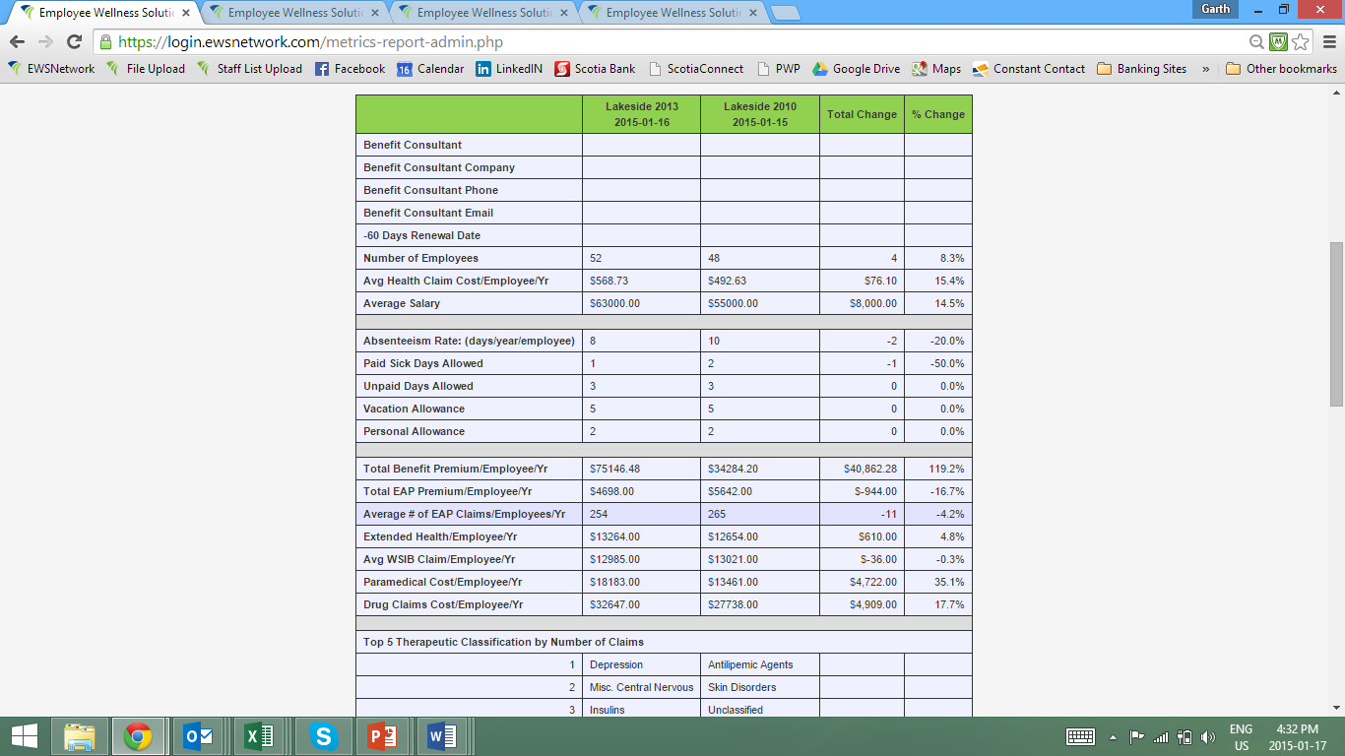
Metrics Report

Slide 22
Results
 | Company A Utilities | Company B Not-for-Profit | Company C Financial
Participation % in 1-on-1 Consultations | 33% of whole company & 86% of those who CAN attend [admin, office, some field] | 45% | 70%
Participation % in the Program | 85% [consults, LNLs, outreach with field workers, workshops, health fairs, awareness materials] | 80% Consultations at each site, [spot consults, outreach to all sites, stretch breaks at manager / supervisor meetings, drop offs at 16 remote sites] | 90% [Spot consults, promo days, staff meetings with wellness components
www.EWSNetwork.com

Slide 23
Results
 | Company A Utilities | Company B Not-for-Profit | Company C Financial
Bottom Line Results | 2009-2013 5 day reduction in sick time Drug costs - 12% reduction Health claim costs – 8% reduction Health risks - reduction in all | 2011-2014 Overall health costs [drug, claims, dental] – 22% reduction Nutrition health risk – 12% reduction Coronary health risk – 25% reduction | 2008-2013 Health claim costs – 10% reduction Weight mgmt risk– 4% reduction Cholesterol risk – 27% reduction Nutrition health risk – 7% reduction
www.EWSNetwork.com

Slide 24
Summary
Ongoing program design
Comprehensive/customized programming
Qualified/certified consultants
Industry leading reporting system
Proven track record
www.EWSNetwork.com

Slide 25
Thank you.
Garth Jansen, President, Employee Wellness Solutions Network
www.EWSNetwork.com I garth@EWSNetwork.com I 519.860.0502

Slide 26
Investment
$3000 - $5800 per month
$7 - $13 per employee per month
Above initiatives plus analysis, planning, scheduling, implementation and evaluation of an EWSNetwork wellness program.
Approximately 8.5-17 hours of one-on-one wellness consultations every week at various locations.
www.EWSNetwork.com

Slide 27
Pay One Annual Premium for Your Program
X
X
1hr
1hr
1hr
1hr
1hr
1hr
Day 1
Day 3
1hr
1hr
1hr
Day 2
October – 2 Lunch n’ Learns
November – use up 2 hours from the pot
www.EWSNetwork.com

