Slide 1


Wellness Program Launch
Century Group
September 25th, 2014
www.EWSNetwork.com
Notes:
A little about EWSNetwork…..and your introduction

Slide 2

Objectives
Employee Wellness Solutions Network
-Who we are?
-What’s in it for you?
-How do we design a wellness program?
WIN $500….annual EWSNetwork incentive
Initial wellness program sign ups – health coaching!
Outreach and communication strategies
Enjoy some fruit smoothies!
www.EWSNetwork.com

Slide 3
EWSNetwork Toolbox
Individual
Virtual
Group
Awareness
www.EWSNetwork.com

Slide 4
Individual Component
(One-on-One Health/Wellness Coaching)
The FREE services of a personal trainer, nutrition advisor, stress/time manager and lifestyle coach, “all-in-one”, on-site!
Be Preventative = Stay Healthy!
Accountability, Follow-up, and Evaluation
www.EWSNetwork.com

Slide 5
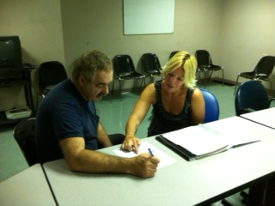
Wellness Consultations
For you, about you, driven by you.
Consultant is here to help you with what you want to change.
100% private and confidential.
Your wellness coach is on your side for support, motivation and “how to” steps.
TODAY, take this opportunity to get signed up for your initial consultation!
www.EWSNetwork.com

Slide 6

Individual Component
(One-on-One Health/Wellness Coaching)
Starts next week!
Whitney Coupland
wcoupland@EWSNetwork.com
Wednesdays 12-3pm
STARTS – Oct 1
**Monday Oct 6…
A little about Whitney…
www.EWSNetwork.com

Slide 7


Group Component
Group Programs
Lunch n’ Learns, Workshops
Pedometer Challenges
Olympics – Own the Podium
Nutrition for Life
Eat Your Colors
Minutes of “ME” Time
Healthy Lifestyle Poker
Spring Scrabble
4-week De-Stress Out
6-week Empowered Living
8-week Extreme Lifestyle Makeover
Exercise classes
Walking/Running groups
And others…
www.EWSNetwork.com

Slide 8

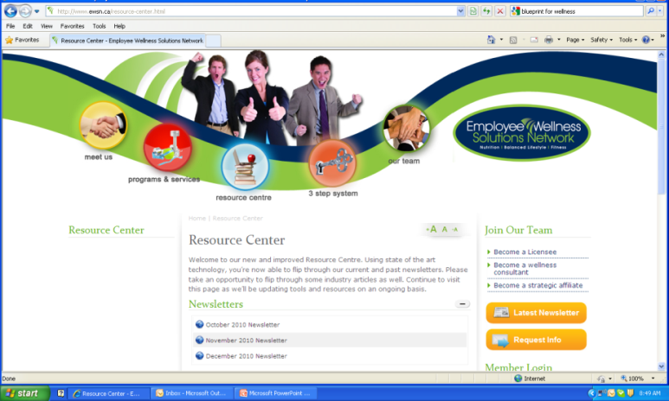
Awareness Component
Awareness Materials / Campaigns
Wellness Kiosks
Awareness Posters
Email Campaigns, BINGOs
Walkabouts
Health Fairs
Monthly Newsletters
Wellness Challenges
EWSNetwork.com
Wellness Resource Centre
News / Articles
  www.EWSNetwork.com
www.EWSNetwork.com

Slide 9

Group and Awareness Components
Heather Barrett
hbarrett@EWSNetwork.com
EWSNetwork Program Director
Main contact for wellness programming
Communications, messaging, promotion
Virtual Component too!
A little about Heather…
www.EWSNetwork.com

Slide 10
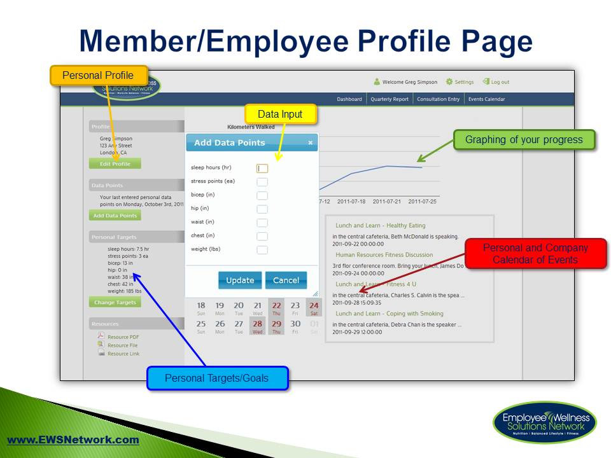
Virtual Component
Online Consultation Signup
Online Event Registration
Online Personal Data Tracking
Awareness Program Notification
www.EWSNetwork.com

Slide 11
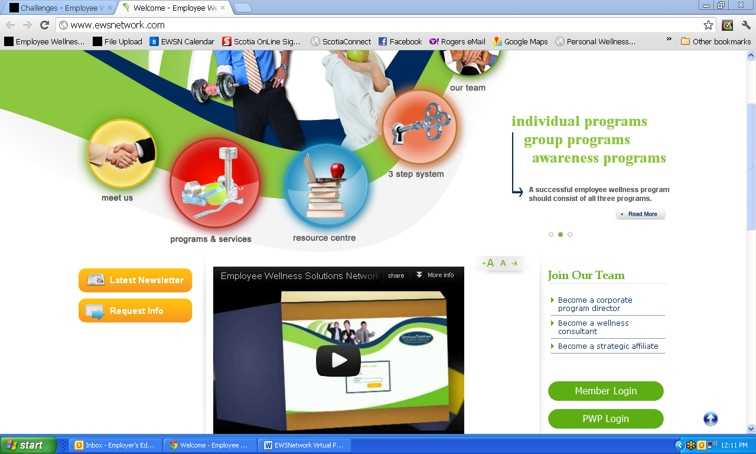
www.EWSNetwork.com
www.EWSNetwork.com

Slide 12
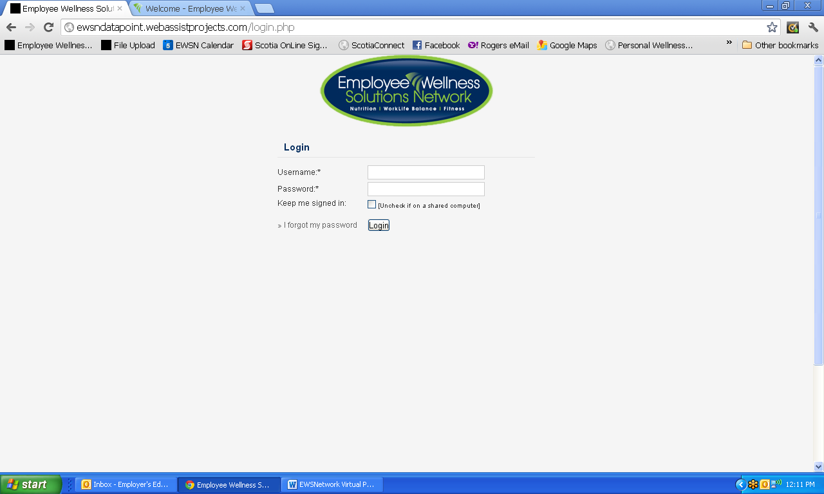
Log In Page
www.EWSNetwork.com

Slide 13
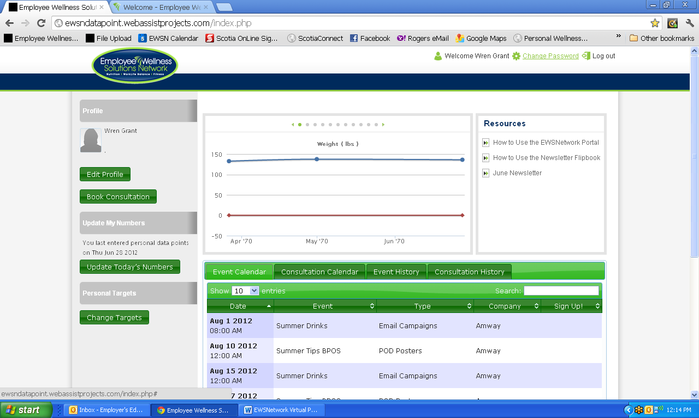
Change Password
www.EWSNetwork.com

Slide 14
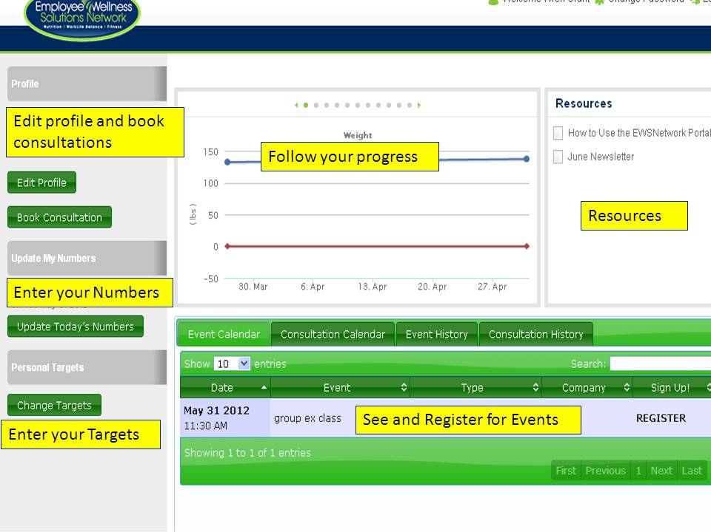
User Dashboard
www.EWSNetwork.com

Slide 15
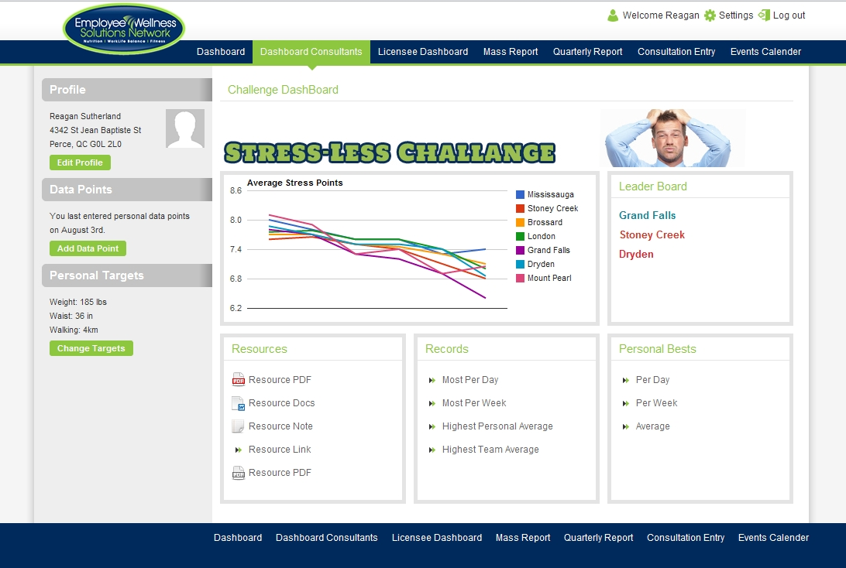
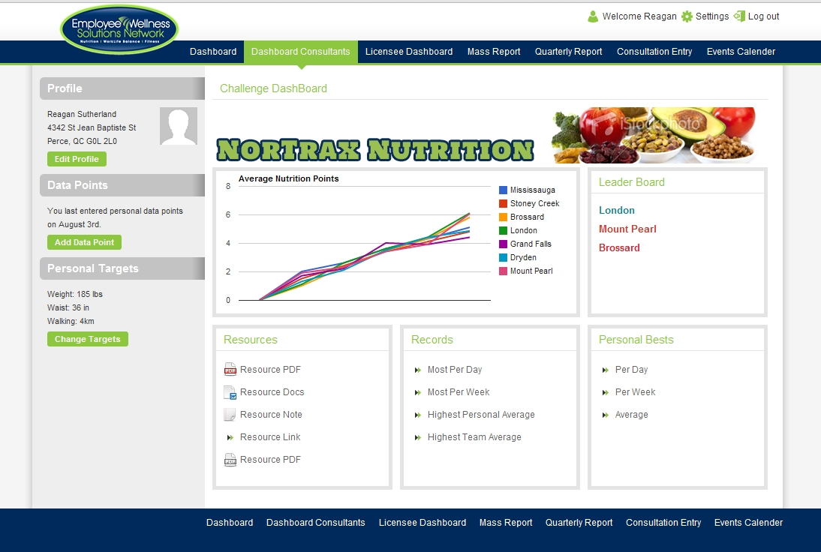
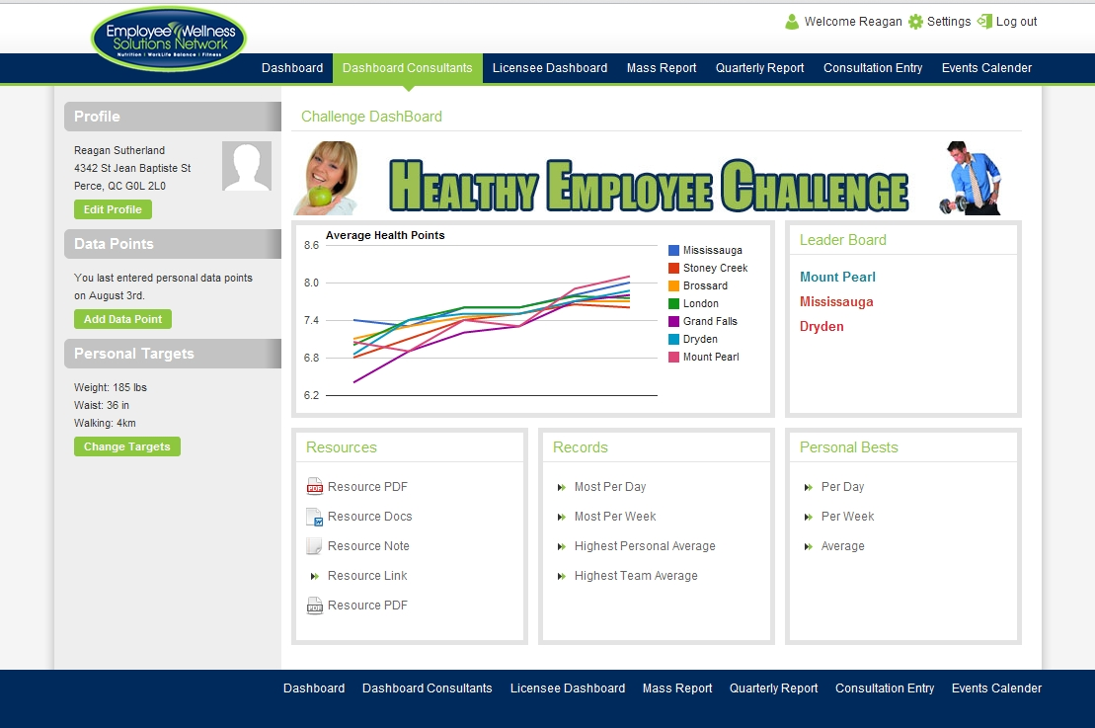
Other Challenges
www.EWSNetwork.com
Notes:
Virtual programming – tba as per wellness committee, etc..
ON YOUR USER DASHBOARD, YOU’LL SEE A VIRTUAL CHALLENGE TAB WHEN WE LAUNCH A VIRTUAL CHALLENGE

Slide 16

Personal Wellness Profile
On-line health risk assessment
    100% confidential
    Immediate reporting
    Wellness scores (coronary, cancer, nutrition, fitness, stress/emotional, substance use, safety)
    Health age
    Recommended health actions
    Interests from participants
Health risk report – individual, group trends
Annual campaign to assess organizational health risk profile, individual comparative report
Chance at winning $500 CASH (all EWSNetwork participants included)
www.EWSNetwork.com

Slide 17
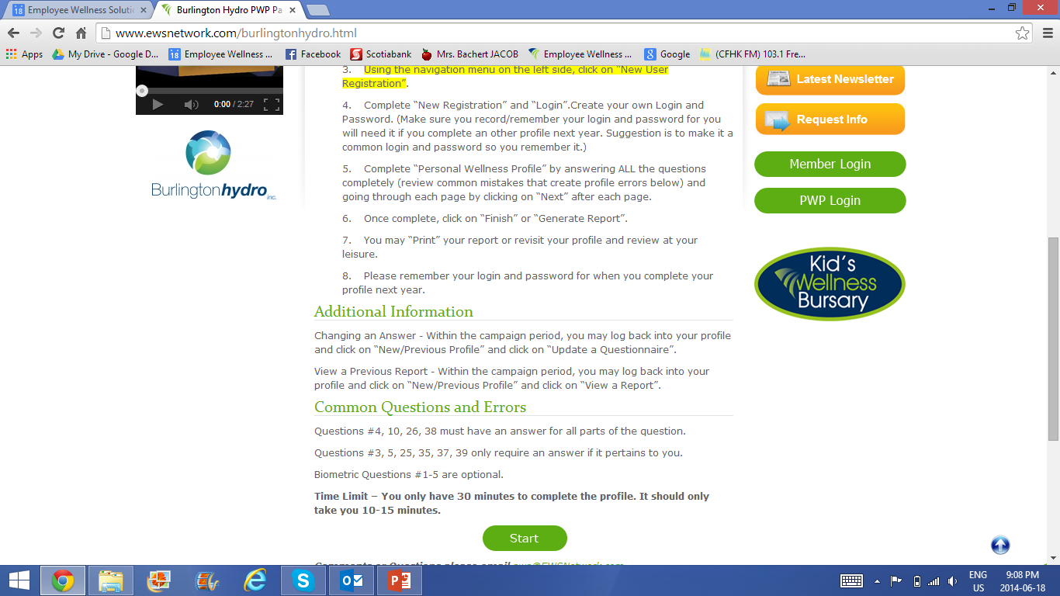
www.EWSNetwork.com/centurygroup
www.EWSNetwork.com

Slide 18
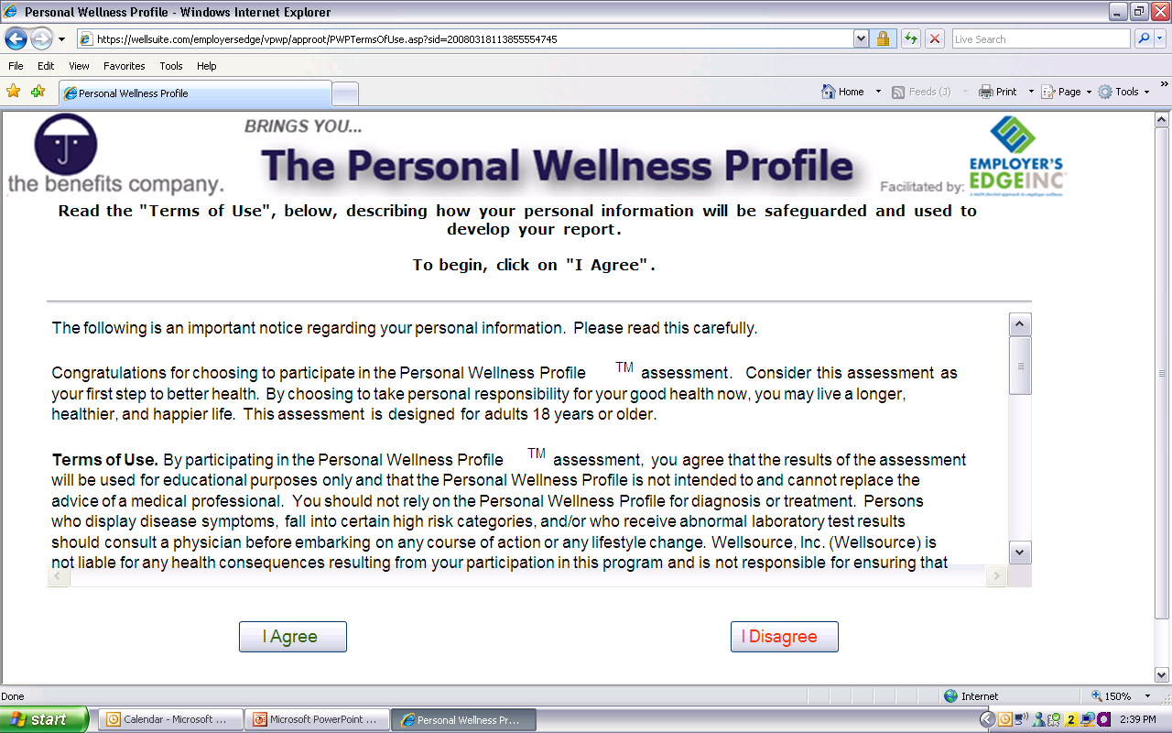
www.EWSNetwork.com/centurygroup
www.EWSNetwork.com

Slide 19
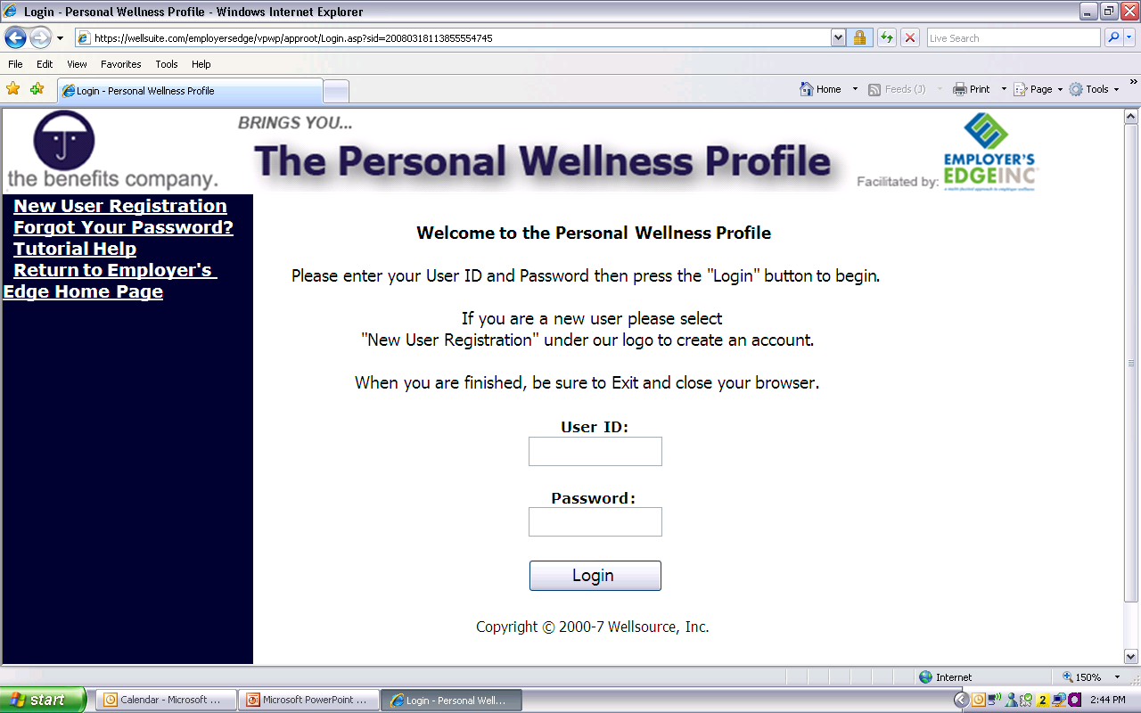
www.EWSNetwork.com/centurygroup
Register yourself as a new user.
Create your own User ID and Password.
www.EWSNetwork.com

Slide 20
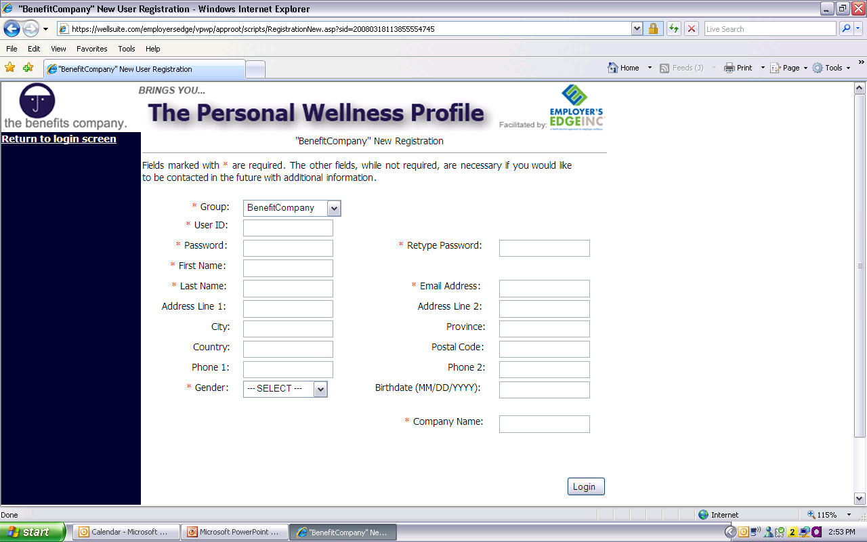
www.EWSNetwork.com/centurygroup
Register your information.
Then Login…
www.EWSNetwork.com

Slide 21
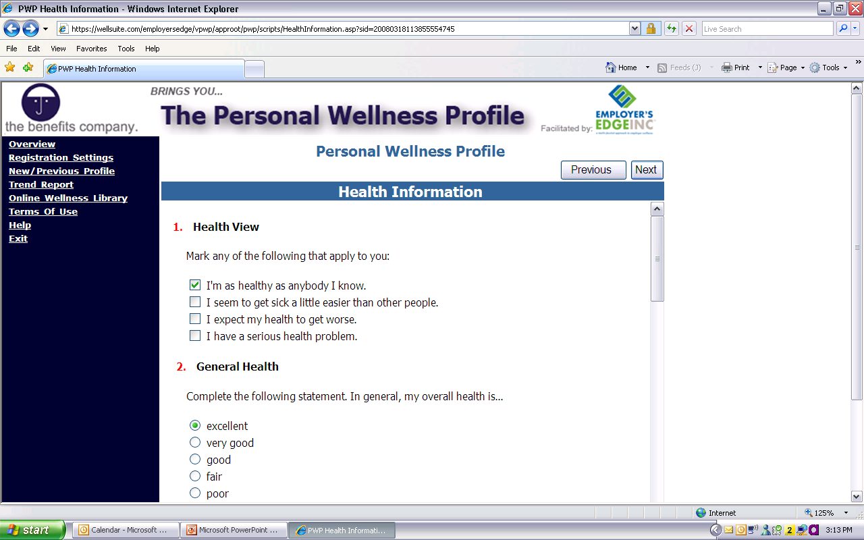
www.EWSNetwork.com/centurygroup
Go through and answer all the questions.
Click on “Next” after completing each page.
(Make sure to answer all the questions)
www.EWSNetwork.com

Slide 22
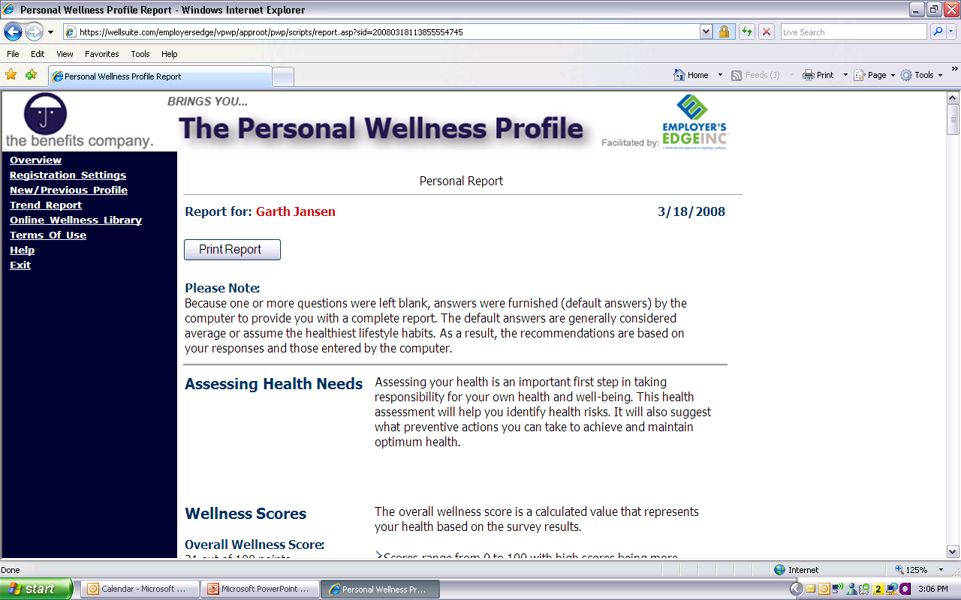
www.EWSNetwork.com/centurygroup
Once complete, print your report for viewing.
You can also view it online and see articles relating to the various areas.
www.EWSNetwork.com

Slide 23

Personal Wellness Profile
www.EWSNetwork.com
www.EWSNetwork.com/centurygroup
Campaign opens TODAY [Sept 25 – Oct 10]
Use any computer, anytime
Remember your user ID and password!!!!
100% confidential
Qualify for INCENTIVE….

Slide 24
Wellness Program Design
Personal Wellness Profiles – top health risks
Objectives Surveys
First month of consultations
Feedback from YOU and the wellness committee
centurygroup@EWSNetwork.com
www.EWSNetwork.com

Slide 25
Wellness Committee
Committee made up of your peers. Cross-section of your organization.
Meet every other month/quarterly to go over past, present and future initiatives.
Very valuable source of feedback.
Ambassadors of the wellness program.
Assistance in wellness initiative promotions.
www.EWSNetwork.com

Slide 26
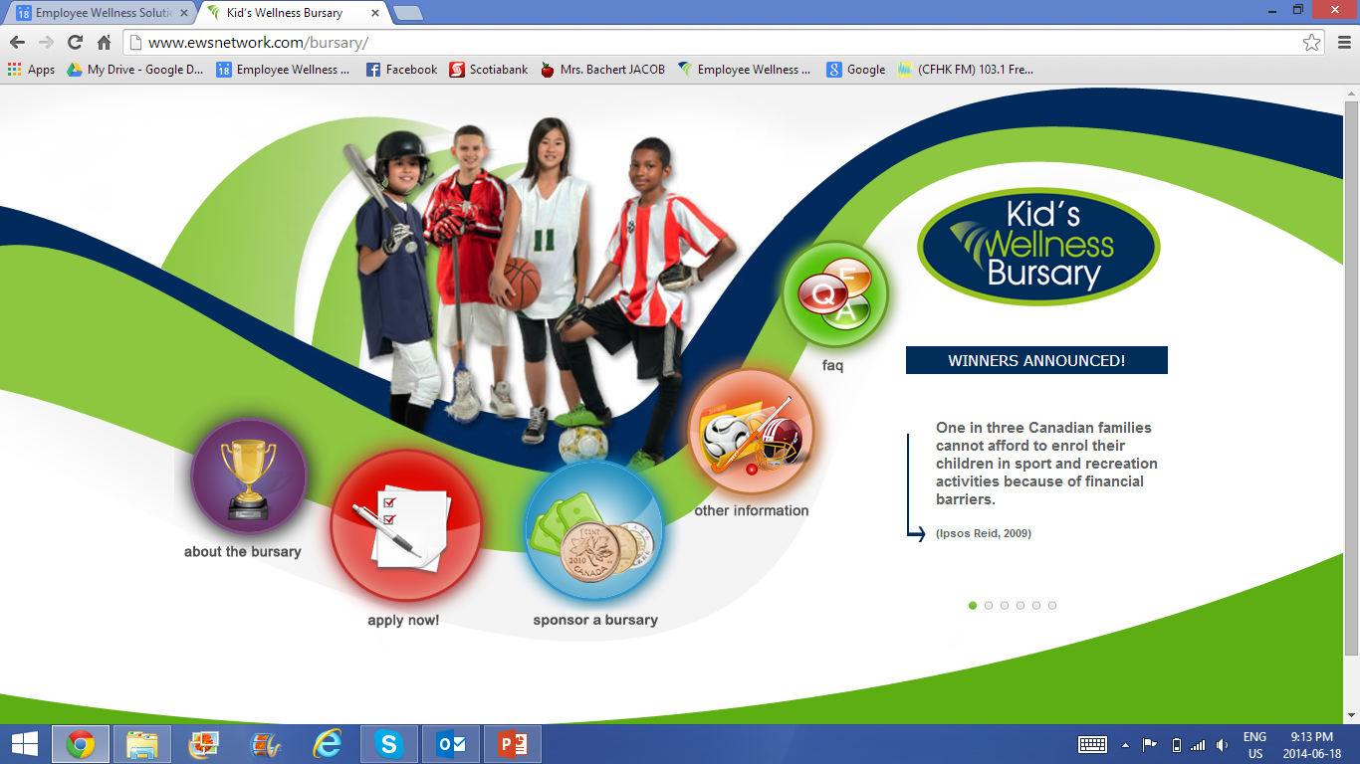
www.EWSNetwork.com/bursary

Slide 27
Get signed up for your initial wellness consultation to meet your wellness consultant, Whitney!
Complete your Personal Wellness Profile – www.EWSNetwork.com/centurygroup
Access your EWSNetwork Portal – www.EWSNetwork.com
4. Nominate someone for an EWSNetwork Wellness Bursary – www.EWSNetwork.com/bursary
Thanks for your participation!
www.EWSNetwork.com

