Slide 1

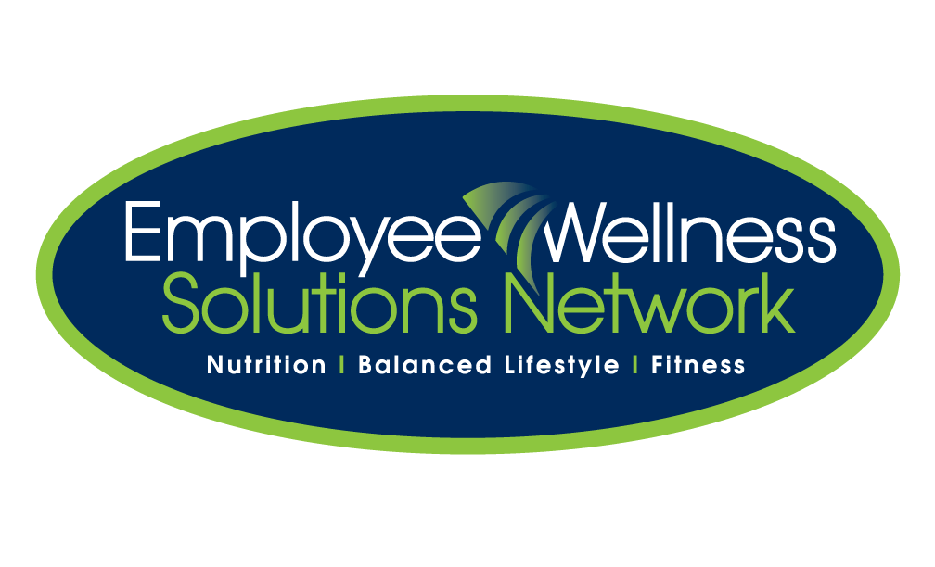

Introducing
A new digital strategy that targets employee wellness, productivity and health plan costs
Notes:
- Introducing a new and exciting digital employee health and wellness program, Health Connected
Addressing key issues that employers face today
Improving health and productivity
Managing plan costs
- Health Connected also used for employee retention strategy ** added benefit realized by companies that have created a stronger culture of health.

Slide 2

Improving Health And Wellness Is Good For Business
75% of employees said a healthier workplace made them feel better about their company.
59% said it was a reason to stay, 63% a reason to recommend the company to others.
Companies with a stronger health culture had lower premiums, less absenteeism & presenteeism and increased loyalty
Notes:
We know that Improving Health and Wellness Is Good For Your Business.
75% of employees felt better about their company.
<Healthy companies had less turnover and attracted quality employees>, 59% said they’d stay at their job and 63% would recommend their healthy company to others
AND… strong health culture means : less costs associated with absenteeism, presenteeism and staff turn-over; improves productivity and manages costs.
OPTIONAL:
Research has also found that healthy companies have:
20% more revenue per employee
16% higher market value
57% higher shareholder return
(Reference: Watson Wyatt Worldwide. Health and productivity Drives Organizational Effectiveness)

Slide 3




Poor Employee Health & Wellness Costs Employers
We Know:
Stress, coping skills and chronic disease impact work satisfaction, productivity and plan cost
Depression accounts for 23% of productivity costs
Back pain, headache and arthritis account for 31%
Health plan costs continue to rise 10-15%
Chapman L. Meta-evaluation of worksite health promotion economic return studies: 2005 Updated. The Art of Health Promotion, July August 2005, 1-11
Notes:
We also know the opposite is true - Poor employee health & wellness costs employers …
Stress, coping skills and chronic disease impact employee satisfaction, productivity and resulting plan costs through increases in STD, LTD, faster progression to expensive biologics, failing to properly manage health and driving up drug plan costs, time off work that results in more expensive temporary workers, other cost drivers
We know some of the key areas for loss in productivity include:
Depression, accounting for 23% of productivity loss
Back pain, headache -often stress related - and arthritis account for 31% - with unmanaged arthritis potentially costing much more due to use or more biologics
The result is health and drug plan costs continue to rise 10-15%. Health Connected targets these issues and can impact your costs.

Slide 4
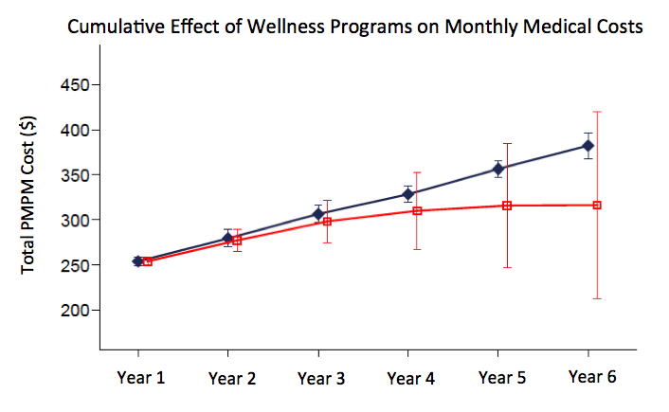
An Effective Health Strategy Can Manage Plan Costs
Direct annual savings of $157¹
Absenteeism benefit $1483²
Presenteeism benefit $1689²
Turnover costs 60% of annual salary³
Without Programs
With Programs
Workplace Wellness Programs Study. Mattke et. al., 2013. Rand Corp., U.S. Department of Labor and the U.S. Department of Health and Human Services.
Workplace Wellness Impacts Absenteeism and Presenteeism. 2013. MediResource Health Risk Assessment Data Analysis of Canadian Employers.
Harvard Business Review. https://hbr.org/2006/12/the-high-cost-of-low-wages
Notes:
So what is the cost benefit of implementing a stronger health and wellness program?
Studies have found that the direct employer cost savings can be $157/employee/year on plan costs alone.
But lets look at the larger cost benefits. Data on the cost of absenteeism and presenteeism collectively can account for much more cost savings, several thousand per employee per year.
Research shows 59% of employees cited a stronger culture of health as a reason to stay. In general the cost of employee turnover ranges from 1 month salary to several years depending on the level, often people use 60% of an employees salary as the cost of turnover.
Health Connected empowers companies big or small to implement a health and wellness program that improve employee health. The benefits to your organization aren’t just in direct savings on health plan costs but impact all these other areas.

Slide 5

Introducing
A NEW! digital health portal that targets employee wellness, productivity and health plan costs
Notes:
This is where Health Connected fits in. Health Connected is a comprehensive and turn-key digital health portal to improve employee health and productivity and reduce costs.
What makes Health Connected different is that it’s a complete and comprehensive wellness program that is package so you can create a long-term strategy. It targets the key issues and cost drivers associated with improving the health and productivity of your company.
Because its digital and multi-dimensional it is accessible to all employees and creates a continuous cycle of engagement over the long-term.

Slide 6

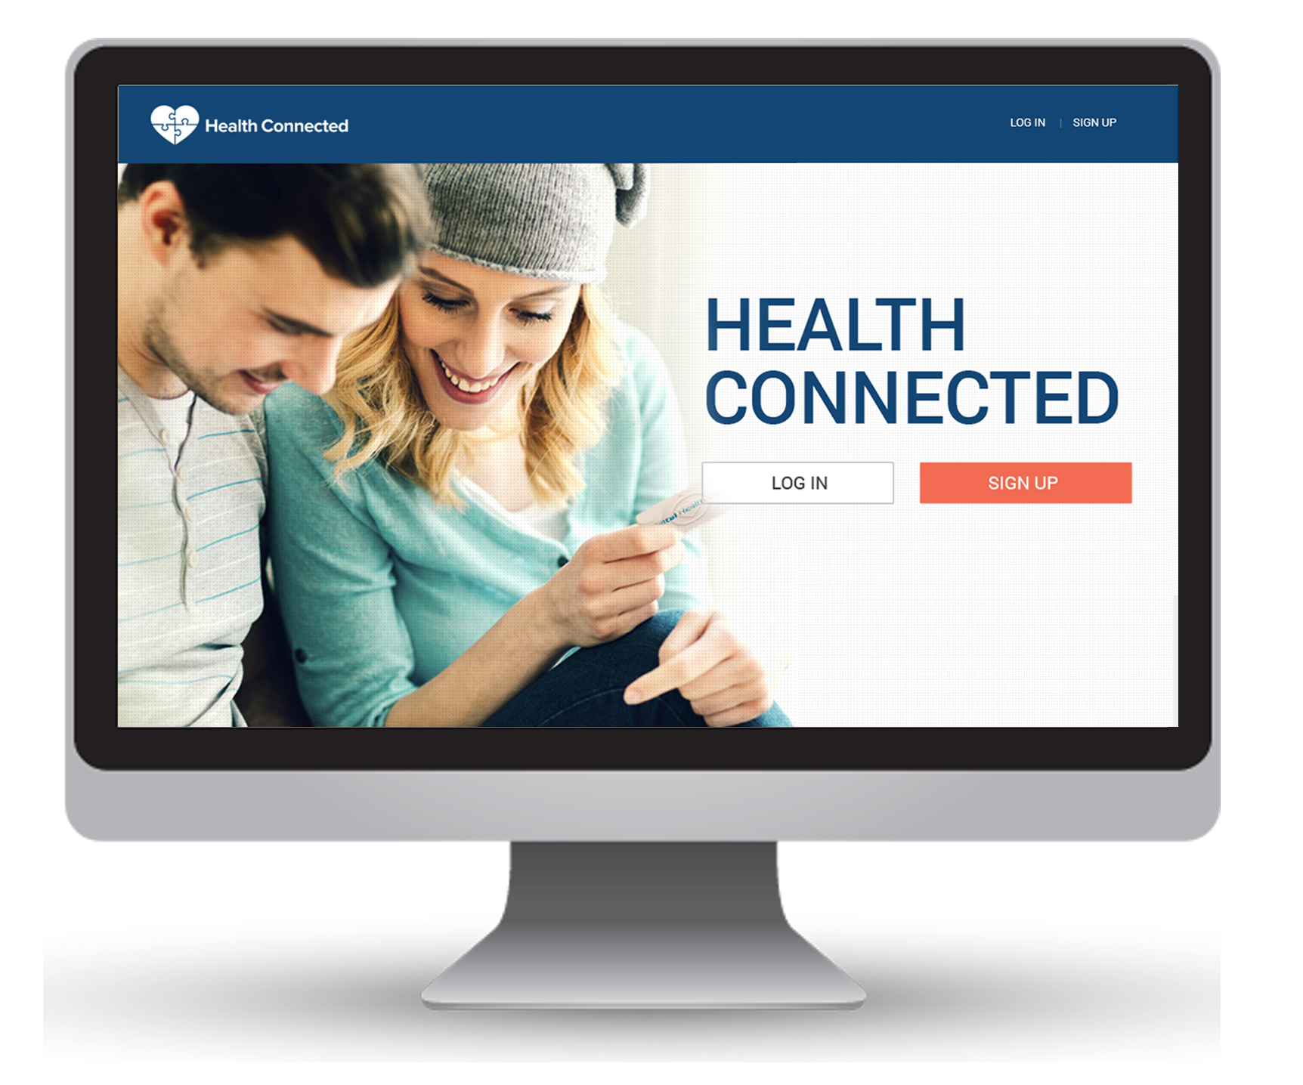

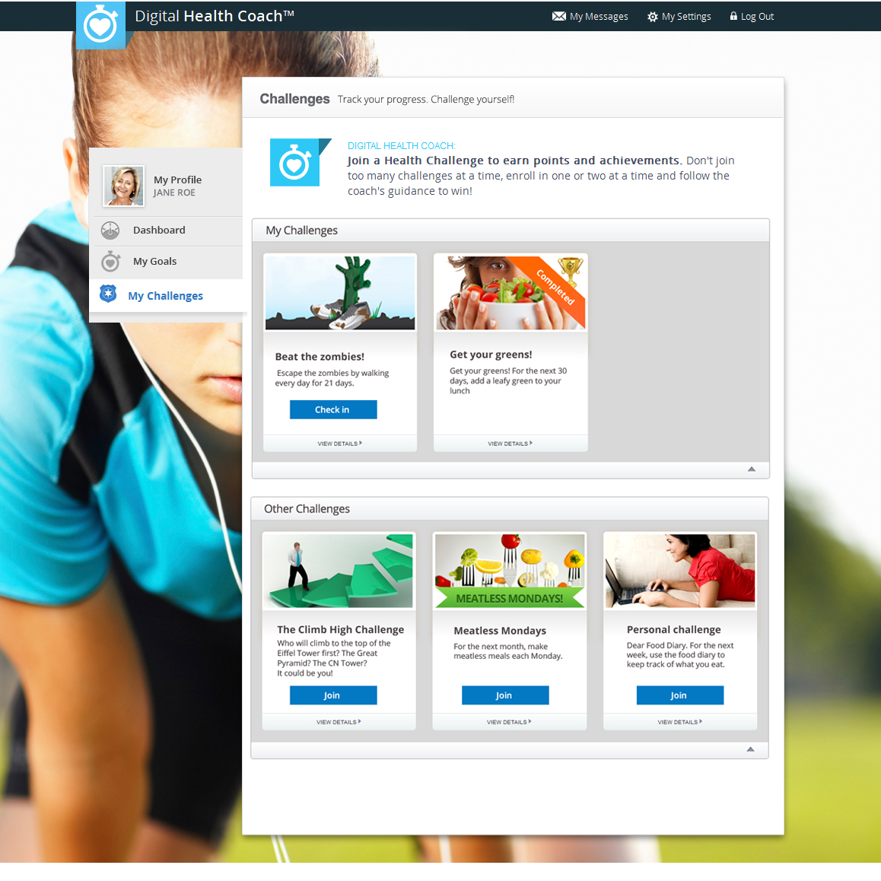
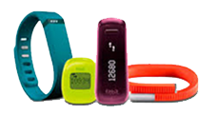
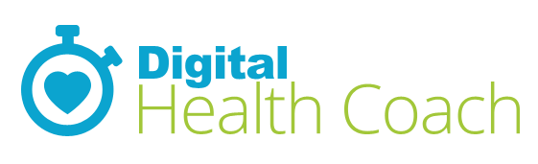
A Complete, Turn-Key, Health Strategy
3 unique programs proven to impact employee health and employer costs
  Health Risk Assessments
  Health Challenges & Tracking Devices
  Digital Health Coaching
Notes:
The core of Health Connected consists of 3 products that are integrated together to target the costs and business issues we’ve discussed.
These include:
A Health Risk Assessment to establishes a baseline risk profile of each employee and aggregate data for your company risk profile. The HRA is also key to identifying what are your main health issues and cost drivers so you can determine what you should do next to focus your efforts. It comes with the industry’s best analytics package to help you.
A second program is the health challenge product. Health challenges allows your employees to participate in individual or team events such as a “Walking challenge” or “healthy eating”. Employees can connect to wearable devices such as FitBit to track progress. You can also use challenges with incentive programs, such as achieve the challenge goal and get a Tim Hortons gift card or some other reward.
The other program is Digital Health Coach. Digital health coach allows people to create a highly personalized health action plan. If you’re familiar with live health coaching, it works much like a business or life coach. You meet with your coach to understand your goals and work together to develop a plan to achive them. This is what Digital Health Coach does.
These 3 products all work together to create a complete end-to-end solution

Slide 7
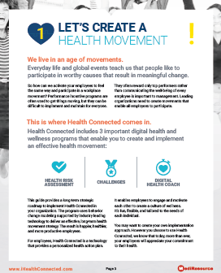
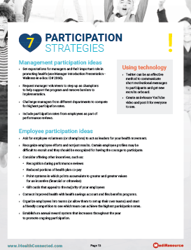
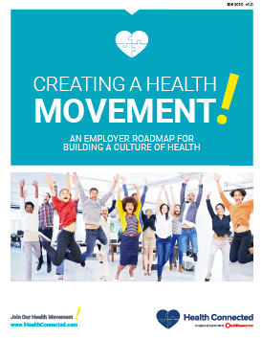
A Total Support Package
To create your own health movement
Completely Automated
As little as 30 minutes monthly or as much as you want
Wellness-in-a-box
A complete roadmap for creating a health movement
PowerPoint presentations for managers and employees
Posters, tent cards, desk cards
Weekly and monthly employee emails
Templates (Word, PPT) of all resources to modify as you like
Notes:
It is easy to implement, requires only a small time investment, as little as 30 minutes per month, and comes with a complete set of employer guides and support materials. This includes:
An employer roadmap to implement a health movement. Its really a how-to guide to implement a wellness program. If you don’t have the staff resources, time or knowledge this guide provides you with all you need to make implementation simple and efficient.
PowerPoint presentations to introduce managers and employees to the program. Use these at lunch and learns or staff meetings.
Posters, promotional emails and a number of other resources.
A set of emails you can simply forward using your internal email system. Do this at whatever frequency you want.
Everything is in a template format so if you want to modify it, or even change the program from a health movement to another strategy, you can.
Our partner in Health Connected is MediResource. They have been leading digital health and wellness since 1996 and are Canada’s largest provider of digital health and wellness products. This program is the result of 20 years of knowledge in implementing digital health and wellness programs. These programs are used by Manulife, Great West Life, Blue Cross and Sunlife.

Slide 8

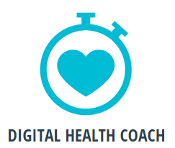
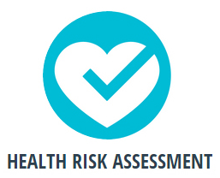
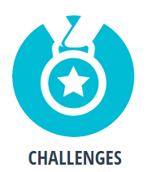

    Make It Fun and Provide Clear Direction
  A Movement Starts With a “Mission”. Missions Create A Strategy
Missions fuel momentum
1 Mission per month (small steps)
    Mission 1:
    Complete a Health Risk Assessment (HRA), get a baseline
    Mission 2:
    Participate in a challenge
    Mission 3:
    Create a personal health action plan
    Mission 4,5,6,+++
    Use analytics and support material to choose next priority mission
Notes:
Engagement is a huge part of getting employee buy-in and participation. So we’ve made the program fun and explained the concept of a health movement in the form of “Missions”
Every movement starts with a mission. So we’ve packaged the three as “Missions” so people can identify with the overall program objectives. Missions are perpetual, once you complete all 3 missions you can start over, or go with whatever mission you want to do next. This ensures the program doesn’t get stale. Remember, all this is supported with “Wellness in a Box” materials and a roadmap to help guide you through the process and make it easy to implement and without heavy time commitment.
People rally around missions, We’ve suggested an order to these missions but you can do them in any order you see fit.
Mission 1 is to complete an HRA. This provides you with a baseline of your company risk profile so you can determine next steps and where its best to focus your efforts.
Mission 2 is possibly a health challenge. Health challenges can include use of wearable devices like Fitbit and allows employees to create teams and collect points or rewards. An example is lets all “Trek Across Canada”, so you’d see teams and leaderboards on progress if you’re participating.
The last Mission in the cycle would be Digital Health Coach. This unique tool provides the digital equivalent of a live health coach. It starts with a “Health Skills Assessment” and then provides a personalized health action plan.
Once you do each mission you can then keep the mission cycle going to maintain momentum and perpetuate your health movement.

