Slide 1
NOTE: THIS IS A SAMPLE TRAINING PRESENTATION OF THE HEALTH CONNECTED EMPLOYER PRESENTATION. CLICK AUDIO IN LOWER RIGHT TO HEAR SCRIPT OR READ SCRIPT NOTES IN BOTTOM SECTION.
Introducing
A new digital program that targets employee wellness, productivity and health plan costs
YOUR LOGO
Notes:
We’re here today to introduce something new and really exciting. It’s a digital employee health and wellness program, called Health Connected.
Why we’re so thrilled to be presenting this today is because of the value we think it’ll bring to your company. Health Connected is a digital program that targets employee wellness, productivity and health plan costs.
We’re constantly looking for innovation we can bring to you and we think we found it with this program. Its got all the feature employees need to get them engaged and participating in their health as well as providing you with the business value you need.

Slide 2
YOUR LOGO
Improving Health And Wellness Is Good For Business
75% of employees said a healthier workplace made them feel better about their company.
59% said it was a reason to stay, 63% a reason to recommend the company to others.
Companies with a stronger health culture had lower premiums, less absenteeism & presenteeism and increased loyalty
Notes:
We know that Improving Health and Wellness Is Good For Your Business.
75% of employees felt better about their company.
59% said they’d stay at their job and 63% would recommend their healthy company to others.
Companies with a strong culture of health had lower premiums, less absenteeism and presenteeism and higher employee loyalty with less staff turn-over.
So building a stronger culture of health has a direct impact on productivity and costs.
OPTIONAL:
Other research has found that healthy companies have:
20% more revenue per employee
16% higher market value
57% higher shareholder return
(Reference: Watson Wyatt Worldwide. Health and productivity Drives Organizational Effectiveness)

Slide 3
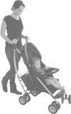
We Know:
Poor Employee Health & Wellness Costs Employers
Stress, coping skills, chronic disease, work satisfaction and productivity all impact costs
Depression accounts for 23% of productivity costs
Back pain, headache and arthritis account for 31%
Health plan costs continue to rise 10-15%
Chapman L. Meta-evaluation of worksite health promotion economic return studies: 2005 Updated. The Art of Health Promotion, July August 2005, 1-11
Notes:
<We also know the opposite is true>. Poor poor employee health & wellness costs you money…
Stress, coping skills, chronic disease, work satisfaction and productivity all impact costs. <employers see these costs through increases in STD, LTD, staff turnover, faster progression to expensive biologics due to poor chronic disease management, having to hire more expensive temporary workers>…<and a list of other cost drivers>
We know some of the key areas for loss include:
Depression, accounting for 23% of productivity loss
Back pain, headache <often stress related> and arthritis account for 31% <with unmanaged arthritis potentially costing more due to earlier use of biologics>
The result is health and drug plan costs continue to rise 10-15%. Health Connected targets these issues and can impact your costs.

Slide 4
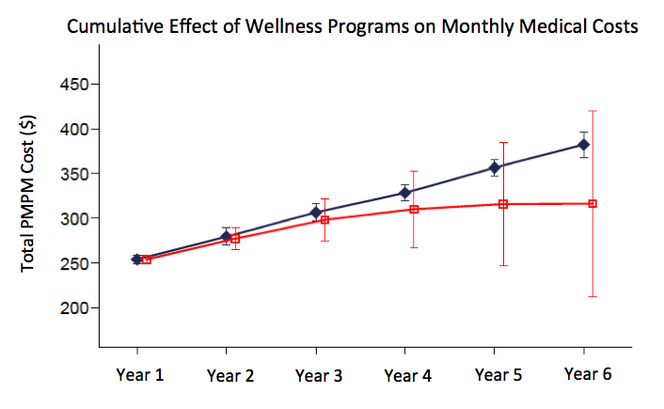
An Effective Health Strategy Can Manage Plan Costs
Direct annual savings of $157¹
Absenteeism costs $1483²
Presenteeism costs $1689²
Turnover costs 60% of annual salary³
Without Programs
With Programs
Workplace Wellness Programs Study. Mattke et. al., 2013. Rand Corp., U.S. Department of Labor and the U.S. Department of Health and Human Services.
Workplace Wellness Impacts Absenteeism and Presenteeism. 2013. MediResource Health Risk Assessment Data Analysis of Canadian Employers.
Harvard Business Review. https://hbr.org/2006/12/the-high-cost-of-low-wages
Notes:
So what is the cost-benefit of implementing a stronger health and wellness program and strategy?
Studies have found that the direct employer cost savings can be $157/employee/year on plan costs alone.
But lets look at the larger costs. Data on the absenteeism and presenteeism collectively can cost much more, several thousand per employee per year.
The cost of staff turnover can be 60% of an employees salary <some use 1 month to 1 year of salary as the cost depending on job level>. Earlier we mentioned that 59% of employees said a stronger culture of health was a reason to stay with their current company so this cost can also be reduced.
Health Connected targets these cost drivers so the benefits to your organization aren’t just increases in productivity and better management of your health plan costs.
They include healthier, happier and more engaged employees.

Slide 5
Introducing
A NEW! digital health program that targets employee wellness, productivity and health plan costs
Notes:
So you know the benefits of a healthier company, so how can Health Connected help?
Health Connected is a comprehensive and turn-key digital program that targets employee health, productivity and employer health plan costs.
What makes Health Connected different is that it’s a complete and comprehensive wellness program that is packaged so you develop a long-term strategy of “Creating a Health Movement”
Because its digital it is accessible office and remote workers providing an ongoing and continuous cycle of engagement over the long-term. It’s a program that works for both large and small companies.

Slide 6
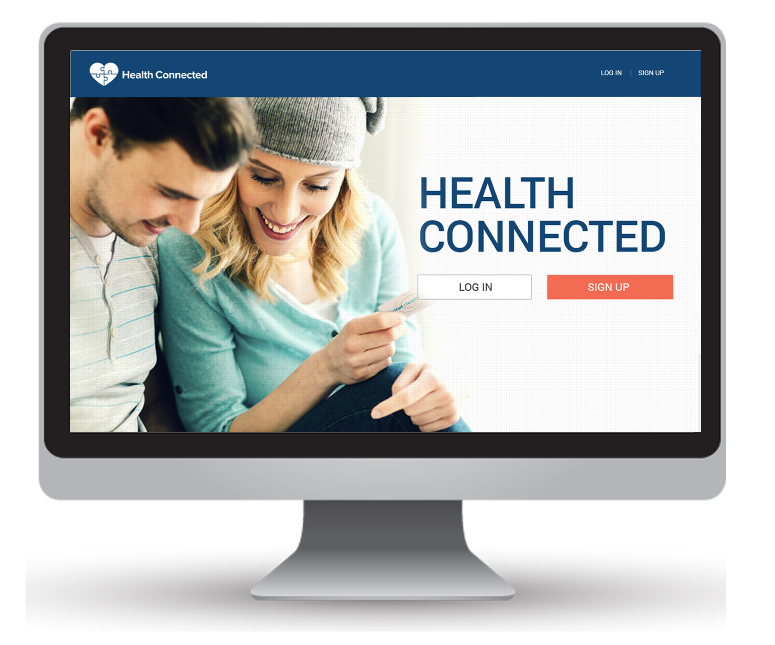
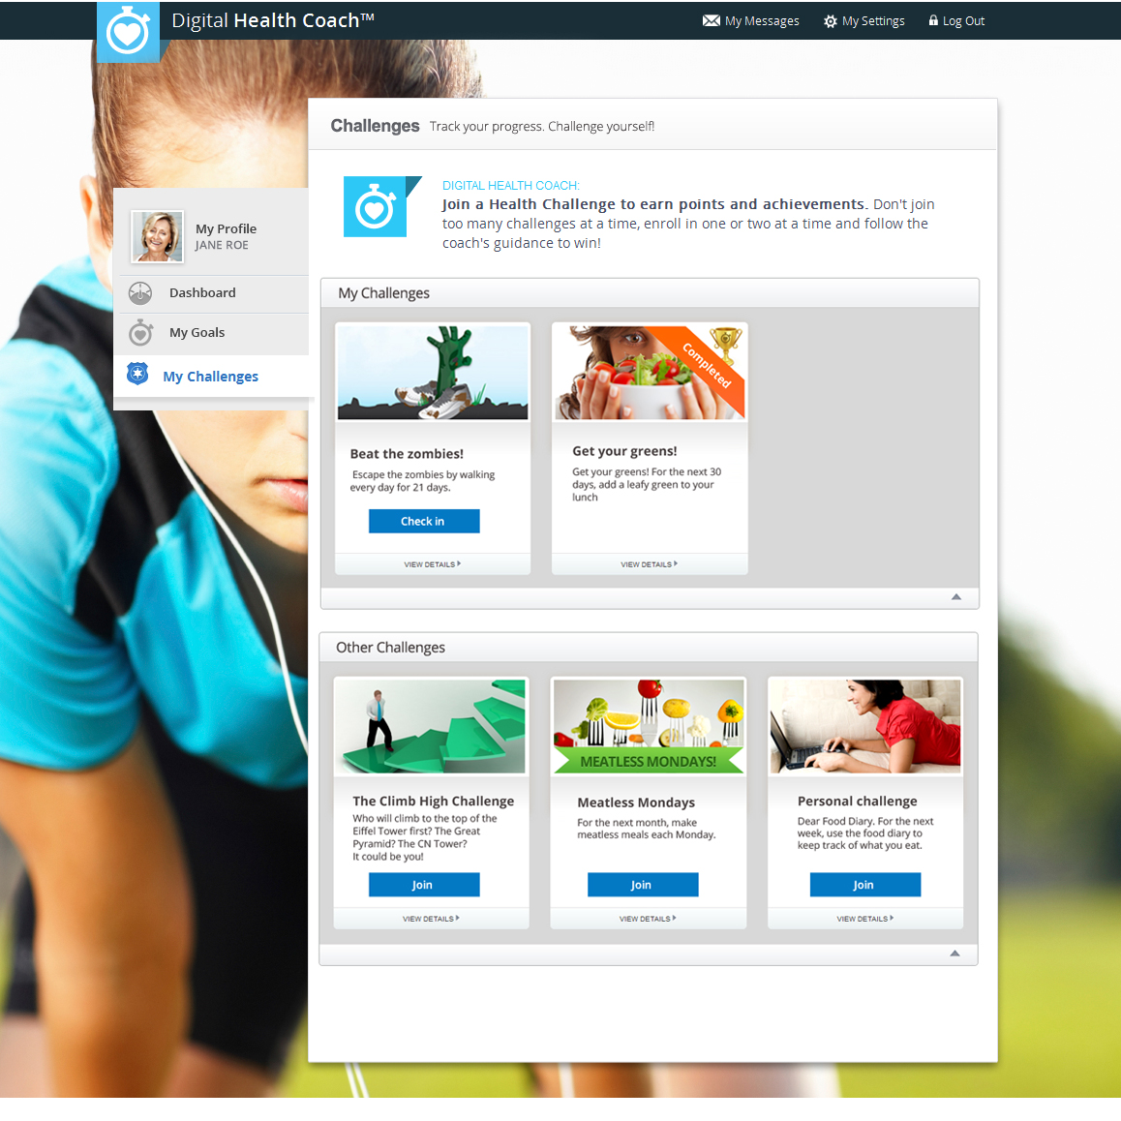
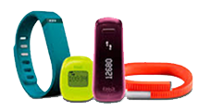
A Complete, Turn-Key, Automated Solution
3 unique programs proven to impact employee health and employer costs
Health Risk Assessments
Health Challenges & Tracking Devices
Digital Health Coaching
Notes:
Health Connected is a complete, turn-key, automated health and wellness solution.
The core of Health Connected is 3 unique and integrated programs proven to impact employee health and employer costs.
These programs are:
A Health Risk Assessment to establish a baseline risk profile of each employee with aggregate data delivered to you so you can see your company health risk profile. It includes the industry’s most extensive reporting and analytics package for employers that aggregates data so you can identify areas to focus your efforts and measure results.
A second program is Health Challenges. Health challenges allows your employees to participate in individual or team events such as a “Walking challenge” or “healthy eating challenge”. Employees can connect to wearable devices such as FitBit to track progress. You can also use challenges with incentive programs, such as getting a Tim Hortons gift card or some other reward.
The third program is Digital Health Coach. Digital Health Coach allows employees to create a highly personalized health action plan. Health coaching is an effective way to impact health behavior, we’ve digitized this process. If you’re not familiar with health coaching it works much like a business or life coach. You meet with your coach to understand your goals and work together to develop a plan to achieve them. This is what Digital Health Coach does for health, it provides employees with a self-management tool that create their very own health action plan based on their health goals and personal situation.
These 3 products all work together to create a complete end-to-end solution.
We know that ease of implementation is a key factor for your business. Health Connected is a complete turn-key, automated solution that requires minimal time investment.

Slide 7
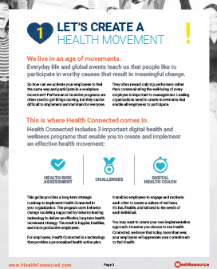
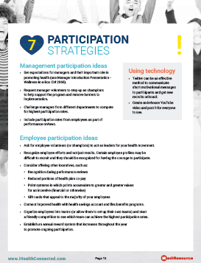
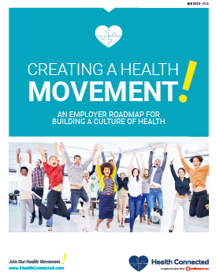
A Total Support Package
To create your own health movement
Completely Automated
As little as 30 minutes monthly or as much as you want
Wellness-in-a-box
A complete roadmap for create a health movement
PowerPoint presentations for managers and employees
Posters, tent cards, desk cards
Weekly and monthly employee emails
Templates (Word, PPT) of all resources to modify as you like
Notes:
For employers we provide a total support package to simplify the process of creating a health movement. We know how difficult it is to find the time and resources for company health and wellness. So we’ve done all that work for you to make it easy.
Health Connected is completely automated. With only a small time investment, as little as 30 minutes per month, you can implement.
Health Connected comes with a complete set of employer guides and support materials we call “WELLNESS-IN-A-BOX”. This includes:
An employer roadmap to create a health movement. Its really a how-to guide to implement a wellness program. If you don’t have the staff or resources, time or knowledge, this guide provides you with all you need to make implementation simple and efficient.
You get several PowerPoint presentations that introduce managers and employees to the program. Use these at lunch and learns or staff meetings.
We also provide posters, tent cards, desk cards <these are small business card sized items you can drop on peoples desk>, for in-office promotion. All you need to do is place post posters in lunch room or hallways and leave other material on desks or common areas.
We provide a set of emails you can simply forward using your internal email system. You can do this weekly or monthly, its your choice.
Everything is in a template format so if you want to modify it, or if you have a program already in place and want to change the “Join Our Health Movement” messaging you can.
Our partner in Health Connected is MediResource. They have been leading digital health and wellness provider since 1996 and are Canada’s largest. This program is the result of nearly 20 years of expertise in implementing digital health and wellness programs. MediResource has provided programs for decades to Manulife, Great West Life, Blue Cross and Sunlife.

Slide 8
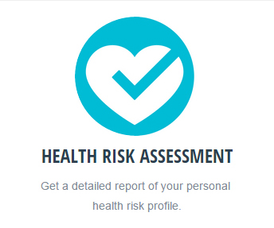
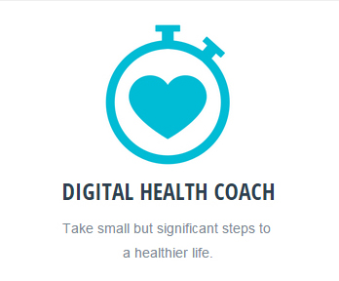
For Employees: Make It Fun and Provide Direction
Each Program Becomes A Mission To Achieve (1 Mission per month)
Any movement starts with a single “Mission”
Missions create your health movement strategy
Mission 1: Complete a Health Risk Assessment (HRA), get a baseline
Mission 2: Participate in a challenge
Mission 3: Create a personal health action plan
Mission 4,5,6,+++
Use analytics and support material to choose next priority mission
Notes:
For your employees lets make it fun and provide clear direction on how to participate in your Health Movement.
So we’ve organized each program to become a mission to achieve. We know people rally around missions, it’s a concept people understand because it provides a defined goal with a specific start and finish.
People can start one mission each month (or over a longer if you’d like). This ensures employees have direction and aren’t overwhelmed. Many people haven’t focused on their health for many years so we want to take small steps over time and not overwhelm them with too many things at once or without a clear path. This approach gives people a greater sense of achievement and builds confidence to participate over the long term.
If you look at any movement it always starts with a mission. Missions fuel momentum for your health movement strategy.
We’ve suggested an order to these missions but you can do them in any order, although we recommend doing a Risk Assessment first to get baseline starting data on where you stand.:
Mission 1 is to complete an HRA. This provides you that baseline of your company risk profile so you can determine next steps and where to best to focus your efforts.
Mission 2 is possibly a health challenge. Health challenges can include use of wearable devices like Fitbit and allows employees to create teams and collect points or rewards. An example of a challenge is lets all “Trek Across Canada”, using pedometers to measure progress. Challenges can include leaderboards and teams for friendly competitions.
The last Mission in the cycle would be Digital Health Coach. This unique tool provides the digital equivalent of a live health coach. It starts with a “Health Skills Assessment” and then provides a personalized health action plan. Its focussed on health skill development so people can achieve their health goals.
<All along the way you have the support materials you need to promote and encourage participation in Missions with the “Wellness in a Box” support materials>
Once you complete all 3 missions, you can begin another cycle but this time you can start at any point. This means Health Connected provides a perpetual program that doesn’t get stale.

Slide 9
A Powerful Analytics Package To Profile Your Company’s Risk And Measure Results
Measures 17 Risk Categories Plus Behavior Data
Over 100 Pages of Automated Analytics & Insights
Notes:
INTERNAL NOTE TO CONSULTANTS: IF YOU HAVEN’T RECEIVED A PRINT SAMPLE OF THE REPORTING PACKAGE REQUEST ONE FROM CUSTOMER SERVICE
Behind the scenes there is the industry’s most powerful analytics engine to profile your company’s overall health and measure results.
We continuously measure 17 different risk categories <such as such as cardiovascular risks, diabetes, stress, sleep, depression and several other chronic disease risks>, as well as aggregating behavior data about employees. Behavior data includes metrics such as their “readiness to change” and a series of health skills like “commitment to change”.
We provide you an online report equivalent of about 100 pages of risk and outcomes metrics as well as insights to help you make decisions. We provide analytics around things such as your actual loss in productivity due to absenteeism and presenteeism, or specific disease states you should focus on <for example, we often hear employers want to focus on smoking cessation and later find their analytics show this is not a big cost driver despite that its an obvious target. The metrics and insights in the report might show they should focus on stress, depression or nutrition first>.
Its simple to use, automated and provides all the insights and guidance you need on where to focus and what to do to next to get the best results.

Slide 10
Powerful Reporting: Identify And Focus On The Right Things
1
E.G. Risk Data on Weight
Insight: 66% employees high to moderate risk
2
Combine Risk + Behavior Insights
74% preparing or taking action
14.3% need a boost to get on track
Capitalize on current momentum, focus on healthy eating vs smoking cessation
Notes:
Lets run through a real example of the reporting that’s included.
Here we separated out some of the analysis for one of the 17 risk factors, in this case “Body Weight”.
The risk data tells us that 66% of employees are moderate to high risk for “body weight”
If we look below, we have some associated behavior for this risk. It shows 74% are ready to act (20.1% that are preparing for it, 53.7% are doing something about it). It also shows that 14.3% falling back into bad habits and need a boost. This tells us that momentum is there to focus on weight management or healthy eating versus another risk category like smoking cessation.
How we integrate those insights to our Health Movement strategy might be to promote a Mission of “Participate in the Healthy Eating Challenge”. We provide you with the Wellness-in-a-Box posters, desk cards and tent cards to promote this “Mission” in the office. To add more awareness of the Mission we also provide Wellness-in-a-Box emails on the topic of healthy eating to send employees reminders to participate or stay on track. Thinking further ahead, the “Mission” after healthy eating might be to re-take the Health Risk Assessment or setup a personal coaching plan for healthy eating to extend the challenge and track progress.

Slide 11
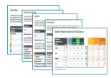
Quantify Productivity, Loss & Focus On Priority Cost Drivers
Example:
Over $1MM in lost productivity due to health issues
Example:
80% loss from 40-59 year olds
Presenteeism 2X absenteeism
Physical demands largest contributor in category of weight
Notes:
The analytics also allows you to drill deeper into the risk of Body Weight. We actually quantify productivity loss and identify where to focus priorities within Body Weight so you can get the best outcome.
We use validated absenteeism and presenteeism measures to quantify productivity loss for each risk factors, in this case Body Weight.
Extending the risk and behavior data from the last section we can see that this company:
Has $1MM in lost productivity annually.
Below we can see that 80% of this comes from 40-59 year olds
Presenteeism is the main issue, costing twice what absenteeism does
And to the left we see the physical demands of the job are where the largest loss originates
The insight here might be to use Health Connected to make a special effort and engage 40-59 year olds in a weight management program that would include a health challenge or setting up a personalized healthy eating action plan in Digital Health Coach.
Nothing in the market provides this level of reporting and ease of use to identify where to focus efforts, measure outcomes and deliver to you a turn-key solution that includes the support materials we provide from “Wellness-in-a-box”.

Slide 12
Summary
3 Integrated Programs, A Complete Support Package, Powerful Analytics and Automated Insights:
Improved workplace health, both short and long-term
Improved productivity. Reducing absenteeism & presenteeism
Improved employee satisfaction with less turn-over
Improved management of health plan costs
Notes:
So in summary:
Health connected provides you with 3 integrated programs, a complete support package for easy implementation, powerful analytics and automated insights to help you plan your long-term health and wellness strategy.
The benefits of Health Connected are:
Improved workplace health, short and long term
Improved productivity. Reducing absenteeism & presenteeism
Improved employee motivation and engagement, with less turn-over
Improved management of your health plan costs

Slide 13
A new digital strategy that targets employee wellness, productivity and health plan costs
Contact:
Your Name
consultant@consultant.com
Notes:
That concludes our overview
SO IS YOUR COMPANY READY TO GET THE BENEFITS OF HEALTH CONNECTED AND JOIN OUR HEALTH MOVEMENT TODAY?
Thank you for your time, are there any questions?

Slide 14
End

Slide 15
Support Slides

Slide 16
This resource is a confidential sales aid to be used between consultants and employers.
Slides 3-6 establish the problem, optional slides if presenter prefers to move to slide 7 and describe HealthConnected offer.
All material copyright MediResource.
Modifications and consultant branding is permitted.
MediResource Contacts:
Main office: 416-383-0010
Sales Support:
Susan Clark (sclark@mediresource.com)
Ruben Benegbi (rbenegbi@mediresource.com)
Customer Service & Employer Setup:
Mon Huang (mhuang@mediresource.com)

Slide 17
Simple Registration and Easy Management
1
2
Setup Employer Account
Consultant (me) activates employer account
Access “Keys” are automatically generated (1 per employee)
Automated “Welcome” email sent to employer administrator containing link to www.iHealthConnected.com
You will be given access to Wellness-in-a-Box resources
Employer simply forwards Welcome Message to Employees
Can modify Welcome Message if desired.
Welcome message that contains the access key to iHealthConnected.com
If no employee email use print notification with the enclosed special code
3
Employee:
Clicks link to iHealthConnected.com
Register, activation email sent
Starts using Health Connected
Notes:
Registration process is simple and easy to manage.
Step 1: We set up your employer account. To do this
As your consultant I will activate your employer account and record the number of employees
Access “Keys” are automatically generated, 1 for each employee
An automated “Welcome” email is sent to you the employer to forward to your employees that will inform them about the program
You will also be given access to Wellness-in-a-Box resources
Step 2: You simply forward the employee welcome message to all of your employees as a single broadcasted message
Feel free to modify the message if you’d like
The welcome message contains a link to the website and an access key for each employee
If you don’t have the employee email we got you covered. We provide a special code you can use to in a print letter. They can register and enter their email later.
Step 3: For employees the process is very simple
They click on the link in the Welcome Message
The begin the registration process which only takes a few minutes. They are sent an activation email
By clicking an activation link they can start using Health Connected.

