Slide 1
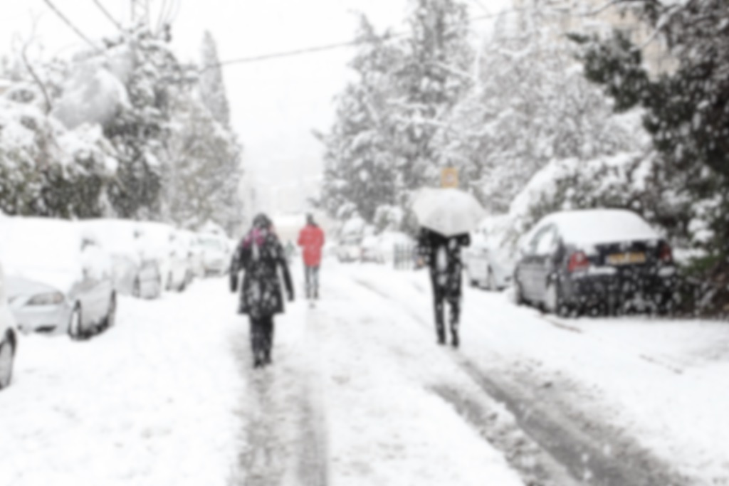

Surviving the Canadian Winter

Slide 2
What is the Canadian Winter?
“Canada has one of the most severe winter climates of any country in the world” – Environment Canada
  Extreme cold – coldest day in Toronto was -31.1 C (1981)
    Last February, lowest was -25.5 (but felt like -40C with wind chill!)
  Blinding blizzards
  Ice storms
Wind chill factor – how it feels like with the wind
Frostbite – injury to body tissues by exposure of cold temperatures
Lasts about 4-5 months (Nov-Mar/Apr)
Notes:
https://www.ec.gc.ca/meteo-weather/default.asp?lang=En&n=D2F64537-1
Blinding Blizzard – violent snowstorm, strong winds, intense snow, prolonged snow, poor visibility
Ice storm – a storm of freezing rain that leavings a coating of ice

Slide 3
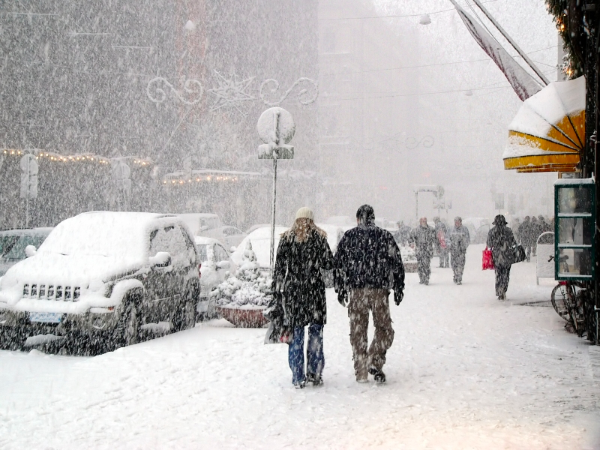
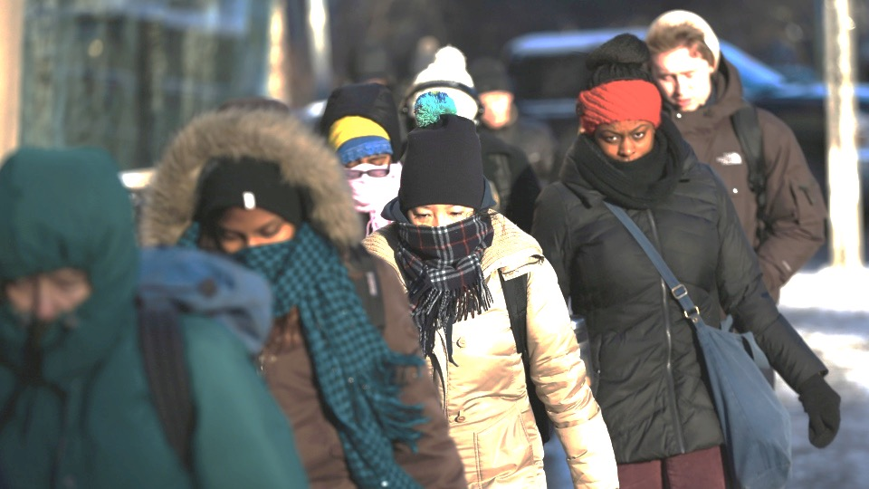
How to Survive the Canadian Winter
Proper clothing
Shoveling
Eating right
Pedestrian safety
Driving safely
Emotional health
Winter activities
Emergency preparedness

Slide 4
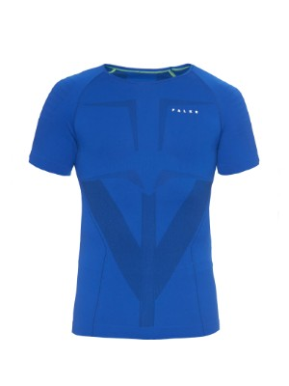
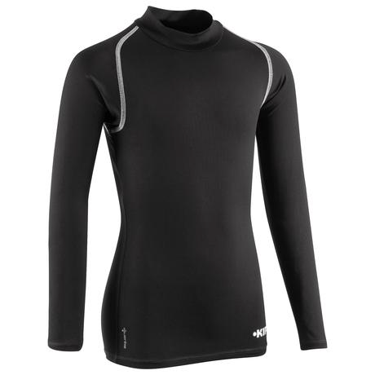
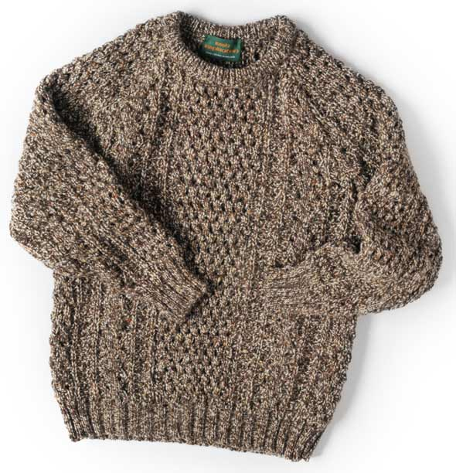
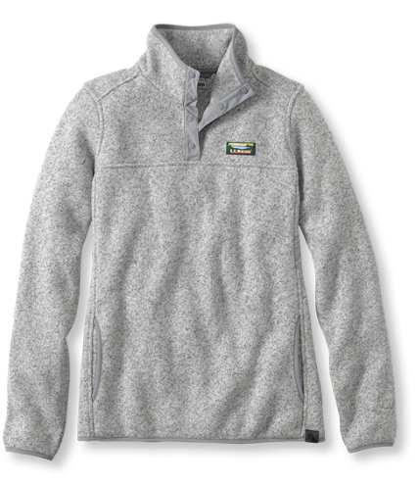
Clothes
Best to invest in winter clothes
1) base layer
  Long sleeve or t-shirt
2) mid layer
  Sweaters (wool, fleece, any warm sweater)
Notes:
don’t buy cheap ones – they most likely won’t protect you from extreme cold temperatures

Slide 5
Jacket
3) outwear (biggest investment)
  Waterproof and warm
  Hard-shell vs soft-shell – will you be physically active?
  Down-filled jacket – best option!
    Warmer for the weight than other types of insulation
  Synthetic insulation – man-made material that traps warm air
    Less expensive than down, but heavier and less compressible
  Omni-heat technology – silver dots to reflect body heat and make the jacket 20% warmer
  Gore-tex – a membrane to make a jacket waterproof by using a Durable Water Repellency process
Notes:
Hard-shell: rigid and waterproof
Soft-shell: more breath-ability, flexible, but not quite waterproof
Will keep snow off but lots of heavy rain will probably soak through
For people who will be physically active e.g. climbing, hiking
Down-filled: 650 fill, 800 fill, higher the number → higher quality of down and warmer
More expensive and doesn’t perform well when wet
Gortex – waterproof and breathable fabric to repel liquid water while allowing water vapour to pass through
Light weight

Slide 6
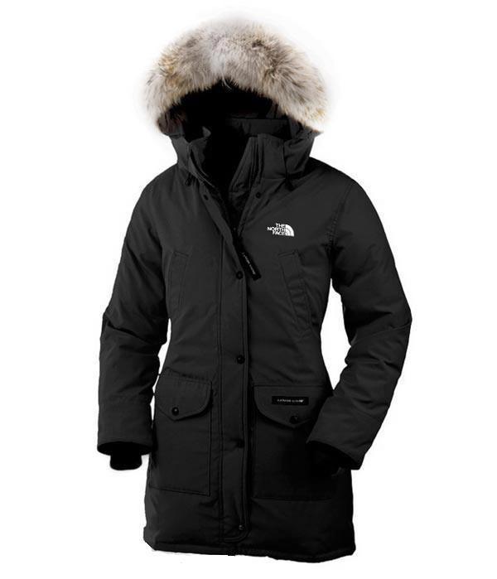
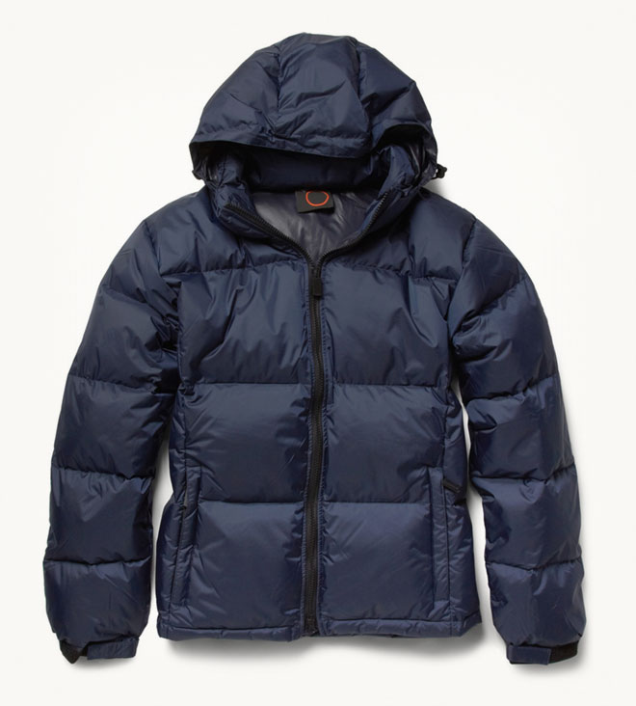
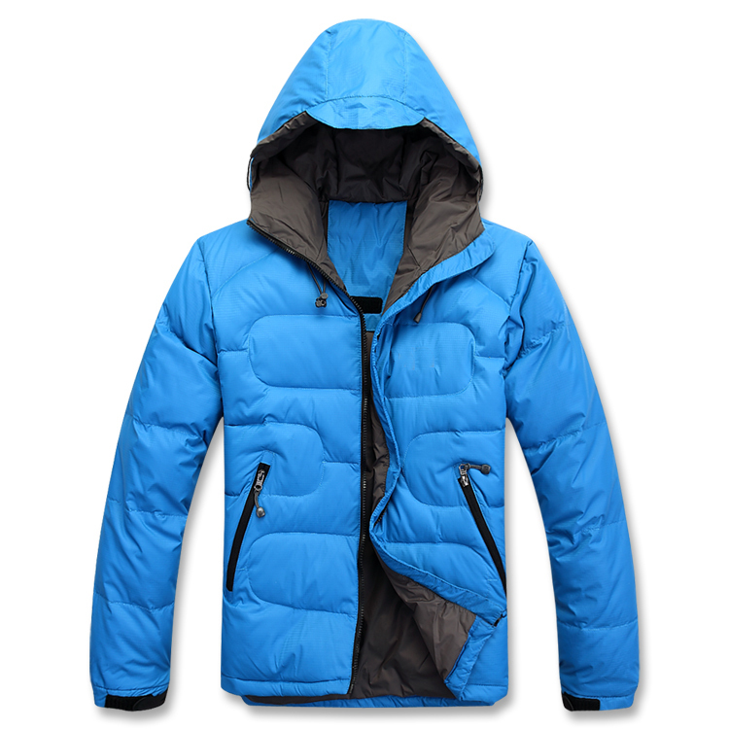
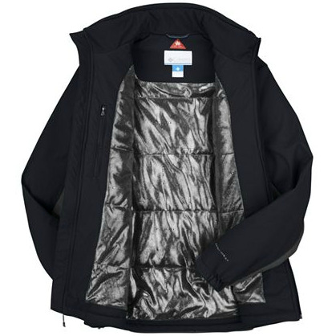
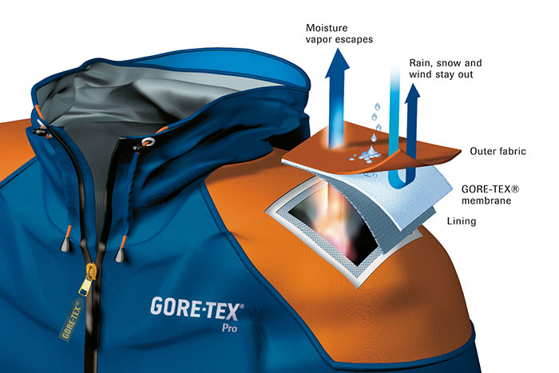
Jacket
Down-filled
Synthetic
Omni-heat
Check out jackets from these stores:
Columbia
North Face
Superdry
Aritzia
Moose Knuckle
Canadian goose
Parajumper

Slide 7
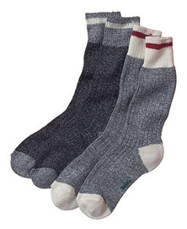
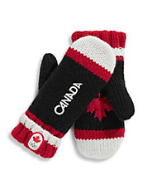
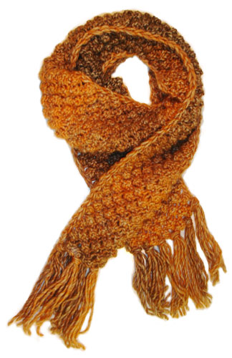
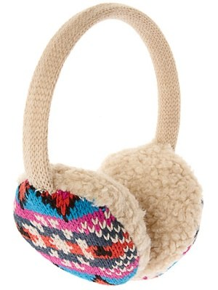
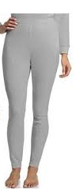
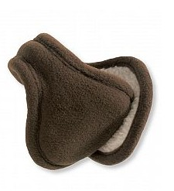
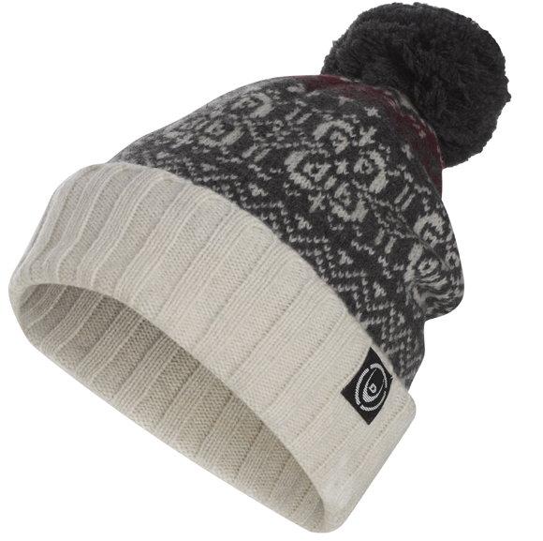
Clothes
Warm long wool socks
Long underwear/tights
Scarf
Mittens/Gloves
Hat
Earmuffs

Slide 8
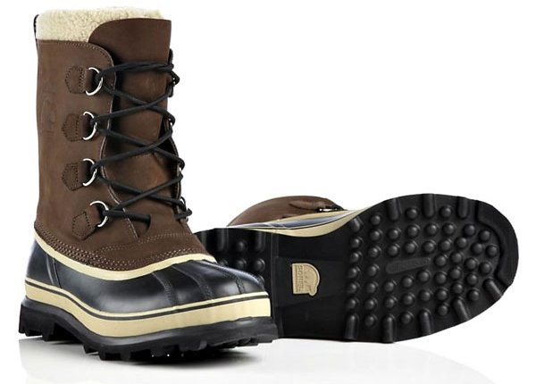
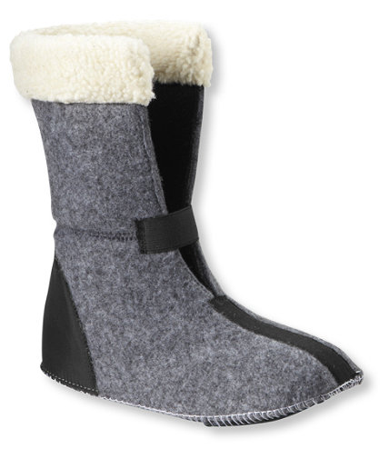
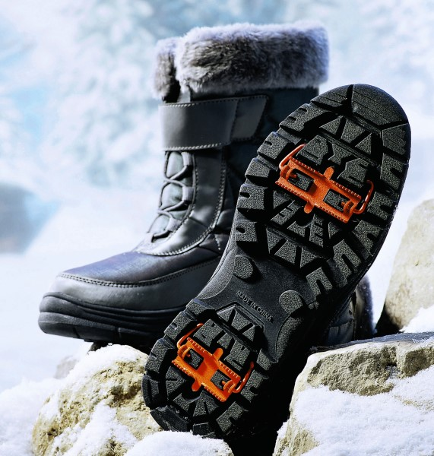
Boots
Lined waterproof boots
  Tall or short?
  Leather or rubber
  Insulation
    Thinsulate – warmth without the weight
    Primaloft – microfiber polyester material that is highly compressible and water resistant
    Heatseaker – long fiber insulation similar to thinsulate
    Wool felt – original insulator, manages moisture well and keeps temperature reasonable
      Generally comes at an additional cost
  Tractor soles for grip
  Removable liners
Notes:
Tall boots offer more protection, but it is more challenging to hike/climb
Shorts boots: harder to tuck in pants if needed
Outer material should be leather or rubber
Removable liners → in case they get wet

Slide 9
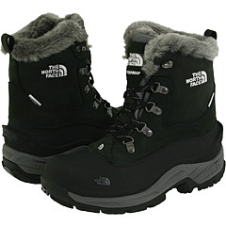
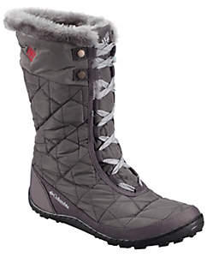
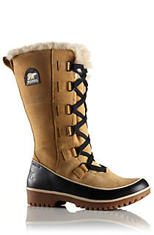
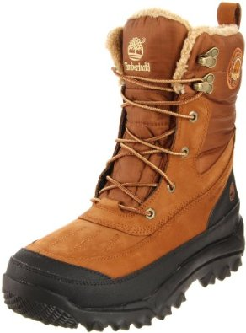
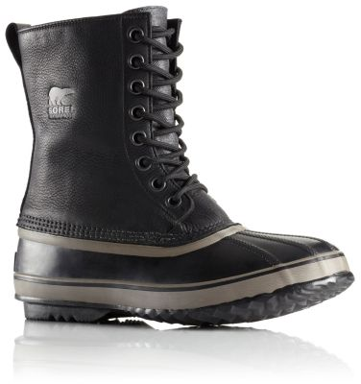
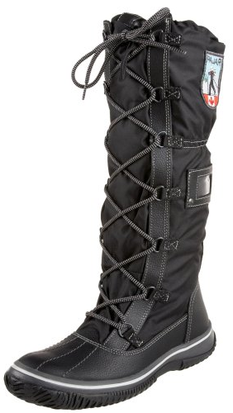
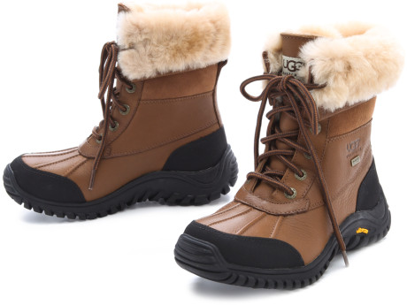
North Face
Columbia
Timberland
Sorel
Check out these brands for boots!
North Face
Columbia
Timberland
Sorels
Pajar
UGG Adirondack ii
Sorel
Pajar
UGG
Notes:
UGGS → don’t get the UGG CLASSIC - not made for the snow and they stain

Slide 10
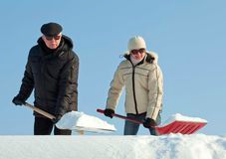
Shoveling
Strenuous effort
  Do not shovel if have back or heart problems or not physically fit
Stretch before you start shoveling
Dress appropriately
  Wear gloves that will give you a good grip
  Boots should have good traction
Choosing a snow shovel (or snow scoop)
  Light-weight ~3 lbs
  Base blade shouldn’t be too large
  Handle is long enough so you don’t have to stoop to shovel
  Grip made out of plastic of wood
Shovel early and more often
  Fresh snow is lighter and more manageable than wet and packed snow
Push the snow rather than lift
Don’t throw the snow over your shoulder

Slide 11



Eat Right
Hot breakfast (instead of cold), oatmeal, eggs, toast, pancakes, soup
Keep your carbohydrates up!
  Pasta
  Rice
  Potatoes
  (Afraid of the weight? Your body will burn those calories to keep you warm)
Vegetables
  Leafy greens, broccoli, carrots
  Hearty soups
Citrus fruits to add sunshine to the winter
  Lemons
  Limes
  Oranges
  Grapefruit

Slide 12
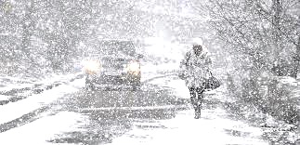
Pedestrian Safety
Sometimes the sidewalks disappear and you may have to walk on the streets
  Walk facing ONCOMING traffic
Never assume the driver will see you – be a defensive walker
Drivers may not be able to stop as quickly because of the snow and ice

Slide 13
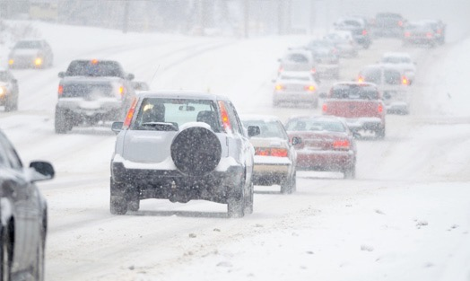
Driving Safety
Change to your winter tires!
Must take extra precautions when driving in the winter (and be alert!!)
Keep a further distance between yourself and the vehicle ahead of you
Brake before turning
Avoid driving in extreme weather conditions (blizzard, extreme cold, high winds)
Things to keep in your car:
  Shove, bag of salt, ice scraper and emergency ski (more on this later)

Slide 14

Emotional Health
SAD – seasonal affective disorder
  Feeling of hopelessness, sadness, losing interests in things you have enjoyed, feeling sluggish, weight gain, sleeping more often
Get outside and play!
  Get outside within two hours of waking up
Make sure to find time to be in the sun
  Even sitting near the windows helps
Manage your workload to reduce stress
Focus on the positive things about winter:
  Can buy a stylish coat
  Sitting by fires
  Drinking hot chocolate
  Make soups
  Ice skating
Connect with friends
Notes:
SAD
Still unknown reason for the cause of SAD
Maybe something to do with biological clock is off because of the reduced sunlight
Reduced sunlight → reduced sunlight levels → drop in serotonin (brain chemical that affects mood)
More prevalent in females and younger people

Slide 15
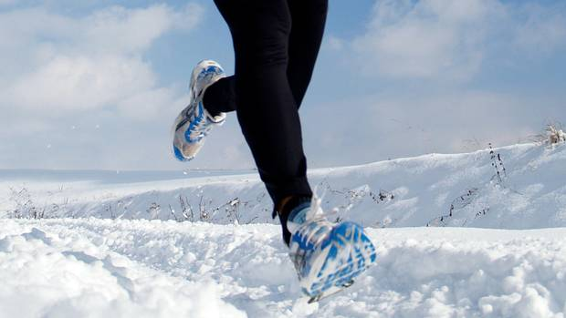
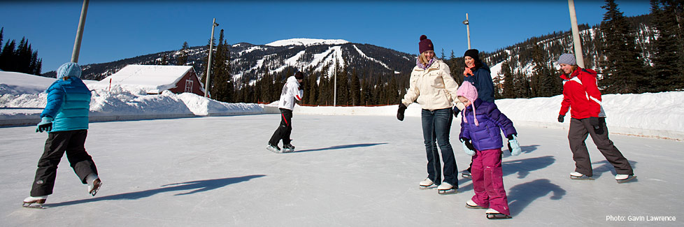
Staying Active
Running
  Tights or thin running pants
  Long –sleeve shirt with insulated jacket or vest
  Gloves, beanie
  Watch for frostbites!
Skating – lots of public skating rinks with affordable rentals
Tobogganing
Cross-country skiing – many provincial parks offer cross-country skiing (cheaper than going to ski resort)
snowboarding
Join a community gym
Dress warmly!

Slide 16
Emergency Preparedness
Know your house
  Where is your water shutoff valve? Emergency shut off value for the gas?
Create an emergency kit for your home and car
  Canned goods
  Cereals that can be eaten dry
  Chocolate bars
  Bottles of water
  Candle + matches
  Batteries + flashlights
  Car charger for cell phone
  Spare batteries for cell phone
  First aid kit
  Car → flares, jumper cables, warm blankets

