Slide 1
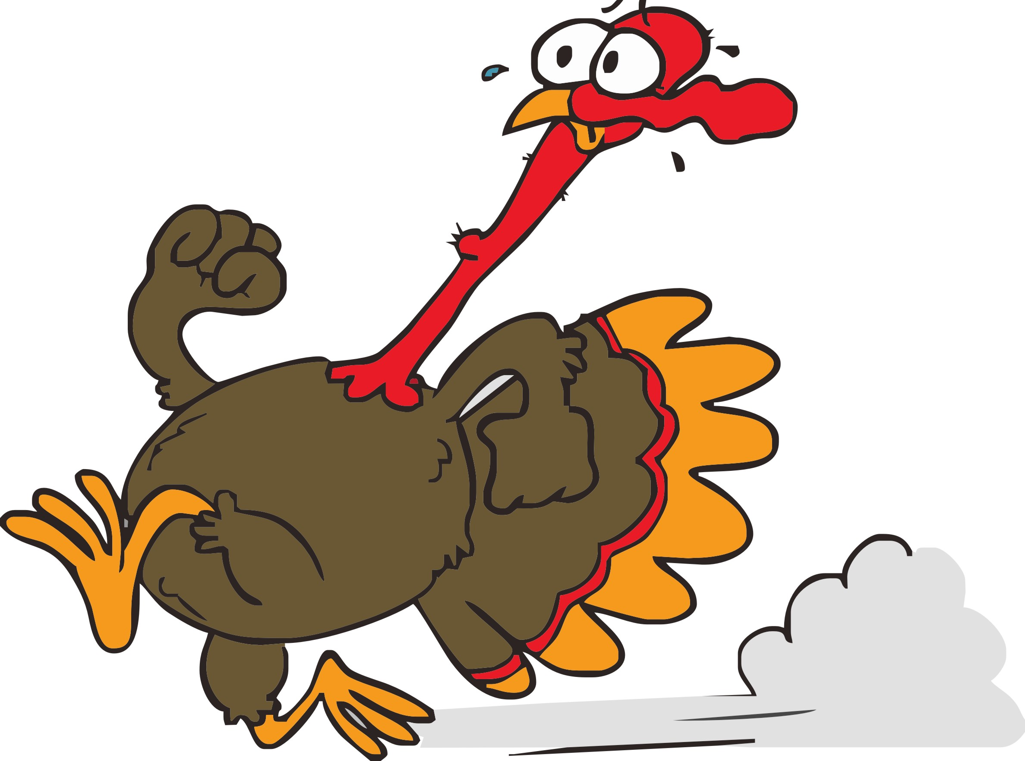
Chase the Turkey Card
For every 1000 steps your pedometer records, cross off a turkey. If you do not have a pedometer, for every 30 minutes you walk, cross off a turkey.
**FULL CARD = 5,000 steps or 30 minutes per day**
AIM = 1,000 steps in 10 minutes to meet the moderate-vigorous intensity standard
Put full cards in the marked envelope/fish bowl. Don’t forget your name and extension! Prize draws will be done at the end of the campaign. The more completed walking cards, the more chances you have to WIN!
Name: ________________________ Ext.: ______________

