Slide 1
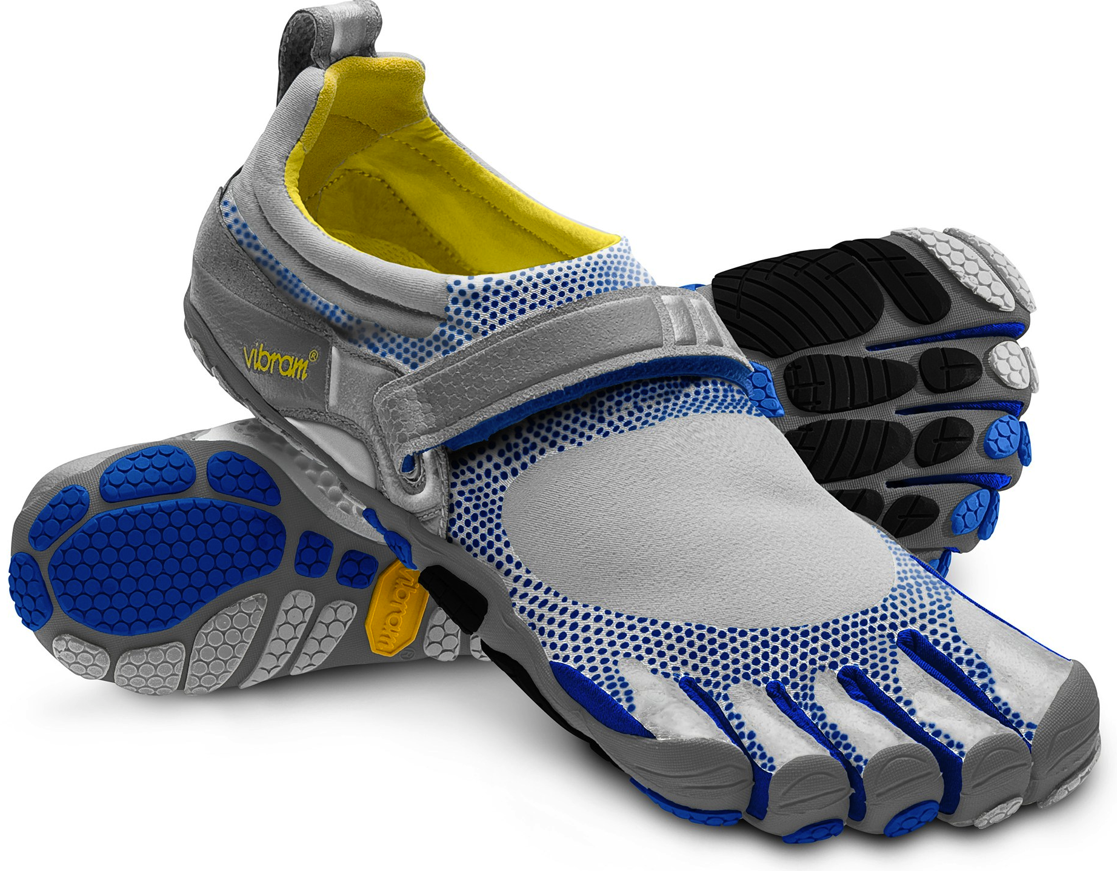
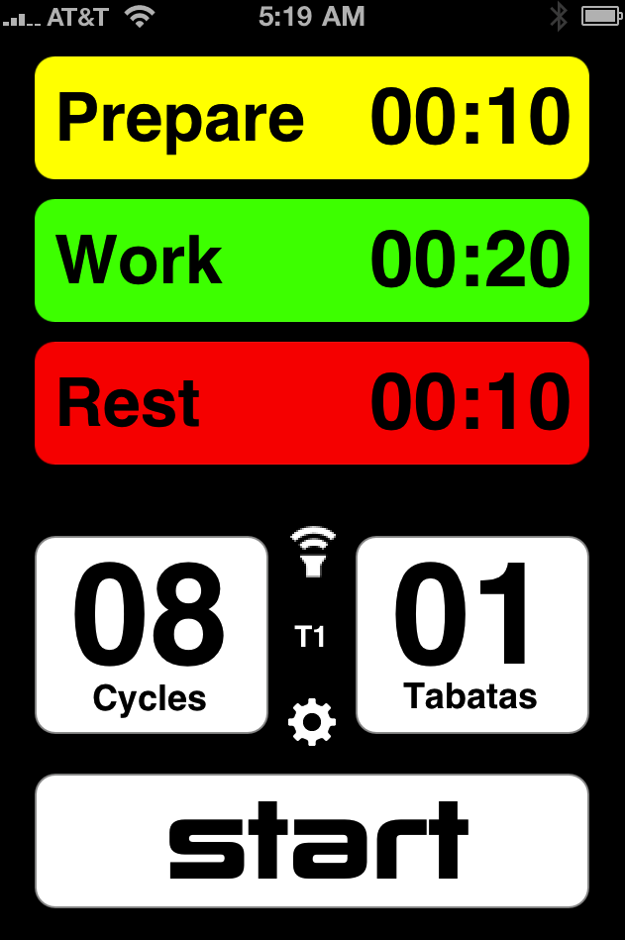
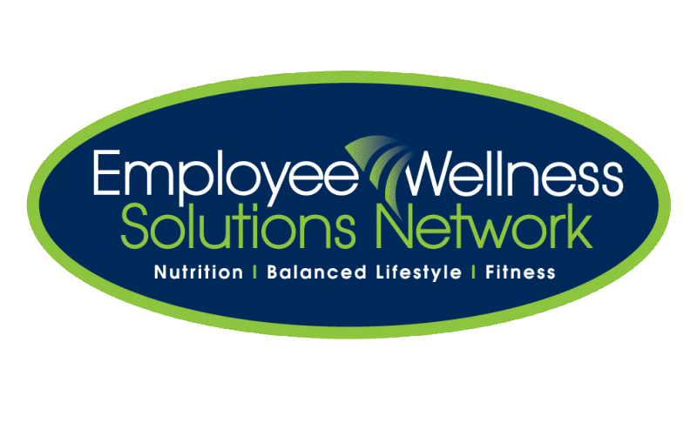
What’s New, What’s True
www.EWSNetwork.com

Slide 2
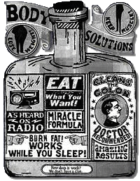
Topics of Discussion
Eggs: Omega 3s, substitutes, yolks
Added Sugar
HIIT
Vibration Platforms
Barefoot Running
Summary
Q & A
Notes:
Purpose of presentation: with media being so widespread nowadays, it’s hard to know what information may or may not be true.

Slide 3
The Lowdown on Eggs
HOW MANY?: One egg a day does not increase heart disease risk in healthy individuals.
… BUT, watch out for diabetics or those with high cholesterol intake (Fernandez, 2006; Hu et al., 1999).
OMEGA 3S: ⬆ unsaturated fat and omega 3 fatty acids, same amount of fat, slightly less cholesterol, and ⬆ Vitamin E compared to regular eggs.
Men (ages 19-70+): 1.6g/day
Women (ages 19-70+): 1.1g/day
Aim to eat six omega-3 eggs or two fish meals per week
(http://www.eggs.ca)
Bottom Line:
Watch your overall fat intake
Eat omega-3 eggs OR consume fish twice a week.
Notes:
How many eggs a day?: Recent research shows that moderate egg consumption – one egg per day, does not increase heart disease risk in healthy individuals and can be part of a healthy diet. But, if you are someone with diabetes or someone who has difficulty controlling total and LDL (“bad”) cholesterol intake, you may want to be cautious about eating egg yolks and opt for egg whites. This was proven in a study where heart disease risk in men and women with diabetes increased when they ate one or more eggs a day. For these people, it is advised to have no more than three yolks per week.
Omega 3s: The difference between omega 3 eggs and regular eggs is what they feed the hens. For omega 3 eggs, the hens have a diet high in flax seed, which is a good source of omega-3 fatty acids. The fatty acids are then transferred into the egg. Omega-3 enriched eggs have a higher level of unsaturated fat and omega-3 fatty acids. The total fat content remains the same. The cholesterol level is slightly lower but it is incorrect to refer to these as low cholesterol eggs. Vitamin E is added to the feed as an antioxidant for the omega-3 fatty acids.
Health Canada and National Academy of Science recommend: Men aged 19 to 70+ should consume 1.6 grams of omega-3 fatty acids daily. Women aged 19 to 70+ should consume 1.1 grams daily.⁴² This level of omega-3 fatty acids can be reached by eating six omega-3 eggs or two fish meals per week. One omega-3 egg can provide approximately 1/4 to 1/3 of the recommended intake of omega-3 fatty acid.
Bottom line: This doesn’t mean you can eat as many eggs as you want if you’re healthy, but watch what else you eat in your diet. Ex. don’t have eggs with bacon, fries and sausage but maybe try eggs with salsa and whole wheat english muffin. Omega 3 eggs are a great way to increase omega 3 fatty acids in your diet but it doesn’t have to completely replace consumption of regular eggs. Aim to increase omega-3 intake by eating omega-3 eggs OR consuming fish twice a week.

Slide 4
YOKE?: One large egg = 186mg cholesterol (all in the yolk)
Recommended DV cholesterol:
Healthy: <300mg/day
CVD, Diabetes, High LDL: <200mg/day
SUBSTITUTES?:
Found in the dairy section for cholesterol-conscious people (not egg allergy people!).
Ex. Egg creations (Burnbrae Farms): liquid egg that is cholesterol and fat free and a source of 11 vitamins and minerals
Bottom Line:
A diet high in cholesterol can contribute to high blood cholesterol levels so limit your cholesterol intake from other foods if eating eggs.
(http://www.burnbraefarms.com/)
Notes:
Yolks: Cholesterol found in egg is all from the yolk but this doesn’t necessarily mean you have to eat egg whites from now on. If you are healthy, it's recommended that you limit your dietary cholesterol to less than 300 milligrams (mg) a day. If you have cardiovascular disease, diabetes or a high low-density lipoprotein (LDL, or "bad") blood cholesterol level, you should limit your dietary cholesterol to less than 200 mg a day.
One large egg has about 186 mg of cholesterol — all of which is found in the yolk.
Bottom Line: If you eat an egg on a given day, it's important to limit other sources of cholesterol for the rest of that day. Just keep track of your daily intake of cholesterol from all foods!
Substitutes: Egg substitutes are different than egg replacements in which they are for those who are watching their diet for lifestyle reasons (i.e high cholesterol or fat). It still contains egg and is not for those with egg allergies! Egg Creations is sold in Canada from Burnbrae Farms that is liquid egg that is cholesterol and fat free and a source of 11 vitamins and minerals. More info can be found on their site.

Slide 5
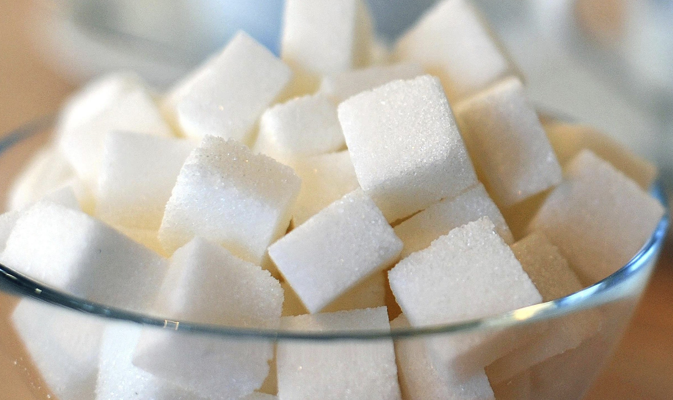
Added Sugar: How Much?
Nutrition Label: Words ending in “ose” (maltose, sucrose), high fructose corn syrup, molasses, cane sugar, corn sweetener, raw sugar, syrup, honey, fruit juice concentrates.
(American Heart Association, 2014)
“The average Canadian consumes 23 teaspoons of added sugar a day”
Culprits: Soft drinks, candy, cake, cookies, pies, fruit drinks, dairy desserts (ice cream, sweetened yogurt), other grains (cinnamon toast)
Statistics Canada
Notes:
Added sugars (different than naturally occurring sugars) are sugars and syrups put in foods during preparation or processing.
Main culprits: Soft drinks, candy, cake, cookies, pies, fruit drinks, dairy desserts (ice cream, sweetened yogurt), other grains (cinnamon toast)
Added sugars contribute zero nutrients and can lead to weight gain and reducing heart health. According to Statistics Canada, the average Canadian eats about 23 teaspoons (92 grams) of added sugar each day from a combination of packaged and prepared foods. That’s a lot of sugar, considering that the Dietary Reference Intakes suggest we consume no more than 12 teaspoons (48 grams) of added sugar in a 2,200 calorie diet.
Where to look if there are added sugars: On the nutrition label under ingredients list, look for the following: words ending in “ose” (maltose, sucrose), high fructose corn syrup, molasses, cane sugar, corn sweetener, raw sugar, syrup, honey, fruit juice concentrates.

Slide 6
Recommended Sugar Intake:
Maximum of 25% or less of energy from added sugars or <12 tsp/day.
(Canadian Sugar Institute, 2014)
12 oz can soda = 8 tsp or 40 g sugar of 130 calories!
American Heart Association:
Men: 9 tsp/day
Women: 6 tsp/day
1 tsp = 5 g
(American Heart Association, 2014; http://www.heartandstroke.com/)
Notes:
To put into perspective, one 12 oz can of soda contains 8 tsp of sugar = 40 g (8tsp x 5g = 40) which is 130 calories!
How much is too much?: Canadian guidelines say max 25% or less of total energy intake from added sugars or no more than 12 teaspoons a day according to dietary reference intake. American guidelines say 6 tsp/day for women, 9 tsp/day for men.

Slide 7
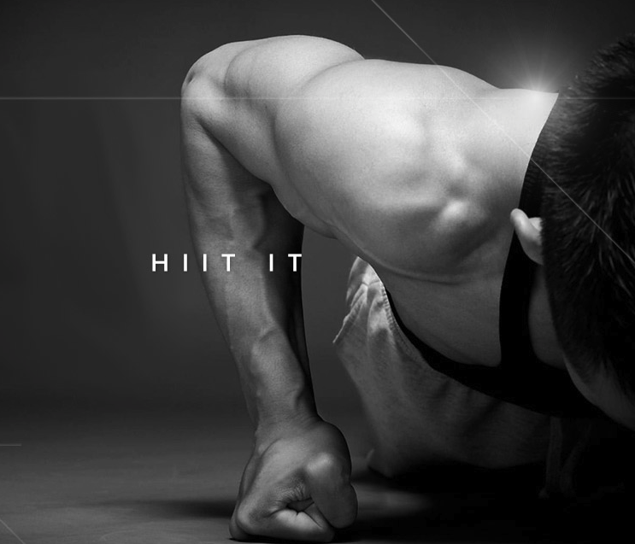
High Intensity Interval Training (HIIT)
HIIT: intervals of repeated bouts of short, high intensity exercise with short, partial recovery periods (Laursen & Jenkins, 2002).
Improves endurance performance more than continuous submaximal training would.
⬆ blood flow, oxygen delivery to muscles, oxygen utilization from muscles, fat metabolism
(Laursen & Jenkins, 2002).
Notes:
HIIT: repeated bouts of short to moderate duration exercise (10 sec – 5 min) completed at an intensity greater than anaerobic threshold. Bouts are separated by brief periods of low intensity or inactivity that allow partial but not a full recovery
Its purpose: repeatedly stress the physiological systems that will be used during endurance exercise to a GREATER extent than what is actually required during the activity
How it works: In sedentary and recreationally active individuals, HIIT improves endurance performance to a greater extent than continuous submaximal training (ex. jogging) alone. From a physiological level, these improvements include increased blood flow, oxygen delivery to muscles, oxygen utilization from muscles, fat metabolism.

Slide 8
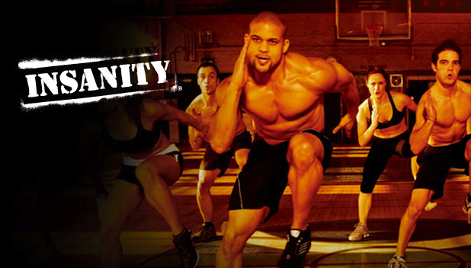
Is it for me?
HIIT is suitable for most people, even those who have not exercised in a long time to athletes. Talk to your doctor first if you are not a regular exerciser, or have a chronic health in addition to diabetes.
What’s in it for me?
Completed in as little as 10 minutes
Very flexible
Suitable for those with a low level of fitness
Can be as effective as much longer periods of continuous exercise
Examples
Do it yourself!
Tabata
Insanity
Notes:
Is it for me: HIIT is suitable for most people, even those who have not exercised in a long time to athletes. Talk to your doctor first if you are not a regular exerciser, or have a chronic health in addition to diabetes.
What’s in it for me/benefits (stress this section!): super efficient - can be undertaken in as little as 10 minutes, Flexible – a wide range of exercises can be chosen, suitable for those with a low level of fitness (this is huge esp for those who are nervous about starting exercise again!), can time saver - be as effective as much longer periods of continuous exercise (you do not have to jog for an hour to get the same benefits from a 10min HIIT workout).
Examples: see handout for ideas of HIIT exercises.
- Tabata: warm up, 8 intervals of 20 seconds all-out intensiy exercise followed by 10 sec of rest, cool down. IMP: you need to ease into this slowly, using NO weights (just cardio) – you may see stuff online for using kettleballs but this is NOT recommended.
Insanity: 60 day home based workout with no weights designed by Beach Body. It is total body, circuit training involving a rigorous 6 days of exercise per week. The system is based on the concept of “max interval training” which is like HIIT but more intensified. Some interval training will be high intensity exercise for short amount of time followed by recovery for a long amount of time. BUT, max interval training reverses it so you work as hard as you can for 3 min then have 30 sec rest in between. (www.webmd.com)
http://www.diabetes.co.uk/high-intensity-interval-training.html
http://www.webmd.com/fitness-exercise/features/fitness-review-beach-body-insanity-program

Slide 9
Whole Body Vibration (WBV)
1. Vertical displacements
2. Oscillations up and down.
(Cardinale, M., & Wakeling, J, 2005)
Notes:
WBV delivers vibration to the whole body via oscillating plates using two designs:
Vertical displacements on the left and right side of a fulcrum
Whole plate oscillating up and down.

Slide 10
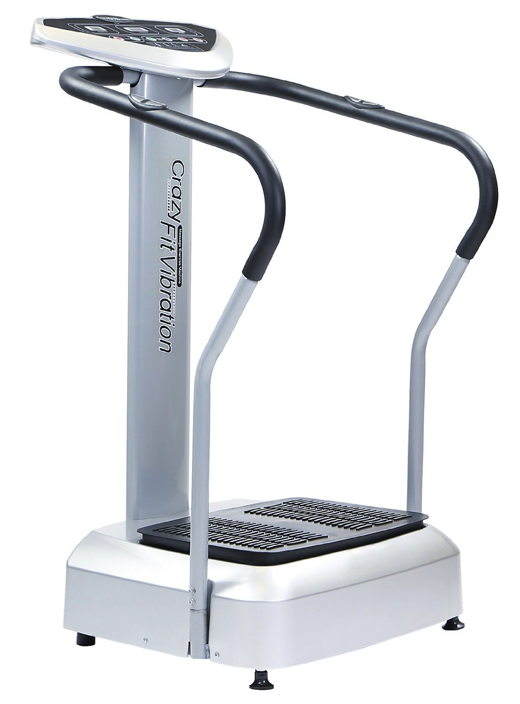
Is it Effective?
Specifically in reducing the results of the ageing process (Cardinale, M., & Wakeling, J, 2005).
Improvements in bone density, circulation and muscle stimulation exercise (www.webmd.com)
Postmenopausal women
Elderly who cannot do traditional exercise.
Is it Safe?
Relatively short time with knees slightly bent (limits vibration waves to the head).
“The marketing and hype is greatly outpacing the research and the scientific evidence... WBV has potential but more research is clearly needed.”
Cedric Bryant, PhD, American Council on Exercise
Notes:
Is it Effective? (Based on scientific studies)
Effective in reducing the results of the ageing process (Cardinale, M., & Wakeling, J, 2005).
Studies have shown improvements in bone density (more than conventional exercise) and positive effects on circulation and muscle stimulation for those who cannot do conventional exercise
Study looking postmenopausal women found at 1% increase in hip bone density and increases in muscle strength after exercising on WBV for 30 min 3x/week for 6 months
Another study found muscle strengthening and improvements in speed of movements in elderly people who were unable to do traditional exercise
Is it Safe?
It is safe to stand on WBV plates for a relatively short time with knees slightly bent (limits vibration waves to the head). There can me negative effects if the frequency is too high or when used for prolonged time.
“The marketing and hype is greatly outpacing the research and the scientific evidence.. WBV has potential but more research is clearly needed.”
Bottom Line: More research is needed. At this point, not enough to say WBV can replace conventional exercise and there is no solid evidence saying it can help you lose weight or impact cellulite.
http://www.webmd.com/fitness-exercise/features/passive-exercise-whole-body-vibration

Slide 11
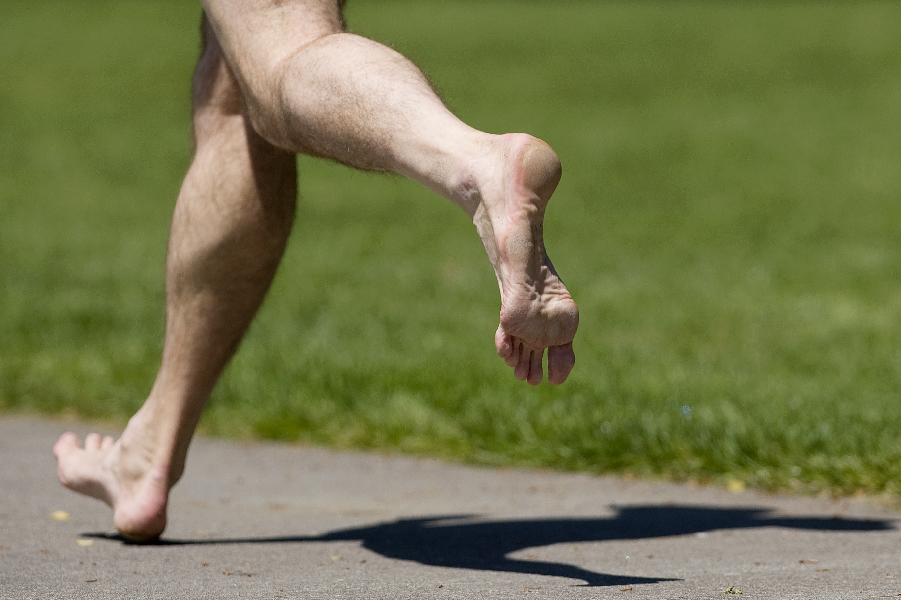
Barefoot Running

Slide 12
The Research Behind Barefoot Running
Research shows that humans can run comfortable and safely when barefoot or in minimal footwear via (Liberman et al., 2010):
Midfoot strike (landing flat foot) or
Forefoot strike (landing on the ball of the foot before bringing heels down)
… vs. 75% of shod runners will heelstrike (Hasegawa et al., 2007).
It is hypothesized that heel striking contributes to some repetitive stress injuries BUT no studies has shown that heel striking contributes to more injuries than forefoot striking.
Notes:
Studies suggest that at least 30% of runners get injured every year (van Gent et al., 2007).
Research shows that humans were able to run comfortable and safely when barefoot or in minimal footwear by (Liberman et al., 2010):
Midfoot strike (landing flat foot) or
Forefoot strike (landing on the ball of the foot before bringing heels down)
… vs. 75% of shod runners (runners with running shoes) will heelstrike (Hasegawa et al., 2007).
http://www.barefootrunning.fas.harvard.edu/5BarefootRunning&TrainingTips.html

Slide 13
Advantages to Minimalist Running or Forefoot Striking | Disadvantages to Minimalist Running or Forefoot Striking
Strengthens foot muscles especially arch Uses less energy May feel great! | Shoes are protective Very hard to transition from heel striking …risk of achilles tendonitis
Becoming a barefoot runner
Consult a physician!
Start slow … minimal shoes that lack high heels and stiff soles
Land gently on your forefoot then gradually bring the heel down
Listen to your body and stretch!
Notes:
Advantages: It strengthens the muscles in your foot, especially in the arch. It may cost less energy to forefoot strike because you use the natural springs in your foot and calf muscles more to store and release energy. Running barefoot or in minimal footwear (usually lighter than traditional running shoes) means that there is less mass to accelerate at the end of the runner's leg with each stride. Running barefoot has been shown to use about 5% less energy than shod running (Divert et al., 2005; Squadrone and Gallozzi, 2009).
Barefoot running feels great! Your feet have lots of sensory nerves. And because there is minimal impact forces on landing it can be very comfortable provided you develop calluses on your feet (see below).
Disadvantages: Thick-soled shoes are much more forgiving when running over glass, sharp objects, ice and so on.
If you have been a heel striker, it takes some time and much work to train your body to forefoot or midfoot strike, especially because you need stronger feet and calf muscles. Runners may be at greater risk of developing Achilles tendonitis when they switch from heel striking to forefoot or midfoot striking.
Becoming a barefoot runner (more info on handout)
Consult a physician! This is just for educational purposes, NOT a substitute for advice from a doctor.
Start slow. If you’ve been a heel striker most of your life, the transition will be very slow and take lots of time. You may want to look into minimal shoes that have (1) no built up heel (if the heel is too large, you’ll overpoint your toes which may cause pain/damager and (2) A flexible sole and no arch support. A stiff sole and arch support will prevent the natural flattening of the arch, preventing the muscles and ligaments of the foot from functioning as they were meant to. If you can’t easily twist and bend the sole of the shoe, then it is probably too stiff.
Tips when actually barefoot running: Land gently on your forefoot then gradually bring the heel down. The landing should feel soft and comfortable
Listen to your body whenever you do feel pain. Only you know your limitations.
Stretch your calves and achilles tendon!

Slide 14
Recap
1 egg a day is okay but watch what else you eat.
Eat more fish to boost omega 3 levels (twice a week).
No more than 12 teaspoons a day of added sugar (even 6 tsp for females and 9 tsp for males).
HIIT is time efficient, builds your endurance, and great for all exercise levels but be cautious when transitioning to it.
WBV needs more research but seems to be especially effective for bone density, circulation and muscle stimulation.
Barefoot running using midfoot or forefoot strike may be advantageous in strengthening foot muscles and using less energy. Be knowledgeable and start slow if you’re going to make the transition.

Slide 15
Resources
Cardinale, M., & Wakeling, J. (2005). Whole body vibration exercise: Are vibrations good for you? British Journal of Sports Medicine, 39, 585-589.
Fernandez, M.L. (2006). Dietary cholesterol provided by eggs and plasma lipoproteins in healthy populations. Current opinion in clinical nutrition and metabolic care 9(8), 8-12.
Hasegawa, H., Yamauchi, T., & Kraemer, W.J. (2007). Foot strike patterns of runners at the 15km point during an elite-level half marathon. Journal of Strength and Conditioning Research, 21 (3).
Hu, F.B., Stampfer, M.J., Rimm, E.B., Manson, J.E., Ascherio, A., Colditz, G.A., Rosner, B.A., Spiegelman, D., Speizer, F.E., Sacks, F.M., Hennekens, C.H., & Willet, W.C. (1999). A prospective study of egg consumption and risk of cardiovascular disease in men and women. JAMA, 281(15), 1387-1394.
Laursen, P.B & Jenkins, D.G. (2002). The scientific basis for high intensity interval training. Sports Medicine, 32(1), 53-73.
Lieberman, D.E., Venkadesan, M., Daoud, A.I., & Werbel, W.A. Biomechanics of foot strikes and applications to running barefoot or in minimal footwear. Retrieved from http:// www.barefootrunning.fas.harvard.edu/
Lieberman, D.E., Venkadesan, M., Werbel, W.A., Daoud, A.I., D’Andrea, S., Davis, I.S., Mang’eni, R.O., & Pitsiladis, Y. (2010). Foot strike patterns and collision forces in habitually barefoot versus shod runners. Nature, 463, 531-535.
Warburton, M. (2001). Barefoot running. Sportscience, 5(3)

Slide 16
Additional Web Resources
http://www.heart.org/
http://www.sugar.ca/
http://www.eggs.ca
http://www.diabetes.co.uk/
http://www.heartandstroke.com/

Slide 17
Questions now or later?
<Consultant Name>
<consultant>@EWSNetwork.com P:123.456.7890
www.EWSNetwork.com

