Slide 1
Employee Wellness Program
www.EWSNetwork.com
Notes:
Rules
Talk about the last 2 years

Slide 2
Onsite
Engagement
Outreach
Encouragement
www.EWSNetwork.com

Slide 3
EWSNetwork
EWSNetwork was founded in October 2003
Clients in over 75 locations and in over 55 cities
Over 25 wellness consultants and many more strategic affiliates
Average client engagement for onsite programs is >85%.
Benefits Canada
Winner - 2011 Benefits Canada Health and Wellness Program of the Year Award (<1000 employees)
Finalist - 2012 Benefits Health and Wellness Program of the Year Award (<1000 employees)
Winner - 2012 Benefits Canada Strategic Partnership Award
Finalist - 2013 Benefits Health and Wellness Program of the Year Award
Finalist - 2013 Benefits Canada Strategic Partnership Award
20 under 40 business recipient
www.EWSNetwork.com

Slide 4
We’re in trouble….
Conditions | % of Canadians
Overweight | 60%
Physically Inactive | 53%
High Cholesterol | 40%
Report Stress | 23%
High Blood Pressure | 20%
Smoking | 17%
Diabetes | 8%
75% of health care costs result from unhealthy lifestyles.
Making the Business Case for Investments in Workplace Health and Wellness,
Conference Board of Canada, June 2012
www.EWSNetwork.com
Notes:
Which on of the 7 would you say burdens your organization the most

Slide 5
Benefits and Objectives
The right thing to do.
Improve the health and wellness of employees.
Improve the culture of the workplace.
Decrease the costs of health benefits.
Decrease STD/LTD and Workmen’s Comp.
Improve productivity and decrease absenteeism.
Retention / Attraction
Marketing (top employer to work for)
Harvard University study found that workplace wellness programs also delivered a significant cost savings for employers. For every $1.00 spent on wellness, medical costs fall by about $3.27 and absenteeism by about $2.73.
www.EWSNetwork.com

Slide 6
Claims Cost Distribution “Disease Costs, Prevention Saves”
20% of employees generate 80% of the costs.
Healthy/ At-Risk High Risk Early Active
Low Risk Symptoms Disease
That means, 80% of employees generate only 20% of the costs.
www.EWSNetwork.com

Slide 7
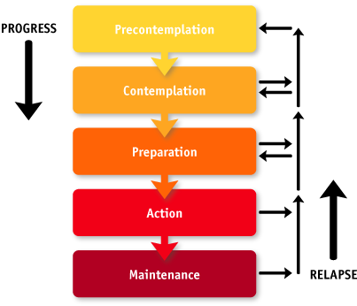
Readiness to Change
Area for Positive Impact and Change
Where Most Companies Spend Their Time
www.EWSNetwork.com
Notes:
Internal programs tend to cater to the healthy

Slide 8
Well Designed, Custom Wellness Strategy Links Components Together Giving the Greatest Opportunity for Success
Group
Awareness
Virtual
Individual
Our virtual programming allows us deliver the other 3 components depending on your company make-up and logistics.
On-site 1-on-1 Wellness Consulting/Coaching
Virtual or Phone Consultations
Personal Wellness Profile
Wellness Kiosks
Point-of-Decision Posters
Newsletters
On-site Health Fairs
Promo Days
Walkarounds
Wellness Challenges
Seminars & Workshops
Group Exercise Classes
Lunch n’ Learns
www.EWSNetwork.com

Slide 9
Case Studies Program Make-up
 | Company A | Company B | Company C
# of Locations | 1 | 17 | 2
Logistical Differences (adaptations) | Office / admin & field / outside workers. [Outreach program for field as they can’t do one-on-one schedule] | Head office and 16 daycare centers | 1 local office, 1 remote
Launch Date | September 2009 | April 2012 | May 2010
www.EWSNetwork.com

Slide 10
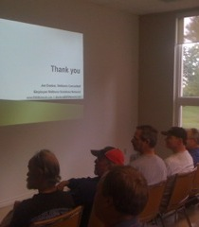
Program Launch
Market the Launch
Posters, emails, flyers, paystub drops, announcements, memos, intranet and any other mode that is applicable.
Launch Presentation
Onsite or virtually, an EWSNetwork representative presents the various components of the new employee benefit and introduces the certified wellness consultants who will be working with the organization.
Consultation Sign-up
Wellness Committee Sign-up
The Health Risk Assessment
Consultations Begin the
following week
www.EWSNetwork.com

Slide 11
Health Risk Assessment
Employee Benefits – Personal Wellness Profile
Private registration, immediate results highlighting participants’ wellness scores, health ages and recommended health actions.
Annually, employees will receive a comparative report.
Employer Benefits – HRA Trend Report
Summary and Program Suggestions/Productivity and Economic Benefits Report (using company specific income and medical values)
Annually, organizations receive a comparative report.
www.EWSNetwork.com/pwp
www.EWSNetwork.com

Slide 12
Wellness Committee
Committee made up of a cross-section of the organization.
Ambassadors of the program.
Ownership in the program – enhanced messaging/culture.
“Tentacles” of the program. Valuable source of feedback.
Marketing, implementation and feedback.
www.EWSNetwork.com

Slide 13
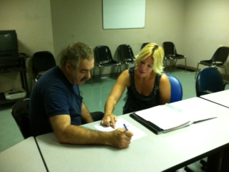
One-on-One Health / Wellness Coaching
30 minute one-on-one confidential appointments with a wellness consultant
Desired turn-around is 4-5 weeks.
Trust, rapport, accountability, motivation, on-going support
Nutrition, fitness, stress, sleep, lifestyle behaviour change
www.EWSNetwork.com

Slide 14
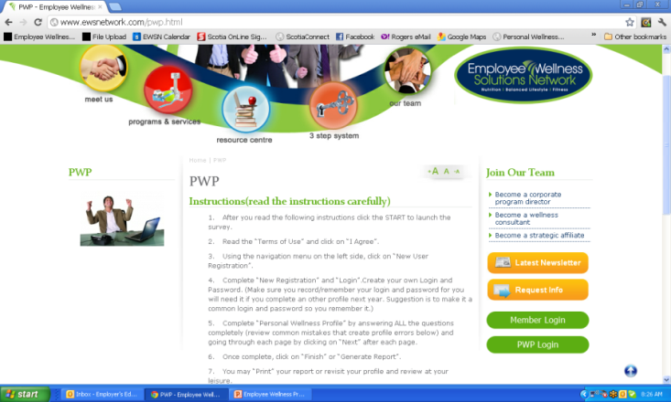
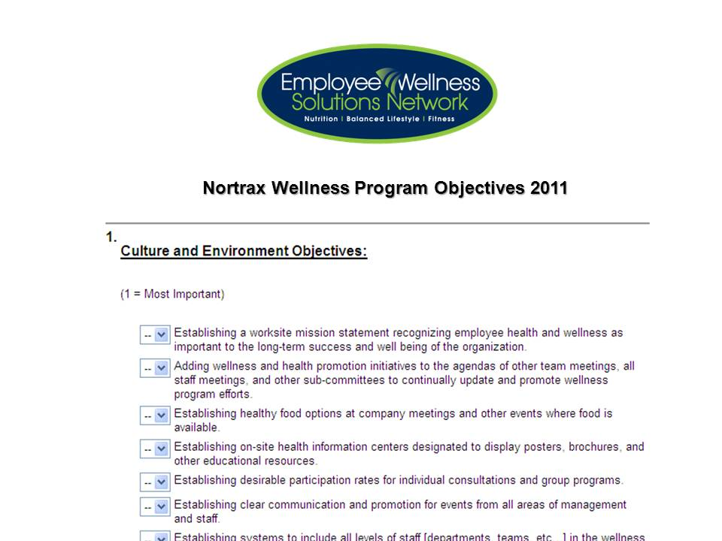
First 30 days Analysis
Health Risk Assessment
Objectives Surveys
Consultation Analysis
Analysis Metrix
Analysis of the First 30-days of
One-on-One Consultations
Drug Classification
# Health Claims
$ Health Claims
… and more
www.EWSNetwork.com

Slide 15
Analysis Results
 | Company A Utilities | Company B Not-for-Profit | Company C Financial
Initial Year’s Focus | Healthy eating Healthy weights Healthy lifestyle habits Exercise | Team challenge Healthy lifestyle Inclusivity of all sites | Culture Team challenge Healthy lifestyle Exercise Heart health
HRA Top 3 Risks | Cancer risk Weight mgmt Nutrition | Nutrition Weight mgmt Fitness Heart health | Weight mgmt Cancer risk Fitness
www.EWSNetwork.com

Slide 16
Custom Year at a Glance
Company ABC Jan-June 2014 At-A-Glance [subject to change as per wellness committee, needs and interests] PWP Focus [weight management, improved fitness, nutrition, heart health, stress]
Initiative | Jan | Feb | March | Apr | May | June
Consultations | One-on-One Consultations – on-site
Individual | NEW Virtual Online Profile, Wellness Tracking, Calendar of Events
PWP |  |  |  |  |  | June
Exercise Class/Series |  |  |  | Walking routes/groups; site specific Yoga/morning stretching
Lunch n’ Learns/Webinars | Healthy Weights | Healthy Weights | It’s In You to Move (coincide with site visit)
Workshop
Group Challenge [team] |  |  | Healthy Potluck at each site |  | Pedometer Challenge
Virtual Challenge [team] | Portal and Challenge
Newsletter | Ongoing Monthly Newsletter and Personal Challenge
Kiosk / Poster Display | A Healthy Weight for You |  |  | It’s in You to MOVE
POD Posters | ongoing
BPOS Sleeve Posters | ongoing
Email/On-site/Pay-Stub Campaign | Healthy Weights | Healthy Weights |  | Taking Breaks | Step Into Summer
Walk Around |  | Healthy Snacking with almonds |  | Desk Stretches |  | PWP Instructions
Promo Day | Healthy Eating Yogurt Parfaits – month tba
Wellness Challenge [Individual] |  |  | Low GI Foods |  | Step Check IC
Virtual Challenge [individual] | Individual Challenge
Health Fair | Fall 2014
Corporate Reporting |  |  | Q1 Report |  |  | PWP & Q2 Report
Componen
t
s
*
*
*
*
*
*
Programs

Slide 17
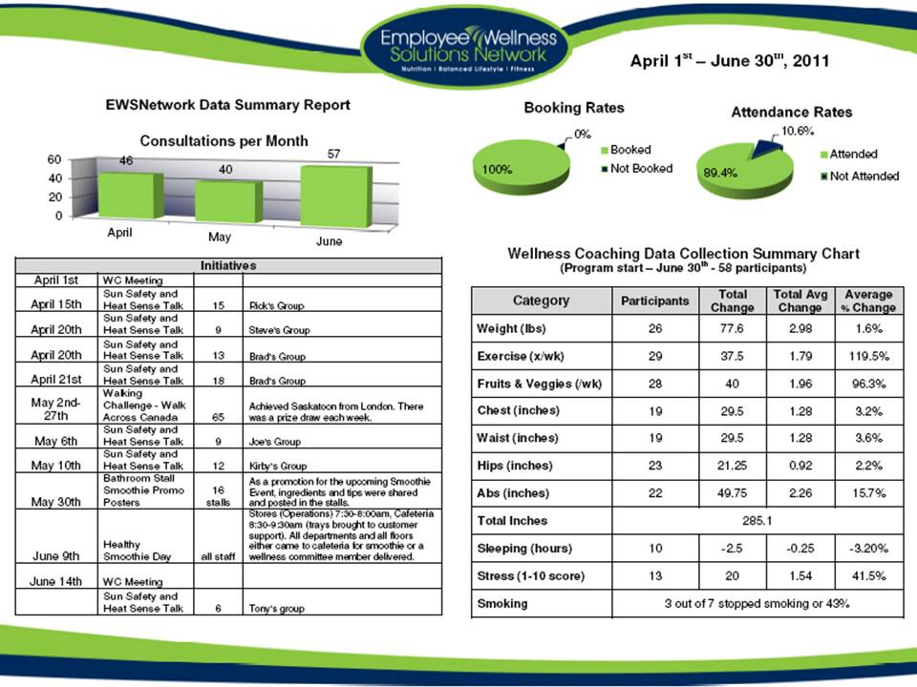
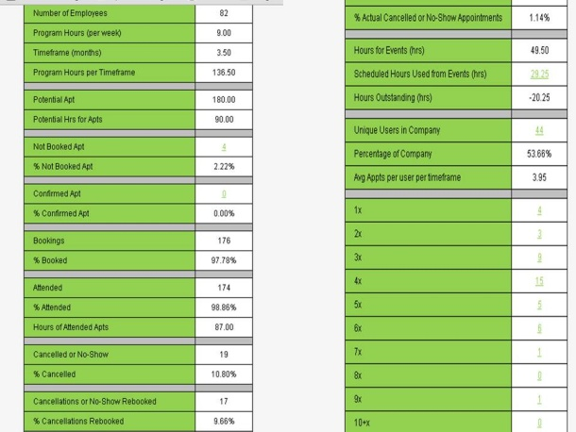
Importance of Reporting
Consultation bookings & attendance rates
Unique users for consultations
Unique users for various event types
Participation in various events
Reconciliation for program hours to serviced hours
Individual data trending
Metrix trends are followed from year to year
www.EWSNetwork.com

Slide 18
Results
 | Company A Utilities | Company B Not-for-Profit | Company C Financial
Participation % in 1-on-1 Consultations | 33% of whole company & 86% of those who CAN attend [admin, office, some field] | 45% | 70%
Participation % in the Program | 85% [consults, LNLs, outreach with field workers, workshops, health fairs, awareness materials] | 80% Consultations at each site, [spot consults, outreach to all sites, stretch breaks at manager / supervisor meetings, drop offs at 16 remote sites] | 90% [Spot consults, promo days, staff meetings with wellness components
www.EWSNetwork.com

Slide 19
Results
 | Company A Utilities | Company B Not-for-Profit | Company C Financial
Bottom Line Results | 2009-2012 35% reduction in sick time 12% reductions in drug costs 8% reduction in health claims reduction in every health risk | Drug costs – 35% reduction Health claims – 2% reduction Overall health costs [drug, claims, dental] – 22% reduction Nutrition health risk – 12% reduction Coronary health risk – 25% reduction | Health claim costs – 34% reduction Weight mgmt risk– 4% reduction Cholesterol risk – 27% reduction Nutrition health risk – 7% reduction
www.EWSNetwork.com

Slide 20
Thank you.
Garth Jansen, President, Employee Wellness Solutions Network
www.EWSNetwork.com I garth@EWSNetwork.com I 519.860.0502

Slide 21
Investment
$2200 - $2900 per month
$15 - $25 per employee per month
Above initiatives plus analysis, planning, scheduling, implementation and evaluation of an EWSNetwork wellness program.
Approximately 20-29 hours of one-on-one wellness consultations every month at various locations.
 | Location | Emp #s | Hrs/Mth | Sample Schedule
1 | Hamilton | 115 | 26 | 2x 3 hour shifts per week
 | Totals | 115 | 26
www.EWSNetwork.com

Slide 22
Retain EWSNetwork to build a custom program for your organization
Consultations
Majority of hours
1hr
1hr
1hr
1hr
1hr
1hr
1hr
1hr
1hr
LnL
Admin Programs
Challenges
Newsletters
Posters, Kiosks
E-campaigns
Analysis & Reporting
Group X
Health Fairs
www.EWSNetwork.com

Slide 23
Pay One Annual Premium for Your Program
X
X
1hr
1hr
1hr
1hr
1hr
1hr
Day 1
Day 3
1hr
1hr
1hr
Day 2
October – 2 Lunch n’ Learns
November – use up 2 hours from the pot
www.EWSNetwork.com

