Slide 1
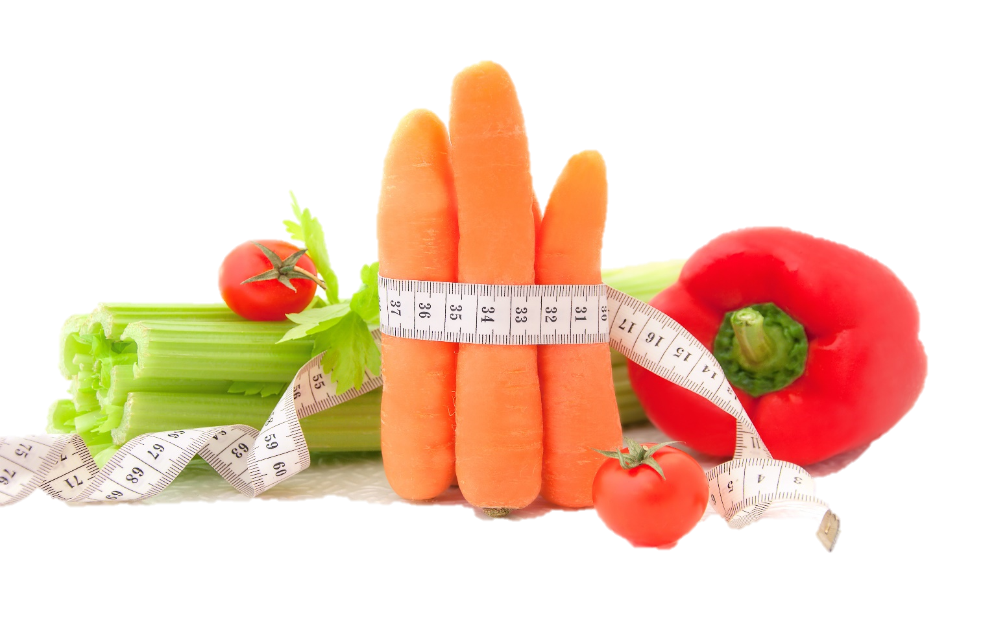
Fit & Lean in 2014
OVERVIEW
www.EWSNetwork.com

Slide 2
What is it?
Weight Management Program
8-weeks [9th week wrap up and potluck]
1230-1 and 1-130
Measurements – done today…
Weekly, done by you
Final in week 8/9
Goals and Subgoals
Weekly Accountability Materials

Slide 3
Week1
Getting Started
Personal Commitment Worksheet
Getting Support Worksheet
Food Diary
Basal Metabolic Rate and Heart Rate
Goal Worksheet

Slide 4
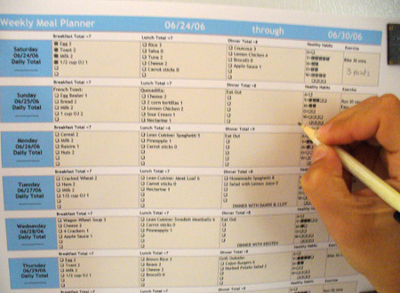
Week 2
Smart Food Choices and Meal Planning
Glycemic Index
Building Health Meals and Snacks
Meal Planner Worksheet
1500cal and 1800cal Meal Plans
Goal Worksheet
Recipes

Slide 5
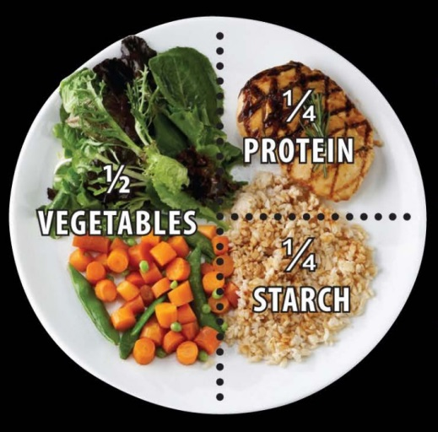
Week 3
Becoming an Educated Eater
Portion Control and Timing
Healthy Eating on a Budget
Reading Food Labels
Food Label Worksheet
Goal Worksheet
Recipes

Slide 6
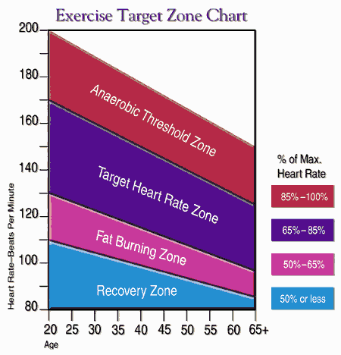
Week 4
Getting Active
Fitness Self-Assessment
Basic Cardio Guidelines
Rating of Perceived Exertion
Strength Training Guidelines
Strength Training Moves
Fitness Tips for Busy Lives
Staying Hydrated
Goal Worksheet

Slide 7
Week 5
Staying Motivated
Positive Affirmations
Art of Gratitude
Gratitude Journal
Importance of Sleep
Goal Worksheet

Slide 8
Week 6
Adapting Your Kitchen and Recipes
Kitchen Makeover Tips
Recipe Box Makeover Tips
Recipes
Goal Worksheet
Group Workout

Slide 9
Week 7
Super and Resources
Healthy Lifestyle Apps and Online Resources
Goal Worksheet
Group Workout

Slide 10
Week 8
Preparing for Maintenance
Goal Worksheet
Final Measurements
Healthy Potluck…or week #9….
Certificates of Achievement

