Slide 1
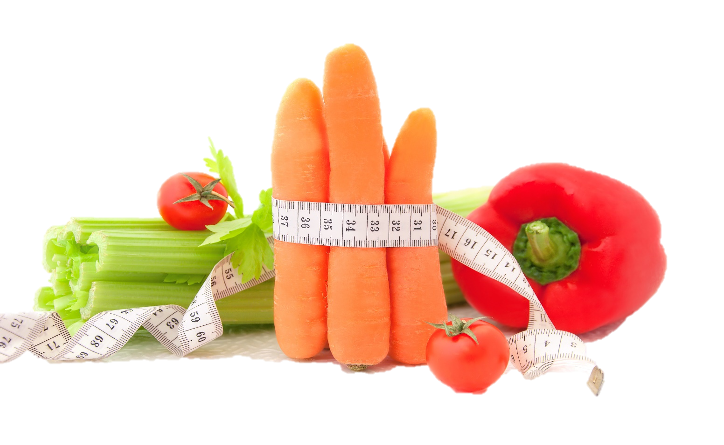

Fit & Lean in 2014
Week Three: Becoming Educated Eaters
www.EWSNetwork.com

Slide 2

How Did Your Week Go?
How did this week go?
Did you achieve any of your goals?
Did you come up with any new goals?
What worked for you this week?
What didn’t work for you this week?
Anything to share with the group that might be helpful to others?

Slide 3

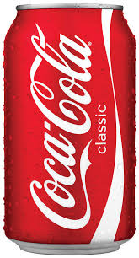
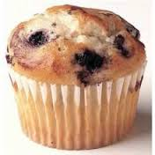



Portion Control
As time has gone by, portion sizes have gotten bigger and so have our waistlines!
Here is a visual example of how food portions have changed in the last 20-30 years:
3-inch bagel
= 140 calories
6-inch bagel
= 350 calories
12-oz. can
= 145 calories
20 oz. bottle
= 242 calories
2.5oz muffin
= 210 calories
4 oz. muffin
= 500 calories

Slide 4







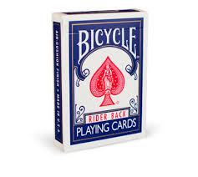


Portion Control
Basic Guidelines
See handout 3.1
= 1 cup
= ½ cup
= 1 oz. or 2 tbsp.
= 1 tbsp.
= 1 slice of bread
= 3 oz. meat
= 3 oz. fish
= 1 oz. deli meat
= 3 oz. muffin
= 1.5oz. cheese
Source: www.webmd.com

Slide 5
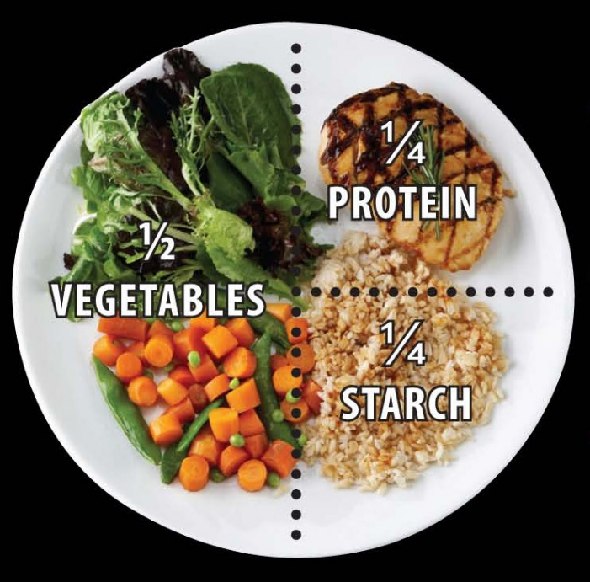
Portion Control
One of the easiest ways to know how much to put on your plate without a measuring cup or food scale is to divide your plate into four sections.
Devote ¼ of your plate to lean protein.
Devote ¼ of your plate to starch, such as rice, potatoes or pasta.
Finally, use the remaining ½ of the plate for vegetables.

Slide 6
Portion Control
Use smaller plates – having less food fill more of the plate can trick your brain into thinking you are eating more than you actually are.
Don’t keep serving bowls on the table as it encourages people to eat more than they should. The one exception to this rule is to keep vegetables easily accessible to encourage you & your family to fill up on veggies rather than higher-calorie options.
Use colour and texture to make healthy food more exciting! Use all five of your senses to really appreciate your food. This will make you a more mindful eater and taking the time to appreciate your food gives your stomach more time to send the signal to your brain that you are full.
Stop eating out of the package! Take the proper serving size out of the package and place it on a dish. It is too easy to overeat when the whole package is in front of you and you’ll find you are satisfied with the proper portion size in time.

Slide 7
Timing Your Meals
Aim to eat every 3-4 hours to keep your blood sugar levels steady and to avoid getting too hungry, which can cause you to make poor food choices.
Eat within 1 hour of rising. Remember that you have been fasting for 7-8 hours and you need to fuel your “tank” to give you the energy you need for the day. When you skip breakfast, you lose its stimulating benefits on your metabolic rate.
Stop eating 3 hours before bedtime. Eating too close to bedtime raises your body temperature, increases blood sugar and insulin, prevents the release of melatonin (the chemical that makes you sleepy) and cuts down on growth hormone release. If you can’t break up with your bedtime snack, make sure to opt for something light that is high in protein and low in carbs & fat. A protein shake is a great option for a pre-bed snack! Also, try a small apple with 12 almonds.

Slide 8
Timing Your Meals
4. Eat proteins first. This will help speed the signal to your brain that you are full.
5. Never do weight training on an empty stomach. You need energy from your foods in order to perform optimally. If you exercise on an empty stomach, your body will break down muscle protein to fuel your workout. However, if you want to do less than 30 minutes of cardio, you can do this on an empty stomach without issue.
6. Always eat within 45 minutes of finishing your workout. Healthy carbs need to be replenished after your workout because they will have been used up as the body’s main source of fuel. Ideally, a post-workout meal or snack should include a high-fiber carbohydrate paired with a lean protein.
Source: www.webmd.com, healthland.time.com

Slide 9

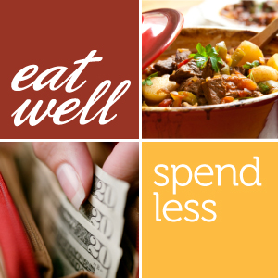
Eating Healthy on a Budget
Let’s be honest, most people would like to eat healthy but it isn’t uncommon for people to feel that eating healthy is more cost-prohibitive than eating prepared & processed foods full of fat, sodium & empty calories.
While it can seem this way, we are here to show you that it IS possible to feed your family wholesome, healthy food without going to the poorhouse!
Yes, some foods are going to cost you a bit more, but you might be surprised to see how much you can save by following our tips and by keeping portion control in mind!
*See handout 3.2

Slide 10
Eating Healthy on a Budget
Plan ahead. Using the tips we’ve shared with you about meal planning, you should be able to build a specific list of food items you need for the week. Never shop without the list and buy only what is on your list!
Consider no-name brands. These are often the exact same product as the brand name but for less money. Compare the nutrition facts and don’t pay more for the same item just for the branding.
Buy in bulk. A great place to save money is to purchase items like grains in bulk. You not only save money by getting the item without the packaging but you are also helping the environment at the same time!
Source: www.eatrightontario.ca

Slide 11
Eating Healthy on a Budget
Start a Meatless Monday in your house! Meat tends to be a big budget item on most grocery lists and simply cutting it out one day per week can have big impacts on your health, your budget & the environment.
Avoid convenience foods and make your own! Pre-packaged foods are priced higher due to their convenience factor. Making your own is almost always less expensive plus you have the benefit of knowing exactly what you are feeding yourself & your family.
Shop the perimeter of the grocery store first. The healthiest foods are placed on the outside of the grocery store while the middle aisles tend to be full of pre-packaged, convenience foods. Avoid the middle aisles and you won’t be as tempted to buy things that aren’t on your list.
Source: www.eatrightontario.ca

Slide 12
Eating Healthy on a Budget
These foods are healthy & cost-effective for households on a budget:
Legumes – buy dry and cook them yourself for the most cost savings. They also make a nutritious alternative to meat and are packed with protein, iron & B vitamins.
Brown rice – great for side dishes, rice salads, casseroles, soups & stews.
Whole wheat pasta – great for hot & cold pasta dishes. Watch serving sizes and always serve with vegetables!
Nonfat plain Greek yogurt – makes a great snack or breakfast and works great as a smoothie ingredient. Save money by purchasing the large container over the individually sized cups.
Old-fashioned oats – a great multi-purpose item: eat hot or cold for breakfast, make your own granola, or use it in recipes like meatloaf or muffins!
Source: www.webmd.com

Slide 13
Eating Healthy on a Budget
These foods are healthy & cost-effective for households on a budget:
Frozen vegetables – an easy side dish, easy to add to soups & stews and once thawed, can be kept in the fridge for snacking on! Cost works out to about $0.25 per serving and is a great way to enjoy produce even out of season.
Fresh, bagged spinach – ditch the iceberg lettuce and start using spinach in your salads for an awesome dose of vitamin A, C, calcium and folic acid. Added to a smoothie, it will affect the colour but not the taste!
Canned tuna – delicious on a salad, in a casserole or in a whole-wheat wrap. A great low-cost protein but make sure you are buying tuna that is canned in water and not oil!
Eggs – so versatile and another great low-cost protein! Keep a few hard-boiled in the fridge for a quick snack anytime….and talk about filling you up!
Source: www.webmd.com

Slide 14
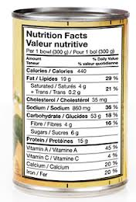
Reading Food Labels
5 Easy Steps to Help You:
Look at the serving size. Compare the serving size to the amount you eat in order to get the amount of calories and nutrients described on the label.
Look at the calories. Calories tell you how much energy you get from one serving.
Look at the % daily value (DV). This scale tells you if there is a little or a lot of a nutrient in one serving of a packaged food. 5% or less is a little. 15% or more is a lot.

Slide 15
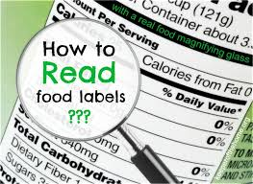

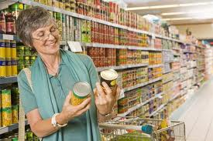
Reading Food Labels
5 Easy Steps to Help You:
4. Try to get more of these nutrients: fiber, [>3-4g], vitamin A, vitamin C, iron, calcium.
5. Try to eat less of these nutrients: fat, saturated fat, [<5g} trans fat, sodium [<300mg], cholesterol [0mg].
Let’s take a look at the food labels you have brought with you and we can analyze them together.
See handout 3.4
Notes:
Consultant should lead a group discussion while analyzing food labels and guiding them to better understanding of how to determine the nutritional value of packaged foods. Notice the suggested grams and mg for some of the BIG FIVE –see handout for others

Slide 16
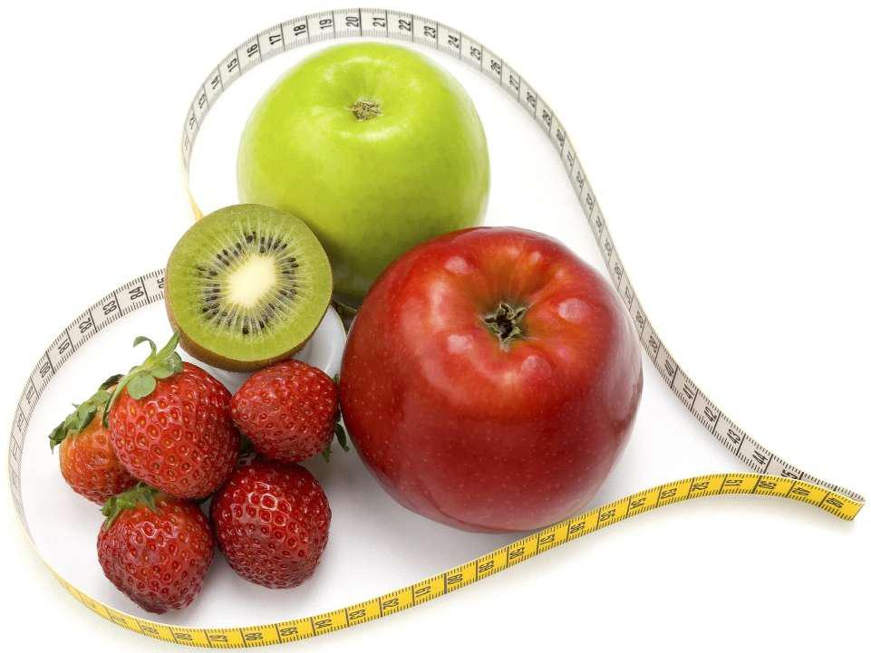
Next Week:
  Let’s get active!
  Fitness self-assessment
  Determining your cardio guidelines
  Rating exertion levels
  Staying hydrated
  Best strength training moves
  Workout ideas for busy lives
  Re-visit weekly sub-goals!

Slide 17
Questions now or later?
<Consultant Name>
<consultant>@EWSNetwork.com P:123.456.7890
www.EWSNetwork.com

