Slide 1
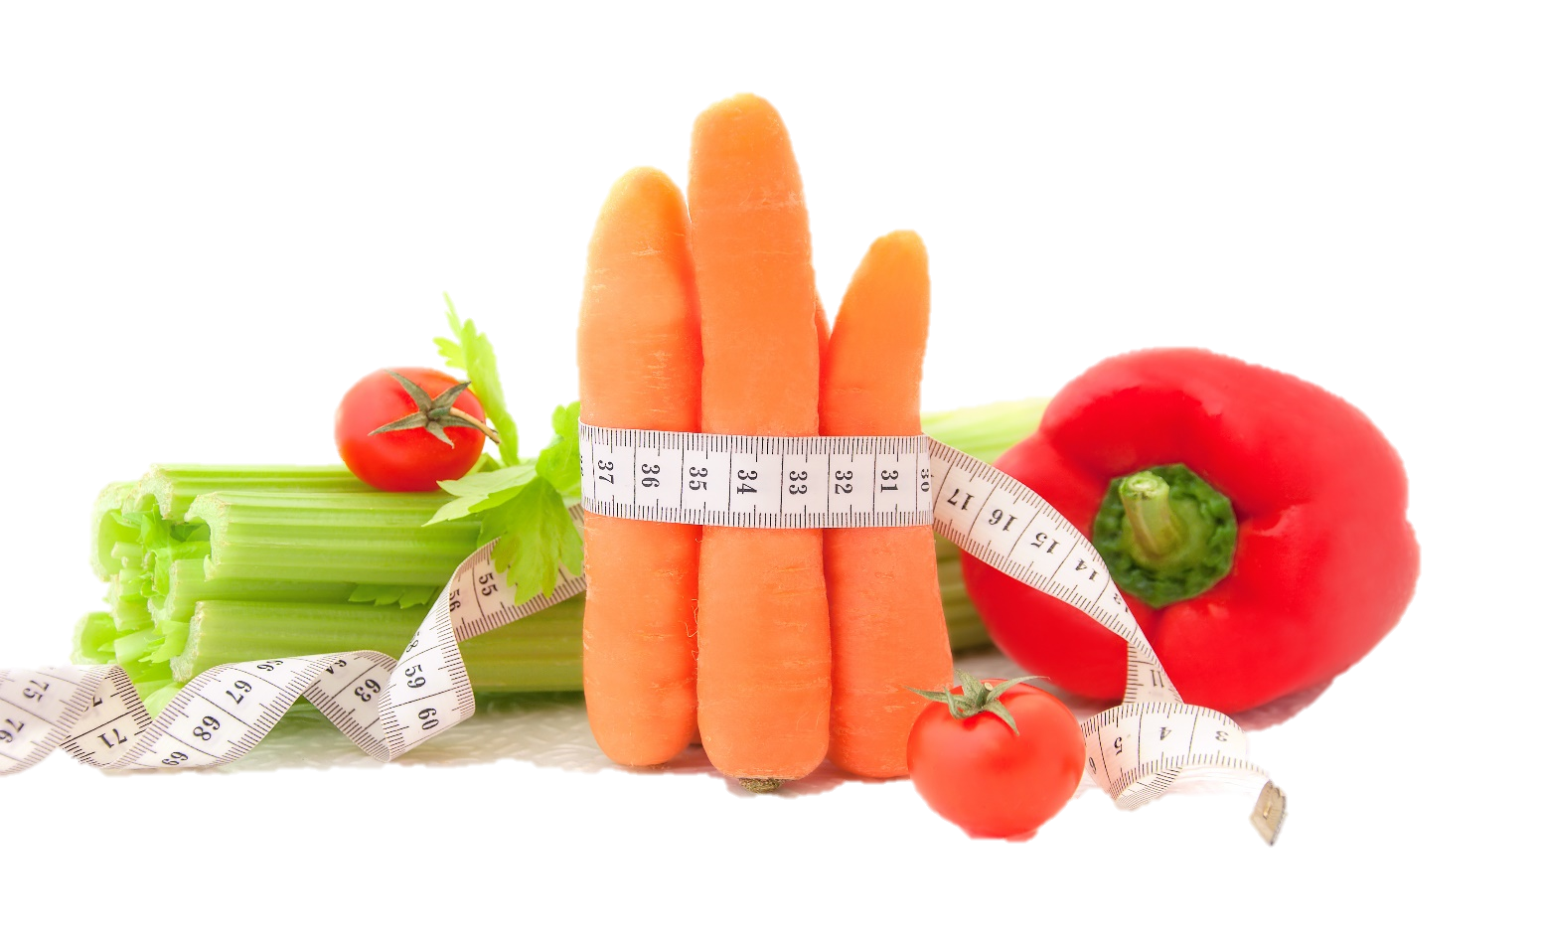
Fit & Lean in 2014
Week Two: Smart Food Choices & Healthy Meal Planning
www.EWSNetwork.com

Slide 2
How Did Your Week Go?
How did your first week go?
Goal jar and SUCCESS STONES!
Did you achieve any of your goals?
Did you come up with any new goals?
What worked for you this week?
What didn’t work for you this week?
Anything to share with the group that might be helpful to others?

Slide 3
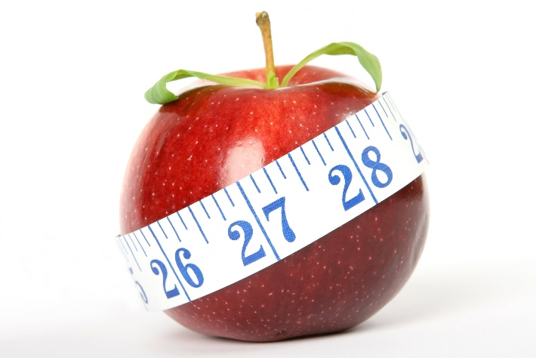
Superfoods for Weight Loss
**follow along on handout 2.1
Apples
Apples are an ideal on-the-go low-calorie snack. Full of fibre & high in water content, they can help you to feel full, longer. Craving pie? Chop up a medium apple and sprinkle with ½ tsp allspice and ½ tsp cinnamon and microwave on high for 90 seconds. Yum!
Eggs
Eggs are a great source of lean protein. Though egg whites contain less fat & calories, there are exclusive nutrients in the yolk that supply food for your brain, metabolism & immunity. Quick & easy to prepare as a meal or snack.

Slide 4
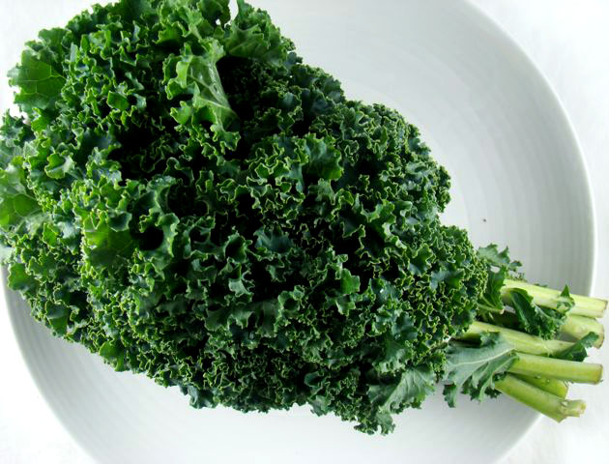
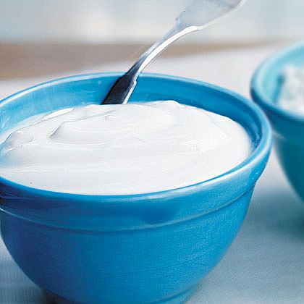
Superfoods for Weight Loss
Kale
One raw chopped cup contains 34 calories and about 1.3g fiber as well as a healthy dose of iron & calcium. Can be used in salads or cooked with tomatoes, garlic & chicken over quinoa for a complete meal. Add some sea salt & bake in the oven for healthy, crispy kale chips!
Yogurt
With its trifecta of carbs, protein & fat, it can stave off hunger by keeping blood sugar levels steady. Use low-fat plain yogurt instead of mayonnaise in chicken or potato salad. Drizzle with honey for a sweeter, dessert-style yogurt. Look for greek yogurt which has more protein than other versions.

Slide 5
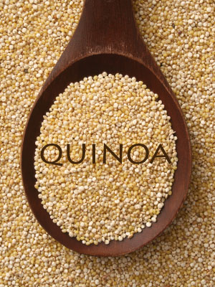
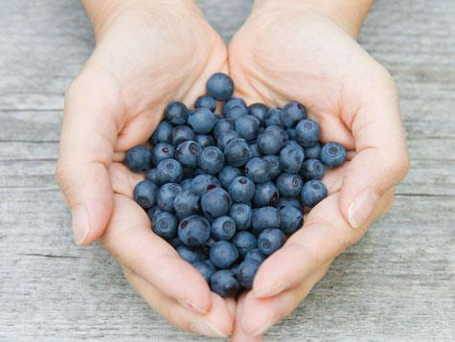
Superfoods for Weight Loss
Blueberries
All berries are great but blueberries have the highest antioxidant level of all commonly consumed fruit and 3.6g of fiber per cup. Instead of topping your cereal with them, fill your bowl with blueberries and top with cereal and milk or yogurt!
Quinoa
Packing both fiber (2.6g per ½ cup) and protein, this grain is a stellar nutrient combo that can keep you satisfied for hours. Try replacing the rice in a stir-fry with quinoa or using topping with fruit, nuts & a drizzle of honey for a hearty breakfast!

Slide 6
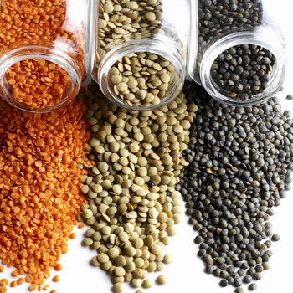
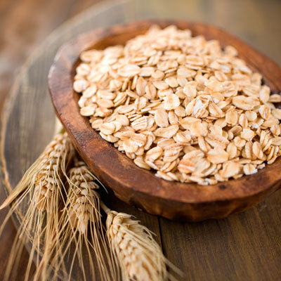
Superfoods for Weight Loss
Lentils
Brimming with fiber (8g per ½ cup!) to help satisfy hunger and specifically, soluble fiber, which also lowers blood cholesterol, lentils are a great addition to a healthy diet. A great source of low-fat protein. Puree in sauces, dips & soups or add to salads or side dish.
Oats
Another great high-fiber food designed to keep you full & keep hunger at bay for longer periods of time. Eat a bowl for breakfast with some fruit and you will be satisfied until lunch! You can also make your own healthy granola with oats and keep a bag in your desk for those mid-afternoon munchies!

Slide 7
Carbs & The Glycemic Index
The glycemic index (GI) measures how fast and how much blood sugar rises after eating a carbohydrate food. White table sugar, white bread and refined carbohydrates raise your blood sugar levels the fastest. *see handout 2.2
Carbohydrates containing fiber, like beans, whole grains and non-starchy vegetables release glucose slowly because they break down slowly. Eating low-GI foods provides a number of benefits, such as:
Keeps energy levels in your body more constant
Increases body’s sensitivity to insulin
Reduces risk of developing heart disease
Reduce blood cholesterol levels
Helps you feel full longer/control your appetite
Helps you lose & control weight
Increases physical endurance
Helps prevent/manage diabetes
Notes:
Have clients turn to GI chart handouts to review guidelines for GI foods to consume regularly, occasionally and those to avoid when possible. Remind them that this might be something handy to put on fridge or on cupboard as a reference in the kitchen.

Slide 8
A Complete, Balanced Meal Requires…
1. Lean Protein
IE: boneless, skinless chicken breast, lean pork & beef (trim all visible fat), beans/legumes, eggs/egg whites, fish & seafood (non-breaded/battered), low-fat yogurt & cottage cheese, whey protein powder, tofu
2. Low GI Carbs
IE: green, leafy vegetables, whole-grain, high-fiber breads (2-3g per slice), oats, quinoa, beans/legumes, non-starchy vegetables, basmati/wild/long-grain rice, apples, oranges, blueberries, grapes, cherries, grapefruit
3. Healthy Fats
IE: olive oil, flaxseed oil, canola oil, avocados, eggs & fish with omega-3 fats, olives, nuts, seeds

Slide 9
Great Energy-Boosting
& Healthy Snack Ideas – all under 200cals
1 small apple with 1 tbsp. of nut butter
4 whole-grain crackers with 1 tbsp. hummus
¼ cup dried fruit & nuts
6 oz. plain non-fat Greek yogurt with 1 tbsp. granola
A whole-grain, high-protein bar
½ a lean turkey sandwich on high-fibre (2-3g per slice) bread
½ cup bell peppers & 1 tbsp. hummus
½ cup low-fat cottage cheese with ½ cup blueberries
Notes:
Advise that ideally, snacks should be less than 200 calories and have a good balance of protein to fiber. WATCH SUGAR LEVELS! A good protein/fiber combo will help keep you full for longer.

Slide 10
Putting It Into Action…
See handout 2.3
Now that you have a basic understanding of meal planning, best foods for weight loss and how to pick a “good” carb from a “bad” carb, it’s time to put it to use!
Remember to include lean protein, low GI carbohydrates and healthy fats in your meals.
The best snacks for weight loss are those containing lean protein & fiber!
Notes:
Consultant should be available to groups as needed for questions or instructions. Allow 10 minutes or so for this project and then have a member from each group present their ideas. Review and suggest any improvements that could be made to their ideas or discuss why their ideas were good.

Slide 11
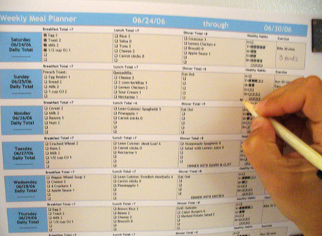
Meal Planning for Success
4 Steps to Healthy Meal Planning … see handout 2.1 and 2.4
1. Schedule a time to plan.
Carve out 30 minutes in your schedule each week to plan your meals and create a shopping list. Many people find the best time to meal plan is in advance of their weekly grocery shopping trip.
2. Evaluate your meal plan.
Does each meal include fruit and/or vegetables? Have you included enough lean protein in each meal & snack? Are you staying within your recommended calorie limits? Take this time to ensure you are achieving your nutrition goals and modify as needed.
Source: weightloss.about.com
Notes:
Have them refer to meal planning template and encourage them to set completing a meal plan for the week as one of their goals this week.

Slide 12
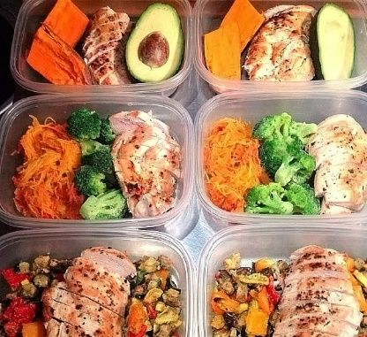
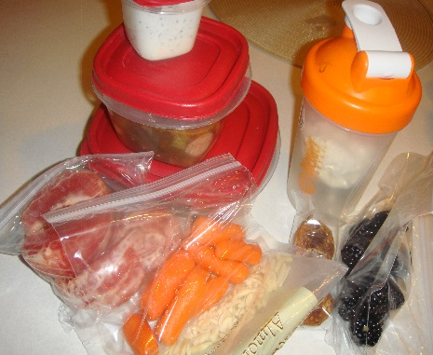
Meal Planning for Success
4 Steps to Healthy Meal Planning
3. Shop & cook.
Here is where meal planning in advance of your weekly grocery run comes in handy! Another great tip is to spend a few hours in the kitchen on the weekend, preparing lunches & snacks in advance. Place in individual portions and you are ready to go for the week!
4. Lay out the day’s food.
This can be done the night before or the morning of, depending on what works best for you. Refer to your plan and pack your items to bring to work and place the items to be eaten at home in the fridge and pantry where they are most easily accessible when you get hungry!

Slide 13
Remember!
Putting the time into planning your meals & snacks is an important investment into your health & success! Failing to plan can easily turn into planning to fail!
Make the time each week to plan your meals & snacks and make time each day to ensure your food options are prepared for the day ahead. This investment of an hour or so per week can make a huge difference in your success!
To help, see handouts 2.5 and 2.6 for meal plan examples!
Before you go….
Let’s goal set – NOW!
*see handout 2.7

Slide 14
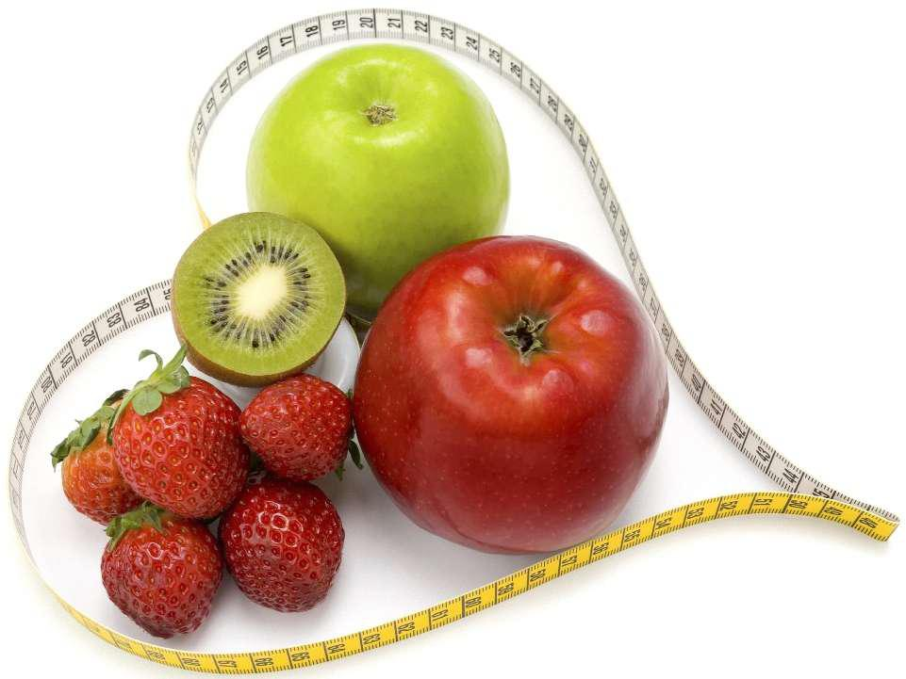
Next Week:
Portion Control
Timing Your Food Intake
Reading a Food Label
**Remember to bring a food label from home
to interpret
Staying Hydrated
Re-visit of weekly sub-goals….

Slide 15
Questions now or later?
<Consultant Name>
<consultant>@EWSNetwork.com P:123.456.7890
www.EWSNetwork.com

