Slide 1
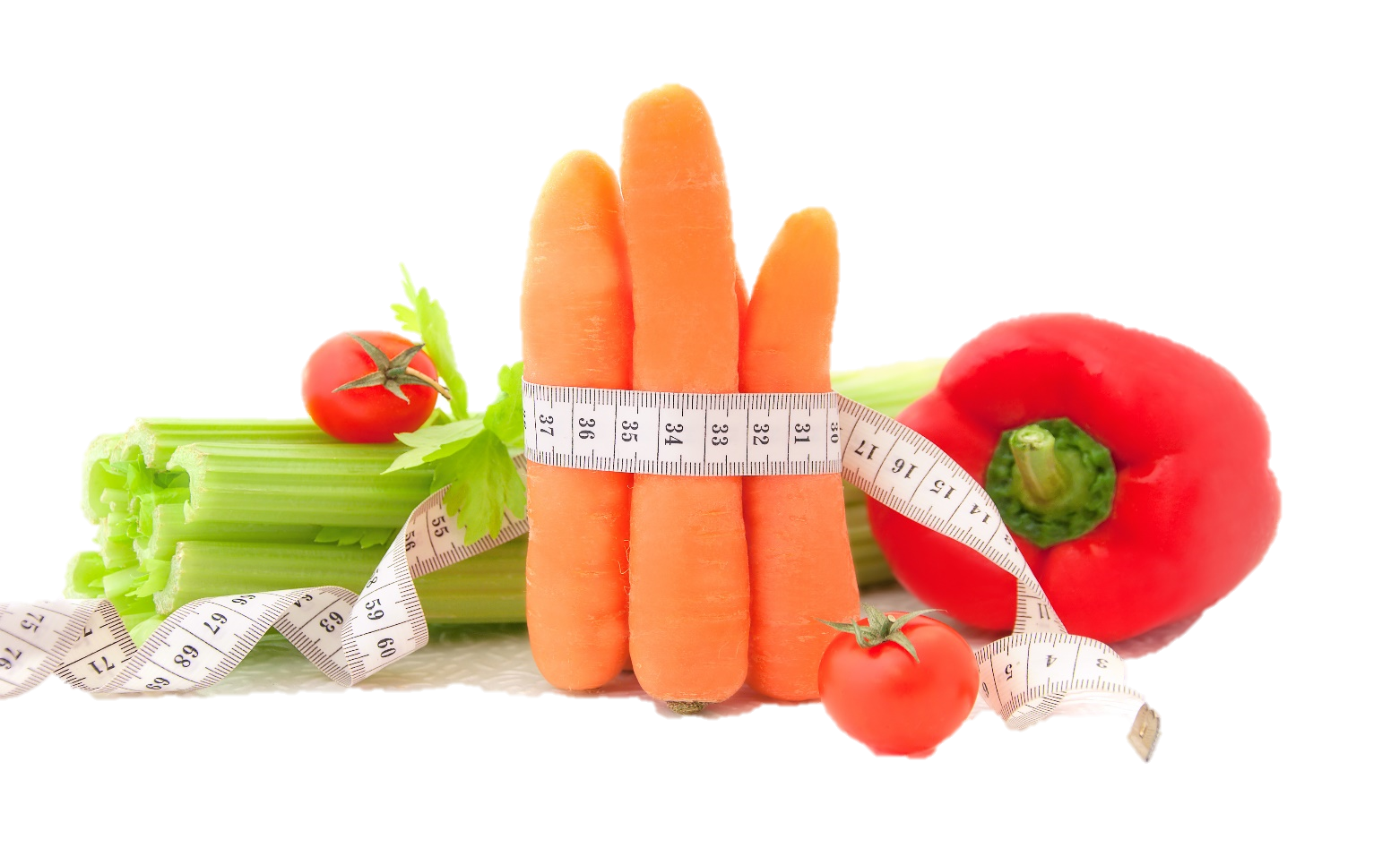
Fit & Lean in 2014
Week Six: Adapting Your Kitchen & Recipes
www.EWSNetwork.com

Slide 2
How Did Your Week Go?
How did your week go?
Goal Jars and SUCCESS STONES
Did you achieve any of your goals?
Did you come up with any new goals?
What worked for you this week?
What didn’t work for you this week?
Anything to share with the group that might be helpful to others?
We’ve been at this for five weeks now – what has been your biggest challenge? Have you come up with a way to overcome it? If not, perhaps your fellow participants might have some suggestions for you!
Notes:
Consultants should encourage a good discussion on challenges and offer suggestions on how to overcome them. Facilitate a strong group discussion to keep them motivated to overcome obstacles at this point in the program. If someone is struggling particularly hard, encourage them to book a one-on-one session for more personalized advice.

Slide 3
Time for a Kitchen Makeover
It’s time to create an environment of success! If a food and/or drink isn’t conducive to your goals, why would you keep it?
A kitchen makeover helps you plan and structure healthy eating. You have enough education in nutrition at this point to be able to understand what food is nutritionally beneficial for you and your household and what isn’t. You and your family deserve the best so let’s get serious about the food we allow in our home! See handout 6.1.

Slide 4
Time for a Kitchen Makeover
We know – wasting food is wrong. However, food should be healthy & nutritious.
If the item has some redeeming nutritional qualities, feel free to donate it to your local food bank. Here is a list of the foods we shouldn’t see in your fridge/pantry!
Chips & cheesies
Processed meats (hot dogs, bacon, most deli meats)
Chocolate or candy (dark chocolate – 70% cocoa or more, is ok)
Soda pop/sweetened drinks
Instant foods like mashed potatoes, ground beef “helper” and cake mix.
Hydrogenated margarines
Most frozen dinners
Spreads such as Cheez Whiz or full fat cream cheese
Most breakfast cereals
Flavoured nuts (beer-nuts, honey-roasted nuts)
Sweetened yogurt
Ice cream
Baked goods
Any bread items not made exclusively of whole-grains
When in doubt – read the label! Refer back to week three handouts if you aren’t sure what you should be looking for!
Notes:
Encourage them to set a kitchen makeover as a goal for this week – there is a tip sheet in the handouts to help them.

Slide 5
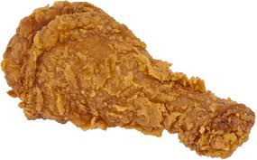
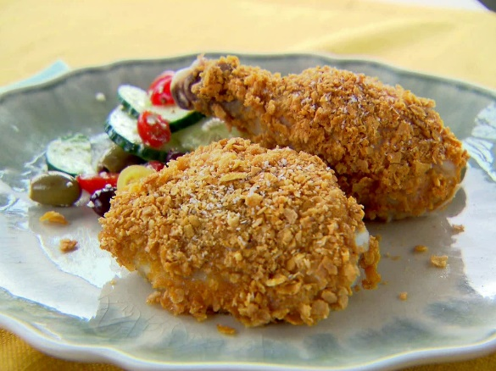
Recipe Box Makeover
Many people have recipes passed down from family & friends – recipes that are family favourites but may not be the healthiest in their current format.
You don’t have to remove it from your recipe box – just modify the recipe with a few simple changes and you can keep this recipe in your collection while still living a healthy lifestyle!
Let’s look at some tips you can use to transform your old recipes into recipes you can continue to use on your path to becoming fit & lean! Check out handout 6.2.
Fried Chicken
Baked Chicken

Slide 6
Recipe Box Makeover Tips
Reduce the amount of fat, sugar & salt.
Using these general guidelines, you can reduce these without sacrificing flavour:
To reduce fat in baked goods, use half the butter, shortening or oil and replace the other half with unsweetened applesauce, mashed banana or prune puree.
Reduce the amount of sugar by 1/3 to 1/2. Instead, add spices like cinnamon, cloves, allspice and nutmeg or flavourings like vanilla or almond extract to boost sweetness.
Reduce salt by 1/2 in baked goods that don’t require yeast. For main dishes, salads, soups and other foods, you can reduce the salt by 1/2 or eliminate it completely.
Source: www.mayoclinic.com

Slide 7
Recipe Box Makeover Tips
Make a healthy substitution.
Healthy substitutions reduce fat, salt & sugar and can also boost nutritional content.
Pasta – use whole-wheat pasta instead of enriched pasta. You’ll triple the fiber and reduce the number of calories.
Milk – prepare a dessert with skim milk instead of whole milk to save 66 calories and almost 8 grams of fat per cup.
Meat – when making casseroles, scale back on meat, poultry or fish and increase the amount of vegetables and beans. You’ll save on fat and gain vitamins, minerals and fiber.
Source: www.mayoclinic.com

Slide 8
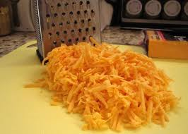
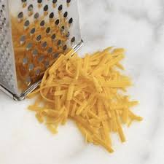
Recipe Box Makeover Tips
Cut back some ingredients:
Toppings – eliminate items normally used out of habit or for appearance, such as frosting or whipped toppings, which are high in fat and calories.
Condiments – cut condiments, such as pickles, olives, butter, mayonnaise, syrup, jelly and mustard, which can have large amounts of salt, sugar, fat and calories. Use less soy sauce than a recipe calls for to decrease the amount of salt.
Cheese – if a recipe calls for 1 cup of shredded cheese, use 1/2 instead.
Source: www.mayoclinic.com

Slide 9
Recipe Box Makeover Tips
Change cooking and prep techniques.
Healthy cooking techniques include braising, broiling, grilling, poaching, sautéing and steaming. If the directions call for basting in oil or drippings, use a small amount of fat-free broth instead. Use non-stick cookware to avoid having to use oil or butter in your pans when cooking.
Now that you’ve got an understanding on how to make your recipes healthier, take a look over your own recipe and determine where you can add healthier items or cut back on fat, salt & sugar.
Before you go….
Let’s goal set – NOW!
*see handout 6.3
Source: www.mayoclinic.com
Notes:
Encourage group to makeover their own recipes – this can be done in session (if time permits) or it should be encouraged as a goal to complete for next week’s session.

Slide 10
Next Week:
Check-in – will focus on overcoming any current struggles you are facing with your plan
The importance of support
Online weight loss resources
Healthy apps for your smartphone
Re-visit your weekly sub-goals…
Notes:
Shortened version – no workout unless there is time

Slide 11
Questions now or later?
<Consultant Name>
<consultant>@EWSNetwork.com P:123.456.7890
www.EWSNetwork.com

