Slide 1
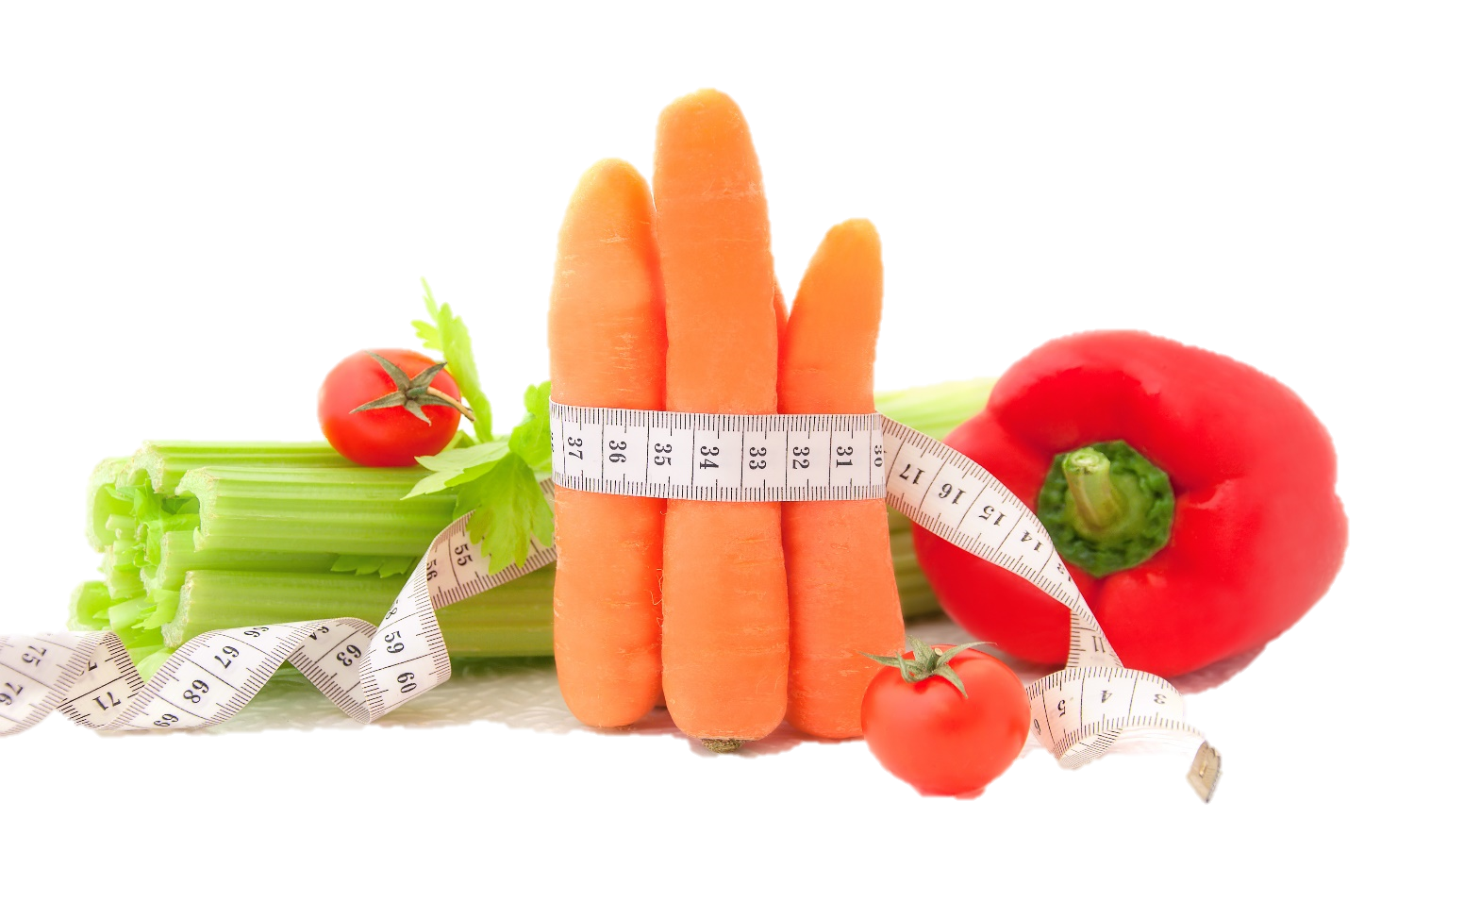
Fit & Lean in 2014
Week Four: Getting Active
www.EWSNetwork.com

Slide 2
How Did Your Week Go?
How did you do this week?
Goal Jar and SUCCESS STONES
Did you achieve any of your goals?
Did you come up with any new goals?
What worked for you this week?
What didn’t work for you this week?
Anything to share with the group that might be helpful to others?

Slide 3
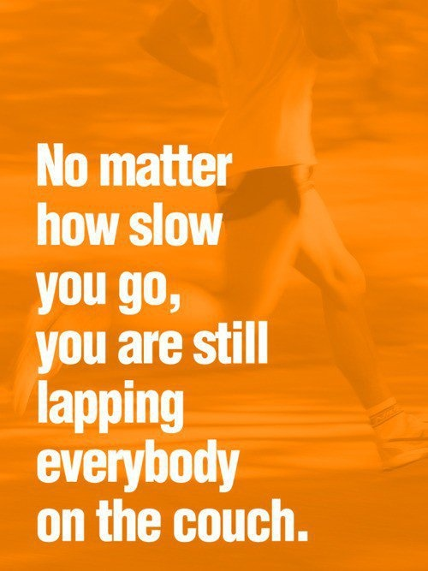
Time to Get Moving!
They say that losing weight is 80% what you eat and 20% what you do. Over the past three weeks, we have focused on the nutrition aspect of your new fit & lean lifestyle.
Now that you are well-stocked with the fundamentals of nutrition and have had time to implement those changes in your life, it’s time to fill in the final piece of the puzzle – physical activity!
*see handout 4.1

Slide 4
6 Benefits of Regular Exercise
Exercise controls weight. When you engage in physical activity, you burn calories. The more intense the activity, the more calories are burned. You don’t need to spend hours in the gym to get the health benefits of regular exercise, you simply need to find ways to be more active in your daily life.
Exercise combats health conditions and diseases. Regular exercise can help you prevent or manage a wide range of health problems, including stroke, metabolic syndrome, type 2 diabetes, depression, certain types of cancer and arthritis.
Exercise improves mood. Having a bad day? A workout at the gym or a brisk 30-minute walk can help by stimulating various brain chemicals that may leave you feeling happier and more relaxed. The results of regular exercise can also leave you feeling better about yourself and your appearance which can boost your confidence and improve self-esteem.
Source: www.mayoclinic.com

Slide 5
6 Benefits of Regular Exercise
Exercise boosts energy. Regular activity can improve your muscle strength and boost your endurance. Exercise helps deliver oxygen and nutrients to your tissues and help your cardiovascular system work more efficiently, which can give you more energy to go about your daily life.
Exercise promotes better sleep. Regular physical activity can help you fall asleep faster and deepen your sleep. Be wary of exercising too close to bedtime, though - you may feel too energized to be able to fall asleep!
Exercise can be FUN! It is a great way to unwind, enjoy the outdoors and spend time with family and friends. We tend to focus on the more serious health benefits but the truth is that when you find the right type of exercise for your lifestyle, exercise becomes enjoyable and becomes something you will actually look forward to doing!
Source: www.mayoclinic.com

Slide 6
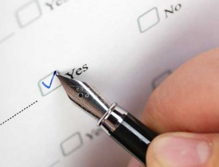
Determining Your Current Fitness Level
First off – let’s refer to handout 4.2 and complete a basic fitness self-assessment to get an idea of whether you are a novice, beginner, intermediate or advanced exerciser. Be honest – there’s no shame in being a novice. Remember, we all start somewhere!
Your EWSNetwork Consultant is here to help you determine your resistance training guidelines so take advantage of this and book your one-on-one session to get personalized guidelines and recommendations.
Notes:
Refer to handout 4.2 and have them complete during workshop.

Slide 7
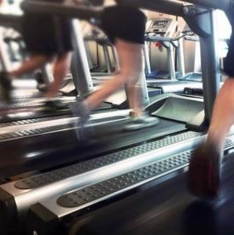
Basic Cardio Guidelines
Cardiovascular exercise is the main component in any comprehensive
exercise program.
For important health benefits, adults need at least:
2 hours and 30 minutes (150 minutes) of moderate-intensity aerobic activity every week
OR
1 hour and 15 minutes (75 minutes) of vigorous-intensity aerobic activity every week
*see handout 4.3
Source: www.cdc.gov

Slide 8
Aerobic Activity: What Counts?
From pushing a lawn mower to swimming to taking a dance class, all types of activity count as long as you are doing them at a moderate or vigorous intensity for at least 10 minutes at a time.
What is moderate intensity aerobic activity?
Activity where you are working hard enough to raise your heart rate and break a sweat. One way to tell is you’re able to talk, but not sing the words to your favourite song.
What is vigorous intensity aerobic activity?
Activity where you’re breathing hard and fast, and your heart rate has gone up quite a bit. If you’re working at this level, you won’t be able to say more than a few words without pausing for a breath.

Slide 9
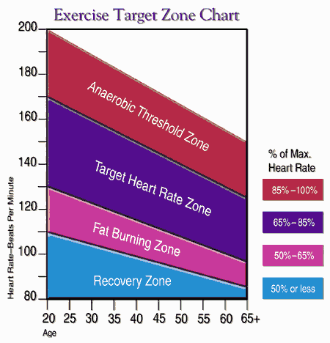
Target Heart Rate Zones
Back in week one, we talked about how to find your resting heart rate (RHR) and your target heart rate zone.
Let’s refer back to handout 1.5 to refresh our memories as this information is very helpful in helping you know that your activity level is in the right intensity zone to achieve your goals!
Notes:
Have them refer back to handout 1.5 – Determining BMR & Target Heart Rate

Slide 10
Rated Perceived Exertion (RPE) Scale [see handout 4.4]
The RPE scale is used to measure the intensity of your exercise. The scale runs from 0-10. The numbers relate to phrases used to rate how easy or difficult you find an activity.
For example, 0 (nothing at all) would be how you feel when sitting in a chair; 10 (very, very heavy) is how you feel at the end of an exercise stress test or after a very difficult activity.
In most cases, you should exercise at a level that feels 3 (moderate) to 4 (somewhat heavy).
When using this scale, remember to include feelings of shortness of breath as well as how tired you feel in your legs and overall.
Source: my.clevelandclinic.org
Notes:
Have group refer to handout 4.4

Slide 11
Part 2: Basic Strength Training Guidelines
The second essential part to any comprehensive exercise program is strength (or resistance) training (see handout 4.5 and 4.6).
You should be performing muscle strengthening activities on 2 or more days a week that work all major muscle groups. These groups consist of:
Legs
Hips
Back
Abdomen
Chest
Shoulders
Arms
Source: www.cdc.gov
Notes:
Encourage group again that you are available to provide personalized guidelines for resistance training through a one-on-one consultation.

Slide 12
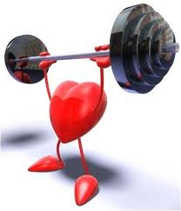
Strength Training: What Counts?
To gain health benefits, these activities need to be done to the point where it’s hard for you to do another repetition without help.
A repetition is one complete movement of an activity, like lifting a weight or doing a sit-up. Try to do 8-12 reps per activity. This would be considered a set.
Try to do at least 1 set of muscle-strengthening activities but for more health benefits, aim to do 2-3 sets.
You can do muscle-strengthening activities on the same day as aerobic activity but keep in mind they do not count towards your aerobic minutes.
Source: www.cdc.gov

Slide 13
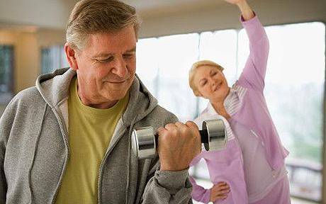
Strength Training: What Counts?
Lifting weights
Working with resistance bands
Doing exercises that use your body weight for resistance (ie: push ups, sit ups, etc.)
Heavy gardening or manual labour (digging, shoveling, etc.)
Yoga

Slide 14
Don’t Overlook Flexibility!
When we talk about the importance of flexibility, we are referring to the range of motion for a given joint. The degree of flexibility you have is influenced by muscles and connective tissues, like ligaments and tendons. A good stretching program can lead to an increase in flexibility. Things to keep in mind:
Use dynamic movement as a warm-up for exercise. (e.g.: if you are going to jog three miles, the best way to warm up is to start walking and increase your speed over a period of five minutes.) The best time to use static stretching (slowly stretching a muscle to its end position and holding it for a short period of time) is during a post-workout cool-down when your muscles are already warm.
Don’t overstretch – you must stretch and hold a muscle beyond its normal length to improve flexibility, however, you should not stretch to the point of pain as it could do serious damage.
Don’t bounce! This can make it harder to control the force and range of motion which could lead to injury.
Working it all into our busy lives? See handout 4.7.
Source: www.webmd.com

Slide 15
The Importance of Staying Hydrated
You’ve heard it before – it is important to ensure you are drinking at least 8 glasses of water a day for good health. If you are physically active, you will need to consume even more water than this. Why?
Lean muscle in the human body is made up of around 80% water and it needs that water to function properly. When you start to become dehydrated, your muscle tissue starts to lose water and it makes it harder for that muscle to contract effectively, reducing your strength and endurance.
Always have a water bottle with you when
exercising and make sure to drink throughout
your workout. See handout 4.8.
Before you go….
Let’s goal set – NOW!
*see handout 4.9
Source: www.webmd.com

Slide 16
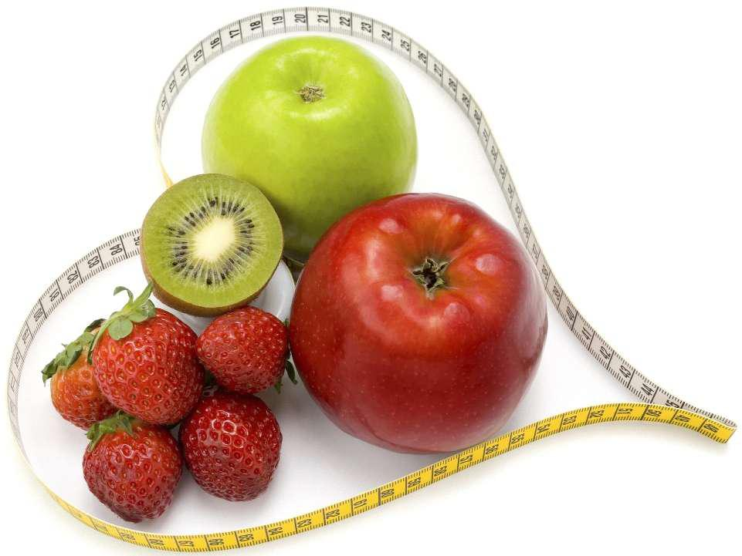
Next Week:
Staying motivated
Using positive affirmations to reprogram
self-defeating inner monologues
Creating a supportive environment
The importance of a good night’s sleep
Re-visit your weekly sub-goals….

Slide 17
Questions now or later?
<Consultant Name>
<consultant>@EWSNetwork.com P:123.456.7890
www.EWSNetwork.com

