Slide 1
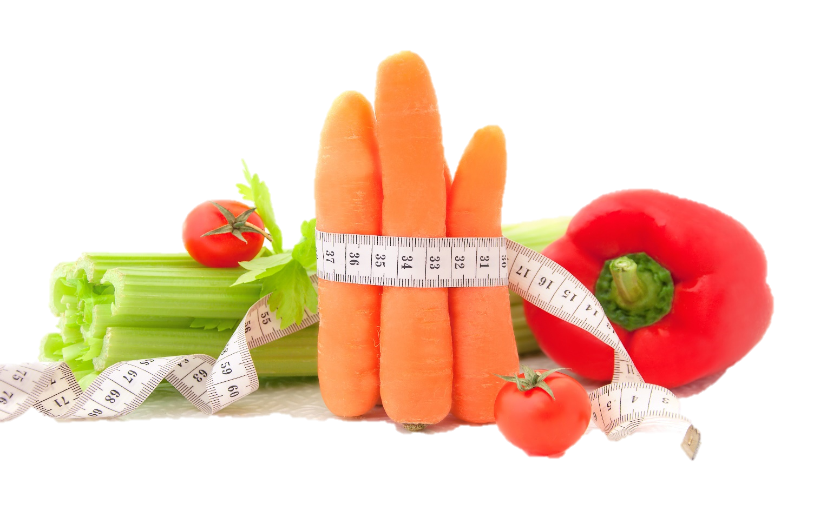
Fit & Lean in 2014
Week Five: Staying Motivated
www.EWSNetwork.com

Slide 2
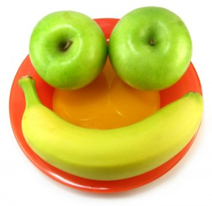
How Did Your Week Go?
How did your week go?
Goal Jars and SUCCESS STONES
Did you achieve any of your goals?
Did you come up with any new goals?
What worked for you this week?
What didn’t work for you this week?
Anything to share with the group that might be helpful to others?

Slide 3
Hitting the Wall
It happens to the best of us…in the beginning you’re excited and inspired to start out on this new road but after awhile, things start to get stale.
Maybe you had some initial losses but you’ve hit a plateau. Or maybe your menu plan is a bit repetitive and fast-food drive-thrus are starting to look better and better.
Let’s talk about how to push through these feelings and how to stay on track to reach your goals…. See handout 5.1.

Slide 4
Great Tips for Staying Motivated
Quiz yourself! For an instant dose of inspiration, answer these questions:
a) If I stop, how will I look in six months to one year?
b) If I stop, how will I feel in six months to one year?
c) If I stop, what will my health be like?
d) If I stop, how will my family and friends be affected?
Answering these questions often helps boost motivation just enough to remind you of why you started in the first place.
Going back to your week one commitment sheet and reminding yourself of your original motivation for getting started can also be helpful. Perhaps you need to post this on your fridge or bathroom mirror so you can see it on a regular basis!
Source: www.shape.com

Slide 5
Great Tips for Staying Motivated
Work on keeping promises. Practice integrity in other areas of your life – clean out that closet you’ve been meaning to clean out for months, keep promises to family & friends, pay off a debt. Stick with commitments in other ways in order to strengthen your own subconscious belief that you are able to uphold the promise of getting fit & healthy that you made to yourself!
Focus on a feeling. Stop focusing on the scale or the measurement tape and concentrate on your mood after you’ve eaten a healthy meal or how you feel after a great workout. Motivation doesn’t always have to come before an activity!
Ensure you are rewarding yourself for achieving different milestones and not just for reaching the end goal. Reaching small goals is just as important – you must achieve the small goals before you can reach the big one. It’s easy to get discouraged when you are only worrying about the finish line and not enjoying the journey!
Source: www.shape.com

Slide 6
Great Tips for Staying Motivated
Act as if! Too often we put things off thinking that we will do them eventually. “When I lose this weight, I’m going to take a dance class.” “When I reach my goal, I’m going to be more social.” Why put it off? Your weight and health shouldn’t be keeping you from living your best life, they should be enhancing the enjoyment you already get out of your life! Live your life like you have already reached your health & fitness goals and move from punishment mode to empowerment mode!
Cultivate compassion. If you find yourself feeling really uninspired or particularly down on your body, try shifting your focus to self-appreciation. Instead of beating yourself up when your weekly weigh-in doesn’t go as you wanted, be grateful for how your body moves and all the things it does for you. Move your mindset from how you look to how you function. Being able to walk and bend and dance is a blessing that is too easily taken for granted!
Source: www.shape.com

Slide 7
Using Positive Affirmations
Positive affirmations are a technique used to program the subconscious mind to effect change by repeating (or meditating on) a key phrase (or series of key phrases) to bring about the desired outcome. Phrases should be in the present tense (“I am…” rather than “I will be…”) and are best when said consciously and aloud (though saying them internally or writing the repeatedly are other options).

Slide 8
Using Positive Affirmations
Great affirmations to get you started:
I follow my dreams, no matter what.
I have the skills and ability to get through this challenge.
I am happy in my own skin and in my own circumstances.
I adopt the mindset to praise myself.
I fully approve of who I am, even as I get better.
Giving up is easy and always an option so let us delay it for another day.
I accept my body shape and acknowledge the beauty and power it holds.
I am grateful for the body I have and all that it does for me.
I let go of unhelpful patterns around food.
I love being physically fit and am grateful for the ability to be active.
Let’s work on creating some personalized affirmations that work best for you… *see handout 5.2
Notes:
Consultant should encourage the group to come up with 2-3 affirmations that they find personally motivating and relevant. Refer to positive affirmations handout 5.

Slide 9
Practicing the Art of Gratitude
Gratitude can not only be deliberately cultivated but can increase levels of well-being and happiness among those who do cultivate it.
In addition, grateful thinking, and especially expression of it to others, is associated with increased levels of energy, optimism and empathy.
Let’s look at ways we can practice more gratitude in our daily lives … see handout 5.3.

Slide 10
Practicing the Art of Gratitude
Remember the bad. To be grateful in your current state, it is helpful to remember the hard times that you have overcome in your life. When you remember how difficult life used to be and how far you have come, you set up an explicit contrast in your mind, which creates a fertile ground for gratitude.
Take time to smell the roses! Use all of your senses to appreciate the beauty of being alive. Life is short and things can go from good to bad at a moment’s notice. Never miss an opportunity to mentally capture a beautiful moment – focus on the smiles of your children, the laughter of your friends and the aroma of a bouquet of flowers or a delicious, healthy meal.
Tell people how grateful you are for them. Become a thank you card writer – gratitude isn’t just about making yourself feel good but it’s about sharing that feeling with others. The simple act of saying “thank you” to people in your life who do good & kind things can create a chain reaction of positivity!

Slide 11
Practicing the Art of Gratitude
Keep a gratitude journal. Establish a daily practice of acknowledging all the good in your life. Focus more on people and situations than material objects. Start with a commitment to acknowledging five things each day that you are grateful for – on days where this is a challenge, focus on the basics: your family, your health, being employed when so many are not, a safe, warm place to sleep – the more you do this, the easier it will be to see all the wonderful things in your life. See handout 5.4.
Notes:
Gratitude Journal handout has been provided. Have the group refer to handout 5.4 and write down three things they are grateful for in this moment. Encourage them to set writing in gratitude journal as one of their weekly mini-goals this week. (Consultant should have extras on hand to provide for those who want to use our template as their gratitude journal.)

Slide 12
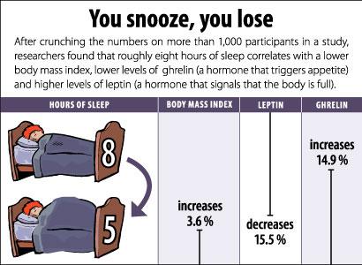
The Importance of Sleep
Exactly how sleep affects our ability to lose weight has a lot to do with two specific hormones: ghrelin and leptin.
*See handout 5.5.
Ghrelin is the ‘go’ hormone that tells you when to eat and when you are sleep deprived, you have increased levels of ghrelin in your system.
Leptin is the hormone that tells you when to stop eating and these hormone levels drop when sleep deprived.
More ghrelin and less leptin = weight gain!
Source: www.webmd.com

Slide 13
Tips on Improving Your Sleep
Experts say that you should aim for 7.5 hours of quality sleep each night. Try the following steps to improve your sleep quality:
Avoid caffeine after 2pm.
Regular exercise will improve sleep quality, however, be wary of exercising too close to bedtime as the increased adrenaline may keep you up.
Remove any sources of light from your room, including digital alarm clocks. At the very least, turn your clock around to avoid being distracted by the light and tempted to check the time throughout the night.
Keep your bedroom free of electronics – experts continually advise that having a television in your bedroom can have a serious impact on the quality of your sleep.
Use room-darkening drapes or a sleep mask to keep the room as dark as possible and consider running a fan, air purifier or white noise machine in order to mask any noises which might keep you from falling into (and staying in) a deep sleep.
Before you go….
Let’s goal set – NOW!
*see handout 5.6
Notes:
Encourage group to set some type of sleep goal for themselves this week – whether it be getting 7.5 hours, improving sleep environment or avoiding caffeine after 2pm.

Slide 14
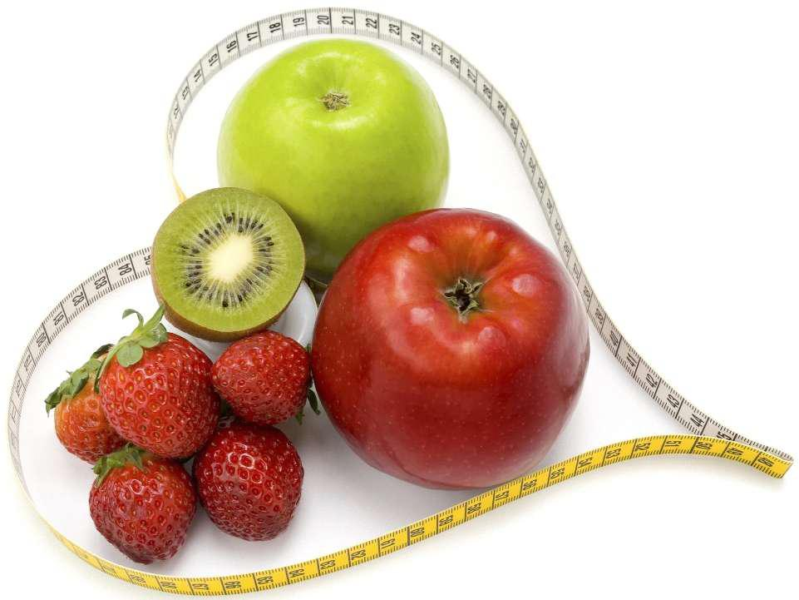
Next Week:
Weekly check-in – will focus on overcoming any current struggles you are facing with your plan
How to improve recipes for health (bring a
favourite recipe to analyze for ways to adapt)
Kitchen makeover tips
Group workout (bring running shoes and
clothing you can move comfortably in)
Re-visit of weekly sub-goals…

Slide 15
Questions now or later?
<Consultant Name>
<consultant>@EWSNetwork.com P:123.456.7890
www.EWSNetwork.com

