Slide 1
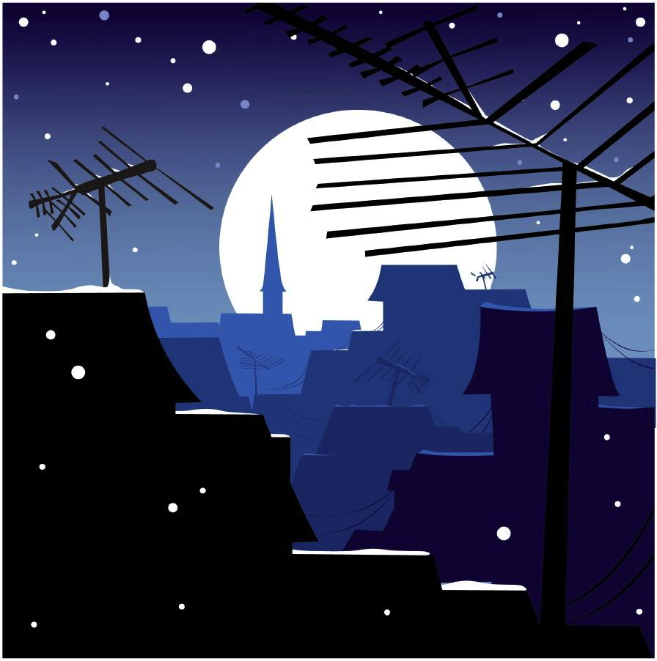
Feelin’ the winter blues?
Seasonal Affective Disorder,
clinically diagnosed depression related to the shortening of daylight hours.
15% of Canadians experience the winter blues
Mood Disorders Society of Canada, 2009
Heads up women!
Women experience SAD 1.8x times more than men.

