Slide 1
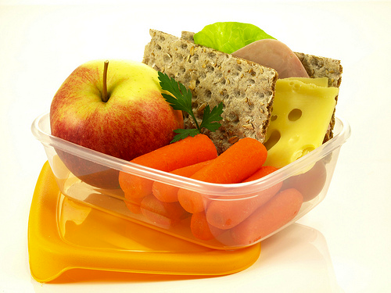
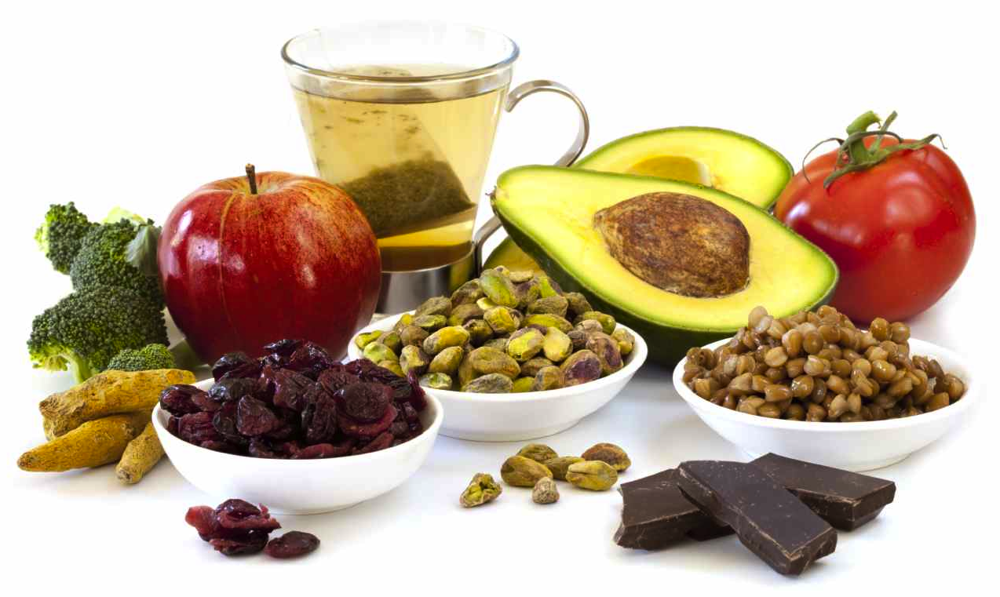
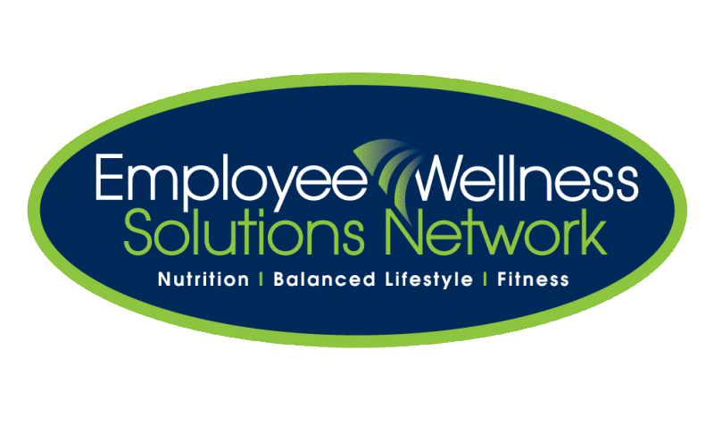
Healthy Snack Choices
Is snacking bad?
What’s considered a “healthy snack”?
How often should I snack?
www.EWSNetwork.com

Slide 2
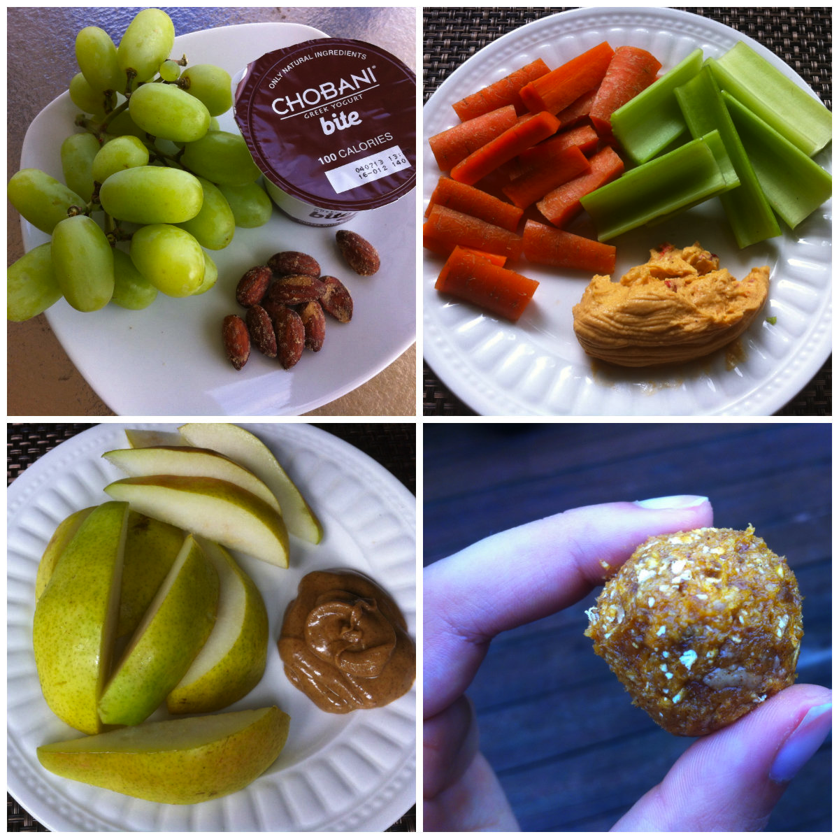
Topics of Discussion
Why we need to snack
Do you really need a snack?
What makes a healthy snack?
What is a “good snack”
Examples of nutrient dense snacks
Eat this, not that

Slide 3
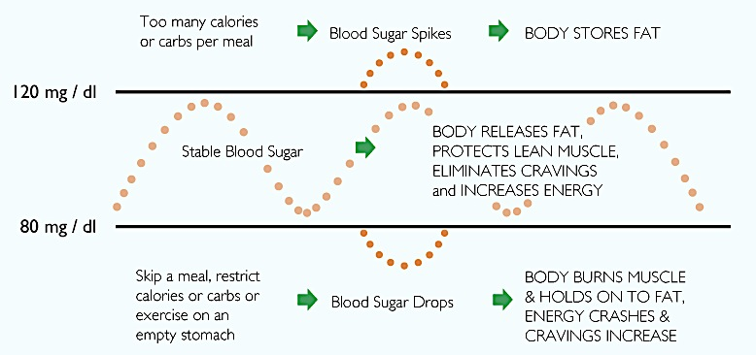
Why we Need to Snack
✖
✔
✖
Source: http://pixelhealth.net/
Notes:
Snacks can keep your blood glucose (sugar) levels stable throughout the day. In this chart, the two RED circles represent poor snacking choices, and the GREEN circle represents healthy snacking. The black lines represent blood glucose levels.
Why do we need to snack? We want to stabilize our blood sugar levels as seen in the middle, green row. As seen in the chart, this results in fewer cravings, increased energy, and a healthy metabolism (using fat and NOT lean muscle to break down food). Therefore, by ensuring you are eating snacks in between meals, your body will begin to burn the calories you are taking in for energy right away. If the body “knows” it will be fed again in a couple of hours, storage won’t happen. This, in turn, burns fat and calories more efficiently!
What happens when you do not snack? As seen in the bottom row, several hours without food will dramatically lower your blood sugar levels. This is not good because your body ends up burning the wrong fuel type (protein but it should be carbohydrates or fat), STORES fat, energy levels plummet, and your food cravings increase which usually means overindulging at meal time. If the body “knows” it won’t be fed for another 6-7 hours, and will start ‘holding’ onto the ingested food (i.e. storing fat).
Eating nutritious foods when you are hungry and stopping when you are full keeps blood sugar levels more constant and can keep you from overeating. Just make sure you stay within your recommended calories for the day or else you’ll be in the top row
More is explained on the next slide.

Slide 4
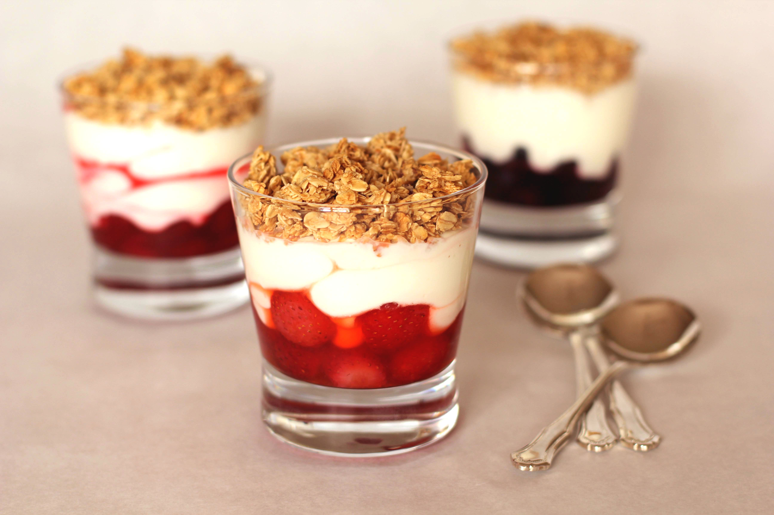
Why we Need to Snack
Snacking between meals keeps your blood glucose levels stable throughout the day.
Body will burn/use the calories you ingest right away (i.e. will not store it).
If you only ate 3 meals a day, body would store the ingested food as fat.
No snacking = blood glucose levels drop = burn protein and store fat = energy levels drop = food cravings increase = possible weight gain
Source: http://www.dietitians.ca/
Notes:
Snacks can keep your blood glucose (sugar) levels stable throughout the day.
When we snack, , your body will begin to burn the calories you are taking in for energy right away. If the body “knows” it will be fed again in a couple of hours, storage won’t happen. This, in turn, burns fat and calories more efficiently! This results in fewer cravings, increased energy, and a healthy metabolism (using fat and NOT lean muscle to break down food).
What happens when you do not snack? Several hours without food will dramatically lower your blood sugar levels. This is not good because your body ends up burning the wrong fuel type (protein but it should be carbohydrates or fat), STORES fat, energy levels plummet, and your food cravings increase which usually means overindulging at meal time. If the body “knows” it won’t be fed for another 6-7 hours, and will start ‘holding’ onto the ingested food (i.e. storing fat). This can lead to possible weight gain.

Slide 5
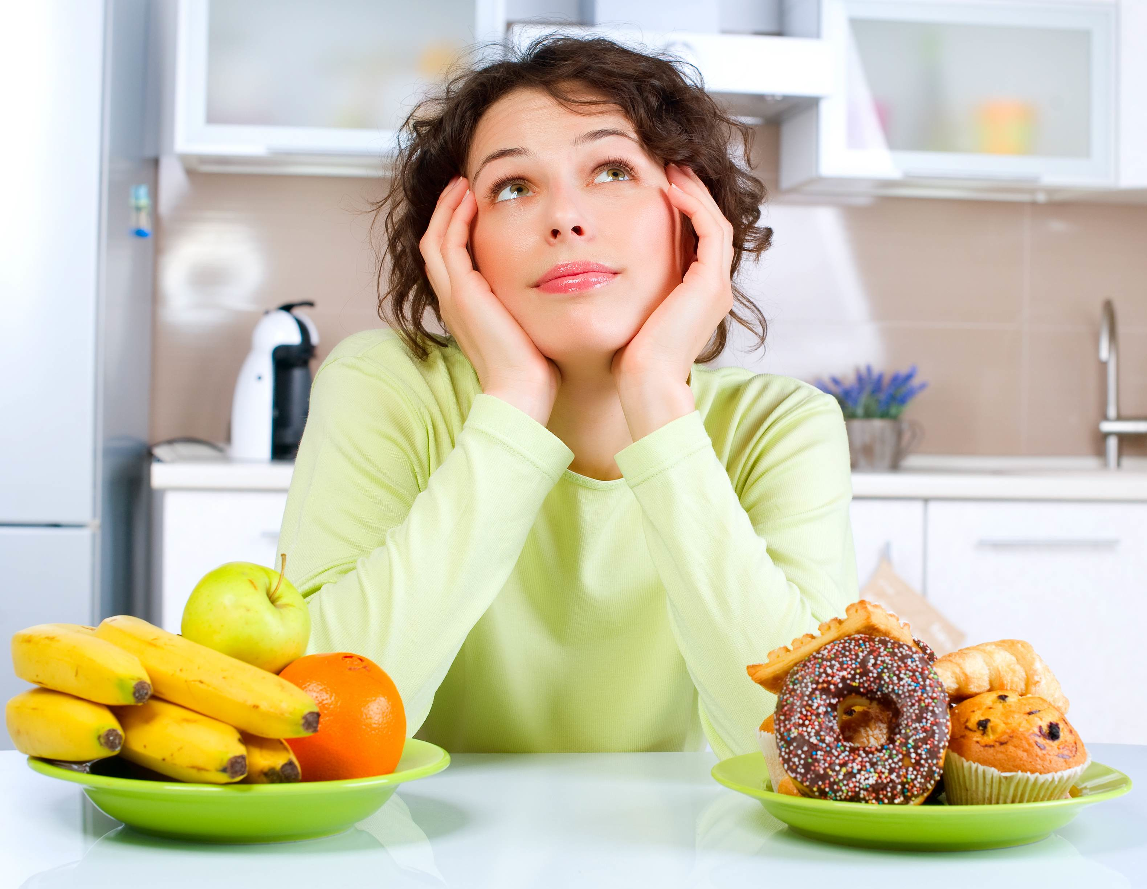
Do you Really Need a Snack?
Are you truly hungry? Try keeping a log to see when you snack!
What is your body saying? Is it thirst or hunger?
**Stay away from soft drinks and sugar beverages!
Do you snack when …
It’s late at night
Bored
Stressed or tired
Lonely
“Because it’s there”
Notes:
Before you reach for a snack, make sure you’re really hungry. To help you determine whether you snack because you are truly hungry or out of habit, keep a log for a few days to help you identify when you snack, what foods you snack on, and any emotion or situation that triggers snacking. This is in the handout and on the next slide.
Do you snack when:
Late at night or bedtime snack: This can contribute to heartburn and weight gain. If you’re really hungry, think about how many calories you have eaten that day (caloric intake) and how much energy you expended through physical activity (caloric outtake). This can help guide what kind of snack you may have. A piece of fruit of whole-grain toast are good options.
Bored: If you have nothing else to do and decide to eat, try walking around the block, drinking water, calling a friend, playing with your pet if you have one, or brushing your teeth.
Stressed or tired: Go outdoors, not to the kitchen! A brisk 15 minute walk invigorates your mind and helps relax tense muscles and calm the body’s stress response (which can stimulate appetite)
Lonely: Studies have shown that eating with family or friends does not increase food intake. If you usually eat while watching TV, you may want to try making mealtime more social and away from the TV.
Because it’s there: Reaching for the kitchen pantry, desk, or drawer makes snacking easy. Clear out your stash of unhealthy snacks (food bank, neighbours, garbarge). Replace them with healthy snacks that you have on hand (baby carrots, nuts, hummus, fruit).
Pay attention to your body’s clues. Sometimes people misread thirst as hunger. When you first feel the need to munch, grab a tall glass of water or cup of tea. Stay away from soft drinks and sweet drinks. Researchers studied 548 school children for 2 school years, looking at various factors linked to the development of obesity. They found a strong link between intake of sugar-sweetened drinks and development of obesity. For every additional can or glass of sugar-sweetened drink consumed, the risk for obesity increased by 60% even after adjusting for other dietary habits and level of physical activity.

Slide 6
Snacking Log
Time | Place | Food | Calories | Circumstance
3:30 | Car | M&Ms, 1 pckg | 250 | Hungry, skipped lunch
Are you snacking because you are truly hungry or out of habit?
Notes:
To help you determine whether you snack because you are truly hungry or out of habit, keep a log for a few days to help you identify when you snack, what foods you snack on, and any emotion or situation that triggers snacking.

Slide 7
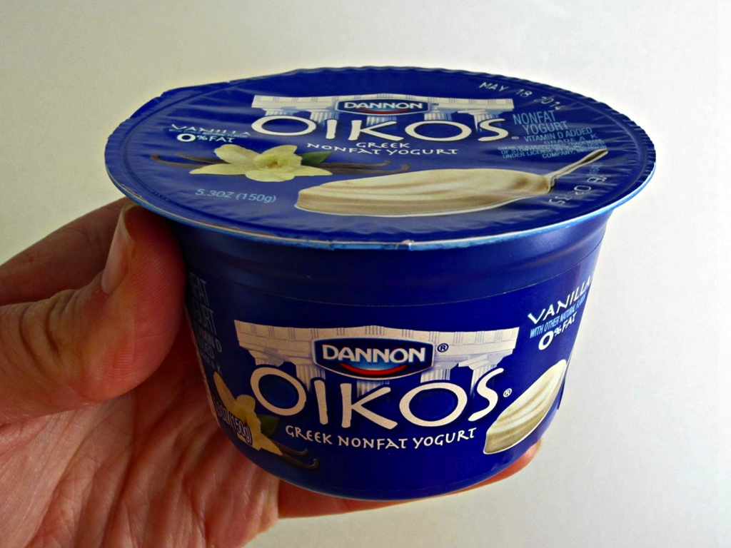
What Makes a Healthy Snack
Danone Oikos Peach Mango 0% Greek Yogurt
NUTRITIONAL INFORMATION
AMOUNT PER 100 G % DAILY VALUE
CALORIES 90
FAT 0 g 0%
SATURATED 0 g
TRANS 0 g
CHOLESTEROL 0 mg
SODIUM 30 mg 1%
CARBOHYDRATE 14 g 5%
FIBRE 0 g 0%
SUGARS 12 g
PROTEIN 8 g
VITAMIN A 0%
VITAMIN C 2%
CALCIUM 8%
IRON 0%
INGREDIENTS Yogurt (skim milk, active bacterial cultures), fruit on the bottom (sugar, peaches, mango, water, corn starch, natural flavours and colour, carrageenan, sodium citrate, lemon juice concentrate).
Source: http://www.nlm.nih.gov/, http://www.mayoclinic.org/
Notes:
If you are not sure if a snack is healthy, read the Nutrition Facts label. (This is outlined in the next slide but you can briefly explain the red circles)
Pay attention to the portion size given on the label. It’s easy to eat more than this amount. This is also the reference point that the rest of the information is based on.
If the calories coming from fat are more than half of the total calories, it is not a healthy choice. You also want to make sure it is low in saturated and trans fat.
Avoid snacks that list sugar or corn syrup as one the first few ingredients.
Pick foods that are low in fat and sugar and high in fiber and water. This means an apple is better than a bag of chips.
Watch out for sodium levels. If something is “low in fat” it may be compromised with the sodium content.
The size of the snack should be the right size, a good balance between enough calories to satisfy you, but still not too many. For a small snack, under 100 calories is a good guide. For a more substantial snack, no more than 200-250 calories is a good cap. The next slide will talk more about calories.
Other factors to think about:
Naturally sweetened is better than foods and drinks that contain added sugar.
Fresh fruit is a healthier choice than a fruit-flavored drink.
In this example, greek yogurt is extremely high in protein which will help you feel fuller longer. This is an excellent example of a healthy snack!
http://www.nlm.nih.gov/medlineplus/ency/patientinstructions/000338.htm
http://www.mayoclinic.org/healthy-living/weight-loss/in-depth/healthy-diet/art-20046267

Slide 8
What Makes a Healthy Snack
On the nutrition facts label, look at…
Portion size. It’s easy to eat more than this amount! Remember to refer back to this serving size when reading the label.
Fat. Watch out if more than half of the total calories are coming from fat. Look for low in saturated and trans fat.
Sugar on ingredient list. If sugar is first on the ingredient list, it’s not a healthy snack. Watch for “corn syrup” or “high fructose corn syrup.”
High in fiber and low in sugar.
Sodium. If something is “low in fat” it may be compromised with higher sodium content.
Total calories. For a small snack, under 100 calories is a good guide. For a more substantial snack, 200-250 calories is a good cap.
Source: http://www.nlm.nih.gov/, http://www.mayoclinic.org/

Slide 9
What is a “Good Snack”?
Nutrient dense = foods that have a lot of nutrients but few calories.
Contains some protein, fiber, healthy fat, and unrefined carbohydrates. Small snack ~100 calories; Substantial snack ~<200-250 calories
Notes:
Nutrient density literally means how many nutrients you get from a food, given the number of calories it contains. Nutrient dense foods give you the most nutrients for the fewest amount of calories. In other words, nutrient dense foods give you the "biggest bang for the buck.” (whfoods.com)
Nutrient dense snacks are crucial for keeping your appetite regulated and your metabolism going. Meaning, you want to choose foods that will leave you feeling satisfied and that provide your body with the nutrients it needs for proper functioning. Let’s look at two snacks, and compare the nutrient density.
As you can see, snack #2 contains a similar amount of calories, but has more fibre and calcium and less fat than snack #1. Snack #2 also contains three different food groups: a grain, a dairy, and a fruit. These make it a more nutrient dense choice. This gives your body more nutrients and will fill you up for a longer period of time.
Thus, you want a snack that contains some protein, fiber, and fat, along with some unrefined carbohydrate (e.g., a raw carrot)
In terms of calories, this depends on whether you had a large meal and want to have a small snack, or if you are going for the “6 small meals” and consuming more substantial snacks along with smaller meals. It also depends on how many calories you have expended, i.e., if you did some physical activity or not. A guide is 100 calories for a small snack and no more than 200-250 calories for a substantial snack

Slide 10
Examples of Nutrient Dense Snacks
^{• 1 apple (72 calories)}
^{• 1banana(105calories)}
^{• 1 cup grapes (100 calories)}
^{• 1 cup carrots (45 calories)}
• 1 cup air-popped popcorn (31 calories)
• 1 rye crispbread cracker (37 calories)
^{• 10 almonds (70 calories)}
• 2 tablespoon hummus (46 calories)
• 1 cup nonfat milk (83 calories)
• 1 ounce of part-skim mozzarella cheese (72 calories)
• Peanut butter and low-sugar jelly sandwich
• Fortified, high-fiber cereal and low-fat milk or soymilk
• 1 tbsp peanut butter, spread evenly on slices from a small apple
• Toasted whole-wheat English muffin half topped with 1⁄4 of a small avocado
^{• Small baked sweet potato}
• 1⁄2 cup pineapple chunks on 1⁄2 cup low-fat cottage cheese
• 1⁄4 cup raw steel-cut oats and 1⁄2 cup of raspberries stirred into 1⁄2 cup of Greek yogurt
About 100 calories or less
Substantial Snacks (200-250 calories)
Notes:
More examples on handout.

Slide 11
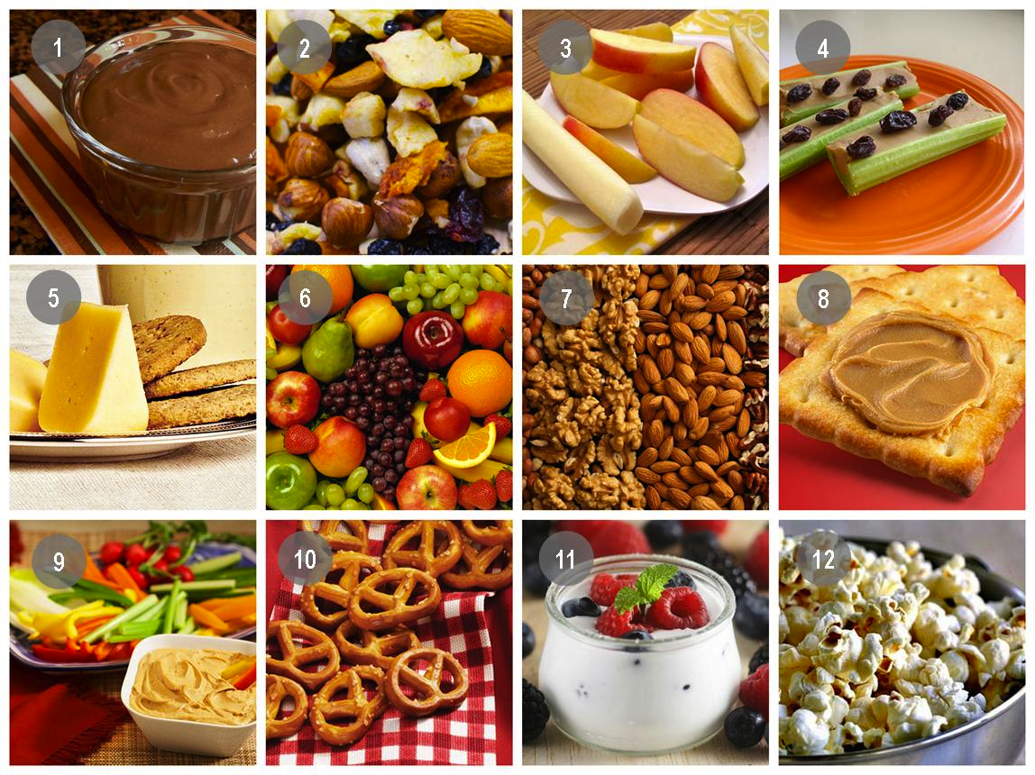
Eat This, Not That
Eat this | Not that
98% Fat free popcorn and drizzle a little margarine | Buttered popcorn
Homemade fruit smoothies, water | Fruit juice, pop, sugary drinks
1 cookie with a piece of fruit | 3 cookies
High-fiber, low-sugar cereal (Oatmeal, Kashi, Shreddies) | Low-fiber, high sugar cereal (Fruit Loops, Rice Krispies)
1 scoop of ice cream with a lot of fresh fruit | 4 scoops of ice cream
Crunchy, low-sugar, high fiber granola bars | “Chewy”, high-sugar, low-fiber granola bars
Source: http://www.webmd.com/
Notes:
Healthy alternatives for common unhealthy snacks

Slide 12
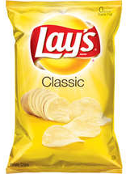
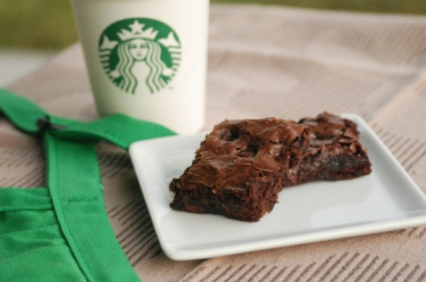
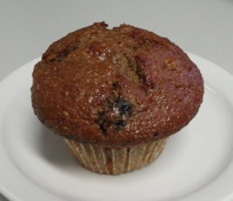
To Snack or Not?
Snack | Serving Size | Calories | Activity Needed
Lay’s Classic Potato Chips | 1 oz | 150 | Jogging: 15 minutes at 8km/h
Starbucks Double Chocolate Brownie | 92 g (1 square) | 430 | Swimming laps: 1 hr 15 min
Tim Horton’s Raisin Bran Muffin | 115 g | 410 | Strength training: 1 hr 45 min
Source: www.emedicinehealth.com, Nutrition Action Healthletter (March 2012), www.caloriecount.about.com.
Notes:
Many people tend to think they can leave a little slack room in their diet as long as they are willing to put in the extra time exercising. But, most people underestimate how much exercise is required in order to burn off that indulgence. Here is how much exercise a 150-pound person would have to do to burn off calories in some popular snacks.

Slide 13
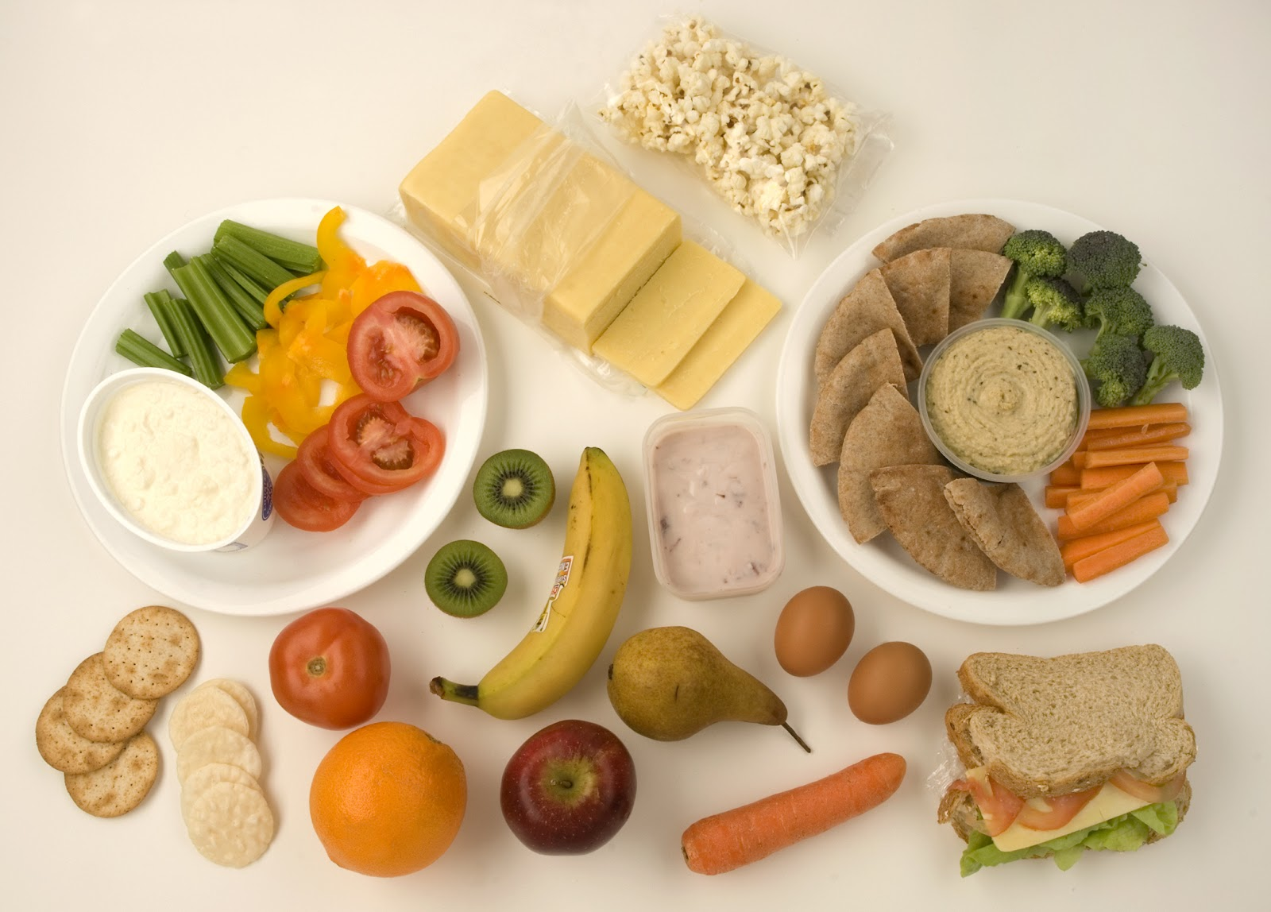
Recap
Snacking between meals keeps your blood glucose levels stable throughout the day.
No snacking can lead to possible weight gain.
Are you snacking because you are truly hungry or out of habit? Try using the Snacking Log.
Look at the 6 things on a nutrition label to see if your snack is healthy.
A good snack is nutrient dense (foods that have a lot of nutrients but few calories).

Slide 14
References
http://pixelhealth.net/
http://www.dietitians.ca/
http://www.nlm.nih.gov/
http://www.mayoclinic.org/
http://www.webmd.com/
www.emedicinehealth.com
www.caloriecount.about.com
Nutrition Action Healthletter (March 2012)

Slide 15
Questions now or later?
<Consultant Name>
<consultant>@EWSNetwork.com P:123.456.7890
www.EWSNetwork.com

