Slide 1
Getting Better Sleep
www.EWSNetwork.com

Slide 2
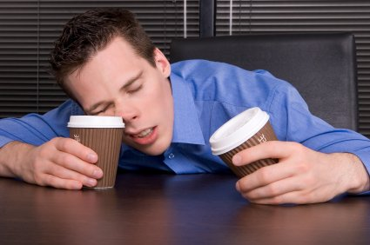
Are You Getting Enough?
In our hectic society, where it always seems like there aren’t enough hours in the day to get everything done, many people are sacrificing a good night’s sleep to check a few more things off the to-do list. Are you one of them? Experts recommend that adults get 7-9 hours of quality sleep each night.
www.EWSNetwork.com

Slide 3
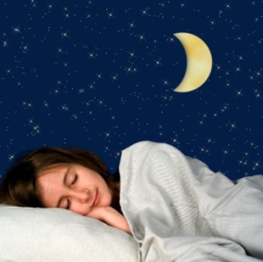
Top Six Reasons You NEED a Good Night’s Sleep
Learning & Memory
Metabolism & Weight
Safety
Mood
Cardiovascular health
Disease
REMEMBER: Sleeping is almost as important as eating or breathing!
www.EWSNetwork.com
Notes:
Learning & Memory: Sleep helps the brain commit new information to memory through a process called memory consolidation. In studies, people who’d slept after learning a task did better on tests later.
Metabolism & Weight: Chronic sleep deprivation may cause weight gain by affecting the way our bodies process and store carbohydrates and by altering levels of hormones that affect our appetites.
Safety: Sleep debt contributes to a greater tendency to fall asleep during the daytime. These lapses may cause falls and mistakes such as medical errors, air traffic mishaps, and road accidents.
Mood: Sleep loss may result in irritability, impatience, inability to concentrate and moodiness. Too little sleep can also leave you too tired to do the things you like to do.
Cardiovascular health: Serious sleep disorders have been linked to hypertension, increased stress hormone levels and irregular heartbeat.
Disease: Sleep deprivation alters immune function, including the activity of the body’s killer cells. Keeping up with sleep may also help fight cancer.
Source: http://www.health.harvard.edu/press_releases/importance_of_sleep_and_health

Slide 4
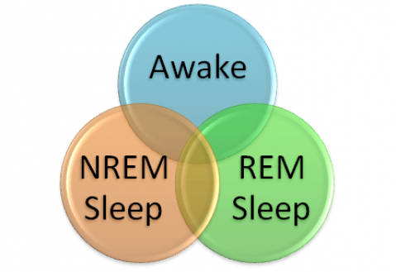
The Basics: Types of Sleep
There are two types of sleep –
NREM – A very relaxed type of sleep that gets progressively deeper
REM – A very active type of sleep where the brain is almost as active as if it was awake.
www.EWSNetwork.com
Notes:
NREM: Deep sleep is essential for restoring energy and allowing the body to undergo maintenance. While in NREM sleep:
Wounds are healed
white blood cells are created to aid your bodies defenses
The muscles are restored
The growth hormone is released
Without enough deep sleep, all of these processes will be hampered.
While under the deepest levels of sleep the brain reorganizes the many mental pathways within the cortex. This process is critical for learning and ongoing brain development.
REM:
Whilst in NREM sleep the brainwaves become progressively slower and deeper, while in REM sleep the brainwaves are almost identical as if you’re awake. REM sleep is known as paradoxical sleep. It may look like you’re fast asleep, but there’s a lot happening inside your brain.
For this reason REM isn’t really what we would consider sleep. We’re not asleep in the sense that the body turns itself off, but we’re not awake either. So what’s the point of REM if we’re neither asleep nor awake?
When you’re awake the majority of your mental input is coming from your surroundings, but when you’re in REM, all this mental stimulus being generated by the brain itself.
This internal mental processing is believed to help to process memories and form new skills. The brain is awake but the body isn’t, so it’s the perfect time for your brain to reorganize the vast amount of thoughts gained during the day.
Dreams, which make up a lot of REM sleep, are believed to help you with this too. Songbirds have been shown to practice new mating calls in their dreams that they heard then they were awake.
Which type of sleep is most important?
You go into NREM sleep as soon as we fall asleep, suggesting that NREM might be the most important. REM only gets its turn later in the night after you’ve first completed a cycle of NREM sleep.
When you’re deprived of NREM sleep, the body tries to make up for it whenever it next gets the chance. The body also tries to make up for REM, although not as much as it does for NREM.
While we need NREM, we don’t appear to need REM sleep after childhood. The brain stimulation is critical for proper brain development. When we were still a fetus or a small child who hadn’t yet developed the senses, REM sleep is the only proper stimulation the brain would get. But when we’re older we can get this stimulation from the outside world.
People deprived of REM sleep, either through an experiment or through the use of some types of antidepressants (that have the effect of blocking REM sleep) don’t appear to develop any major health problems.
REM interrupts deep sleep in 90 minutes cycles throughout the night. Maybe this is because deep sleep cannot be sustained for long periods of time. Such inactivity could be bad for the brain. Maybe coming out of deep sleep prevents us from having too much sleep, which we know can be harmful.
Maybe then REM is a way of waking up the body, without causing you to regain awareness. If the body woke you up then you would be faced with having to fall asleep again. Many people find it hard to fall asleep the first time at night, never mind after every 90 minutes of previous sleep. Instead, if the brain becomes active but keeps you asleep, it removes the need to wake up and fall back to sleep, and the brain can send you back to sleep whenever it wishes.
Source: http://www.sleepforall.com/types-of-sleep.htm

Slide 5
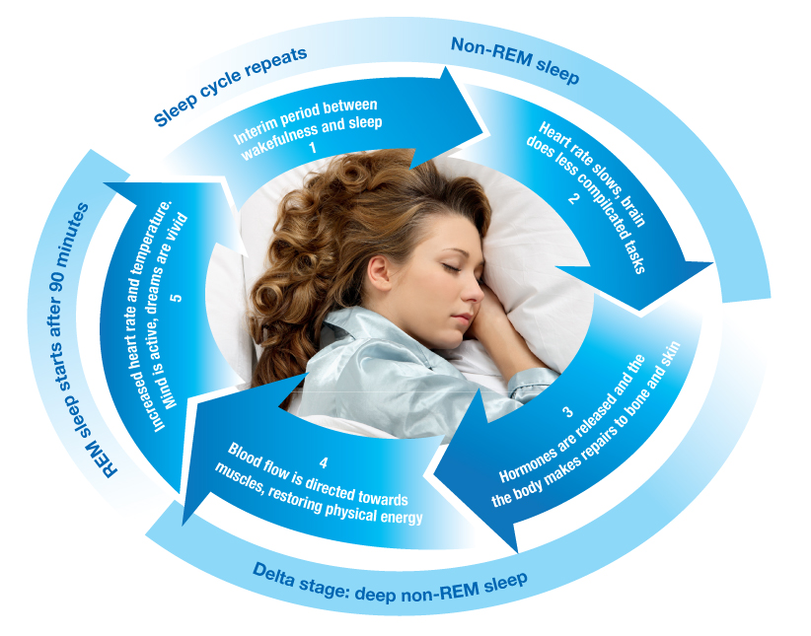
The Basics: The Five Stages of Sleep
Sleep is prompted by natural cycles of activity in the brain , consisting of the two basic sleep types (NREM & REM). NREM sleep makes up stages 1-4 followed by a period of REM sleep before the cycle starts again.
www.EWSNetwork.com
Notes:
The period of NREM sleep is made up of stages 1-4. Each stage can last from 5 to 15 minutes. A completed cycle of sleep consists of a progression from stages 1-4 before REM sleep is attained, then the cycle starts over again.
Stage 1: Polysomnography (sleep readings) shows a reduction in activity between wakefulness and stage 1 sleep. The eyes are closed during Stage 1 sleep. One can be awakened without difficulty, however, if aroused from this stage of sleep, a person may feel as if he or she has not slept. Stage 1 may last for five to 10 minutes. Many may notice the feeling of falling during this stage of sleep, which may cause a sudden muscle contraction (called hypnic myoclonia).
Stage 2: This is a period of light sleep during which polysomnographic readings show intermittent peaks and valleys, or positive and negative waves. These waves indicate spontaneous periods of muscle tone mixed with periods of muscle relaxation. The heart rate slows and the body temperature decreases. At this point, the body prepares to enter deep sleep.
Stages 3 and 4: These are deep sleep stages, with stage 4 being more intense than Stage 3. These stages are known as slow-wave, or delta, sleep. If aroused from sleep during these stages, a person may feel disoriented for a few minutes.
During the deep stages of NREM sleep, the body repairs and regenerates tissues, builds bone and muscle, and appears to strengthen the immune system. As you get older, you sleep more lightly and get less deep sleep. Aging is also associated with shorter time spans of sleep, although studies show the amount of sleep needed doesn't appear to diminish with age.
Usually, REM sleep occurs 90 minutes after sleep onset. The first period of REM typically lasts 10 minutes, with each recurring REM stage lengthening, and the final one may last up to an hour. Polysomnograms show brainwave patterns in REM to be similar to that recorded during wakefulness. In people without sleep disorders, heart rate and respiration speed up and become erratic during REM sleep. During this stage the eyes move rapidly in different directions.
Intense dreaming occurs during REM sleep as a result of heightened brain activity, but paralysis occurs simultaneously in the major voluntary muscle groups. REM is a mixture of encephalic (brain) states of excitement and muscular immobility. For this reason, it is sometimes called paradoxical sleep.
The percentage of REM sleep is highest during infancy and early childhood. During adolescence and young adulthood, the percentage of REM sleep declines. Infants can spend up to 50% of their sleep in the REM stage of sleep, whereas adults spend only about 20% in REM.
Source: http://www.webmd.com/sleep-disorders/excessive-sleepiness-10/sleep-101

Slide 6
Sleep & Hormones
Human sleep is regulated by exposure to light or to darkness. Exposure to light stimulates a nerve pathway from the retina to an area in the brain called the hypothalamus. There, the supra-chiasmatic nucleus (SCN) initiates signals to other brain areas which control hormones, body temperature & other functions that play a role in making us feel sleepy or awake.
Once exposed to the first light of day, the SCN begins performing functions like raising body temperature and releasing stimulating hormones, such as cortisol. It also delays the release of melatonin, which is associated with sleep onset, until many hours later when darkness arrives.
www.EWSNetwork.com
Notes:
Source: http://www.sleepfoundation.org/article/sleep-topics/melatonin-and-sleep
Note that this is why it is important to ensure people are being exposed to daylight for at least 15 minutes a day. **Make sure you wear sunscreen when out in the sun!!**
RE: Melatonin:
Melatonin is a natural hormone made by your body's pineal (pih-knee-uhl) gland. This is a pea-sized gland located just above the middle of the brain. During the day the pineal is inactive. When the sun goes down and darkness occurs, the pineal is "turned on" by the SCN and begins to actively produce melatonin, which is released into the blood. Usually, this occurs around 9 pm. As a result, melatonin levels in the blood rise sharply and you begin to feel less alert. Sleep becomes more inviting. Melatonin levels in the blood stay elevated for about 12 hours - all through the night - before the light of a new day when they fall back to low daytime levels by about 9 am. Daytime levels of melatonin are barely detectable.
Besides adjusting the timing of the clock, bright light has another effect. It directly inhibits the release of melatonin. That is why melatonin is sometimes called the "Dracula of hormones" - it only comes out in the dark. Even if the pineal gland is switched "on" by the clock, it will not produce melatonin unless the person is in a dimly lit environment. In addition to sunlight, artificial indoor lighting can be bright enough to prevent the release of melatonin.
The amount of melatonin released at night varies among individuals, but it is somewhat related to age. Children on average secrete more melatonin than adults, which decreases further with age. However, research has shown that older people with sleep problems do not always have lower melatonin levels than people who experience normal sleep.

Slide 7
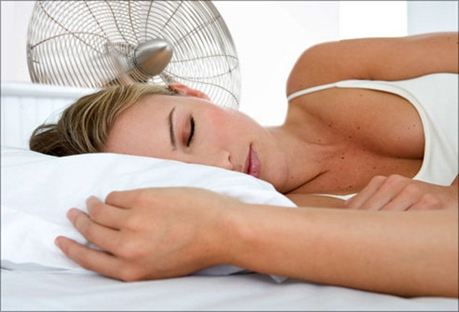
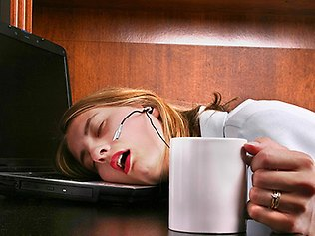
Tips for Better Sleep
Tip #1 – Neutralize Noise
The noise of life can add up to big time sleep loss. Soothing white noise covers up the bumps in the night that can keep us awake. Use a fan, an air conditioner or a simple pair of ear plugs to cover up superfluous noise which may keep you up at night.
Tip #2: Avoid Naps
Napping makes matters worse if you have trouble falling asleep. If you must nap, keep it brief, 20 minutes or less and do it early in the day. Any sleep 8 hours before your bedtime can sabotage a good night’s sleep.
www.EWSNetwork.com

Slide 8
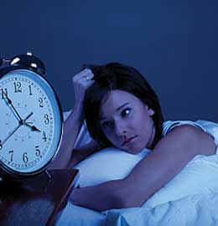
Tips for Better Sleep
Tip #3 – Block the Clock
Glancing at the clock during the night affects your sleep by causing you to worry about how many hours of sleep are left before your busy day begins. Clock watchers should turn the clock away from view or cover it at night.
Tip #4 – Keep the Bedroom a Sanctuary
A bedroom should be a place of peace and relaxation. Try removing the television and digital devices such as computers, phones or tablets from the bedroom for one month and see the difference in your quality of sleep.
www.EWSNetwork.com

Slide 9
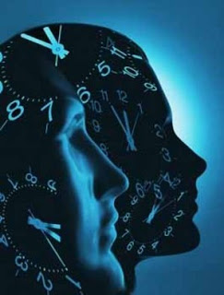
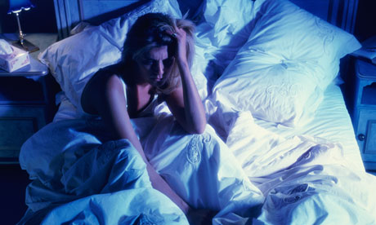
Tips for Better Sleep
Tip #5 – Set Your Body Clock
Go to sleep and wake up at the same time every day, including weekends. This puts your brain & body on a healthy sleep-wake cycle, making it easier to fall asleep and sleep soundly through the night.
Tip #6 – Don’t Toss & Turn
Tossing & turning is counter-productive and creates more stress. If you can’t fall asleep within 15-20 minutes, move to another room and try reading a calming book. Only when drowsy should you return to your bedroom.
www.EWSNetwork.com

Slide 10
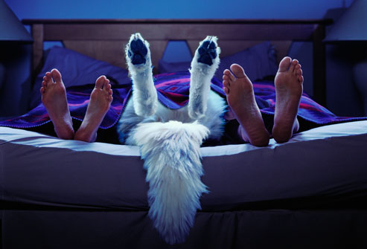
Tips for Better Sleep
Tip #7 – Skip the Smoke
Need another reason to quit smoking? Nicotine is a stimulant, just like caffeine. Smoking can keep you from falling asleep. While working on your quitting strategy, you may sleep better if you smoke fewer cigarettes in the 3-4 hours before bed.
Tip #8 – Keep Pets Out of the Bed
A cat or dog’s night movements can prevent you from settling into the deep sleep you need. Fleas, pollen, fur & dander brought into the bed can also trigger sleep-wrecking allergies. Train Fluffy & Fido to sleep happily in their own beds or keep your bedroom door closed.
www.EWSNetwork.com

Slide 11
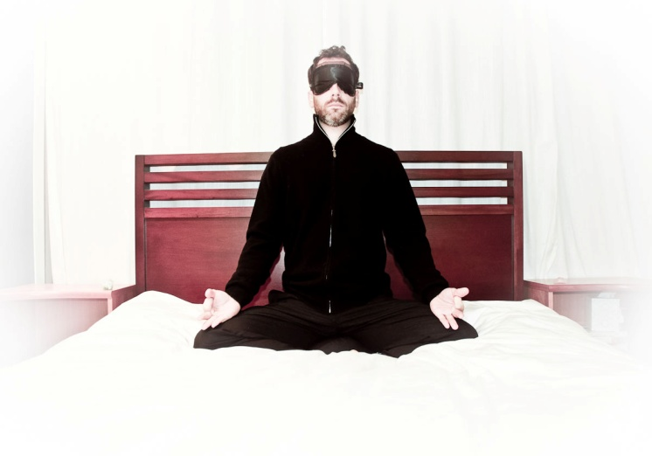
How to De-Stress Before Bed
One of the best things you can do to train your body to get into sleep mode is to create and implement a de-stress routine to help your body unwind after your busy day. An hour before your scheduled bedtime, try reading a calming book, meditating, writing in a gratitude journal, listening to soft music or taking a warm bath. If you are going to read in bed, switch your bedside lamp to a 15 watt bulb. Low lighting is key to signaling your body to prepare for sleep.
www.EWSNetwork.com

Slide 12
De-Stress Tip: Keep a “Worry Journal”
How many times have you kept yourself awake at night worrying about a bill you forgot to pay or a big work presentation that is due tomorrow? We all have worries but learning to purge these thoughts before bed can be infinitely helpful to your well-being. If you know you are a habitual bedtime worrywart, try keeping a “worry journal”! No later than one hour before bedtime, jot down all those nagging thoughts into your journal and if you know how you want to resolve those items, feel free to include a game plan for resolution as well. Once you’ve written in the notebook, close the book while you tell yourself “I will worry about this in the morning, not now”.
www.EWSNetwork.com

Slide 13
Exercise & A Good Night’s Sleep
Regular exercise has been shown to improve sleep quality, as long as you don’t work out too close to bedtime. Aim to finish any vigorous exercise 3-4 hours before your bedtime. However, gentle mind-body exercise, like yoga and tai chi, are perfect matches for a pre-bedtime sleep-inducing nightcap!
www.EWSNetwork.com

Slide 14
Ideal Evening Snacks
While these foods have qualities that can be beneficial before sleep, it is recommended that you stop eating one hour before bedtime and keep portion sizes small so that your body can complete digestion before it’s time to get to sleep.
Cherries
Cherries are one of the few natural foods to contain melatonin, the chemical that helps control our body’s internal clock.
Bananas
Bananas can help promote sleep because they contain the natural muscle relaxants magnesium and potassium.
www.EWSNetwork.com

Slide 15
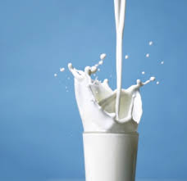
Ideal Evening Snacks
Milk
Having a glass of warm milk before bed is not just an old wives’ tale! Milk contains the amino acid tryptophan (the same sleepy chemical found in turkey), a precursor to the brain chemical serotonin (promotes relaxation and happiness).
Jasmine Rice
Jasmine rice ranks high on the glycemic index, meaning the body digests it slowly, releasing glucose gradually into the bloodstream. Clinical nutritionists speculate that high-glycemic index meals may up the production of tryptophan.
www.EWSNetwork.com

Slide 16
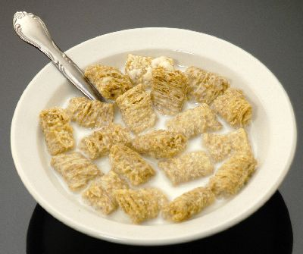
Ideal Evening Snacks
Fortified Cereal
Try a bowl of Kashi cereal or shredded wheat which both contain complex carbs, which are great for sleep. Top with some milk and you are getting two great foods with sleep-promoting qualities for the price of one!
Chamomile Tea with Honey
This herbal tea lacks caffeine and has a calming effect on the body. Adding honey can cause a slight rise in blood sugar which can reduce production of orexin in the brain. Orexin is a neurotransmitter that’s been linked to wakefulness. Another great two-for-one sleep promoter!
www.EWSNetwork.com

Slide 17
Pre-Bedtime No-No’s
Caffeine: A well-known stimulant, you should try and avoid consumption after noon. Caffeine can be found in coffee, tea, chocolate & energy drinks.
Heavy fat-loaded foods: Fat stimulates production of acid in the stomach which can spill up into your esophagus, causing heartburn.
Alcohol: Although the tranquilizing effects of alcohol may make you sleepy, after the initial effects wear off, it actually causes more frequent awakenings at night and less restful sleep.
Protein: Digestion is supposed to slow by about 50% while you’re sleeping but if you consume a lot of protein, you digest even more slowly. Instead of focusing on sleeping, your body is focusing on digestion. The only exception to this rule is turkey, which contains tryptophan, a chemical which can cause drowsiness.
Spicy Foods: Heavy spices can keep you awake at night and cause heartburn. Spicy & high-fat in the same late day meal can be a potentially sleep-wrecking combo! Avoid spicy foods 3-4 hours before bedtime.
www.EWSNetwork.com

Slide 18
Better Sleep Checklist
We hope that you have learned some new tips and had some refresher lessons as well! Here is a handy checklist to help put you on the path to blissful, restful sleep. See how many you can check off over the next 30 days!
I went to sleep and woke up at about the same time every day this week.
I made my bedroom dark , quiet and comfortable.
I didn’t eat a big meal close to bedtime any night this week.
When I couldn’t sleep, I got up and read a book.
I took the computer and TV out of my bedroom.
I didn’t take a nap today.
I moved my pet out of my bed.
www.EWSNetwork.com

Slide 19
Better Sleep Checklist
I brought up any sleep worries at my last medical check up.
I tried to stick to a relaxing bedtime routine most nights this month.
I didn’t drink caffeine before bed any night this week.
I exercised almost every day this month, but not close to bedtime (with exception of yoga/tai chi)
I started a worry journal this month
I tried to get at least 7 hours of sleep every night this week
I didn’t drink any alcohol last night.
I wore sunscreen and spent some time in the sunlight today.
www.EWSNetwork.com

Slide 20
Questions now or later?
<Consultant Name>
<consultant>@EWSNetwork.com P:123.456.7890
www.EWSNetwork.com

