Slide 1


Employee Wellness Program Launch
January 22nd and 24th, 2013
www.EWSNetwork.com

Slide 2
Objectives
Employee Wellness Solutions Network
-Who we are?
-Components of our wellness program
-How do we design the wellness program for Libro?
Wellness Committee
Branch Specifics
WIN $500 or $100 Sport Chek Gift Card
Initial wellness program sign ups
www.EWSNetwork.com

Slide 3

Bridging the Gaps
Fitness…Wellness
Weight loss…Lifestyle
Multi-faceted
  Sleep…Energy…Heart Health…Food…Stress…Back Health…anything related to healthy lifestyles
www.EWSNetwork.com

Slide 4
EWSNetwork Toolbox
Individual
Virtual
Group
Awareness
www.EWSNetwork.com

Slide 5
Individual Component
(One-on-One Health/Wellness Coaching)
The FREE services of a personal trainer, nutrition advisor, stress/time manager and lifestyle coach, “all-in-one”, on-site!
Be Preventative = Stay Healthy!
Accountability, Follow-up, and Evaluation
www.EWSNetwork.com

Slide 6

Wellness Consultations
For you, about you, driven by you.
Consultant is here to help you with what you want to change.
100% private and confidential.
Your wellness coach is on your side for support, motivation and “how to” steps.
www.EWSNetwork.com

Slide 7
Individual Component
(One-on-One Health/Wellness Coaching)
Starts Week of January 28th, 2013
Laura Bonter
Admin Office, Sarnia
Angie Mailhot
Admin office, London South, Watford, Arkona, London East, London Downtown, London North, London Talbot [when opens], St. Thomas, Blenheim, Strathroy
Stacy Lancaster
Wingham, Beechwood, Stratford, Williamsburg, Waterloo
www.EWSNetwork.com
Notes:
Hours spread over month – admin, branch
Re-look at how hours are working…adjust down road

Slide 8
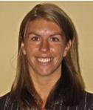
Laura Bonter
 | Wednesday
 | Admin Office 12-4
 | Sarnia 12-4
 | Admin Office 12-4
Week 1
Week 2
Week 1
laura@EWSNetwork.com
Week 3
Week 2
Week 3
Week 4
Week 4
www.EWSNetwork.com
Notes:
Hours spread over month – admin, branch
Re-look at how hours are working…adjust down road

Slide 9
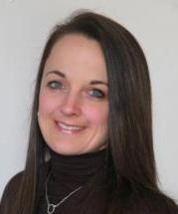
Angie Mailhot
 | Tuesday | Wednesday
 | Admin Office 830-1230
 | London South 1-4 | St Thomas 1-4
 | Watford 930-12
 | Arkona 1-4 | Blenheim 1-4
 | London East 830-1230
 | London Dtown 1-5 | Admin Office 1230-430
 | London North 9-12
 | London Talbot 1-4 | Strathroy 1230-430
Week 1
Week 2
amailhot@EWSNetwork.com
Week 3
Week 4
www.EWSNetwork.com
Notes:
Hours spread over month – admin, branch
Re-look at how hours are working…adjust down road

Slide 10
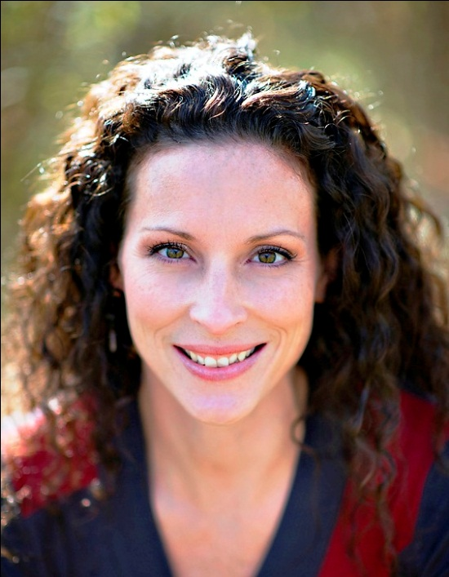
Stacy Lancaster
 | Wednesday | Thursday | Friday
 |  |  | Wingham 1030-130
 | Beechwood 10-1130
 | Stratford 1230-330 | Williamsburg 12-3
 |  | Waterloo 12-3
Week 1
Week 2
slancaster@EWSNetwork.com
Week 3
Week 4
www.EWSNetwork.com
Notes:
Hours spread over month – admin, branch
Re-look at how hours are working…adjust down road

Slide 11
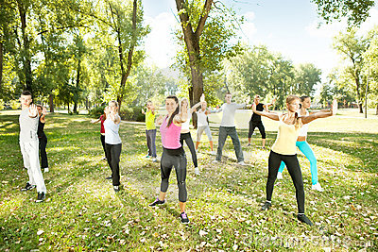

Group Component
Group Programs
Lunch n’ Learns, Workshops
Pedometer Challenges
Olympics – Own the Podium
Nutrition for Life
Eat Your Colors
Minutes of “ME” Time
Healthy Lifestyle Poker
Spring Scrabble
4-week De-Stress Out
6-week Empowered Living
8-week Extreme Lifestyle Makeover
Exercise classes
Walking/Running groups
And others…
www.EWSNetwork.com

Slide 12

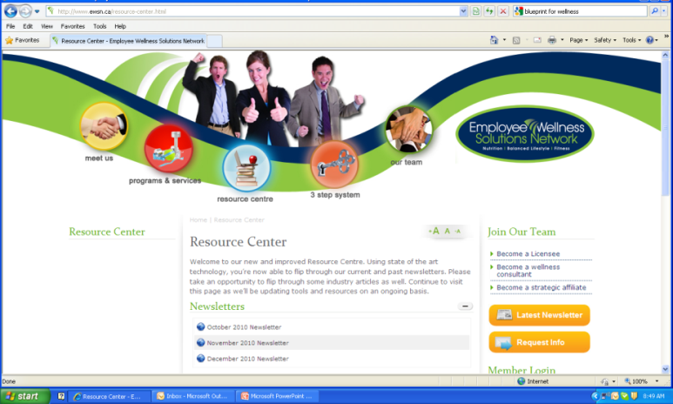
Awareness Component
Awareness Materials / Campaigns
Wellness Kiosks
Awareness Posters
Email Campaigns, BINGOs
Walkabouts
Health Fairs
Monthly Newsletters
Wellness Challenges
EWSNetwork.com
Wellness Resource Centre
News / Articles
  www.EWSNetwork.com
www.EWSNetwork.com

Slide 13
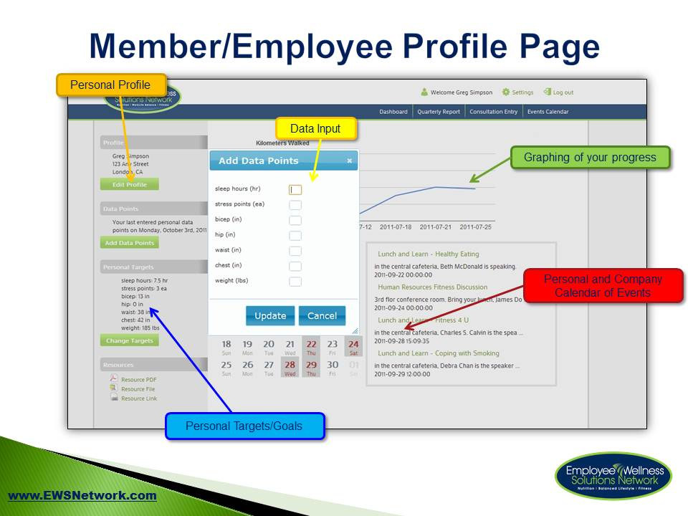
Virtual Component
Online Consultation Signup
Online Event Registration
Online Personal Data Tracking
Awareness Program Notification
Online Challenges
www.EWSNetwork.com

Slide 14
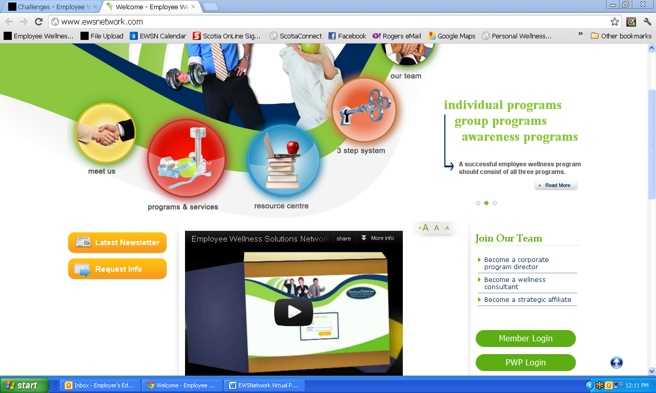
www.EWSNetwork.com
www.EWSNetwork.com

Slide 15
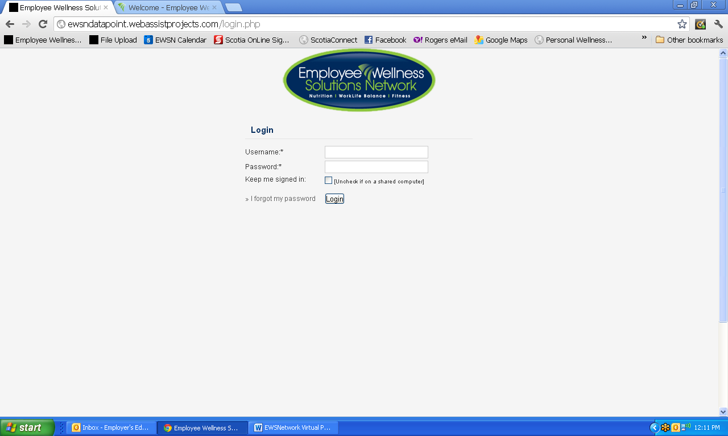
Log In Page
www.EWSNetwork.com

Slide 16
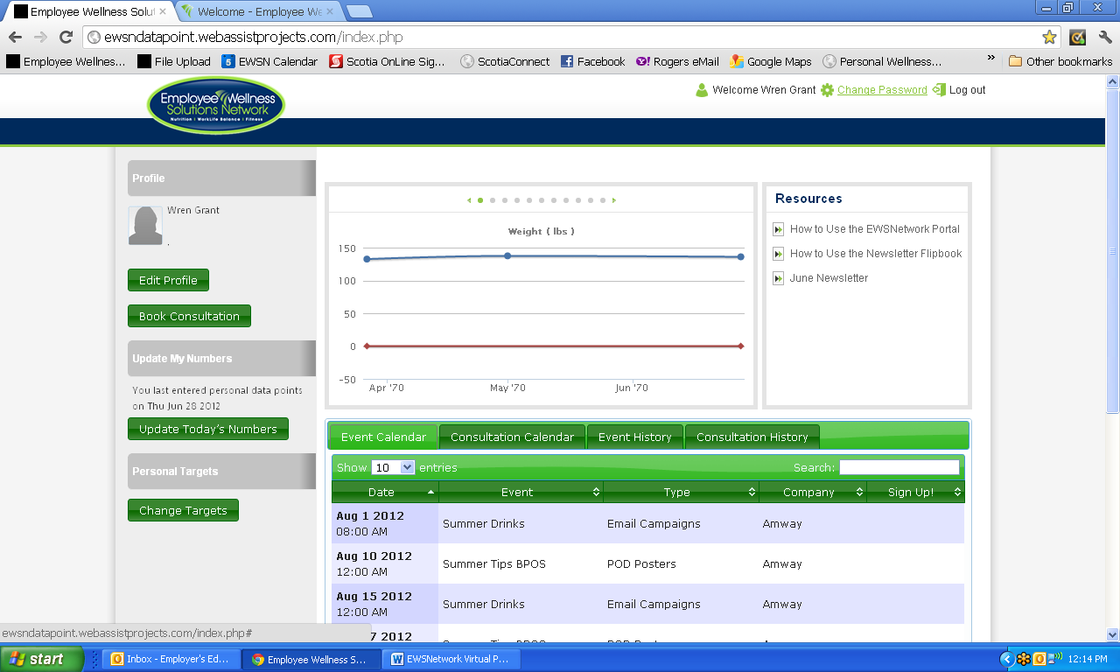
Change Password
www.EWSNetwork.com

Slide 17
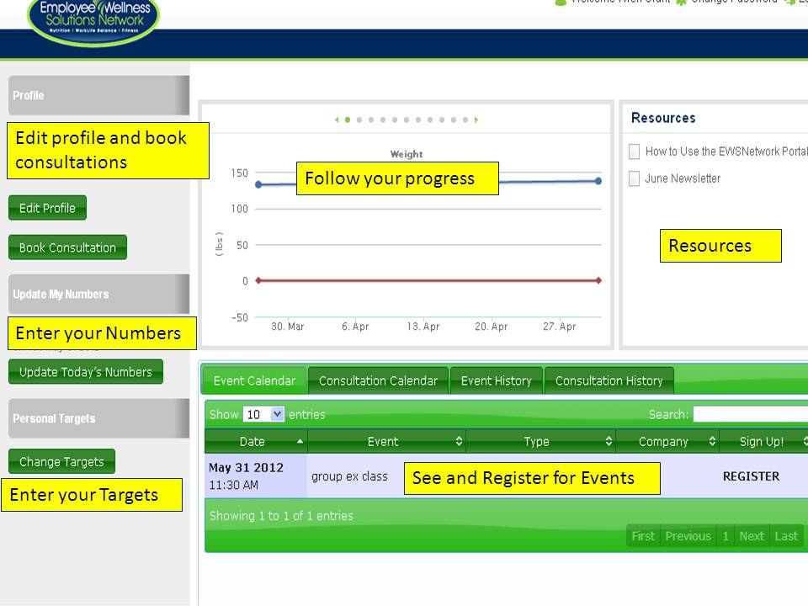
User Dashboard
www.EWSNetwork.com

Slide 18
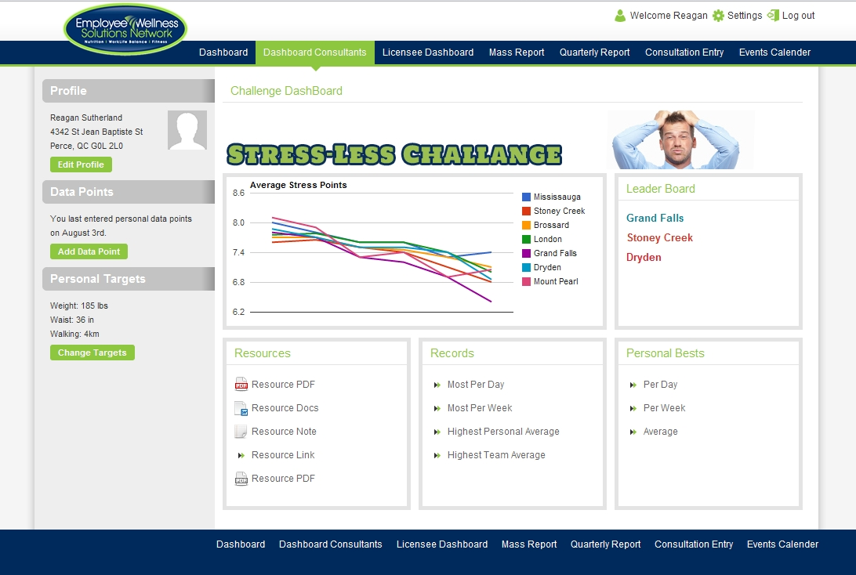
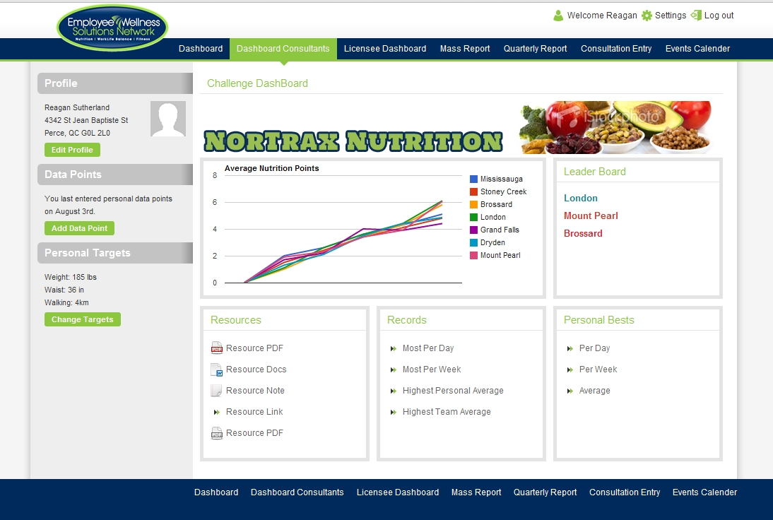
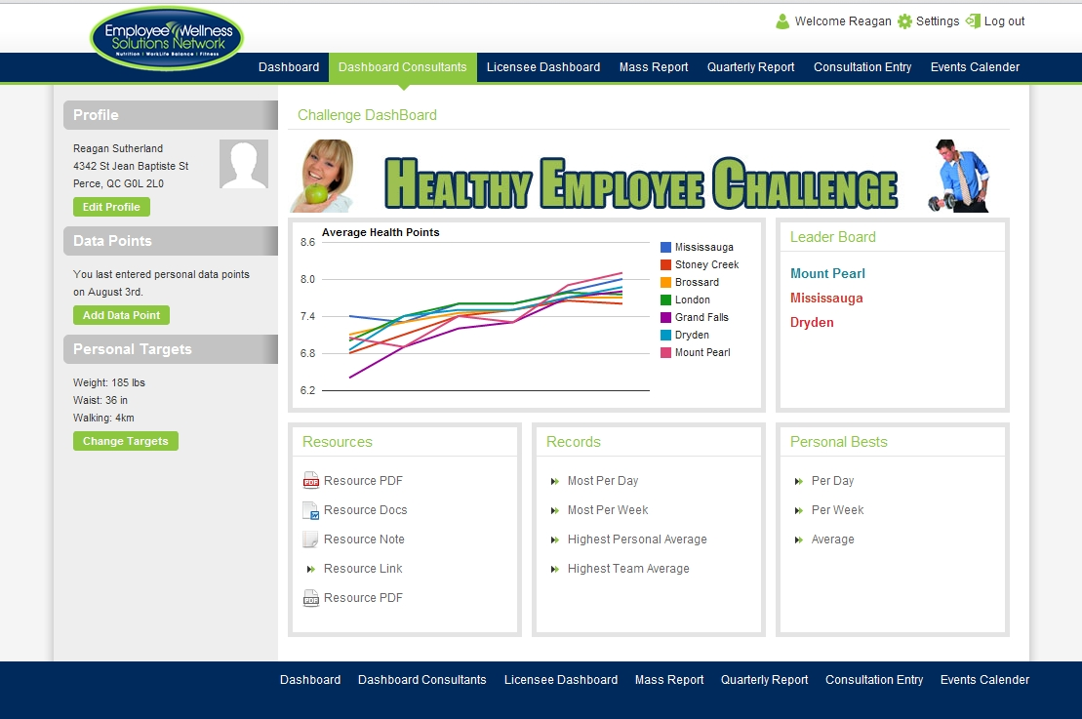
Other Challenges
www.EWSNetwork.com
Notes:
60% Obese or Overweight (36 out of 60ppl)
40% High Cholesterol
25% get 35% of calories from fat
23% BMI over 30
16.4% High BP

Slide 19

Personal Wellness Profile
On-line health risk assessment
    100% confidential
    Immediate reporting
    Wellness scores (coronary, cancer, nutrition, fitness, stress/emotional, substance use, safety)
    Health age
    Recommended health actions
    Interests from participants
Health risk report – individual, group trends
Annual campaign to assess organizational health risk profile, individual comparative report
Chance at winning $500 CASH [all eligible EWSNetwork Clients]
Chance at winning $100 Sport Chek Gift Card [for Libro participants only]
www.EWSNetwork.com

Slide 20
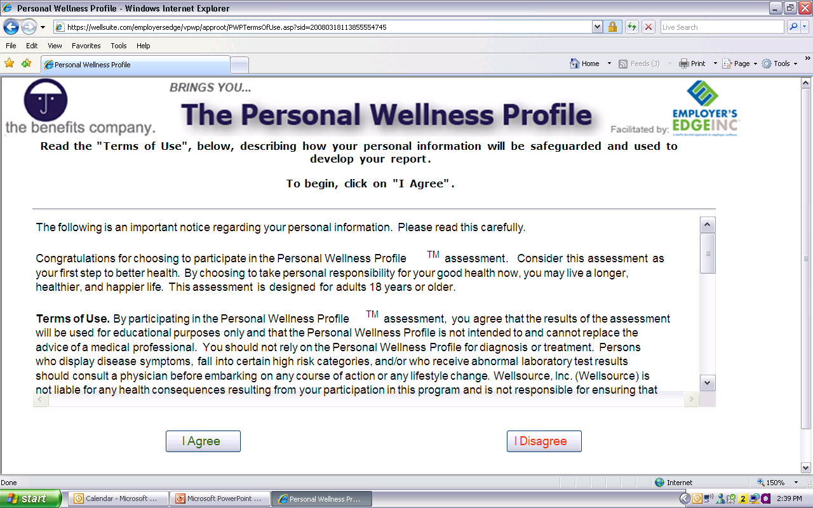
www.EWSNetwork.com/libro
www.EWSNetwork.com

Slide 21
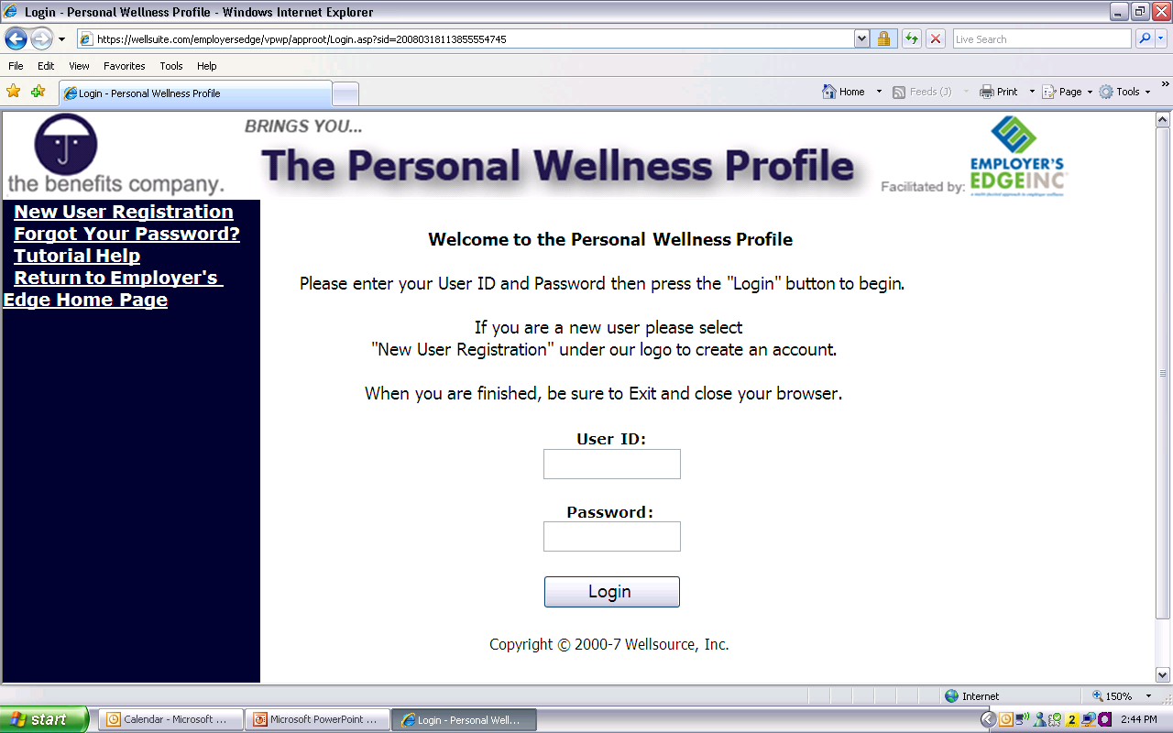
www.EWSNetwork.com/libro
Register yourself as a new user.
Create your own User ID and Password.
www.EWSNetwork.com

Slide 22
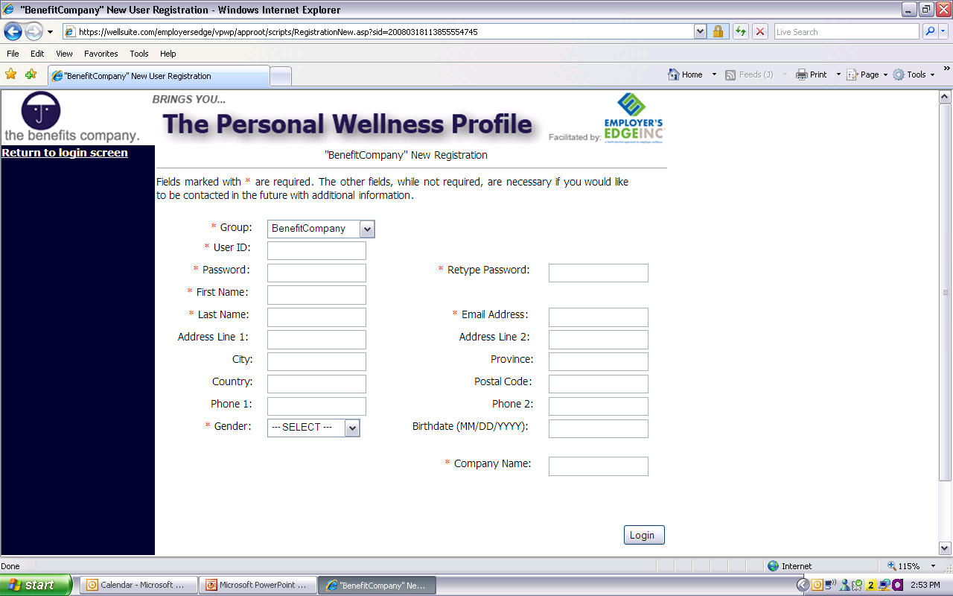
www.EWSNetwork.com/libro
Register your information.
Then Login…
www.EWSNetwork.com

Slide 23
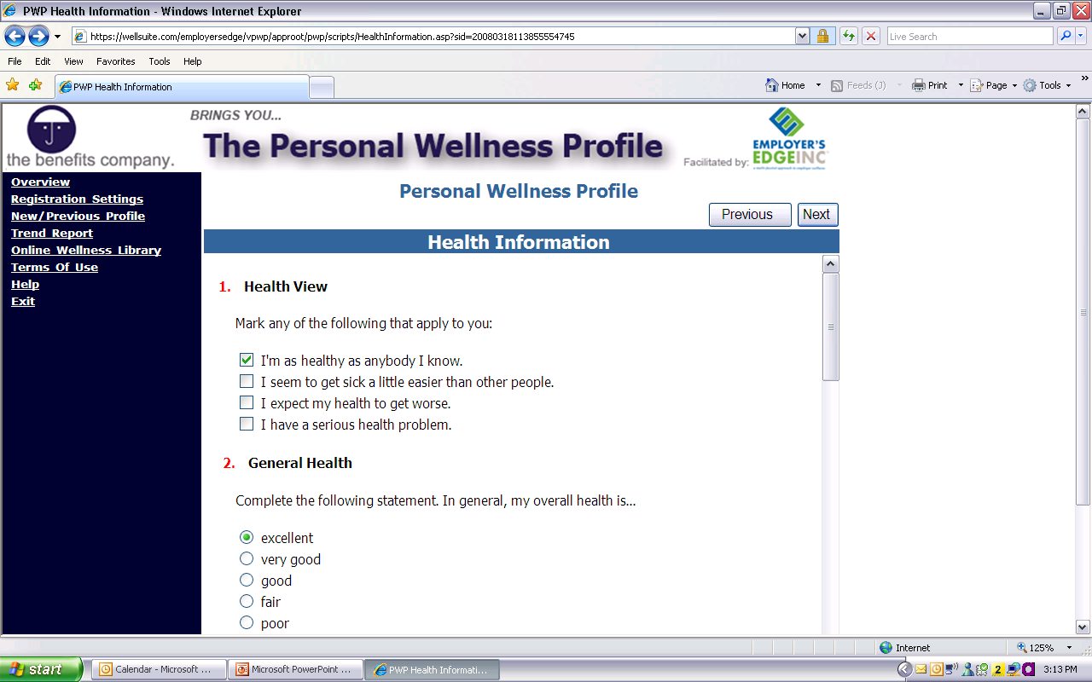
www.EWSNetwork.com/libro
Go through and answer all the questions.
Click on “Next” after completing each page.
(Make sure to answer all the questions)
www.EWSNetwork.com

Slide 24
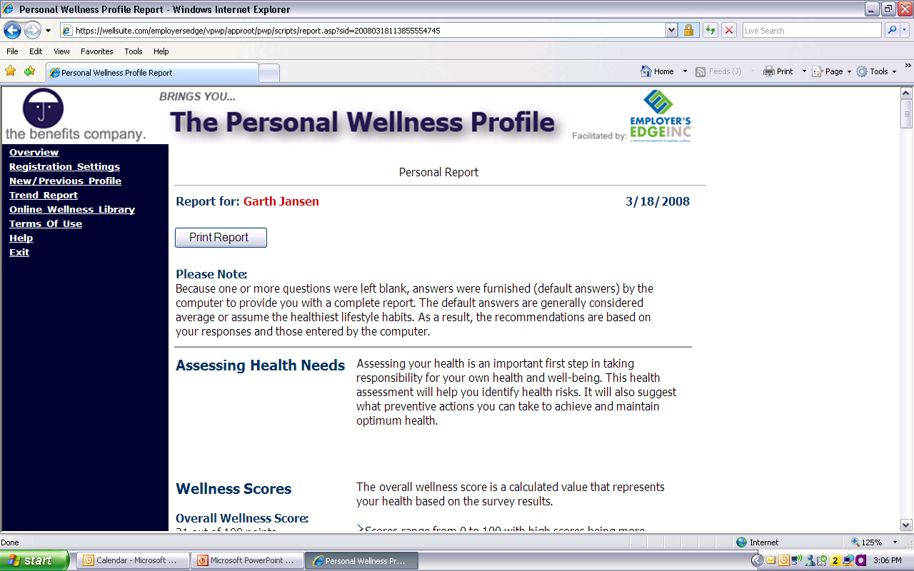
www.EWSNetwork.com/libro
Once complete, print your report for viewing.
You can also view it online and see articles relating to the various areas.
www.EWSNetwork.com

Slide 25


Personal Wellness Profile
www.EWSNetwork.com
www.EWSNetwork.com/libro
Campaign opens TODAY [January 22 – February 8]
Use any computer, anytime
Remember your user ID and password!!!!
100% confidential
Qualify for INCENTIVES….

Slide 26
Libro Wellness Program Design
Personal Wellness Profiles – top health risks
Objectives Surveys – wellness committee and management
First month of wellness consultations
Feedback from staff to wellness committee or to
libro@EWSNetwork.com
www.EWSNetwork.com

Slide 27
Wellness Committee
Committee made up of peers. Cross-section of your organization.
Meet every other month to go over past, present and future initiatives.
Very valuable source of feedback.
Ambassadors of the wellness program.
Assistance in wellness initiative promotions.
www.EWSNetwork.com

Slide 28
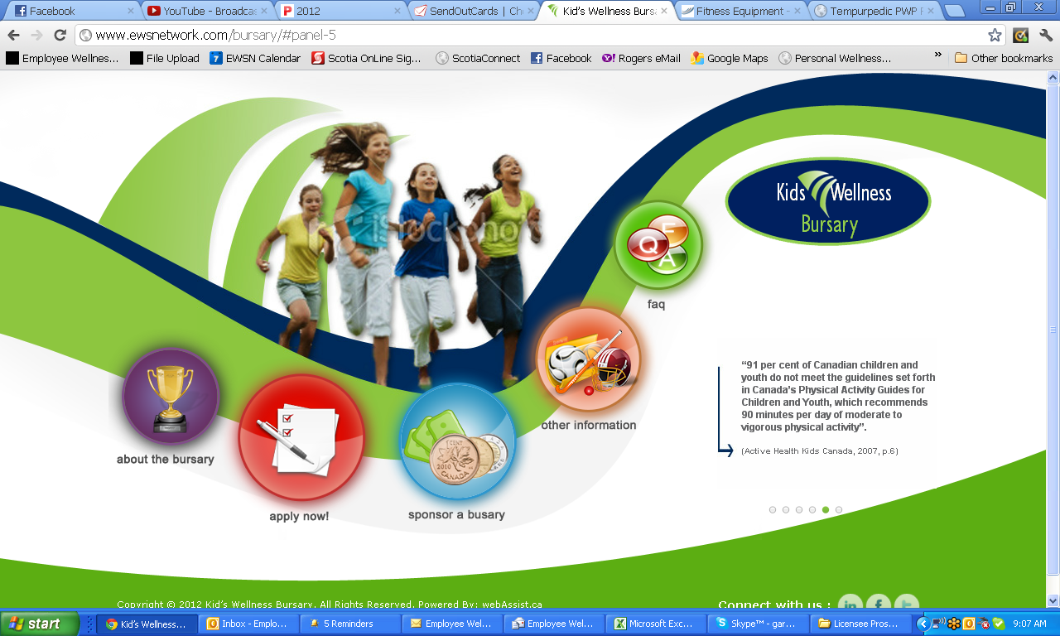

www.EWSNetwork.com/bursary

Slide 29
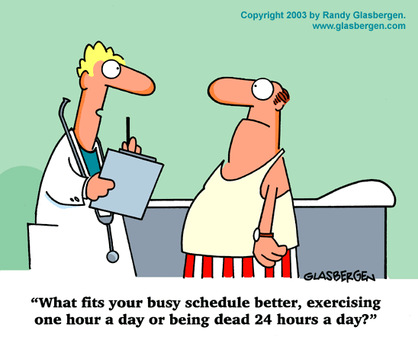
“Take every opportunity to enhance your wellness,
one step at a time.”
www.EWSNetwork.com

Slide 30
FOUR Action Steps
Get signed up for your initial Wellness Consultation to meet the consultants! SIGN UP TODAY…
Complete your Personal Wellness Profile. [www.EWSNetwork.com/libro].
Check LibroNet.
3. Activate your EWSNetwork Portal.
[user name: Libro email address; password: libro12345].
Check LibroNet.
Nominate someone for the Kids’ Wellness Bursary [www.EWSNetwork.com/bursary]
Thanks for your participation!
www.EWSNetwork.com

Slide 31
Questions now or later?
Meaghan Jansen, MSc.
Corporate Program Director
www.EWSNetwork.com I meaghan@EWSNetwork.com

