Slide 1
Fit & Lean in 2014
Week Eight: Preparing for Maintenance
www.EWSNetwork.com

Slide 2
It’s Our Final Session!
Let’s talk about what we’ve learned and how far we’ve come!
What was the most important lesson you learned?
What was the thing you were most proud of achieving as one of your goals?
What was the biggest challenge for you and how did you learn to manage or overcome it?
How do you feel about continuing to maintain these habits on your own now that the program is coming to an end?
Notes:
Consultant should facilitate an open discussion that should act as a way for the group to really reflect on what they’ve learned over the course of the program. It should also give them an opportunity to ask any final questions they may have – this is also a good opportunity to remind them that you are available for them as ongoing support even though the program is ending.
This discussion should make up the bulk of this session – maintenance tactics can be discussed following and final weigh-in & measurements can be done for those who would like your assistance – if they aren’t comfortable doing this as part of this session, encourage them to book a one-on-one session to have this done privately.

Slide 3
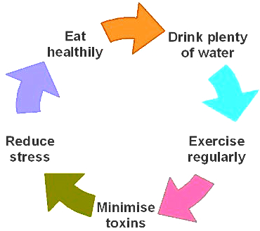
Preparing for Maintenance
Maybe you’ve reached your goal by the end of this program or maybe you still have more to accomplish.
Either way, it is important to realize that this road doesn’t end once you have achieved your goals.
Many people who have achieved weight loss struggle to keep it off as time goes on.
Let’s talk about the best ways to maintain what you have achieved so far…Follow along on handout 3.7.

Slide 4
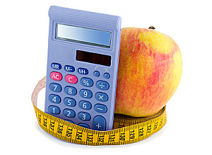
Maintenance Lessons
Know your caloric target for weight maintenance.
As discussed in week one, if you know your BMR (base metabolic rate), you can calculate how many calories your body needs in order to maintain its present weight. Once you are content with where you are, use the formula we provided (handout 1.4) to re-calculate your BMR and then try and stay within that target.
Keep in mind that you may need to work to that number gradually to figure out what your metabolism will tolerate. Try adding 150-200 calories at a time and see what effect that has on your weight.
Source: www.sparkpeople.com
Notes:
Have them re-visit handout 1.4. Perhaps they have lost some weight, so a new calculation may need to be done to ensure they are eating the right number of calories to maintain their new weight or new activity level ….!

Slide 5
Maintenance Lessons
Exercise, Exercise, Exercise!
By far the most important factor in maintaining a weight loss is a consistent level of regular activity and exercise.
Not only will you need to maintain the activity level you were at during the loss phase but you will actually need to work to increase it over time. This is because your caloric intake will be a little higher to maintain your weight than it was during the loss phase.
If you enjoy what you are doing, you won’t mind increasing the intensity or length of your workouts!
Source: www.sparkpeople.com

Slide 6
The Habits of the Fit & Healthy
They eat breakfast. This characteristic is almost universally common in those who successfully lost weight and kept it off for over a year. People who struggle with overeating tend to be those who undereat during the first part of the day, specifically those who skip breakfast!
They drink water. Not soda, iced tea or juice – just plain old water. Drinking enough water assists your body in almost every aspect of functioning. Aim to drink six to eight 8oz glasses of water daily – more if you are exercising.
They eat small and often. Eating small meals more often reduces cortisol levels. Cortisol is a stress hormone that signals the body to store fat in the abdominal region. Eating smaller meals more often also keeps your blood sugar levels steady and keeps you from getting too hungry (which can result in overeating or making poor nutritional choices).
Source: www.mayoclinic.com

Slide 7
The Habits of the Fit & Healthy
Embrace the outdoors. Exercising outdoors is beneficial, both psychologically and physiologically. Studies show that working out in nature boosts a person’s mood and lowers tension, anxiety and stress levels.
Increase your intensity slowly. Don’t expect to get 150 minutes of exercise a week right from the get-go. Slowly building up to more intense workouts gives your body the time it needs to adjust and can help reduce strain and injury. Your goals should be dynamic and include gradual increase of both the length and intensity of your workouts.
Track your workouts. The most consistent exercisers log their daily activity. This can be done with a plain pen and paper or by using online programs or smartphone apps. This helps track progress, which can be incredibly motivating and inspire you to beat your personal best!
Source: “Superbodies: Peak Performance Secrets from the World’s Best Athletes” by Greg Wells

Slide 8
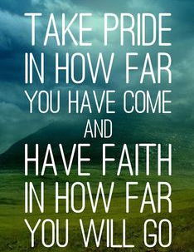
Remember….
This isn’t a diet. This is not a temporary thing you are doing for yourself – this is a lifestyle change and something you can keep up for the rest of your life.
Not only will you look and feel better but you are reducing the risk of serious health issues and diseases and giving yourself and your family the opportunity to live a longer, healthier and happier life!
It’s not always easy but it is so very, very worthwhile!
You are worth the effort!
We encourage all of you to make this past eight weeks just the beginning of a lifelong commitment to your health & wellness and we look forward to being able to continue to support and encourage you as you pursue your goals!
Before you go….
Let’s goal set – NOW!
*see handout 8.2

Slide 9
Next Week:
Bring in a healthy dish to share for our
celebration potluck!
Certificates of Completion will be handed out
Person with the most success stones will be
announced!
We sure hope you’ve enjoyed this program. We’d love to hear your feedback too. Stay tuned for the short questionnaire to follow this week.

Slide 10
Questions now or later?
<Consultant Name>
<consultant>@EWSNetwork.com P:123.456.7890
www.EWSNetwork.com

