Slide 1
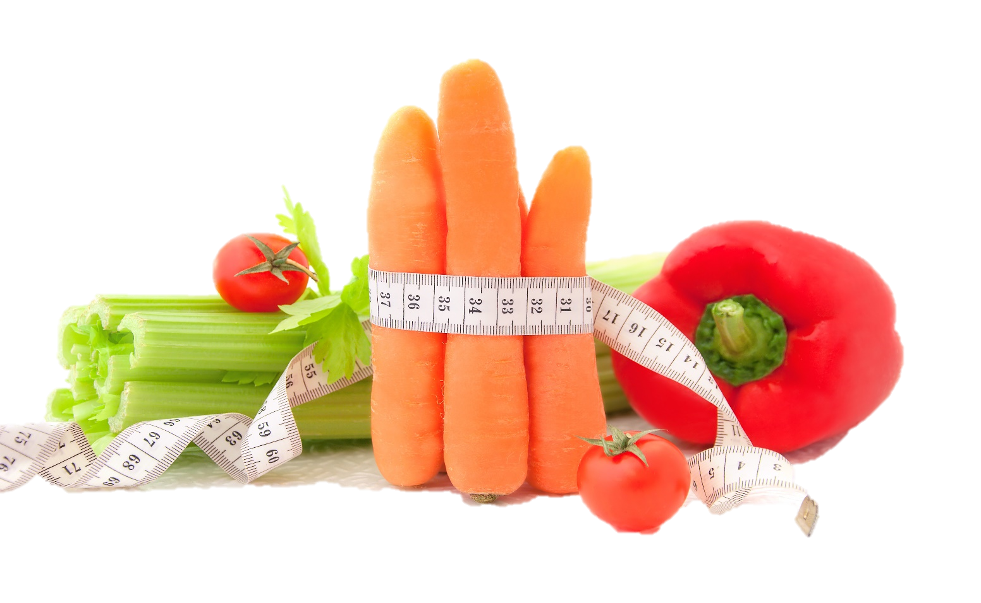

Fit & Lean in 2014
Week One: Getting Started
www.EWSNetwork.com

Slide 2
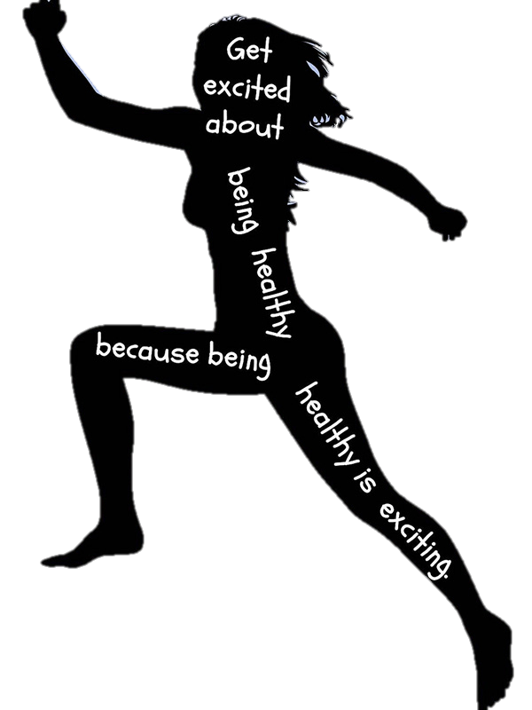
Welcome!
Congratulations on taking the first step to a fitter, healthier you!
Over the next 8 weeks, you are going to learn about & implement the fundamentals of weight loss.
Along with your fellow participants, your EWSNetwork Consultant is here to support & encourage you. Your consultant is here to provide one-on-one support and guidance throughout your journey and beyond the initial 8 week program.
Make sure you take advantage of this and book your one-on-one consultation to help you achieve your goals!

Slide 3
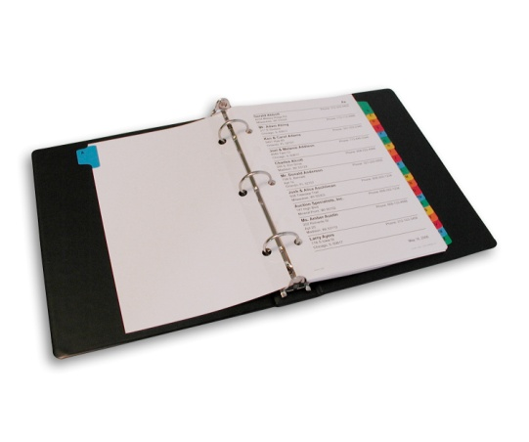
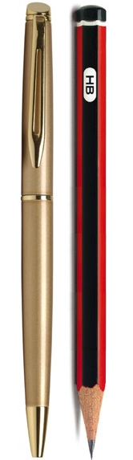

Fit & Lean in 2014
Things to bring to each session:
Your lunch
Three ring binder/duotang
Pen/pencil
Open mind & desire to learn!
Questions

Slide 4
The Starting Line…
Losing weight takes more than desire. It takes commitment and a well-thought out plan. Let’s look at the five steps to getting started:
Make a commitment.
Take stock of where you are.
Set realistic goals.
Identify resources for information and support.
Continually “check in” with yourself and monitor your progress.
Source: www.cdc.gov/healthyweight

Slide 5
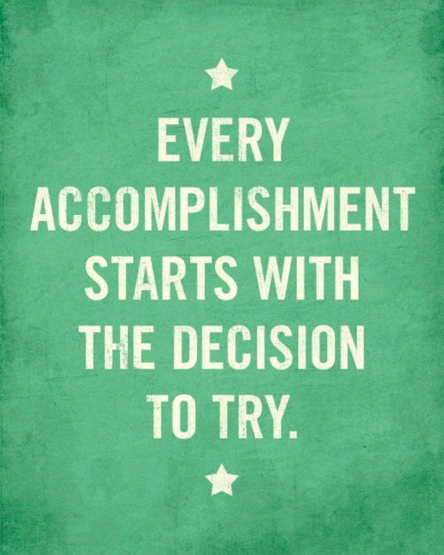
Make a commitment
Making the decision to lose weight, change your lifestyle and become healthier is a big step to take. Start simply by making a commitment to yourself!
Writing down the reasons why you want to lose weight can also help. Signing a contract with yourself can also be helpful and serve as a formal reminder of the promise you have made to yourself to improve your health.
We have provided a worksheet [see handout 1.2] which you can fill out with your reasons for starting this journey and a simple promise to yourself to commit to a healthier lifestyle.
Notes:
Have the group take out the sheet and fill it out & sign it before the next slide.

Slide 6
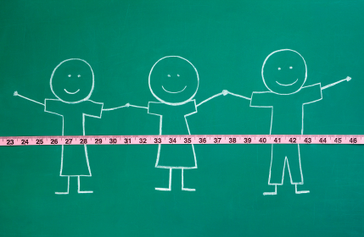
Identify resources for
information and support.
Find friends and family members that you can rely on for support. It is so important to have people that you can talk to and get advice and encouragement from during this process. Complete worksheet 1.3.
Look for a “buddy” that you can share healthy recipes and perhaps start a walking group with some co-workers on your lunch hour.
Being part of this program is also a great resource and source of support – know that if you have any questions, your EWSNetwork Consultant is also here to help you!

Slide 7
Building a Strong Support System
It can be very difficult when one person in a household is trying to change their eating habits when the rest of the family doesn’t feel they have to – difficult, but not impossible!
The first step is to be clear in knowing exactly what you want and need for continued success. A great way to figure this out is to write your “Perfect World” list. See Refer back to handout 1.3. Any alterations to be made?
Write down exactly what you would want “in a perfect world” in terms of support from the other members of your household. Be as specific as possible.
Instead of saying “Be nicer to me” or “Help me”, give specific ideas about what you would like them to do or not do. If you don’t want to have to watch other people eat ice cream in front of you – write that specifically. If you don’t want people to constantly ask you about what you ate today, write it down! Don’t worry about whether it’s reasonable or not, this is your “perfect world” list – just put it down for now, it can be modified to be “reasonable” afterwards.
Source: www.mayoclinic.com
Notes:
Have the group turn to 1.3 and write at least 3 ways that their family can support their healthy choices.

Slide 8
Take stock of where you are.
It is important to have a clear idea of where you are and any obstacles in your path before starting on any journey. Consider the following:
Keep a food diary for a few days and write down everything you eat. Eat as you normally would – don’t worry about restrictions for the first few days. By doing this, you become more aware of what and when you are eating which can help you avoid mindless eating. See handout 1.4.
Examine your current lifestyle. Identify things that may pose a challenge to your weight loss efforts. Do you have odd or long work hours? Do your co-workers frequently bring high-calorie items, like donuts, to the workplace to share? Think through things you can do to overcome these challenges.
Your EWSNetwork Consultant can help you evaluate your weight loss goals and help you to take your baseline weight & measurements to compare against as the weeks progress. See your handouts which include a log to record this information and track your future progress.

Slide 9
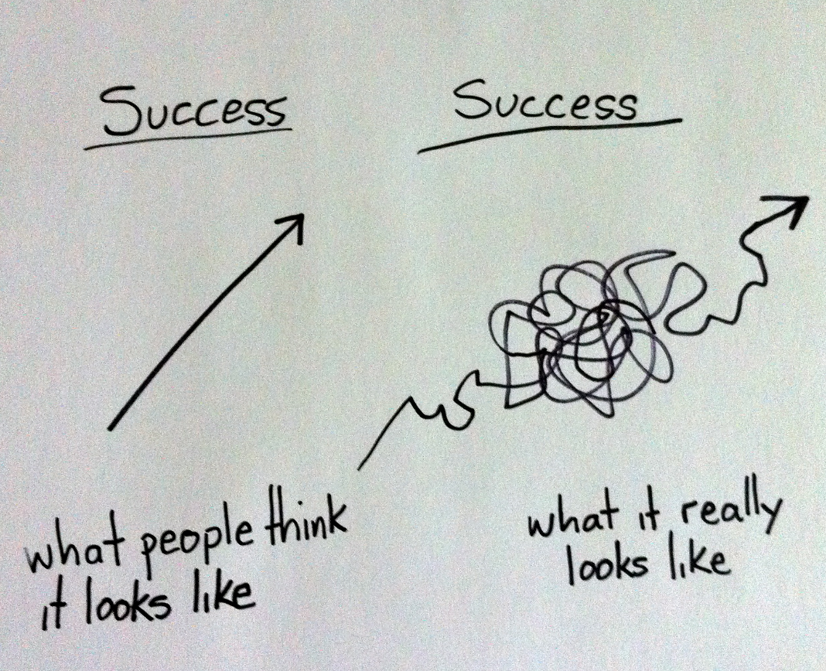
Continually “check in” with yourself
to monitor progress.
Success is more of a winding road than a straight line. You must be prepared to re-route when obstacles present themselves!
Revisit your goals frequently and tweak where necessary. Morning workouts not happening? What about lunch hour or just after dinner?
If you are consistently achieving goals, try adding newer, more challenging goals to keep things from getting stale.

Slide 10
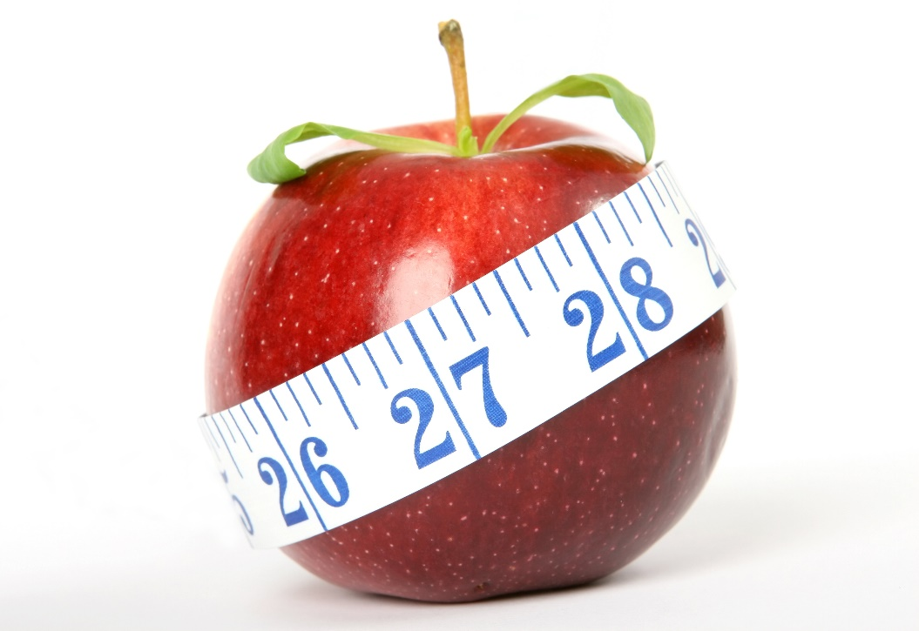
Remember, success takes commitment,
preparation & hard work.
Take the time to think about:
Why you want to lose weight
The steps it will take to lose weight
The challenges that may prevent you from reaching your goals
How you can get around those challenges
Who you can turn to for support and encouragement

Slide 11

Weight Loss is Science, not Magic!
To lose weight, you must burn more calories than you take in.
1 pound of fat = 3500 calories
To burn 3500 calories per week, you must either:
Cut out 500 calories from your diet OR
Burn an extra 500 calories per day OR
Cut out 250 calories AND burn an extra 250 calories per day.
“But how do I know how many calories I need?”

Slide 12
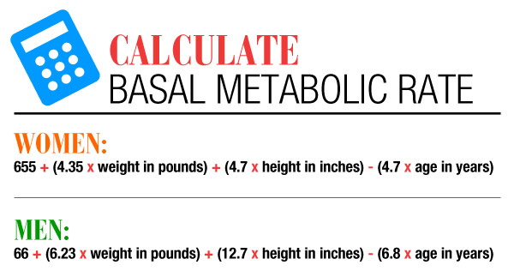

Calculating Your
Basal Metabolic Rate (BMR)
BMR = the amount of calories your body burns at rest for basic functioning
**Harris-Benedict BMR Formula

Slide 13
Calculating Your BMR:
An Example**see handout 1.5
Sally Jones
Age: 42 years old
Weight: 176lbs
Height: 5’4” (64 inches)
Sally Jones BMR Calculation:
655 + (4.35 X 176 = 765.6) + (4.7 X 64 = 300.8) – (4.7 X 42 = 197.4)
(655 + 765.7 + 300.8 – 197.4)
= BMR of 1524
**This means that Sally requires at least 1524 calories/day to have her body perform basic functions and maintain her current weight.
Notes:
Have group complete their own BMR, if they know their weight. BMR worksheets are included in handouts.

Slide 14
Calculating Your BMR:
Factoring in Activity Level
Amount of Exercise | Daily Calories Needed
Little to no exercise | BMR X 1.2
Light exercise (1-3 days/week) | BMR X 1.375
Moderate Exercise (3-5 days/week) | BMR X 1.55
Heavy Exercise (6-7 days/week) | BMR X 1.725
Very Heavy Exercise (intense workouts twice per day) | BMR X 1.9
Notes:
Have clients use BMR worksheets to factor in their activity level. Note that if they work a highly physical job, this will also factor in – ie: construction/heavy duty type work will need to be calculated as the equivalent of heavy exercise. This will help them to determine how many calories they can consume in order to achieve goal of cutting out 500 calories a day (or whichever method they choose to follow – ie: 250 cut from diet, 250 added to activity)

Slide 15
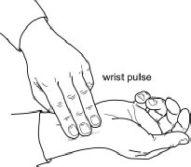
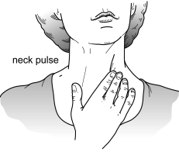
Your Pulse & Target Heart Rate
How to Take Your Pulse:
Place tips of your index, second and third fingers on the palm side of your other wrist, below the base of the thumb. Or, place the tips of your index and second fingers on your lower neck, on either side of your windpipe (see illustrations).
Press lightly with your fingers until you feel the blood pulsing beneath your fingers. You might need to move your fingers around slightly up or down until you feel the pulsing.
Use a watch or clock with a second hand function.
Count the beats you feel for 10 seconds. Multiply this number by six to get your heart rate per minute.
            **see handout 1.5

Slide 16
Your Pulse & Target Heart Rate
How to Calculate your Maximum Heart Rate:
220 – Your Age = Predicted Maximum Heart Rate
Target Heart Rate
You gain the most benefits and lessen the risks when you exercise in your target heart rate zone. Usually this is when your exercise heart rate is 60-80% of your maximum heart rate.
If you are a beginner, start at the lower end and if you are more physically fit, you can work towards the 75-80% range.
To find out if you are exercising in your target zone, stop exercising and check your 10-second pulse. If your pulse is below the target zone, increase the intensity, if it is above the target zone, decrease the intensity.
Notes:
Could mention heart rate monitors can be helpful in determining this as well and can be had for $60-200, depending on model. Good reward for reaching a big fitness goal!
Have them determine their maximum heart rate & target heart rate on the worksheet in the handouts, also discuss exertion assessment.

Slide 17

Set realistic goals.
Set both short & long term goals.
Goals should be SMART:
Specific
Manageable
Achievable
Realistic
Timely
Be realistic – you will encounter the occasional setback. When they happen, get back on track quickly and think about how to avoid that setback in the future.
When you reach a sub goal, even if it was a small one, REWARD yourself!
Goal Jar and Success Stones
Let’s goal set – NOW!
*see handout 1.6
Notes:
Note that people should avoid using food as a reward! Aim more for things like new workout gear, a massage or a new fitness DVD.
Goal worksheets are included in this week’s handout. Please have group refer to worksheet and work on defining at least one goal they want to achieve over the next 8 weeks.
Participants should be encouraged to set a minimum of three small, achievable goals for themselves each week (maximum 5 goals/week).
You can also introduce the “Success Stones” and jar at this slide – for each goal achieved, they will receive a success stone to add to their jar. “Success stones” can be found in floral décor/candle section of your local dollar store. If working with men, success stones could be swapped out for screws , nuts, bolts, etc. Good idea for manufacturing clients. The participant who completes the most goals during the program will receive a health/fitness related prize at the end of the program (pedometer, resistance bands, water bottle, etc)
**ensure you take some time and have them do this exercise for the next week….**

Slide 18
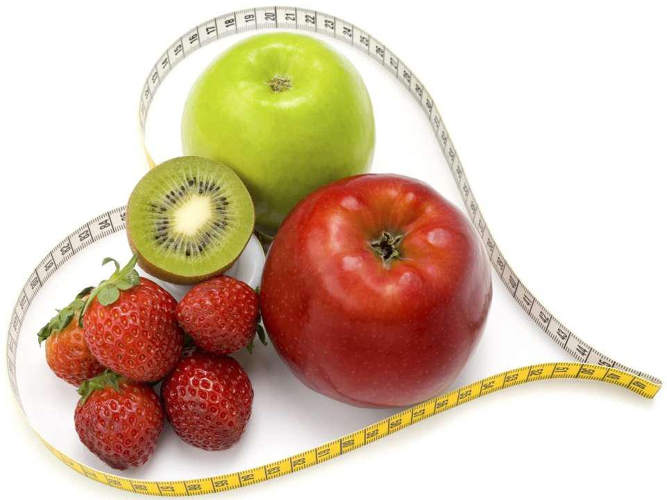
Next Week:
  Smart food choices
  Meal plan ideas
  Interactive group/pair work to come up with
  healthy meals & snacks
  Staying full, for longer!
  Great, healthy energy-boosting foods to get
  you through the work day
  Handouts will include some great, healthy & easy recipes!
  Re-visit of your weekly sub-goals…
Notes:
Doing weekly measurements is up to the CPD. People can be taught how to do their own measurements in order to save time

Slide 19
Questions now or later?
<Consultant Name>
<consultant>@EWSNetwork.com P:123.456.7890
www.EWSNetwork.com

