Slide 1
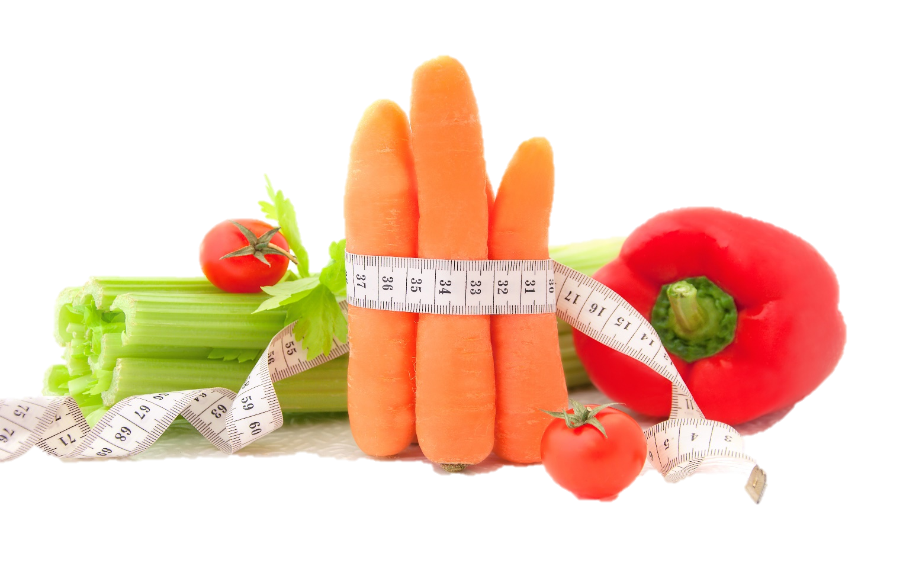
Fit & Lean in 2014
Staying Motivated, Support & Sustaining Success
www.EWSNetwork.com

Slide 2
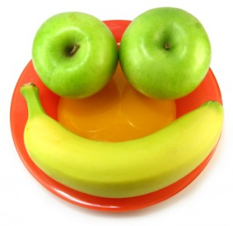
It’s Our Final Session!
Let’s talk about what we’ve learned and how far we’ve come!
What was the most important lesson you learned?
What was the thing you were most proud of achieving as one of your goals?
What was the biggest challenge for you and how did you learn to manage or overcome it?
How do you feel about continuing to maintain these habits on your own now that the program is coming to an end?
Notes:
Consultant should facilitate an open discussion that should act as a way for the group to really reflect on what they’ve learned over the course of the program. It should also give them an opportunity to ask any final questions they may have – this is also a good opportunity to remind them that you are available for them as ongoing support even though the program is ending.

Slide 3
Hitting the Wall
It happens to the best of us…in the beginning you’re excited and inspired to start out on this new road but after awhile, things start to get stale.
Maybe you had some initial losses but you’ve hit a plateau. Or maybe your menu plan is a bit repetitive and fast-food drive-thrus are starting to look better and better.
Let’s talk about how to push through these feelings and how to stay on track to reach your goals….See handout 3.1.

Slide 4
Great Tips for Staying Motivated
Quiz yourself! For an instant dose of inspiration, answer these questions:
a) If I stop, how will I look in six months to one year?
b) If I stop, how will I feel in six months to one year?
c) If I stop, what will my health be like?
d) If I stop, how will my family and friends be affected?
Answering these questions often helps boost motivation just enough to remind you of why you started in the first place.
Going back to your commitment sheet and reminding yourself of your original motivation for getting started can also be helpful. Perhaps you need to post this on your fridge or bathroom mirror so you can see it on a regular basis!
Source: www.shape.com

Slide 5
Great Tips for Staying Motivated
Work on keeping promises. Practice integrity in other areas of your life – clean out that closet you’ve been meaning to clean out for months, keep promises to family & friends, pay off a debt. Stick with commitments in other ways in order to strengthen your own subconscious belief that you are able to uphold the promise of getting fit & healthy that you made to yourself!
Focus on a feeling. Stop focusing on the scale or the measurement tape and concentrate on your mood after you’ve eaten a healthy meal or how you feel after a great workout. Motivation doesn’t always have to come before an activity!
Ensure you are rewarding yourself for achieving different milestones and not just for reaching the end goal. Reaching small goals is just as important – you must achieve the small goals before you can reach the big one. It’s easy to get discouraged when you are only worrying about the finish line and not enjoying the journey!
Source: www.shape.com

Slide 6
Great Tips for Staying Motivated
Act as if! Too often we put things off thinking that we will do them eventually. “When I lose this weight, I’m going to take a dance class.” “When I reach my goal, I’m going to be more social.” Why put it off? Your weight and health shouldn’t be keeping you from living your best life, they should be enhancing the enjoyment you already get out of your life! Live your life like you have already reached your health & fitness goals and move from punishment mode to empowerment mode!
Cultivate compassion. If you find yourself feeling really uninspired or particularly down on your body, try shifting your focus to self-appreciation. Instead of beating yourself up when your weekly weigh-in doesn’t go as you wanted, be grateful for how your body moves and all the things it does for you. Move your mindset from how you look to how you function. Being able to walk and bend and dance is a blessing that is too easily taken for granted!
Source: www.shape.com

Slide 7
Using Positive Affirmations
Positive affirmations are a technique used to program the subconscious mind to effect change by repeating (or meditating on) a key phrase (or series of key phrases) to bring about the desired outcome. Phrases should be in the present tense (“I am…” rather than “I will be…”) and are best when said consciously and aloud (though saying them internally or writing the repeatedly are other options).
**See handout 3.2.
Notes:
Refer to handout 3.2

Slide 8
Using Positive Affirmations
Great affirmations to get you started:
I follow my dreams, no matter what.
I have the skills and ability to get through this challenge.
I am happy in my own skin and in my own circumstances.
I adopt the mindset to praise myself.
I fully approve of who I am, even as I get better.
Giving up is easy and always an option so let us delay it for another day.
I accept my body shape and acknowledge the beauty and power it holds.
I am grateful for the body I have and all that it does for me.
I let go of unhelpful patterns around food.
I love being physically fit and am grateful for the ability to be active.
Let’s work on creating some personalized affirmations that work best for you…
Notes:
Consultant should encourage the group to come up with 2-3 affirmations that they find personally motivating and relevant. Refer to positive affirmations handout 3.2.

Slide 9
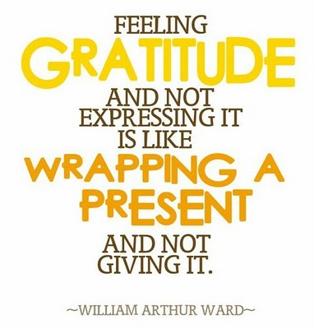
Practicing the Art of Gratitude
Gratitude can not only be deliberately cultivated but can increase levels of well-being and happiness among those who do cultivate it.
In addition, grateful thinking, and especially expression of it to others, is associated with increased levels of energy, optimism and empathy.
Let’s look at ways we can practice more gratitude in our daily lives… Check out handout 3.3.
Notes:
Refer to handout 3.3

Slide 10
Practicing the Art of Gratitude
Remember the bad. To be grateful in your current state, it is helpful to remember the hard times that you have overcome in your life. When you remember how difficult life used to be and how far you have come, you set up an explicit contrast in your mind, which creates a fertile ground for gratitude.
Take time to smell the roses! Use all of your senses to appreciate the beauty of being alive. Life is short and things can go from good to bad at a moment’s notice. Never miss an opportunity to mentally capture a beautiful moment – focus on the smiles of your children, the laughter of your friends and the aroma of a bouquet of flowers or a delicious, healthy meal.
Tell people how grateful you are for them. Become a thank you card writer – gratitude isn’t just about making yourself feel good but it’s about sharing that feeling with others. The simple act of saying “thank you” to people in your life who do good & kind things can create a chain reaction of positivity!

Slide 11
Practicing the Art of Gratitude
Keep a gratitude journal. Establish a daily practice of acknowledging all the good in your life. Focus more on people and situations than material objects. Start with a commitment to acknowledging five things each day that you are grateful for – on days where this is a challenge, focus on the basics: your family, your health, being employed when so many are not, a safe, warm place to sleep – the more you do this, the easier it will be to see all the wonderful things in your life. See handout 3.4.
Notes:
Gratitude Journal handout has been provided. Have the group refer to handout 3.4 and write down three things they are grateful for in this moment. Encourage them to set writing in gratitude journal as one of their weekly mini-goals this week. (Consultant should have extras on hand to provide for those who want to use our template as their gratitude journal.)

Slide 12
Building a Strong Support System
Some people do better in a team environment and some people do better working individually – but when it comes to adopting a healthy lifestyle and achieving weight loss goals, we ALL need support in one way or another.
A study done by the Western Psychiatric Institute and Clinic showed those participants who were recruited for a weight loss study with a friend experienced a higher success rate during the weight loss phase and beyond.
Source: http://www.ncbi.nlm.nih.gov/pubmed/10028217
Notes:
Refer to handout 3.5

Slide 13
Building a Strong Support System
Remember workout 1.2? Did you share it with your family? Any reactions? Remember, be prepared to compromise so that your family is willing to go /stay on board. If you go in prepared with negotiation points and things you can offer up in return for their cooperation, it may be easier to get it!
Come up with some healthy activities that you and the family can do together – the more you make this about doing what’s best for the entire family and encourage their participation, the better! Check out handout 3.5.
Source: www.mayoclinic.com
Notes:
Go over handout 3.5

Slide 14
Tips for Getting Your Family On Board
1. Ask each member of the family to make a list of his/her favourite treats. Then pick those that you like the least and allow those to be kept in the house. You won’t be tempted and they won’t feel deprived!
2. Be a little sneaky! Add shredded veggies to sauces, add cauliflower to mashed potatoes, water down the orange juice, use the recipe swaps we discussed last week to make recipes healthier. Go for gradual changes so as to not overwhelm them – and mum’s the word!
3. Try the 5-2 plan. Five days a week, you plan the meals and two days a week, the rest of the family can choose what and where to eat. You can make healthier choices while out with them (a salad with dressing on the side) or choose to limit your portions more carefully.
Source: www.webmd.com

Slide 15
Going it Alone…
What if you’re having trouble getting people on board? What if you live alone or your friends are too busy or live too far away? The good news is that you don’t need anyone but yourself to succeed! Sure, it’s great to have people supporting you and cheering you on but the real control is in your own hands. You have the power to do this on your own!
In other good news – it’s the age of the internet and support is only the click of a mouse away! There are plenty of great websites out there where you can interact with other people who are trying to live healthy and lose weight. Join an online support group, sign up to a message board, follow people on their own health journeys on YouTube or Twitter!
The options for support continue to grow – and don’t forget that your EWSNetwork consultant is also here to support & encourage you! We want you to succeed and are happy to help you with answers to your questions and personalized suggestions.
Notes:
Refer to handout 7.2 – will have lists of websites they can access for support.

Slide 16
Using Technology to Help You Succeed
Applications (apps) on smartphones are accessible, convenient and inexpensive. Most of us use some type of mobile electronic device these days and this makes them an obvious choice to promote healthy habits.
Consistently recording dietary intakes and health information can be a key component to successful weight loss and electronics makes this easier.
While an app certainly isn’t a magic pill, they can be an invaluable support tool to help keep you on track and help you to achieve your goals. See handout 3.6.
Notes:
Refer to handout 3.6 – will have lists of websites they can access for support.

Slide 17
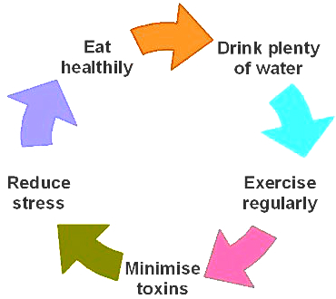
Preparing for Maintenance
Maybe you’ve reached your goal by the end of this program or maybe you still have more to accomplish.
Either way, it is important to realize that this road doesn’t end once you have achieved your goals.
Many people who have achieved weight loss struggle to keep it off as time goes on.
Let’s talk about the best ways to maintain what you have achieved so far…Check out handout 3.7.
Notes:
Refer to handout 3.7

Slide 18
The Habits of the Fit & Healthy
They eat breakfast. This characteristic is almost universally common in those who successfully lost weight and kept it off for over a year. People who struggle with overeating tend to be those who undereat during the first part of the day, specifically those who skip breakfast!
They drink water. Not soda, iced tea or juice – just plain old water. Drinking enough water assists your body in almost every aspect of functioning. Aim to drink six to eight 8oz glasses of water daily – more if you are exercising.
They eat small and often. Eating small meals more often reduces cortisol levels. Cortisol is a stress hormone that signals the body to store fat in the abdominal region. Eating smaller meals more often also keeps your blood sugar levels steady and keeps you from getting too hungry (which can result in overeating or making poor nutritional choices).
Source: www.mayoclinic.com

Slide 19
The Habits of the Fit & Healthy
Embrace the outdoors. Exercising outdoors is beneficial, both psychologically and physiologically. Studies show that working out in nature boosts a person’s mood and lowers tension, anxiety and stress levels.
Increase your intensity slowly. Don’t expect to get 150 minutes of exercise a week right from the get-go. Slowly building up to more intense workouts gives your body the time it needs to adjust and can help reduce strain and injury. Your goals should be dynamic and include gradual increase of both the length and intensity of your workouts.
Track your workouts. The most consistent exercisers log their daily activity. This can be done with a plain pen and paper or by using online programs or smartphone apps. This helps track progress, which can be incredibly motivating and inspire you to beat your personal best!
Source: “Superbodies: Peak Performance Secrets from the World’s Best Athletes” by Greg Wells

Slide 20
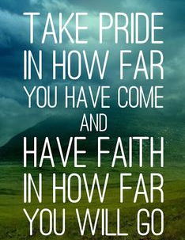
Remember….
This isn’t a diet. This is not a temporary thing you are doing for yourself – this is a lifestyle change and something you can keep up for the rest of your life.
Not only will you look and feel better but you are reducing the risk of serious health issues and diseases and giving yourself and your family the opportunity to live a longer, healthier and happier life!
It’s not always easy but it is so very, very worthwhile! You are worth the effort!
We encourage all of you to make this past three months just the beginning of a lifelong commitment to your health & wellness and we look forward to being able to continue to support and encourage you as you pursue your goals!

Slide 21
Questions now or later?
<Consultant Name>
<consultant>@EWSNetwork.com P:123.456.7890
www.EWSNetwork.com

