Slide 1
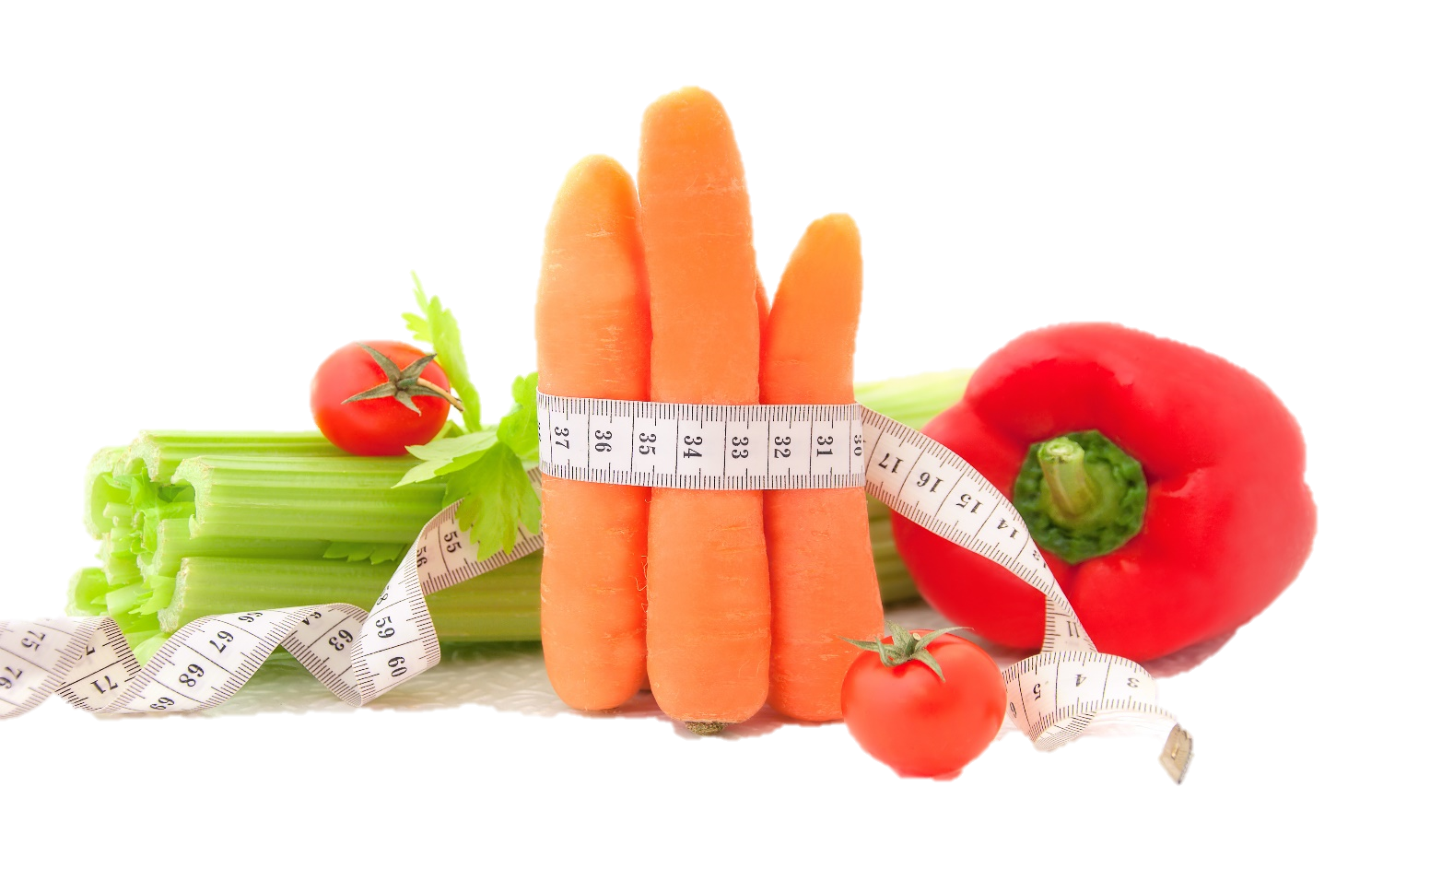
Fit & Lean in 2014
Getting Active & Becoming an Educated Eater
www.EWSNetwork.com

Slide 2
How Did Your Month Go?
How did your month go?
Did you achieve any of your goals?
Did you come up with any new goals?
What worked for you last month?
What didn’t work for you last month?
Anything to share with the group that might be helpful to others?

Slide 3
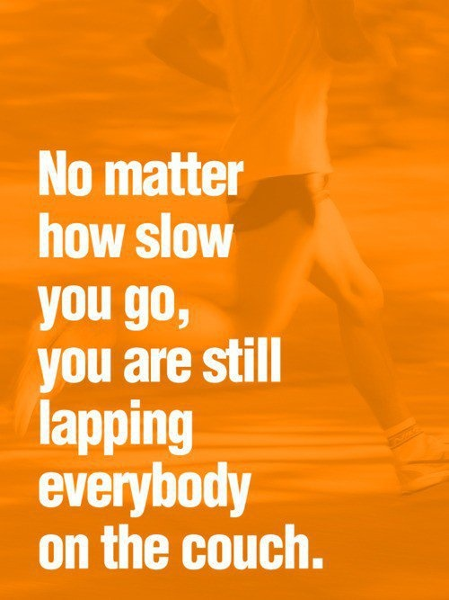
Time to Get Moving!
They say that losing weight is 80% what you eat and 20% what you do. Over the past month, we have focused on the nutrition aspect of your new fit & lean lifestyle.
Now that you are well-stocked with the fundamentals of nutrition and have had time to implement those changes in your life, it’s time to fill in the final piece of the puzzle – physical activity!

Slide 4
Determining Your Current Fitness Level
First off – let’s refer to handout 2.1 and complete a basic fitness self-assessment to get an idea of whether you are a novice, beginner, intermediate or advanced exerciser. Be honest – there’s no shame in being a novice. Remember, we all start somewhere!
Your EWSNetwork Consultant is here to help you determine your resistance training guidelines so take advantage of this and book your one-on-one session to get personalized guidelines and recommendations.
Notes:
Refer to handout 2.1 and have them complete during workshop.

Slide 5
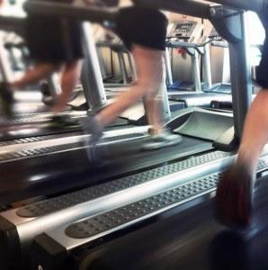
Basic Cardio Guidelines
Cardiovascular exercise is the main component in any comprehensive exercise program.
For important health benefits, adults need at least:
2 hours and 30 minutes (150 minutes) of moderate-intensity aerobic activity every week
OR
1 hour and 15 minutes (75 minutes) of vigorous-intensity aerobic activity every week
*see handout 2.2
Source: www.cdc.gov
Notes:
Refer them to handout 2.2

Slide 6
Basic Strength Training Guidelines
The second essential part to any comprehensive exercise program is strength (or resistance) training.
You should be performing muscle strengthening activities on 2 or more days a week that work all major muscle groups. These groups consist of:
Legs
Hips
Back
Abdomen
Chest
Shoulders
Arms
Source: www.cdc.gov
Notes:
Refer to handout 2.3. Encourage group again that you are available to provide personalized guidelines for resistance training through a one-on-one consultation.

Slide 7
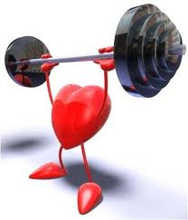
Strength Training: What Counts?
To gain health benefits, these activities need to be done to the point where it’s hard for you to do another repetition without help.
A repetition is one complete movement of an activity, like lifting a weight or doing a sit-up. Try to do 8-12 reps per activity. This would be considered a set.
Try to do at least 1 set of muscle-strengthening activities but for more health benefits, aim to do 2-3 sets.
You can do muscle-strengthening activities on the same day as aerobic activity but keep in mind they do not count towards your aerobic minutes. See handout 2.3.
Source: www.cdc.gov

Slide 8
Don’t Overlook Flexibility!
When we talk about the importance of flexibility, we are referring to the range of motion for a given joint. The degree of flexibility you have is influenced by muscles and connective tissues, like ligaments and tendons. A good stretching program can lead to an increase in flexibility. Things to keep in mind:
Use dynamic movement as a warm-up for exercise. (e.g.: if you are going to jog three miles, the best way to warm up is to start walking and increase your speed over a period of five minutes.) The best time to use static stretching (slowly stretching a muscle to its end position and holding it for a short period of time) is during a post-workout cool-down when your muscles are already warm.
Don’t overstretch – you must stretch and hold a muscle beyond its normal length to improve flexibility, however, you should not stretch to the point of pain as it could do serious damage.
Don’t bounce! This can make it harder to control the force and range of motion which could lead to injury.
Source: www.webmd.com

Slide 9
Rated Perceived Exertion (RPE) Scale
The RPE scale is used to measure the intensity of your exercise. The scale runs from 0-10. The numbers relate to phrases used to rate how easy or difficult you find an activity. See handout 2.4.
For example, 0 (nothing at all) would be how you feel when sitting in a chair; 10 (very, very heavy) is how you feel at the end of an exercise stress test or after a very difficult activity.
In most cases, you should exercise at a level that feels 3 (moderate) to 4 (somewhat heavy).
When using this scale, remember to include feelings of shortness of breath as well as how tired you feel in your legs and overall.
Source: my.clevelandclinic.org
Notes:
Have group refer to handout 4.4

Slide 10
The Importance of Staying Hydrated
You’ve heard it before – it is important to ensure you are drinking at least 8 glasses of water a day for good health. If you are physically active, you will need to consume even more water than this. Why?
Lean muscle in the human body is made up of around 80% water and it needs that water to function properly. When you start to become dehydrated, your muscle tissue starts to lose water and it makes it harder for that muscle to contract effectively, reducing your strength and endurance.
Always have a water bottle with you when exercising and make sure to drink throughout your workout.
*see handout 2.5
Source: www.webmd.com
Notes:
Refer to handout 2.5

Slide 11
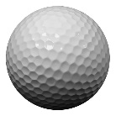
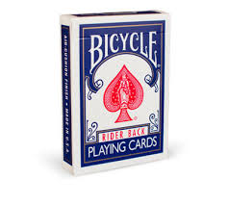
Portion Control
Basic Guidelines – handout 2.6
= 1 cup
= ½ cup
= 1 oz. or 2 tbsp.
= 1 tbsp.
= 1 slice of bread
= 3 oz. meat
= 3 oz. fish
= 1 oz. deli meat
= 3 oz. muffin
= 1.5oz. cheese
Source: www.webmd.com
Notes:
Refer to handout 2.6

Slide 12
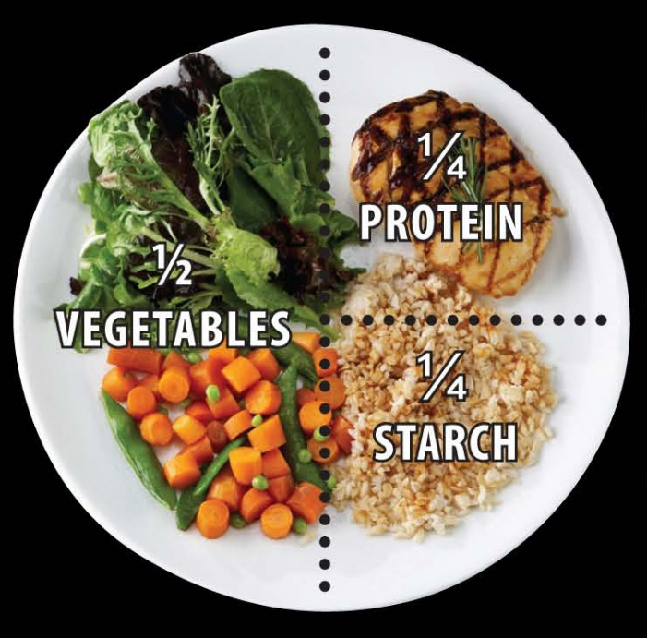
Portion Control
One of the easiest ways to know how much to put on your plate without a measuring cup or food scale is to divide your plate into four sections.
Devote ¼ of your plate to lean protein.
Devote ¼ of your plate to starch, such as rice, potatoes or pasta.
Finally, use the remaining ½ of the plate for vegetables.

Slide 13
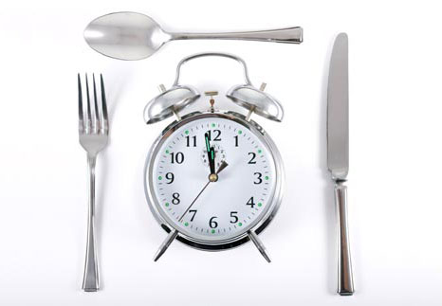
Timing Your Meals
Simply learning how to time your eating can be helpful in controlling cravings and helping you to avoid overeating.
Eating at the right times of day can also help improve your fat loss by preventing excess insulin, allowing leptin (a protein hormone produced by fatty tissue which is believed to regulate fat storage in the body) to work its magic on appetite control and metabolism and by balancing the stress hormone, cortisol.

Slide 14
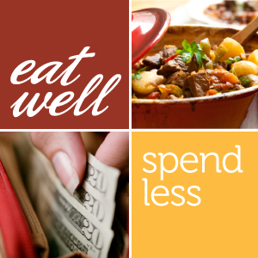
Eating Healthy on a Budget
Let’s be honest, most people would like to eat healthy but it isn’t uncommon for people to feel that eating healthy is more cost-prohibitive than eating prepared & processed foods full of fat, sodium & empty calories.
While it can seem this way, we are here to show you that it IS possible to feed your family wholesome, healthy food without going to the poorhouse!
Yes, some foods are going to cost you a bit more, but you might be surprised to see how much you can save by following our tips and by keeping portion control in mind! See handout 2.7.
Notes:
Refer to handout 2.7

Slide 15
Eating Healthy on a Budget
Plan ahead. Using the tips we’ve shared with you about meal planning, you should be able to build a specific list of food items you need for the week. Never shop without the list and buy only what is on your list!
Consider no-name brands. These are often the exact same product as the brand name but for less money. Compare the nutrition facts and don’t pay more for the same item just for the branding.
Buy in bulk. A great place to save money is to purchase items like grains in bulk. You not only save money by getting the item without the packaging but you are also helping the environment at the same time!
Source: www.eatrightontario.ca

Slide 16
Eating Healthy on a Budget
Start a Meatless Monday in your house! Meat tends to be a big budget item on most grocery lists and simply cutting it out one day per week can have big impacts on your health, your budget & the environment.
Avoid convenience foods and make your own! Pre-packaged foods are priced higher due to their convenience factor. Making your own is almost always less expensive plus you have the benefit of knowing exactly what you are feeding yourself & your family.
Shop the perimeter of the grocery store first. The healthiest foods are placed on the outside of the grocery store while the middle aisles tend to be full of pre-packaged, convenience foods. Avoid the middle aisles and you won’t be as tempted to buy things that aren’t on your list.
Source: www.eatrightontario.ca

Slide 17
Reading Food Labels
Making healthy food choices is made much easier once you learn how to read & understand food labels. See handout 2.8.
Food labels are found on packaged foods and provide information on nutritional value, ingredients, recommended serving size and nutrition claims.
Nutrition claims must follow certain rules to make sure they are consistent and not misleading.
Notes:
Refer to handout 3.3

Slide 18
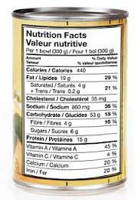
Reading Food Labels
5 Easy Steps to Help You:
Look at the serving size. Compare the serving size to the amount you eat in order to get the amount of calories and nutrients described on the label.
Look at the calories. Calories tell you how much energy you get from one serving.
Look at the % daily value (DV). This scale tells you if there is a little or a lot of a nutrient in one serving of a packaged food. 5% or less is a little. 15% or more is a lot.

Slide 19
Reading Food Labels
5 Easy Steps to Help You:
4. Try to get more of these nutrients: fiber, vitamin A, vitamin C, iron, calcium.
5. Try to eat less of these nutrients: fat, saturated fat, trans fat, sodium, cholesterol.
Let’s take a look at the food labels you have brought with you and we can analyze them together . Handout 2.9!!
Notes:
Refer to handout 2.9. Consultant should lead a group discussion while analyzing food labels and guiding them to better understanding of how to determine the nutritional value of packaged foods.

Slide 20
The Importance of Sleep
Just as exercise & nutrition are essential for good health, so is sleep! The quality of your sleep directly affects the quality of your waking life, including your mental sharpness, productivity, emotional balance, creativity and even your weight! No other activity delivers so many benefits with so little effort!
Check out handout 3.0
Notes:
Refer to handout 3.0

Slide 21
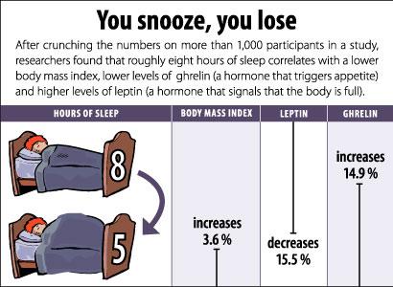
The Importance of Sleep
Exactly how sleep affects our ability to lose weight has a lot to do with two specific hormones: ghrelin and leptin.
Ghrelin is the ‘go’ hormone that tells you when to eat and when you are sleep deprived, you have increased levels of ghrelin in your system.
Leptin is the hormone that tells you when to stop eating and these hormone levels drop when sleep deprived.
More ghrelin and less leptin = weight gain!
Source: www.webmd.com

Slide 22
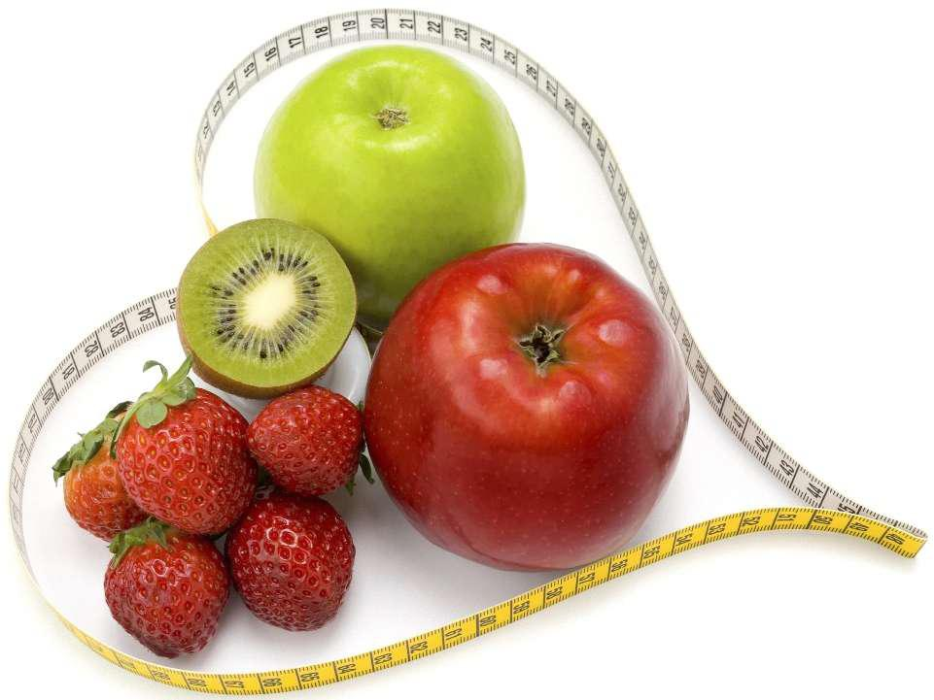
Next Month:
Monthly check-in and group discussion
Staying motivated
Using positive affirmations to reprogram
self-defeating inner monologues
Creating a supportive environment
Preparing for Maintenance
Re-visit sub-goals…
Completion Certificates

Slide 23
Questions now or later?
<Consultant Name>
<consultant>@EWSNetwork.com P:123.456.7890
www.EWSNetwork.com

