Slide 1
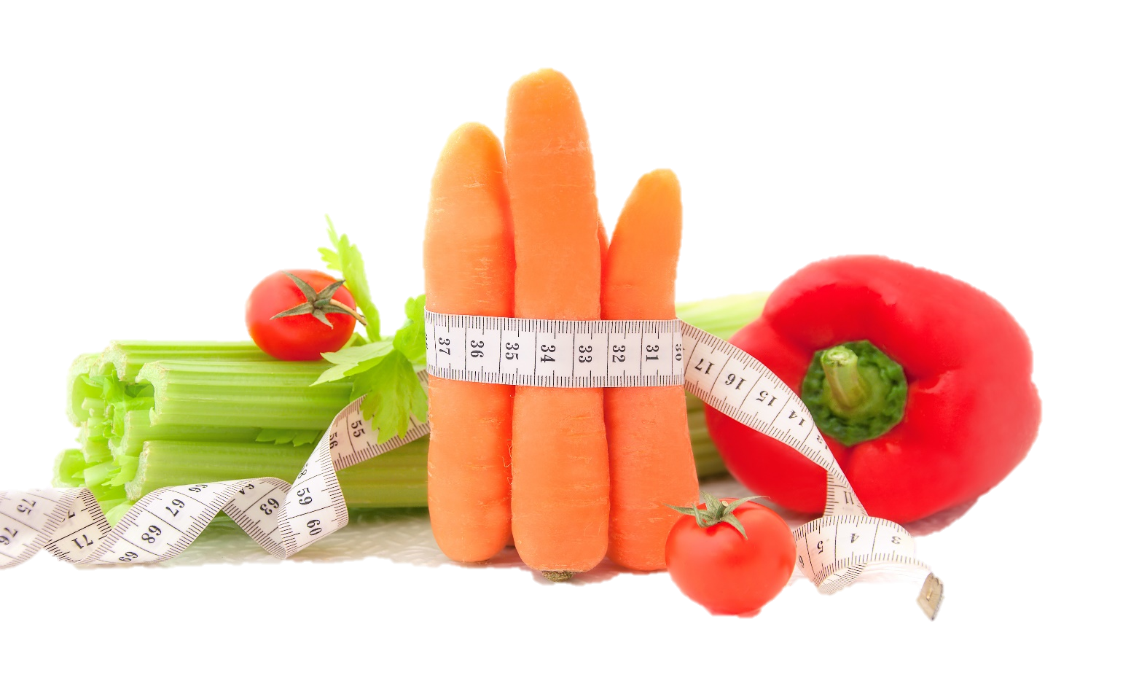
Fit & Lean in 2014
Getting Started &
Making Smart Food Choices
www.EWSNetwork.com

Slide 2
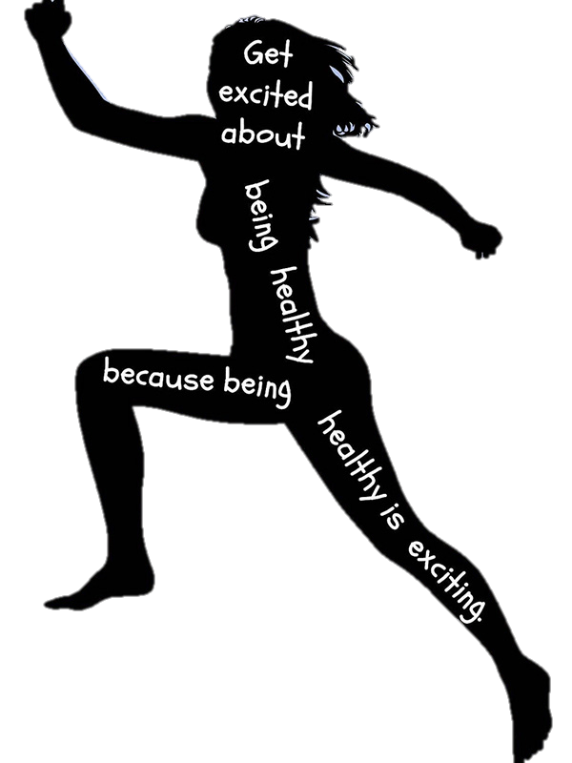
Welcome!
Congratulations on taking the first step to a fitter, healthier you!
Over the next 3 months, you are going to learn about & implement the fundamentals of weight loss.
Along with your fellow participants, your EWSNetwork Consultant is here to support & encourage you. Your consultant is here to provide one-on-one support and guidance throughout your journey and beyond the initial 3 month program.
Make sure you take advantage of this and book your one-on-one consultation to help you achieve your goals!
Notes:
Measurement log – take them through how to do it. give them their measuring tape and walk them through how to do it. You can also do their measurements during their one-on-ones too.

Slide 3
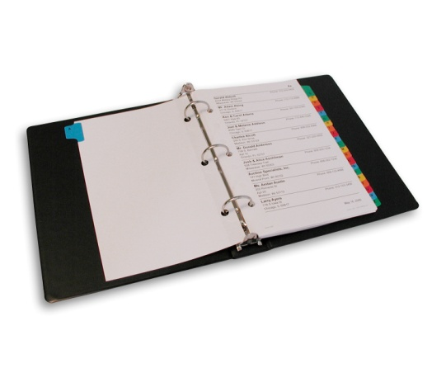
Fit & Lean in 2014
Things to bring to each session:
Your lunch or a snack
Three ring binder/duotang
Pen/pencil
Open mind & desire to learn!
Questions

Slide 4
The Starting Line…
Losing weight takes more than desire. It takes commitment and a well-thought out plan. Let’s look at the five steps to getting started:
Make a commitment.
Take stock of where you are.
Set realistic goals.
Identify resources for information and support.
Continually “check in” with yourself and monitor your progress.
Source: www.cdc.gov/healthyweight

Slide 5
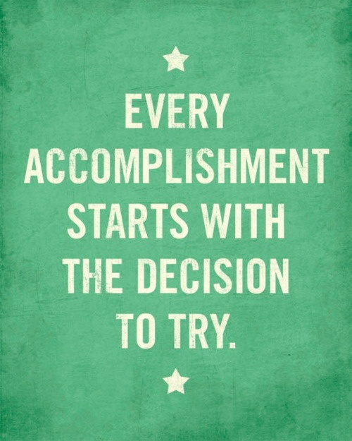
Make a commitment
Making the decision to lose weight, change your lifestyle and become healthier is a big step to take. Start simply by making a commitment to yourself! See handout 1.1.
Writing down the reasons why you want to lose weight can also help. Signing a contract with yourself can also be helpful and serve as a formal reminder of the promise you have made to yourself to improve your health.
We have provided a worksheet which you can fill out with your reasons for starting this journey and a simple promise to yourself to commit to a healthier lifestyle.
Notes:
Have the group take out the sheet (handout 1.1) and fill it out & sign it before the next slide.

Slide 6
Building a Strong Support System
It can be very difficult when one person in a household is trying to change their eating habits when the rest of the family doesn’t feel they have to – difficult, but not impossible!
The first step is to be clear in knowing exactly what you want and need for continued success. A great way to figure this out is to write your “Perfect World” list. See Refer back to handout 1.2. Any alterations to be made?
Write down exactly what you would want “in a perfect world” in terms of support from the other members of your household. Be as specific as possible.
Instead of saying “Be nicer to me” or “Help me”, give specific ideas about what you would like them to do or not do. If you don’t want to have to watch other people eat ice cream in front of you – write that specifically. If you don’t want people to constantly ask you about what you ate today, write it down! Don’t worry about whether it’s reasonable or not, this is your “perfect world” list – just put it down for now, it can be modified to be “reasonable” afterwards.
Source: www.mayoclinic.com
Notes:
Have the group turn to 1.2 and write at least 3 ways that their family can support their healthy choices.

Slide 7
Set realistic goals.
Set both short & long term goals.
Goals should be SMART:
Specific
Manageable
Achievable
Realistic
Timely
Be realistic – you will encounter the occasional setback. When they happen, get back on track quickly and think about how to avoid that setback in the future.
When you reach a goal, even if it was a small one, REWARD yourself! See handout 1.3.
Notes:
Note that people should avoid using food as a reward! Aim more for things like new workout gear, a massage or a new fitness DVD.
Goal worksheets are included as handout 1.3. Please have group refer to worksheet and work on defining at least one goal they want to achieve over the next 3 months. PARTICIPANTS WILL BE GIVEN ONE GOAL SHEET FOR EACH WEEK IN BETWEEN SESSIONS….ASK THEM TO KEEP UP A GOAL SHEET PER WEEK…WORK IN BITE-SIZE!
Participants should be encouraged to set a minimum of three small, achievable goals for themselves each week (maximum 5 goals/week).
You can also introduce the “Success Stones” and jar at this slide – for each goal achieved, they will receive a success stone to add to their jar. “Success stones” can be found in floral décor/candle section of your local dollar store. If working with men, success stones could be swapped out for screws , nuts, bolts, etc. Good idea for manufacturing clients. The participant who completes the most goals during the program will receive a health/fitness related prize at the end of the program (pedometer, resistance bands, water bottle, etc)

Slide 8
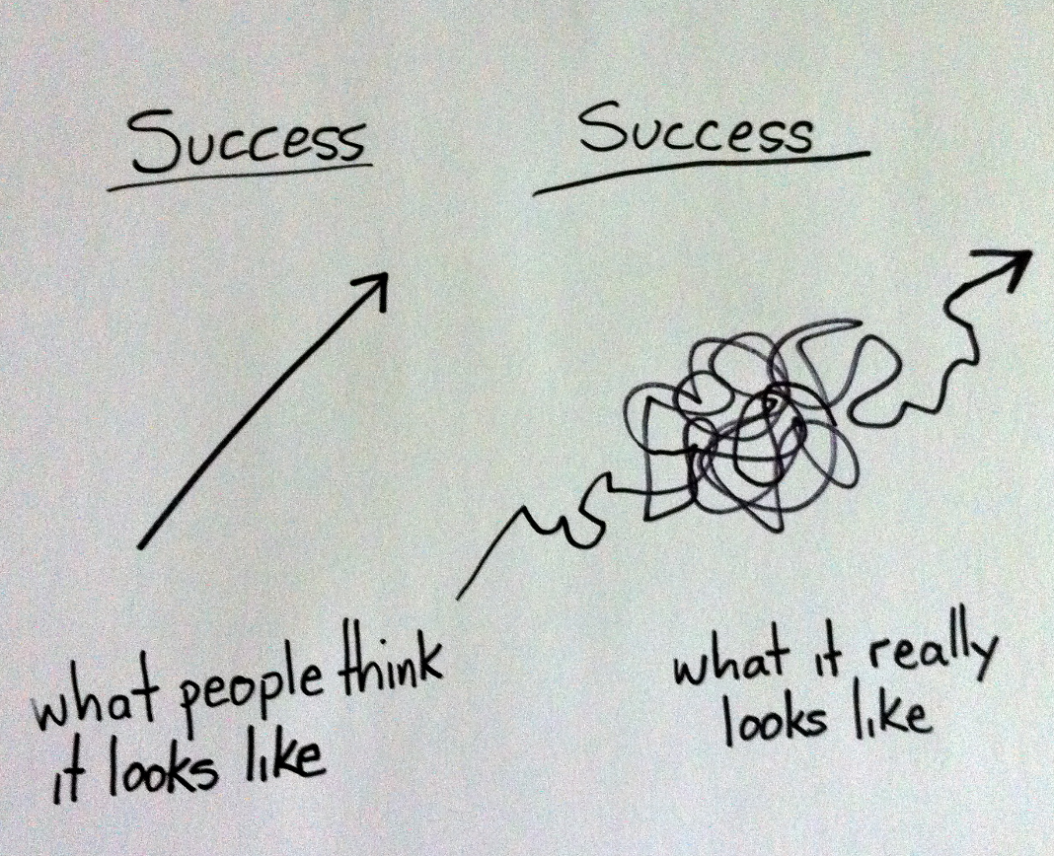
Continually “check in” with yourself
to monitor progress.
Success is more of a winding road than a straight line. You must be prepared to re-route when obstacles present themselves!
Revisit your goals frequently and tweak where necessary. Morning workouts not happening? What about lunch hour or just after dinner?
If you are consistently achieving goals, try adding newer, more challenging goals to keep things from getting stale.

Slide 9
Weight Loss is Science, not Magic!
To lose weight, you must burn more calories than you take in.
1 pound of fat = 3500 calories
To burn 3500 calories per week, you must either:
Cut out 500 calories from your diet OR
Burn an extra 500 calories per day OR
Cut out 250 calories AND burn an extra 250 calories per day.
“But how do I know how many calories I need?”

Slide 10
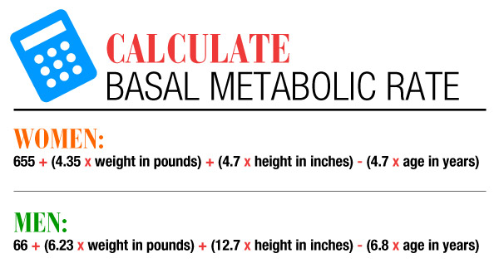
Calculating Your
Basal Metabolic Rate (BMR)
**see handout 1.4
BMR = the amount of calories your body burns at rest for basic functioning
**Harris-Benedict BMR Formula
Notes:
Have group refer to handout 1.4 and help them to understand how to calculate both BMR and target heart rate.

Slide 11
Your Pulse & Target Heart Rate
How to Calculate your Maximum Heart Rate:
220 – Your Age = Predicted Maximum Heart Rate
Target Heart Rate
You gain the most benefits and lessen the risks when you exercise in your target heart rate zone. Usually this is when your exercise heart rate is 60-80% of your maximum heart rate.
If you are a beginner, start at the lower end and if you are more physically fit, you can work towards the 75-80% range.
To find out if you are exercising in your target zone, stop exercising and check your 10-second pulse. If your pulse is below the target zone, increase the intensity. If it is above the target zone, decrease the intensity.
Notes:
Could mention heart rate monitors can be helpful in determining this as well and can be had for $60-200, depending on model. Good reward for reaching a big fitness goal!
Have them determine their maximum heart rate & target heart rate on the worksheet in handout 1.6.

Slide 12
Carbs & The Glycemic Index
The glycemic index (GI) measures how fast and how much blood sugar rises after eating a carbohydrate food. White table sugar, white bread and refined carbohydrates raise your blood sugar levels the fastest.
Carbohydrates containing fiber, like beans, whole grains and non-starchy vegetables release glucose slowly because they break down slowly. Eating low-GI foods provides a number of benefits, such as:
Keeps energy levels in your body more constant
Increases body’s sensitivity to insulin
Reduces risk of developing heart disease
Reduce blood cholesterol levels
Helps you feel full longer/control your appetite
Helps you lose & control weight
Increases physical endurance
Helps prevent/manage diabetes
** Check out handout 1.5
Notes:
Have clients turn to GI chart (handout 1.5) to review guidelines for GI foods to consume regularly, occasionally and those to avoid when possible. Remind them that this might be something handy to put on fridge or on cupboard as a reference in the kitchen.

Slide 13
A Complete, Balanced Meal Requires…
**Follow along on handout 1.6
1. Lean Protein
EG: boneless, skinless chicken breast, lean pork & beef (trim all visible fat), beans/legumes, eggs/egg whites, fish & seafood (non-breaded/battered), low-fat yogurt & cottage cheese, whey protein powder, tofu
2. Low GI Carbs
EG: green, leafy vegetables, whole-grain, high-fiber breads (2-3g per slice), oats, quinoa, beans/legumes, non-starchy vegetables, basmati/wild/long-grain rice, apples, oranges, blueberries, grapes, cherries, grapefruit
3. Healthy Fats
EG: olive oil, flaxseed oil, canola oil, avocados, eggs & fish with omega-3 fats, olives, nuts, seeds

Slide 14
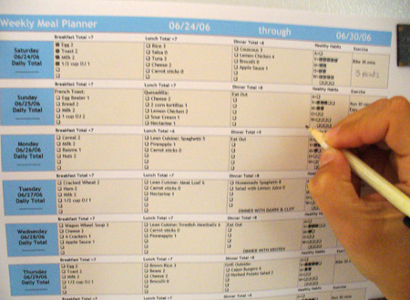
Meal Planning for Success
4 Steps to Healthy Meal Planning
1. Schedule a time to plan.
Carve out 30 minutes in your schedule each week to plan your meals and create a shopping list. Many people find the best time to meal plan is in advance of their weekly grocery shopping trip.
2. Evaluate your meal plan.
Does each meal include fruit and/or vegetables? Have you included enough lean protein in each meal & snack? Are staying within your recommended calorie limits? Take this time to ensure you are achieving your nutrition goals and modify as needed.
Source: weightloss.about.com
Notes:
Have them refer to meal planning template (handout 1.7) and encourage them to set completing a meal plan for the week as one of their goals over the next 4 weeks.

Slide 15
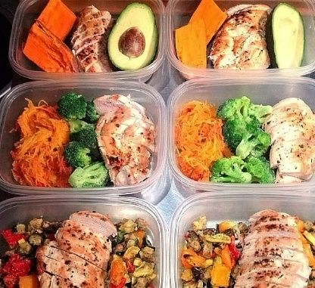
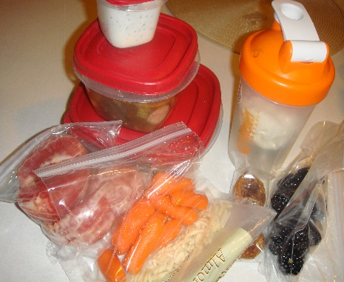
Meal Planning for Success
4 Steps to Healthy Meal Planning
3. Shop & cook.
Here is where meal planning in advance of your weekly grocery run comes in handy! Another great tip is to spend a few hours in the kitchen on the weekend, preparing lunches & snacks in advance. Place in individual portions and you are ready to go for the week!
4. Lay out the day’s food.
This can be done the night before or the morning of, depending on what works best for you. Refer to your plan and pack your items to bring to work and place the items to be eaten at home in the fridge and pantry where they are most easily accessible when you get hungry!
Notes:
Have audience share what they do, tips they follow, how they stay organized..

Slide 16
Putting It Into Action…
Now that you have a basic understanding of meal planning, best foods for weight loss and how to pick a “good” carb from a “bad” carb, it’s time to put it to use!
In groups of 2-3, take what we have discussed and the handouts at your disposal and come up with some other ideas for healthy meals & snacks. See Worksheet 1.7. [also 1.9 and 1.10]
Remember to include lean protein, low GI carbohydrates and healthy fats in your meals.
The best snacks for weight loss are those containing lean protein & fiber!
Each group should come up with three meals and at least one snack. We’ll review them as a group to determine if the plans are great as is or if there is room for improvement! You can stock pile meal and snack ideas using your Meal Planner Template – handout 1.8.
Notes:
Refer to handout 1.7. Consultant should be available to groups as needed for questions or instructions. Review and suggest any improvements that could be made to their ideas or discuss why their ideas were good. After the discussion, they can copy down the meal plan ideas onto their meal planner template 1.8. also point out 1.9 and 1.10 for other ideas..

Slide 17
Remember!
Putting the time into planning your meals & snacks is an important investment into your health & success! Failing to plan can easily turn into planning to fail!
Make the time each week to plan your meals & snacks and make time each day to ensure your food options are prepared for the day ahead. This investment of an hour or so per week can make a huge difference in your success!

Slide 18
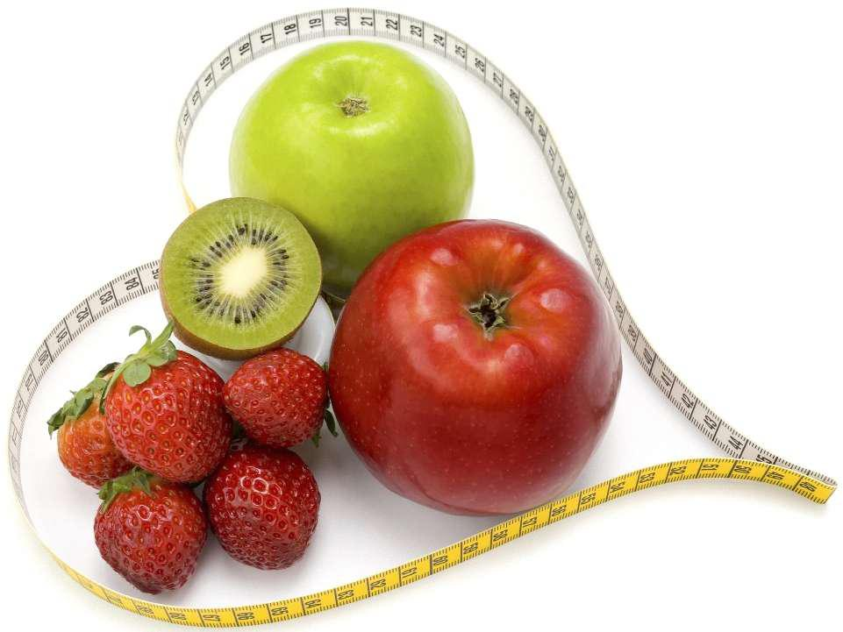
Next Month:
Monthly check-in and group discussion
Getting active
Basic cardio & strength training guidelines
Rating of Perceived Exertion (RPE) Scale
Portion Control
Timing of meals
Eating well on a budget
Reading & understanding food labels
The importance of sleep
Re-visit sub-goals!

Slide 19
Questions now or later?
<Consultant Name>
<consultant>@EWSNetwork.com P:123.456.7890
www.EWSNetwork.com

