Slide 1
Employee Wellness Program
www.EWSNetwork.com
Notes:
Rules
Talk about the last 2 years

Slide 2
EWSNetwork
EWSNetwork was founded in October 2003
Clients in over 75 locations and in over 55 cities
Average company size is 118 employees
Over 25 wellness consultants and many more strategic alliances
Average client engagement for onsite programs is >85%. Over 55% specifically with the health coaching.
Benefits Canada
Winner - 2011 Benefits Canada Health and Wellness Program of the Year Award (<1000 employees)
Finalist - 2012 Benefits Health and Wellness Program of the Year Award (<1000 employees)
Winner - 2012 Benefits Canada Strategic Partnership Award
Finalist - 2013 Benefits Health and Wellness Program of the Year Award
Finalist - 2013 Benefits Canada Strategic Partnership Award
www.EWSNetwork.com

Slide 3
We’re in trouble….
60% of Canadians are currently overweight or obese (67% of men and 54% of women).*
1 in 5 Canadian adults have high blood pressure (17% are unaware they have high blood pressure).*
40% of Canadian adults have high cholesterol.*
Over 2.5 million Canadians have diabetes.*
www.EWSNetwork.com
Notes:
Obesity - Annual medical expenditures are 36% higher for obese adults vs. those of normal weight.
Obese employees are absent on average 13 times more than non-obese and incur almost 7 times more medical costs. [Ipsos Reid Health Survey 2010]
Nine in 10 Canadians (90%) have at least one risk factor for heart disease or stroke (smoking, alcohol, physical inactivity, obesity, high blood pressure, high blood cholesterol, diabetes) (PHAC, 2009).
Canada has the 2nd highest prevalence of diabetes among its peer countries and the incidence of the disease continues to increase for both men and women.
- Adult-onset diabetes is 5 times more common among obese people

Slide 4
Lots of trouble….
17% of Canadians 15 years of age and older smoke (Health Canada, 2011).
52.5% of Canadian women ages 12 and over are physically inactive and 46.5% of Canadian men ages 12 and over are physically inactive (PHAC, 2009).
Nearly a quarter (23%) of Canadians report a high degree of life stress (PHAC, 2009).
www.EWSNetwork.com
Notes:
Total annual cost of $3,396 / smoking employee. (Benefits Canada) due to increased absenteeism, decreased productivity and the costs of smoking facilities. (Conference Board of Canada 2007)
Stress - 30% of all disability recorded at work, 55% of EAP cost and 19% of Absenteeism. (Tangri's research)
Employees who experience high stress cost employers almost 50% more in health expenditures. (Canadian Medical Association Journal

Slide 5
Health Care Costs
75% of health care costs result from unhealthy lifestyles.
Factors such as:
Obesity
Poor eating habits
Physical inactivity
Smoking
are responsible for the vast majority of health risks and their associated costs. These health risks are skyrocketing in the Canadian population.
Making the Business Case for Investments in Workplace Health and Wellness, Conference Board of Canada, June 2012
www.EWSNetwork.com
Notes:
Let’s face it, health care costs are eating into the bottom line – if we can help reduce those costs, we’re on the right track!
75% of health care costs result from unhealthy lifestyles. Factors such as smoking, physical inactivity, poor eating habits are responsible for the vast majority of health risks and their associated costs.

Slide 6
Costs associated with an aging workforce…
Benefits usage
Benefits costs
Disability claims
Accommodating disabilities/energy levels/shift availability etc, especially in physically demanding roles
www.EWSNetwork.com
Notes:
In Canada, an aging population and anticipated labour and skills shortages are driving corporate investments in health and wellness.
The number of days of work missed due to illness or disability tends to increase with age, as does the incidence of physical chronic disease.
Costs related to employee benefits and absenteeism have the potential to increase significantly if employers do not put in place solutions to help older employees maintain and improve their health.

Slide 7
Benefits of a Comprehensive
Wellness Program
(Know Your Objectives )
Improve the health and wellness of employees
Decrease health risks for aging workforce
Educate and motivate staff towards a healthier lifestyle
Proactively address individual health concerns
Improve the culture of the workplace
Decreased cost of health benefits
Decrease STD/LTD and Workman’s Comp
Improved productivity and decreased absenteeism
Retention / Attraction
Marketing (top employer to work for)
www.EWSNetwork.com

Slide 8
Looking at the Business Case
Harvard University study found that workplace wellness programs also delivered a significant cost savings for employers. For every $1.00 spend on wellness, medical costs fall by about $3.27 and absenteeism by about $2.73.
#1 – Reduced this by only 5% that would equal a $6.25 / employee / month savings. ($625 based on 100 person company with $1500 average.)
#2 – Reduce this by only 1 day / year (based on a $50,000 income) and your company will save $16.00 / employee / month . ($1,600 based on 100 person company) [National average is 7.4days]
#3 – To recruit, train and manage a new quality employee it may cost your organization an average of $50,000. Reduce this by only ½ new employee / year due to STD, LTD or retention and you will save $20.83 / employee / month . ($2,083 based on 100 person company)
Achieve these 3 positive results your organization will save $43.08 / employee / month or $4,308.00 / month.
www.EWSNetwork.com

Slide 9
2009 to 2012 Health Benefit Data Results
2009
2012
Health Claims / Person / Year
was reduced by 8%
Drug $ / Person / Year
was reduced by 12%
5.24 Day Reduction
Sick Days
2009 to 2012 Health Risk Results
www.EWSNetwork.com

Slide 10
Claims Cost Distribution “Disease Costs, Prevention Saves”
“Disease Costs, Prevention Saves”
20% of employees generate 80% of the costs.
Healthy/ At-Risk High Risk Early Active
Low Risk Symptoms Disease
That means, 80% of employees generate only 20% of the costs.
www.EWSNetwork.com

Slide 11
The EWSNetwork System
www.EWSNetwork.com
Notes:
60% Obese or Overweight (36 out of 60ppl)
40% High Cholesterol
25% get 35% of calories from fat
23% BMI over 30
16.4% High BP

Slide 12
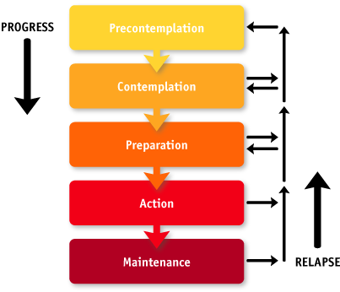
Readiness to Change
Area for Positive Impact and Change
Where Most Companies Spend Their Time
www.EWSNetwork.com

Slide 13
Well Designed Wellness Strategy Links Components Together Giving the Greatest Opportunity for Success
Group
Awareness
Virtual
Individual
www.EWSNetwork.com

Slide 14
Components of a Successful Wellness Program
The EWSNetwork
Award Winning Program
2011 Health and Wellness Program
(for companies with <1000 employees)
2012 Strategic Partnership Award
Senior Management Support
Pilots the overall direction of the program and cultural objectives.
Helps with scheduling and department support.
Wellness Committee
Committee made up of your peers.
Ambassadors of the program.
“Tentacles” of the program. Very valuable source of feedback.
Meet bi-monthly to go over past, present and future initiatives.
Marketing, implementation and feedback from previous events.
www.EWSNetwork.com

Slide 15
Components of a Successful Wellness Program
Health Risk Assessment
Employee Benefits – Personal Wellness Profile
Private registration, immediate results highlighting participants’ wellness scores, health age and recommended health actions.
Annually employees will receive a comparative report.
Employer Benefits – HRA Trend Report
Summary and Program Suggestions and Productivity and Economic Benefits Report (using company specific income and medical values)
Annually organizations receive a comparative report.
www.EWSNetwork.com/pwp
www.EWSNetwork.com

Slide 16
Components of a Successful Wellness Program Individual Programs
One-on-One Health / Wellness Coaching
The service of a fitness advisor, nutrition advisor, stress/time manager and lifestyle coach, “all-in-one”!
30 minute one-on-one appointments.
Desired turn-around 4-5 weeks.
Proven Results – behaviour modification is most effective working with the individual
Personalized Goals – accountability, follow-up, evaluation
www.EWSNetwork.com

Slide 17
Components of a Successful Wellness Program
Group Programs
Cross-Canada Challenge
Mountain Climb Pedometer Challenge
Own the Podium
Lunch n’ Learns, Workshops
WorkLife Balance Program
Nutrition at Work
4-week Stress and You
6-week Empowered Living
8-week Extreme Lifestyle Makeover
And many others…
Group Exercise Programs
Depending on your facility and surroundings EWSNetwork offers a wide variety of exercise programs.
Walking / Running Programs
Pilates and Yoga Classes
Muscle Toning
Stretching Instruction
Kick-Boxing, Zumba, Step Classes
www.EWSNetwork.com

Slide 18
Components of a Successful Wellness Program Awareness Programs
Materials / Campaigns
Wellness Kiosks
Awareness Posters
POD (Point-of-Decision)
Monthly Newsletters
Health Fairs
E-campaigns
Recipe campaigns
Walk-arounds
Consultant walks around the worksite to take information to the individual
Spot consultations
Opens up employee to consultant relationship
Increases awareness
Builds engagement within the wellness program
www.EWSNetwork.com

Slide 19
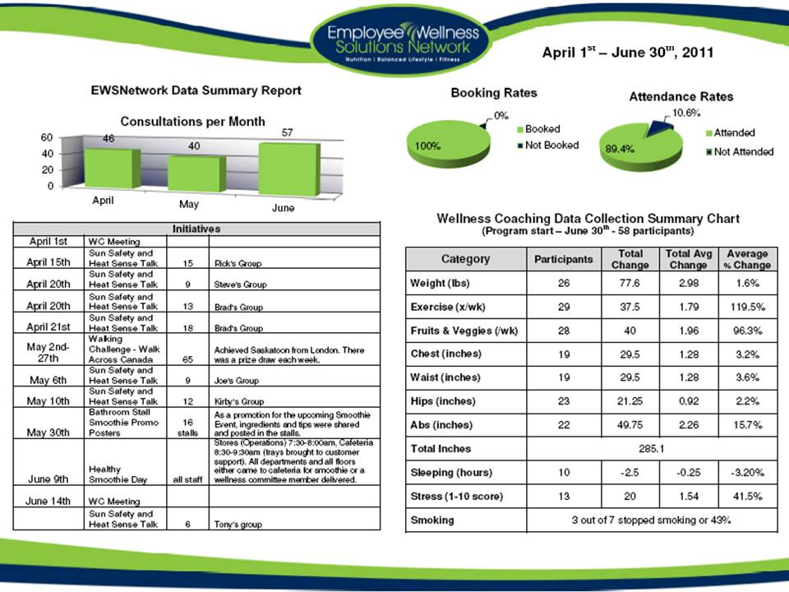
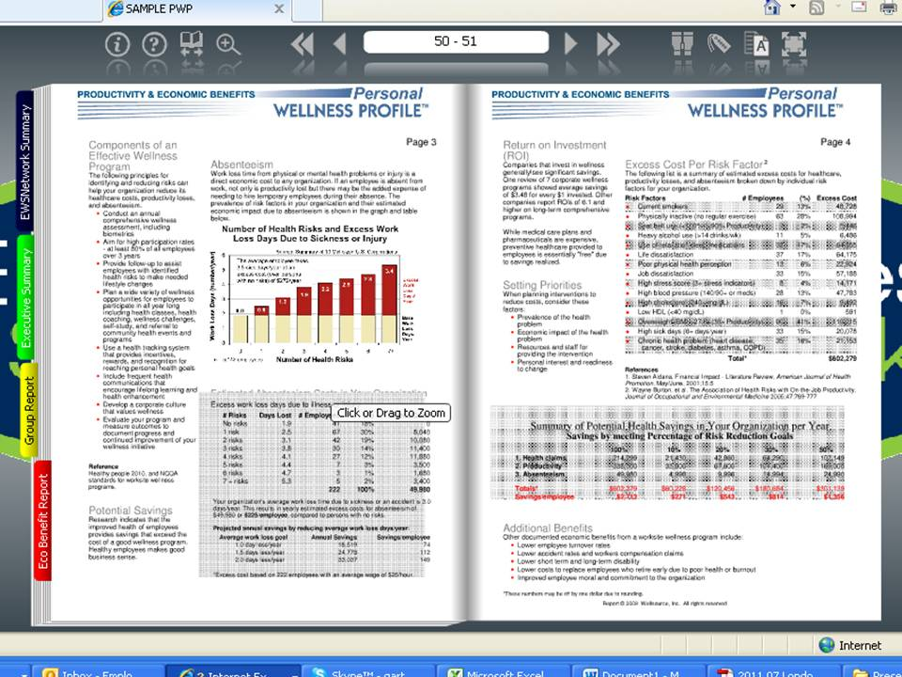
Progression Reports
Every 6 months
Wellness coaching participation rates
Group program participation rates
Past initiative schedule
Wellness committee feedback
Participant feedback
Annual Reporting
Health Risk Assessment / Personal Wellness Profile
Individual participants will receive a comparison report
Corporate reporting will include year to year profile changes and results
Easily shared with other management via pdf, online link, hard copy
www.EWSNetwork.com

Slide 20
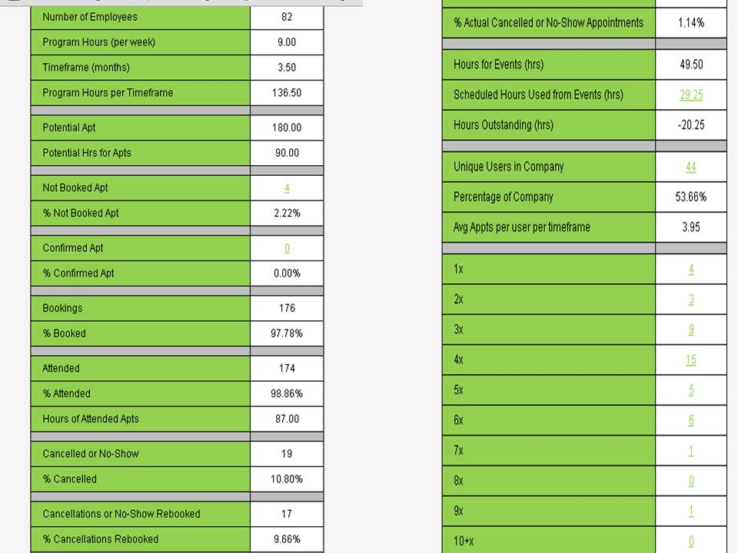
www.EWSNetwork.com

Slide 21
Program Launch
www.EWSNetwork.com
Notes:
60% Obese or Overweight (36 out of 60ppl)
40% High Cholesterol
25% get 35% of calories from fat
23% BMI over 30
16.4% High BP

Slide 22
Program Launch Step 1 Decide on the Program
Consider Organizational Set-up
Corporate and Organizational Objectives
Number of locations
Number of employees at each location
Industry
www.EWSNetwork.com

Slide 23
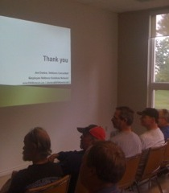
Program Launch Step 2
Market the Launch - posters, emails, flyers, paystub drops, announcements, memos, intranet and any other mode that is applicable.
Launch Presentation – Onsite or virtually an EWSNetwork representative presents the various components of the new employee benefit and introduces the certified wellness consultants who will be working with the organization.
Consultation Sign-up - Employees have an opportunity to schedule their first one-on-one consultation at the launch.
Wellness Committee Sign-up - Employees have an opportunity to sign up for the wellness committee.
The Health Risk Assessment - [Personal Wellness Profile] launched that day.
Consultations - The wellness consultations begin shortly after the launch.
www.EWSNetwork.com

Slide 24
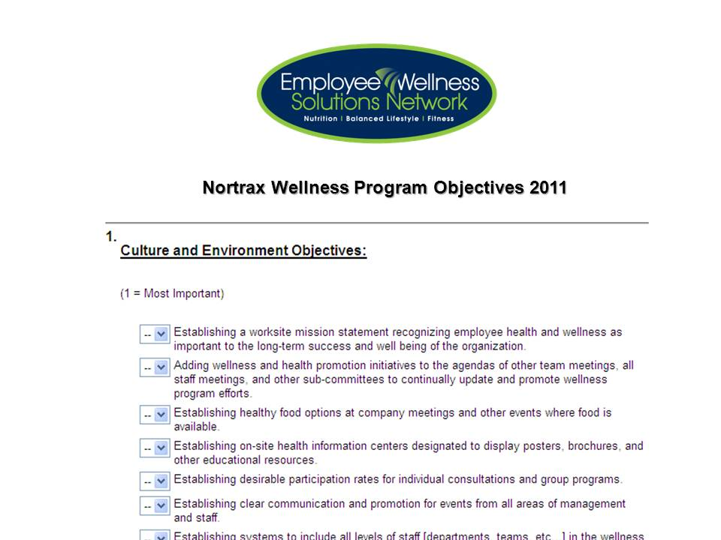
Program Launch Step 3 First 30 days
Health Risk Assessment
www.EWSNetwork.com/abc
Objectives Surveys
Unique for both Wellness Committee
& Management
Analysis of
Company Metrix
(drug clasification, health claims, etc.)
Analysis of the First 30-days of
One-on-One Consultations
www.EWSNetwork.com

Slide 25
6 Month in a Glance
Initiative | July | August | September |  |  | October | November |  |  | December
Consultations | One-on-One Consultations/Phone/Skype Schedule (ongoing)
Individual | Online Profile and Wellness Tracking |  |  |  |  |  |  |  | Personal Wellness Profile
Kiosk Posters |  |  |  | Beat the Bug
Webinar |  | Healthy Home (evening) |  |  |  | Healthy Home (evening) |  |  |  | Healthy Home (evening)
Lunch n' Learns |  |  | It’s in You to MOVE |  |  |  | Maintain Don’t Gain
Posters | Small Steps to Fit |  | Walking Works |  |  |  | Maintain Don’t Gain
Newsletter | Ongoing Monthly Newsletters
Wellness Challenge | Exercise 30-60 Minutes Daily |  | Walk 10000 Steps |  |  |  | Stay Fit During the Holidays
Walk Around or Station Awareness | Dark Chocolate |  | Almond Serving
Challenges | Healthy Employee and Office of the Quarter Award (ongoing)
 |  |  | Track Your Distance Challenge
Group Exercise Classes |  |  | Walking Group and Routes
Email or Paystub Campaign |  |  |  |  | Tips to Beat the Bug (every other week) |  |  |  | Maintain Don’t Gain (every other week)
Corporate Reporting |  |  | Snapshot Report |  |  |  | HRA Reporting |  |  | Annual HRA Report

Slide 26
Enhancing Online Presence
www.EWSNetwork.com
Notes:
60% Obese or Overweight (36 out of 60ppl)
40% High Cholesterol
25% get 35% of calories from fat
23% BMI over 30
16.4% High BP

Slide 27
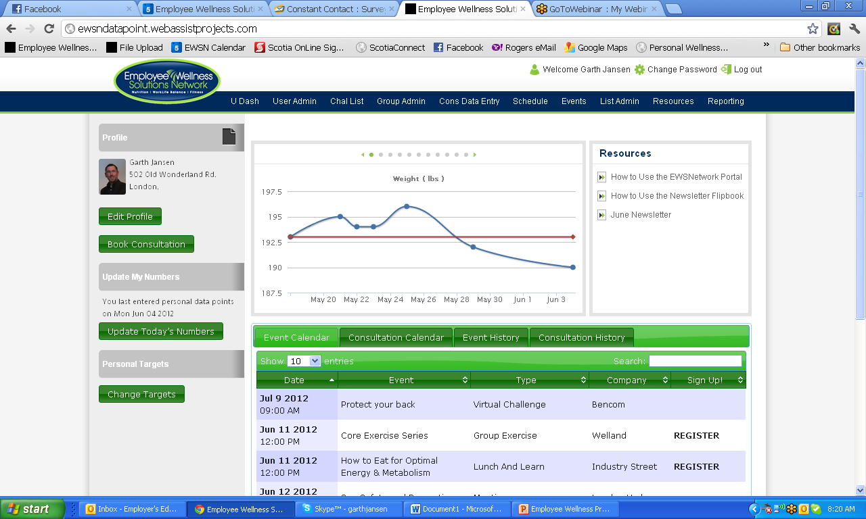
Custom Resource Centre
Data Entry and Graphing
Member/Employee Profile Page
Set Targets / Goals
Current & Past Events & Consultations Calendars

Slide 28
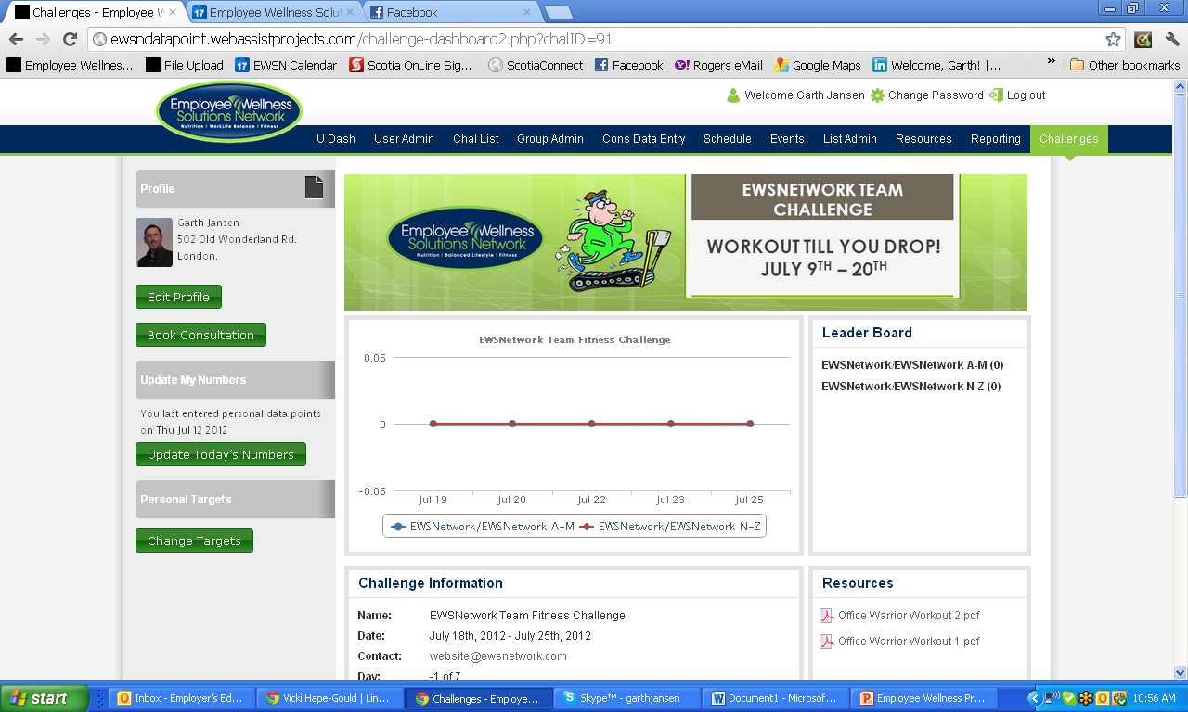
Virtual Challenge Dashboard
www.EWSNetwork.com
Notes:
60% Obese or Overweight (36 out of 60ppl)
40% High Cholesterol
25% get 35% of calories from fat
23% BMI over 30
16.4% High BP

Slide 29
Thank you.
Garth Jansen, President, Employee Wellness Solutions Network
www.EWSNetwork.com I garth@EWSNetwork.com I 519.860.0502

