Slide 1
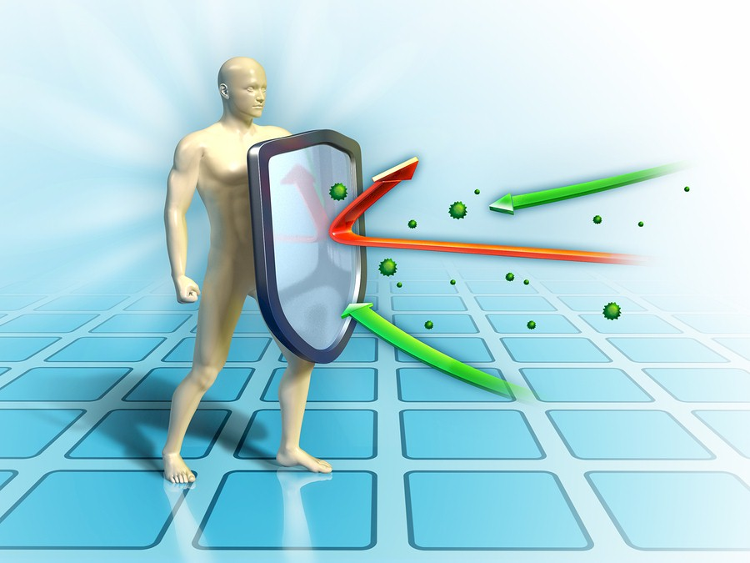
Building & Maintaining a
Strong Immune System
www.EWSNetwork.com

Slide 2
Topics of Discussion
Immune System 101
Strengthening Your Immune System – Nutrition
Strengthening Your Immune System – Exercise
Strengthening Your Immune System – Sleep
Strengthening Your Immune System - Stress
Summary
Q & A

Slide 3
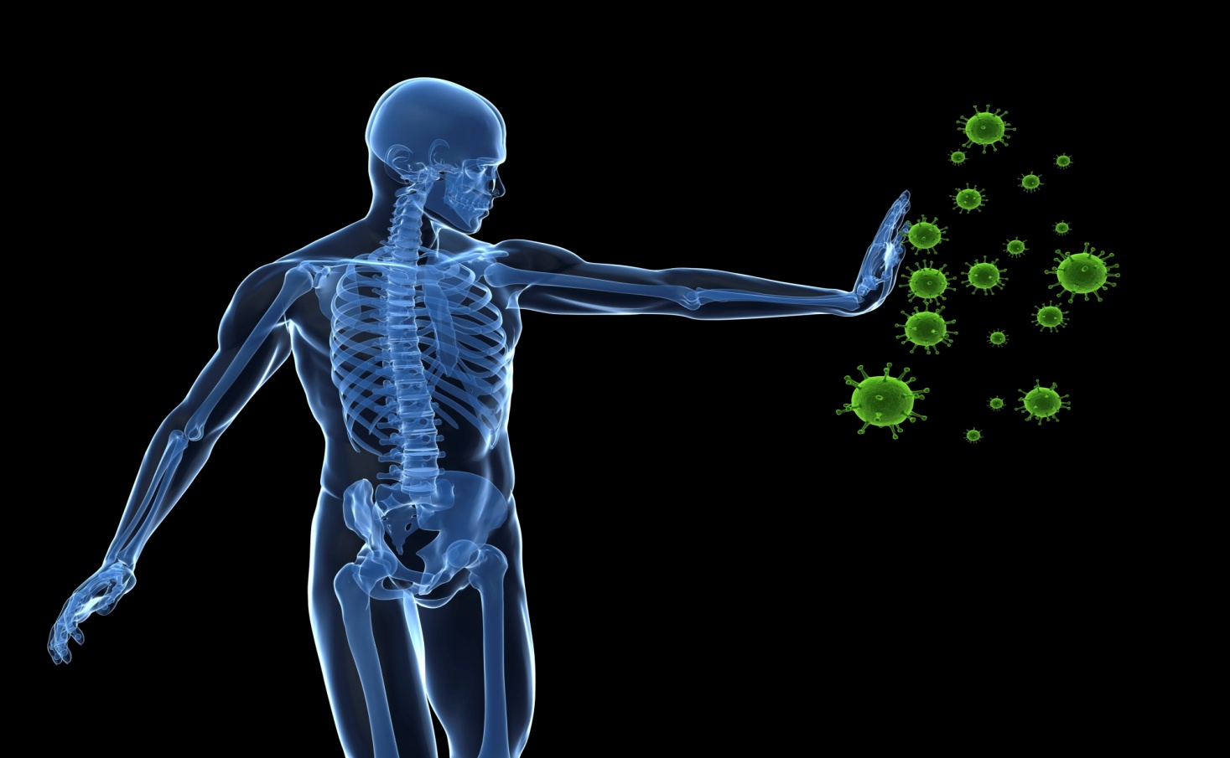
Immune System 101
Your immune system is designed to defend you against millions of bacteria, microbes, viruses, toxins and parasites that would love to invade your body!

Slide 4
Immune System 101
The Immune System protects the body by:
Recognizing the presence of infection
Containing the infection and working to eliminate it
Regulating itself so it does not damage the body
Remembering pathogens to prevent diseases from recurring
Notes:
Pathogens = a bacterium, virus, or other microorganism that can cause disease (bacteria, viruses, parasites, fungi)

Slide 5
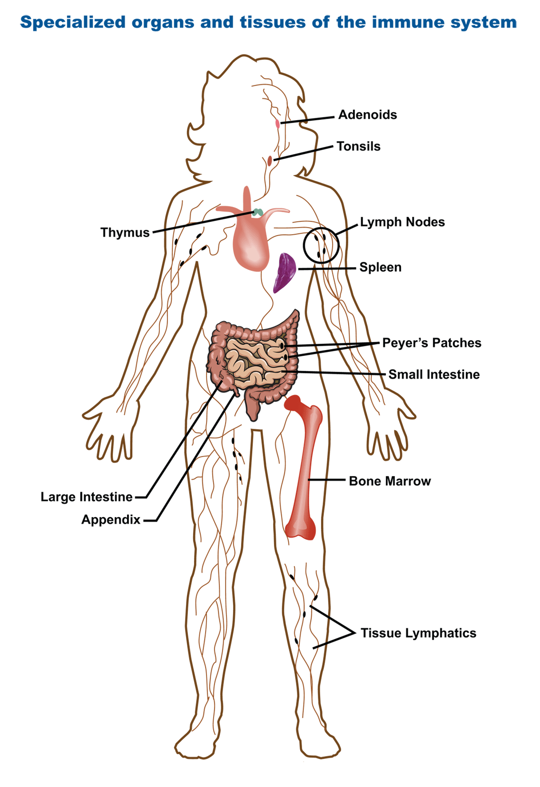
Immune System 101
Notes:
Adenoids & tonsils = work together to trap allergens that are inhaled or swallowed from entering into your immune system. Adenoids are made up of cells that make antibodies to help your body fight infections
Thymus = function is to produce mature T-cells. Immature thymocytes, also known as prothymocytes, leave the bone marrow and migrate into the thymus. As they mature, T cells that are beneficial to the immune system are spared, while those T cells that might evoke a detrimental autoimmune response are eliminated. The mature T-cells are then released into the blood stream.
Lymph nodes = function as an immunologic filter for the bodily fluid known as “lymph”. Located throughout the body. Nodes drain fluid from most of our tissues. Antigens are filtered out through the lymph in the lymph node before returning the lymph to circulation. They capture antigens that present these foreign materials to T & B cells, initiating an immune response.
Spleen = an immunological filter of the blood. Made up of B cells & T cells, macrophages, dendritic cells, natural killer cells and red blood cells. This organ can be thought as an immunological conference centre. In the spleen, B cells become activated and produce large amounts of antibody. Also, old red blood cells are destroyed in the spleen.
Bone marrow = All the cells of the immune system are initially derived from the bone marrow. Bone marrow produces B cells, natural killer cells, granulocytes and immature thymocytes, in addition to red blood cells and platelets.
Intestines = large intestines are inhabited by trillions of bacteria often referred to as probiotics (pro=encouraging, biotic = life). Without probiotics, humans would be extremely vulnerable to food borne illnesses, be deficient in key nutrients and vitamins and have a much weaker immune system in general
Appendix = a “safe house” for the beneficial bacteria living in the human gut. Populated with different microbes that help digestive system break down the food we eat. In return, the gut provides nourishment and safety to the good bacteria.

Slide 6
Immune System 101

Slide 7
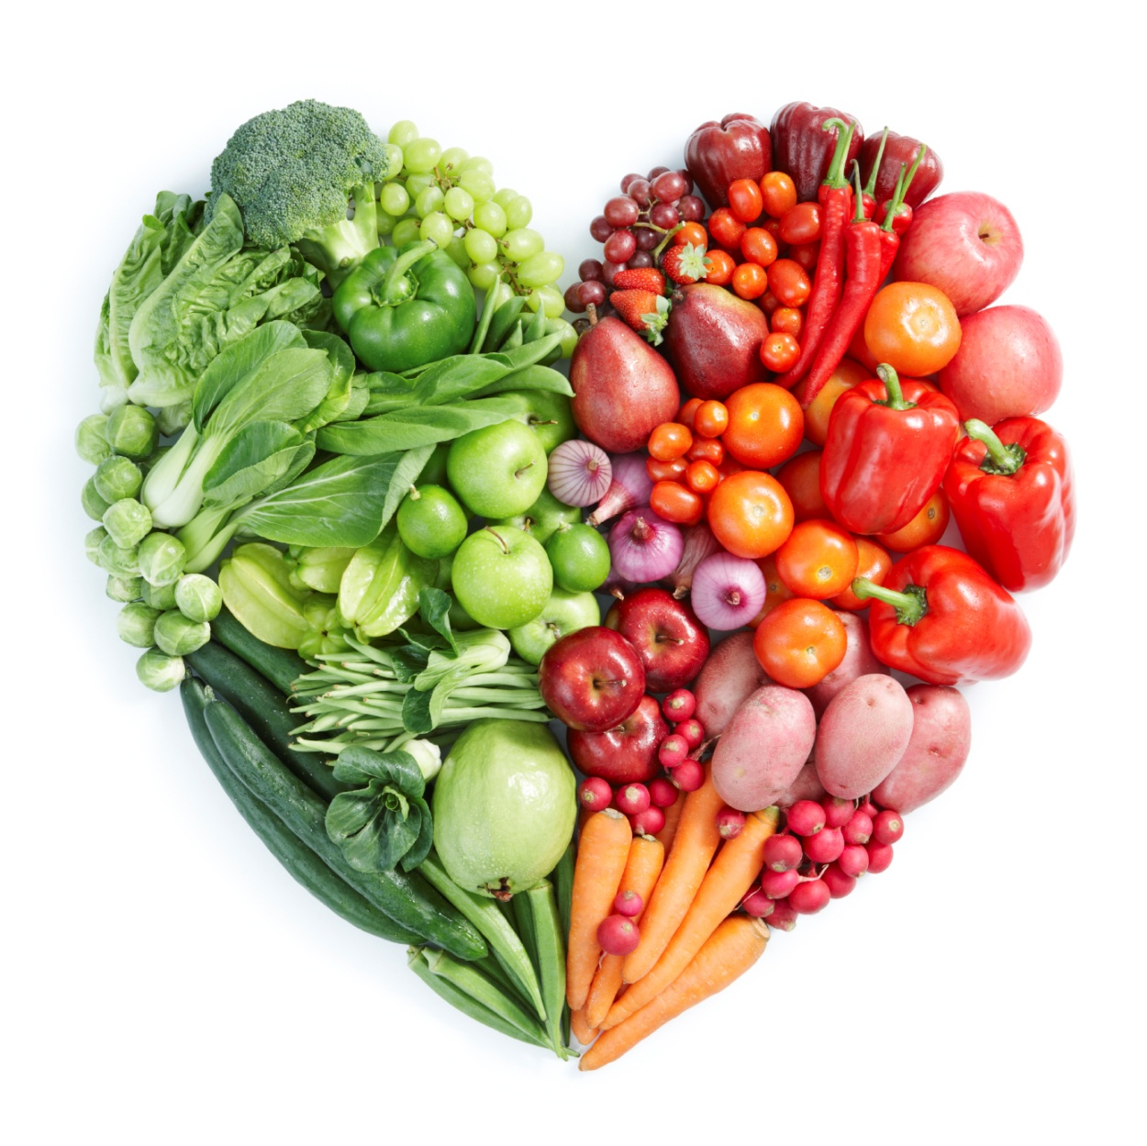
Nutrition & The Immune System
Notes:
You can ensure your body and immunity run smoothly by including plenty of colourful fruits & veggies & 8-10 glasses of water per day. You can help your immune system get stronger by adding a variety of immune-boosting foods such as….(next slide)

Slide 8
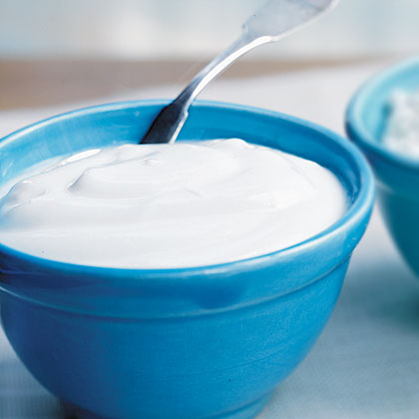
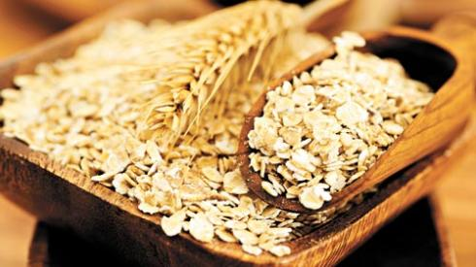
Nutrition & The Immune System
Yogurt
The live active cultures in yogurt are healthy bacteria that keep the gut & intestinal tract free of disease-causing germs. Your optimal dosage is two 6-ounce servings a day.
Oats & Barley
These grains contain beta-glucan, a type of fibre with antimicrobial and antioxidant capabilities more potent than echinacea. Your optimal dose is at least 1 out of 3 daily servings of whole grains

Slide 9
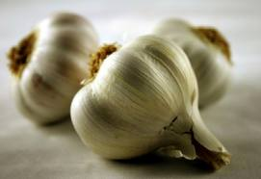
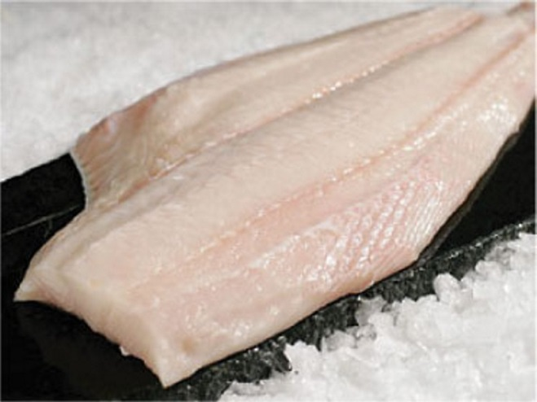
Nutrition & The Immune System
Garlic
Contains the active ingredient allicin, which fights infection and bacteria. Your optimal dosage is two raw cloves a day and add crushed garlic to your cooking several times a week.
Fish
Salmon, mackerel and herring are rich in omega-3 fats, which reduce inflammation, increasing airflow and protecting lungs from colds & respiratory infections. Your optimal dosage is two servings/week.
Notes:
Other great immune-boosting foods:
Tea – the amino acid, L-theanine, is abundant in both black and green tea – decaf versions have it too. Optimal dosage is several cups daily.
Beef – contains zinc which is important for development of white blood cells. Optimal dosages is a 3oz serving of lean beef provides about 30% of DV for zinc. (Zinc can also be found in oysters, fortified cereals, pork, poultry, yogurt & milk.
Sweet potatoes – good source of Vitamin A, which your skin relies on to stay strong & healthy. Skin serves as first line fortress against bacteria, viruses and other undesirables. Optimal dosage is a half cup serving and 40% of DV of vitamin A.

Slide 10
Exercise & The Immune System
Notes:
Recent studies have shown that if you complete moderate exercise just a few times every week, you can drastically reduce the number of colds that you get every year. Outside of just keeping you in shape and helping you to become healthier over time, exercise can boost your immune system and help your body fight off harmful diseases and colds/infections.

Slide 11
Exercise & The Immune System
Regular exercise boosts the immune system by:
Strengthening your heart
Better equipping your lungs at handling oxygen and distributing it to the rest of your body
Providing a boost to the cells in your body that are assigned to attach bacteria
Notes:
Beware of over-exercising! Too much exercising can actually cause your immune system to weaken. In order to avoid having this effect on your immune system, make sure that you get enough rest for your body.

Slide 12
Sleep & The Immune System
Not getting enough sleep has been linked to a number of mental and physical health problems, including those that stem from an impaired immune system.

Slide 13
Sleep & The Immune System
T-cells go down if we are sleep deprived and inflammatory cytokines go up which could potentially lead to greater risk of developing a cold or flu.
Sleep loss also plays role in fighting illnesses when we have them. Bodies fight infection with fever and fevers tend to rise at night while we sleep. If we are awake, fever reaction may not be primed and not waging war on infection as best as possible.
Try to get 7-9 hours of sleep per night in order to help keep your immune system working at its optimal condition

Slide 14
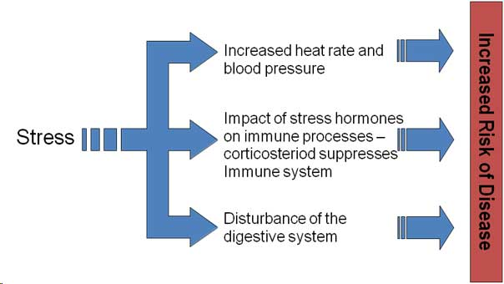
Stress & The Immune System
The long term activation of the stress-response system – and subsequent overexposure to cortisol and other stress hormones – can disrupt almost all of your body’s processes which puts you at increased risk of numerous health problems.

Slide 15
Stress & The Immune System
It is important to learn how to incorporate stress management techniques into your daily life. Some suggestions to get you started are:
Practicing deep breathing and learning to meditate
Fostering healthy friendships
Having a sense of humour
Writing in a journal
Seeking professional counselling when needed

Slide 16
Remember…
Your immune system needs your help in order to work at its optimal levels. By incorporating the right foods, regular exercise and working to get enough sleep and manage your stress levels, you can reduce your chances of catching minor colds & flus and avoiding more serious health problems like cancer. You & your family deserve to live your best lives possible and a strong immune system will help all of you to do just that!

Slide 17
Questions now or later?
<Consultant Name>
<consultant>@EWSNetwork.com P:123.456.7890
www.EWSNetwork.com

