Slide 1
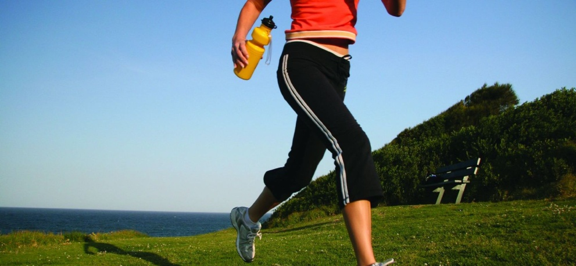

Pedometer Challenge!
May 13 – June 7, 2013

Slide 2

EWSNETWORK TEAM CHALLENGE
WORKOUT TILL YOU DROP!
JULY 9TH – 20TH

Slide 3
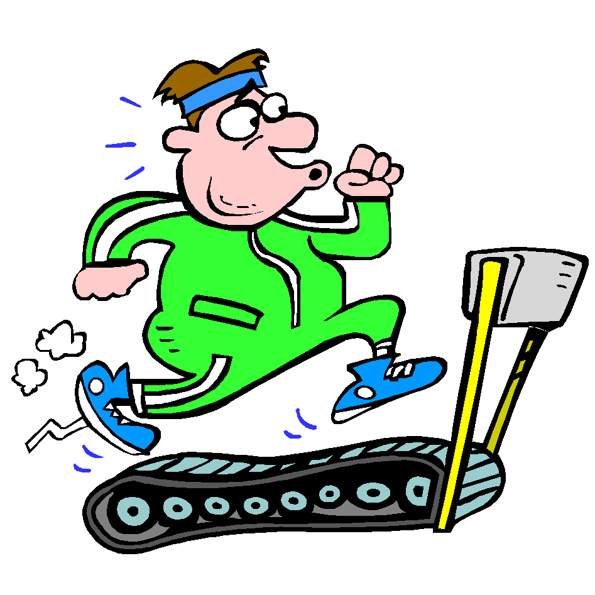

Labatt Workout CHALLENGE
Workout in the new facility and WIN!!!
August 1st – October 31st

Slide 4

Moosehead Staff
Walk / Run Challenge
November 1st – December 31st

Slide 5

Moosehead Staff
Walk / Run Challenge
November 1st – December 31st

