Slide 1
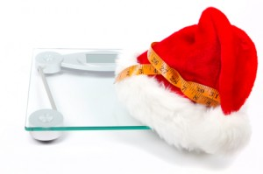
Holiday Preemptive Strike!
Because this year, it’s going to be different!!

