Slide 1
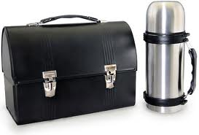
Brown Bag Lunch
Bring It!
www.EWSNetwork.com
Notes:
Thank you for having me, my name is Rose Parr and Monday, Wednesday and Friday I operate Wellington Wellness Personal Training and Nutrition Counselling.
For those of you already bringing a healthy lunch, great, hopefully you pick up at least one additional tip here today. And you will love our prizes!!

Slide 2
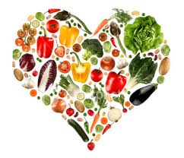
We Need Food
Food affects everything we do.
How we look, feel and act.
How well we function every day.
Your body makes 100 million cells a day
It remakes itself every 7 years.
Food supplies the nutrients we need to function properly
Growing, repairing, sleeping soundly, energy levels, moods
thinking, focus, memory, hormone levels.
www.EWSNetwork.com
Notes:
(Except for eyeballs and part of your brain)
7 years from now, you’ll have a new arm. Will it be made of diet pop and cookies or of apples and almonds?
Which one will help you live longer? Which one will give you the energy to garden and golf when you retire?
Which one will help prevent heart disease, cancer, diabetes?

Slide 3
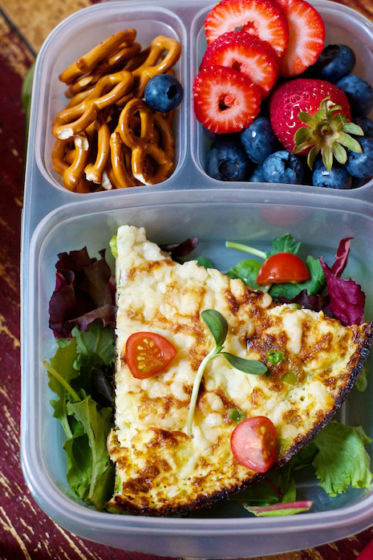
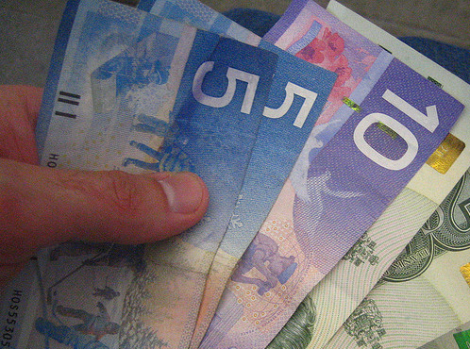
Buy it VS Bring it
Buy it From Truck
Bring it From Home
Cost
Tempted by less nutritious choices
Portions decided for you
Packaged Food choices
Time used to purchase
Convenience
Less Expensive
No temptation, you eat what you bring
You Control portion sizes
Made from fresh
More time to sit and eat
Must be organized and make ahead
www.EWSNetwork.com
Notes:
Kristy-Food truck
Make it special, Monday-didn’t make it to the grocery store
Wednesday-hump day
Friday-treat?

Slide 4
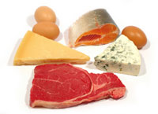
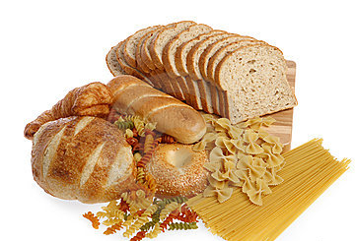
“Okay I’m bringing it!”
Lean Protein
Whole Grains
www.EWSNetwork.com
Notes:
“So what do I pack?”
Fats-take care of themselves, good and bad, saturated fat in meat and dairy, Healthy fat in nuts, avocadoes,
Dairy-under protein umbrella

Slide 5
Water
found in every cell and in the spaces around the cells
carries nutrients throughout body
assists in digesting foods, removing wastes, regulating temperature, and cushioning sensitive parts of our body
each day we lose 2 to 3 quarts
Signs of
Dehydration
Thirst , Dry Mouth
Loss of Appetite
Dry Skin , Skin Flushing
Dark Colored Urine
Fatigue , Weakness
Chills , Head Rushes
Headaches
www.EWSNetwork.com
Notes:
One more “food group” water!!!
Anti inflammatory-water weight

Slide 6
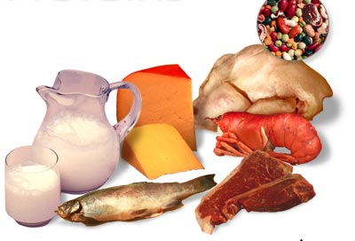
Lean Protein
Protein will help satisfy your
appetite and give you energy
for the afternoon.
Nuts, Nut butters
Bean Salad, Chili, Chickpea Salad, Hummus
Lean beef, pork, chicken
Fish –Tuna, Salmon, Sardines, Seafood
Tofu, Soy Milk
Protein Shake, Protein Bar
Milk, Cheese, Yogurt
Turkey, Bison Pepperette
Hard Boiled Eggs – Egg Salad
www.EWSNetwork.com

Slide 7
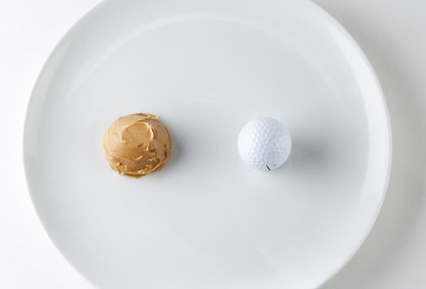
Portion Sizes-Meat and Alternatives
2 eggs (1 egg=1 oz protein)
3oz. cooked poultry or meat- your palm, a deck of cards
¾ cup cooked beans-baseball
2 Tbsp peanut butter-ping-pong ball
1 tablespoon peanut butter = 1 oz. Meat - thumb tip 3 ounces grilled/baked fish - check book , eye glass case
www.EWSNetwork.com

Slide 8
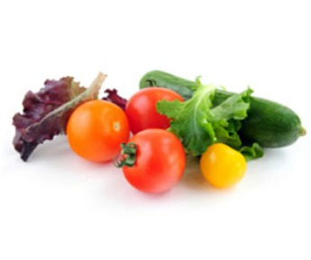
Vegetables
We need 7-10 servings of vegetables
and fruit each day.
Try to squeeze in one or two at each meal.
Baby carrots, cucumber or pepper slices
Veggie soup, vegetarian chili
Grape tomatoes
Spinach salad
V-8 juice, Green Drink
Fresh Sprouts from our local farmers market
www.EWSNetwork.com

Slide 9
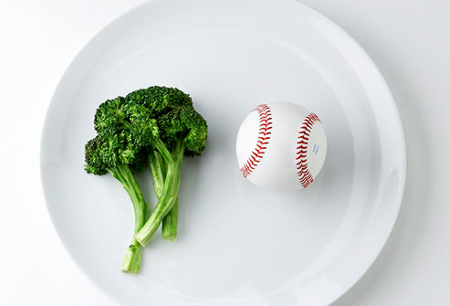
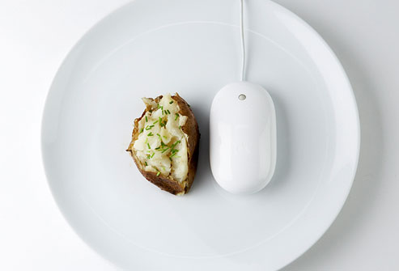
Portion Sizes-Vegetables
250 mL (1 cup) leafy raw vegetables or salad- baseball or a fist
125 mL (½ cup) fresh, frozen or canned vegetable or fruit
1 ear of corn on the cob
1/2 cup cooked broccoli -light bulb, baseball
1 medium baked potato - computer mouse or a fist
www.EWSNetwork.com
Notes:
Dont worry about veggie portions
Worry about the butter and salt on your cob of corn
The gravy on your potato

Slide 10
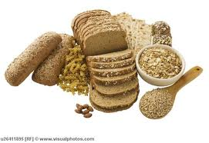
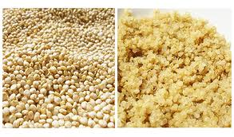
Whole Grains
You need fiber for overall good health, colon health and to help with cholesterol.
“It doesn’t have to be wheat.”
Whole grain, Rye, Kamut,
Spelt bread
Pitas-high protein ones, Tortillas
Kamut, Quinoa, Spelt pasta
Crackers, Wasa, Ryvita, Rice
Oatmeal, Quinoa, Barley, Brown Rice
www.EWSNetwork.com
Notes:
Vegehut, family owned, closed fridays and saturdays, open sundays
Quinoa-high in protein
Huvla-pita-high ih protein

Slide 11
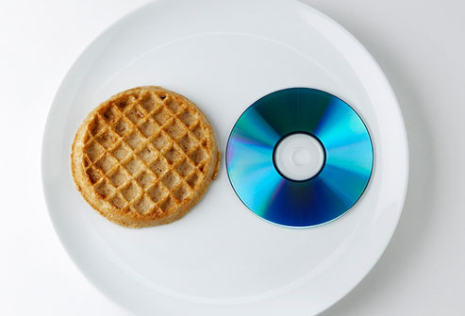
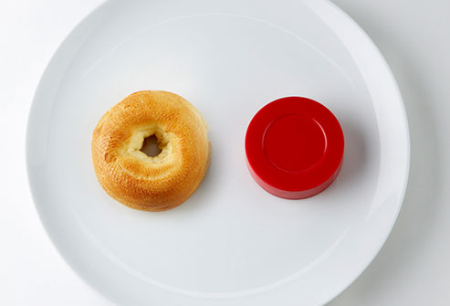
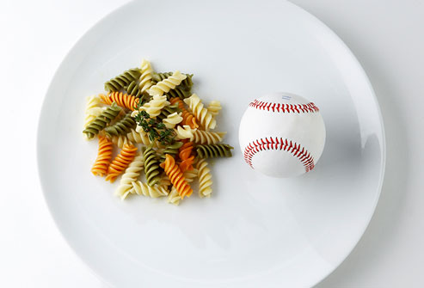
Portion Sizes-Grains
1 slice bread
½ bagel, ½ English muffin – hockey puck
½ pita or ½ tortilla
½ cup cooked rice, pasta –tennis ball
1 cup of pasta for 210 lb man - a fist
1 cup cold cereal or ¾ cup hot cereal
1 pancake - compact disc (CD)
www.EWSNetwork.com
Notes:
Measure your “cereal” bowls, they probably hold 2 1/2 cups
All Bran buds, 1/3 cup, 80 calories, 11g fibre, 3g protein (but I'm not eating it for the protein)
Vector they list nutrition for 1 ¼ cup-3g fibre, 11g sugar, 215 calories 5.5g protein, box says 13g on front—with 200ml milk, almost a whole glass

Slide 12
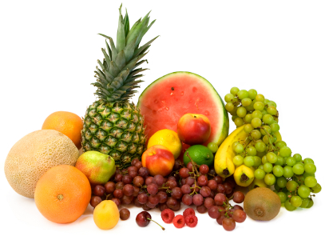
Fruit
Fresh fruit is a great way to end a meal
with a little “sweet”.
If you are too full to eat it at lunch,
it makes a great afternoon snack.
Add a protein to it to balance blood sugar.
Fresh apples, oranges, bananas, grapes, berries,
Cut up Melons, grapefruit, pineapple
Dried Fruit-small amount, very high in sugar
Canned (in light syrup)
www.EWSNetwork.com
Notes:
½ a banana- go for the whole thing
-1 cup of grapes has about 104 calories, and 1 cup raisins -over 434 calories.-ten grapes - 34 calories and ten raisins -16 calories.
Grapefruit from costco
-pineapple good if you are a big meat eater

Slide 13
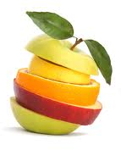
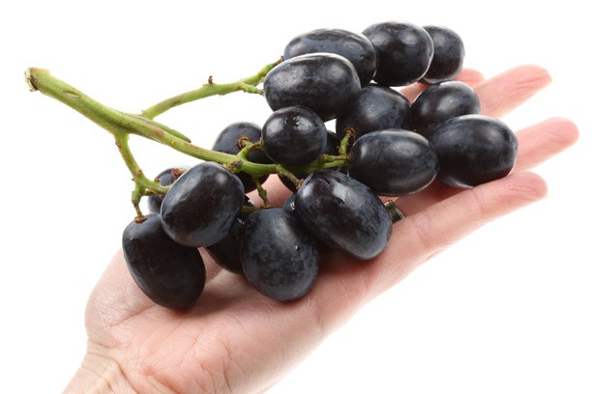
Portion Sizes-Fruits
1/2 cup of grapes (15 grapes) -light bulb
1/2 cup of fresh fruit – hand cupped
1 medium size fruit -tennis ball or a fist
1 cup of cut up fruit - baseball or a fist
1/4 cup raisins -large egg
www.EWSNetwork.com

Slide 14
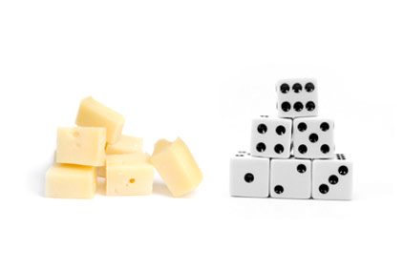
Portion Sizes-Milk and Alternatives
¾ cup yogurt
1 ½ oz cheese - 9-volt battery
1 ounce of cheese is the size of 6 dice
1 ounce of processed cheese - your thumb
1 cup milk or fortified soy beverage
www.EWSNetwork.com
Notes:
Babel cheeses now in light
Measure your drinking glasses A glass of milk is not necessarily a “cup” of milk.

Slide 15
What type of Lunch Box Personality
Are You?
Low Carb Clean – Gluten Free, Paleo
Vegetarian
Low Voltage-Microwave leftovers
Low Guidelines – Eat what you want
Low on Time
Even Lower on Time
www.EWSNetwork.com

Slide 16
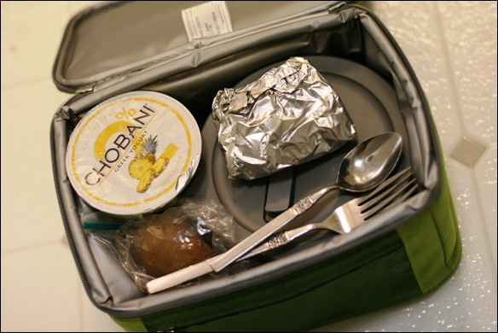
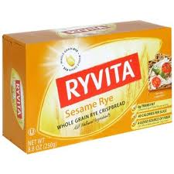
Low Carb, Clean, Paleo, Gluten Free
Protein- Turkey Pepperette, leftover chicken, tuna salad in bowl
Veggies, - Cut up peppers, zucchini, carrots, salad
Grains- Ryvita or Wasa flatbread crackers,
gluten free bread or pasta, Quinoa
Fruit,- apple, banana, cut up pineapple to help digest meat
www.EWSNetwork.com
Notes:
Weight loss

Slide 17
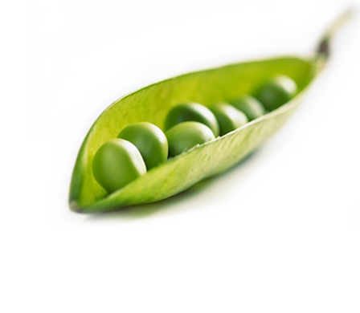
Vegetarian
Protein- Hard boiled eggs, chickpea salad, soy, canned marinated bean salad, hummus, nuts, protein powder , bars, Greek Yogurt, cheese
Peas, Spinach, broccoli, chickpeas, artichoke, potatoes and corn are higher protein vegetables.
Sprouted seeds (sunflower, pea, lentils, broccoli) will have more protein than regular vegetables. Sprouts can be added to sandwiches and salads.
Grains – Quinoa has more protein than any other grain. Avoid white bread, bagels, crackers.
Fruit – Avocados, peaches and figs have more protein than other fruits. The healthy fat in avocado will help keep you fuller longer.
www.EWSNetwork.com
Notes:
please eat vegetables if you are a vegetarian!

Slide 18
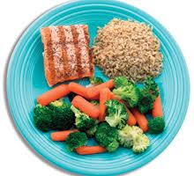
Low Voltage Microwave Leftovers
Protein- last nights pot roast, roast chicken, lentil stew, chili, soup
Veggie- leftover green beans, baked potato, roasted beets
Starches- brown rice, sweet potato, corn , crackers for your soup
Fruit- save it until 3pm and add a few almonds to balance blood sugar
www.EWSNetwork.com

Slide 19
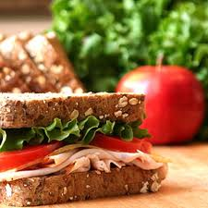
Low Guidelines – Eat what you want
Protein- Sliced ham, turkey or roast beef,
Swiss cheese,
Yogurt- mix small flavoured container
with real yogurt.
Veggie- cut up veggies and dip
Grains- High Fibre Multigrain Bread, Hearty Kaiser
Fruit-Bring your favourite!!
www.EWSNetwork.com
Notes:
Colon cancer-processed meats

Slide 20
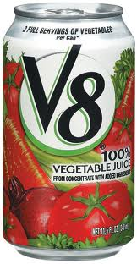
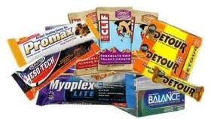
Low on Time
Protein – protein bar, almonds
Veggie- v-8 juice
Grains- rice cakes
Fruit- Apple
www.EWSNetwork.com
Notes:
Make it count-nutrient dense foods
Costco – packs of almond

Slide 21
Even Lower on Time Shake’n Go
Protein- Pure Isolate, 12-24g per woman,
24 plus for men
Carbs- some carbs will help with nutrient absorption
Popeye's on Stone Road provide samples, bring in your
free shaker cup and see which kind is best for you.
Whey, rice, soy, pea, plain, vanilla, chocolate, etc
Vegetarian varieties as well
www.EWSNetwork.com
Notes:
Take white shaker cups in for a free smoothie sample or try one of their greens

Slide 22
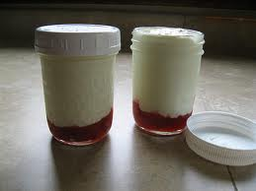
Healthy Breakfast
-Fruit
-whole grain buns,
-no sugar added jams
-peanut butter
-granola bars
-yogurt plain – honey
-almonds/walnuts ¼ c
www.EWSNetwork.com
Notes:
Fresh or frozen sliced fruit in bottom, plain or vanilla Greek yogurt, granola, nuts-parfait for snack!!
Use a mason jam jar
Low fat Granola pc

Slide 23
Thank you.
Garth Jansen, Employee Wellness Solutions Network
www.EWSNetwork.com I garth@EWSNetwork.com I 519.860.0502

