Slide 1
Employee Wellness Program
www.EWSNetwork.com
Notes:
Rules
Talk about the last 2 years

Slide 2
The Need
Obesity
Obese employees are absent on average 13 times more than non-obese and incur almost 7 times more medical costs. [Ipsos Reid Health Survey 2010]
Stress
Employees who experience high stress cost employers almost 50% more in health expenditures. (Canadian Medical Association Journal)
Smoking
$3,396 annually due to increased absenteeism, decreased productivity and the costs of smoking facilities. (Conference Board of Canada 2007)
Health-care costs
Doubling every five years. Joseph Henry (AstraZenece)
More people die of overweight/obesity
issues than of starvation.
(World Health Organization)
www.EWSNetwork.com
Notes:
60% Obese or Overweight (36 out of 60ppl)
40% High Cholesterol
25% get 35% of calories from fat
23% BMI over 30
16.4% High BP

Slide 3
Wellness vs. EAP
Wellness Programs | EAP
Pro-Active | Re-Active
Risk factors are currently a-symptomatic | High and immediate need
Employee is currently present | Employee is presenting with acute symptoms
Productivity may or may not be effected by risk factors | May or may not involve STD or LTD
All who engage will benefit | Required intervention is easily identified
Reaching those who want it and those who need it | Employee seeks assistance
Higher use = higher savings | Higher use = higher cost
www.EWSNetwork.com

Slide 4
Know Your Objectives
Additional benefit
Health concerns
STD/LTD and Workman’s Comp
Retention / Attraction
Marketing (top employer to work for)
Improve the health and wellness of employees
Meet corporate directive
Improved productivity and decreased absenteeism
Decreased cost of health benefits
Educate and motivate staff towards a healthier lifestyle
www.EWSNetwork.com

Slide 5
Looking at the Business Case
Harvard University study found that workplace wellness programs also delivered a significant cost savings for employers. For every $1.00 spend on wellness, medical costs fall by about $3.27 and absenteeism by about $2.73.
#1 – Reduced this by only 5% that would equal a $6.25 / employee / month savings. ($625 based on 100 person company with $1500 average.)
#2 – Reduce this by only 1 day / year (based on a $50,000 income) and your company will save $16.00 / employee / month . ($1600.00 based on 100 person company) [National average is 7.4days]
#3 – To recruit, train and manage a new quality employee it may cost your organization an average of $40,000. Reduce this by only 1/2 new employee / year due to STD, LTD or retention and you will save $33 / employee / month . ($3,300 based on 100 person company)
Achieve these 3 positive results your organization will save $55.25 / employee / month or $5,525 / month.
www.EWSNetwork.com

Slide 6
Employee Wellness Solutions Network
Client Distribution
Company Size,
% of overall Clients
Monthly Investment,
% of overall Clients
www.EWSNetwork.com

Slide 7
Claims Cost Distribution “Disease Costs, Prevention Saves”
“Disease Costs, Prevention Saves”
20% of employees generate 80% of the costs.
Healthy/ At-Risk High Risk Early Active
Low Risk Symptoms Disease
That means, 80% of employees generate only 20% of the costs.
www.EWSNetwork.com

Slide 8
The EWSNetwork System
www.EWSNetwork.com
Notes:
60% Obese or Overweight (36 out of 60ppl)
40% High Cholesterol
25% get 35% of calories from fat
23% BMI over 30
16.4% High BP

Slide 9
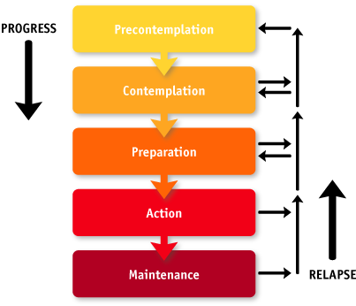
Readiness to Change
Area for Positive Impact and Change
Where Most Companies Spend Their Time
www.EWSNetwork.com

Slide 10
Well Designed Wellness Strategy Links Components Together Giving the Greatest Opportunity for Success
Group
Awareness
Virtual
Individual
www.EWSNetwork.com

Slide 11
Components of a Successful Wellness Program
Senior Management Support
Pilots the overall direction of the program and cultural objectives.
Helps with scheduling and department support.
The EWSNetwork
Award Winning Program
2011 Health and Wellness Program
(for companies with <1000 employees)
www.EWSNetwork.com

Slide 12
Components of a Successful Wellness Program
Wellness Committee
Committee made up of your peers.
Ambassadors of the program.
“Tentacles” of the program. Very valuable source of feedback.
Meet bi-monthly to go over past, present and future initiatives.
Marketing, implementation and feedback from previous events.
www.EWSNetwork.com

Slide 13
Components of a Successful Wellness Program
Health Risk Assessment (HRA/Personal Wellness Profile)
Employee Benefits –
Private registration, immediate results highlighting participants’ wellness scores (coronary, cancer, nutrition, fitness, stress/emotional, substance use, safety), health age and recommended health actions.
Annually employees will receive a comparative report.
Employer Benefits
Summary and Program Suggestions, Executive Summary Report, Group Summary Report, Productivity and Economic Benefits Report (using company specific income and medical values)
Annually organizations receive a comparative report.
www.EWSNetwork.com/pwp
www.EWSNetwork.com

Slide 14
Components of a Successful Wellness Program Individual Programs
One-on-One Health / Wellness Coaching
The service of a personal trainer, nutrition advisor, stress/time manager and lifestyle coach, “all-in-one”, right at your fingertips!
30 minute one-on-one appointments with a wellness specialist.
Desired turn-around 4-5 weeks.
Help change the individual … they help to change their surroundings
Proven Results – behaviour modification is most effective working with the individual
Personalized Goals – accountability, follow-up, evaluation
www.EWSNetwork.com

Slide 15
Consultation Bookings and Attendance
[January – December 2011]
www.EWSNetwork.com

Slide 16
Components of a Successful Wellness Program
Group Programs
Cross-Canada Challenge
Mountain Climb Pedometer Challenge
World Cup Challenge
Lunch n’ Learns, Workshops
WorkLife Balance Program
Nutrition at Work
4-week Stress and You
6-week Empowered Living
8-week Extreme Lifestyle Makeover
And many others…
Group Exercise Programs
Depending on your facility and surroundings EWSNetwork offers a wide variety of exercise programs.
Walking / Running Programs
Pilates and Yoga Classes
Muscle Toning
Stretching Instruction
Kick-Boxing, Zumba, Step Classes
www.EWSNetwork.com

Slide 17
Components of a Successful Wellness Program Awareness Programs
Materials / Campaigns
Wellness Kiosks
Awareness Posters
POD (Point-of-Decision)
Monthly Newsletters
Health Fairs
E-campaigns
Recipe campaigns
Walk-arounds
Consultant walks around the worksite to take information to the individual
Spot consultations
Opens up employee to consultant relationship
Increases awareness
Builds engagement within the wellness program
www.EWSNetwork.com

Slide 18
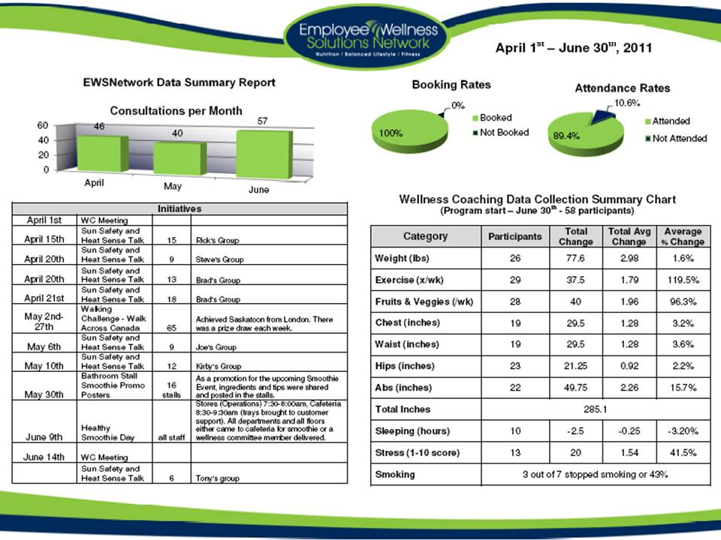
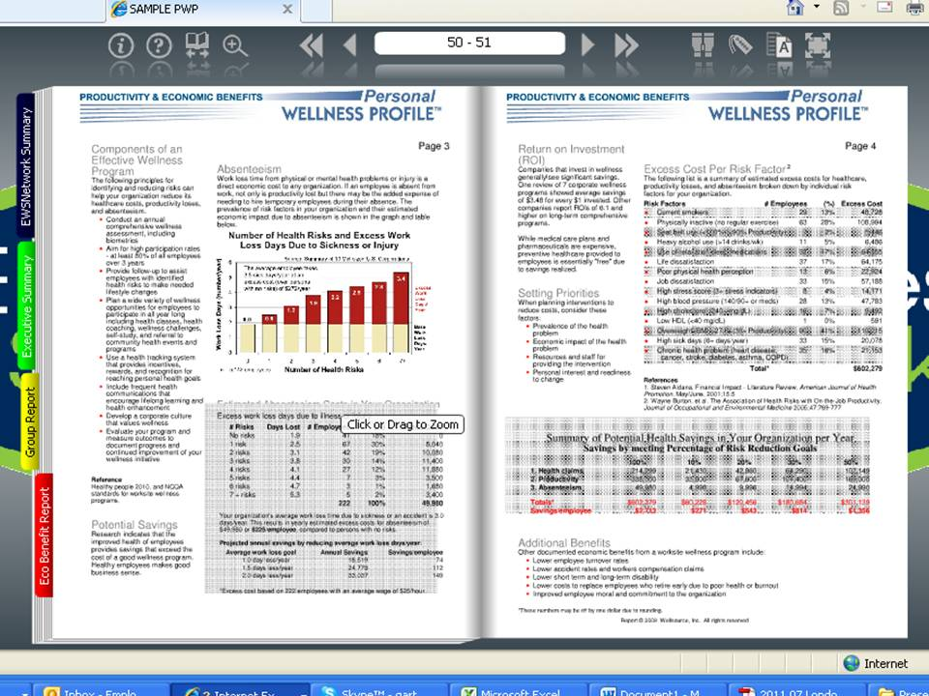
Quarterly Snapshot Reports
Every 3-4 months
Individual Stat Trends
Consultation Numbers
Initiative participation chart
Progression Reports
Every 6 months
Wellness coaching participation rates
Group program participation rates
Past initiative schedule
Wellness committee feedback
Participant feedback
Annual Reporting
Health Risk Assessment / Personal Wellness Profile
Individual participants will receive a comparison report
Corporate reporting will include year to year profile changes and results
Easily shared with other management via pdf, online link, hard copy
www.EWSNetwork.com

Slide 19
Program Launch
www.EWSNetwork.com
Notes:
60% Obese or Overweight (36 out of 60ppl)
40% High Cholesterol
25% get 35% of calories from fat
23% BMI over 30
16.4% High BP

Slide 20
Program Launch Step 1 Decide on the Program
Consider Organizational Set-up
Corporate and Organizational Objectives
Number of locations
Number of employees at each location
Industry
www.EWSNetwork.com

Slide 21
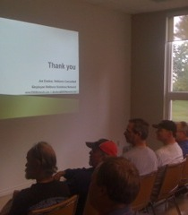
Program Launch Step 2
Marketed with posters, emails, flyers, paystub drops, announcements, memos, intranet and any other mode that is applicable.
An EWSNetwork representative presents the various components of the new employee benefit and introduces the certified wellness consultants who will be working with the organization.
Employees have an opportunity to schedule their first one-on-one consultation at the launch.
Employees have an opportunity to sign up for the wellness committee.
The Health Risk Assessment [Personal Wellness Profile] is launched.
The wellness consultations begin shortly after the launch.
www.EWSNetwork.com

Slide 22
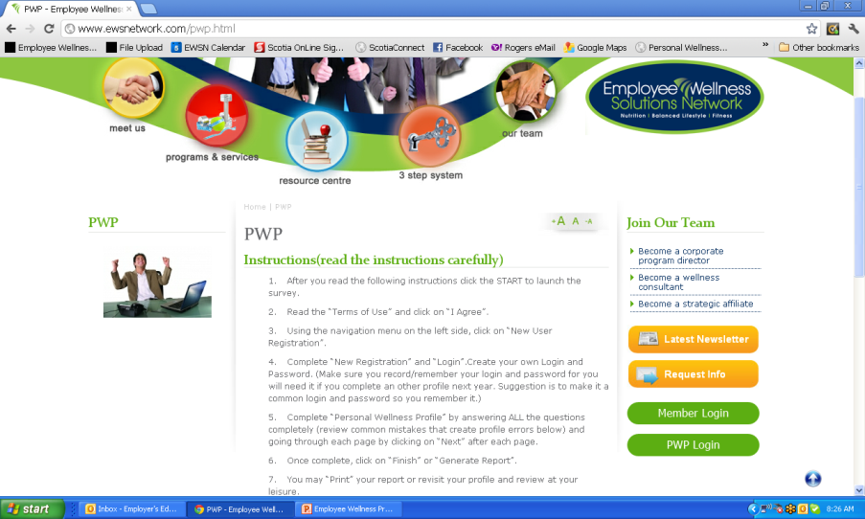
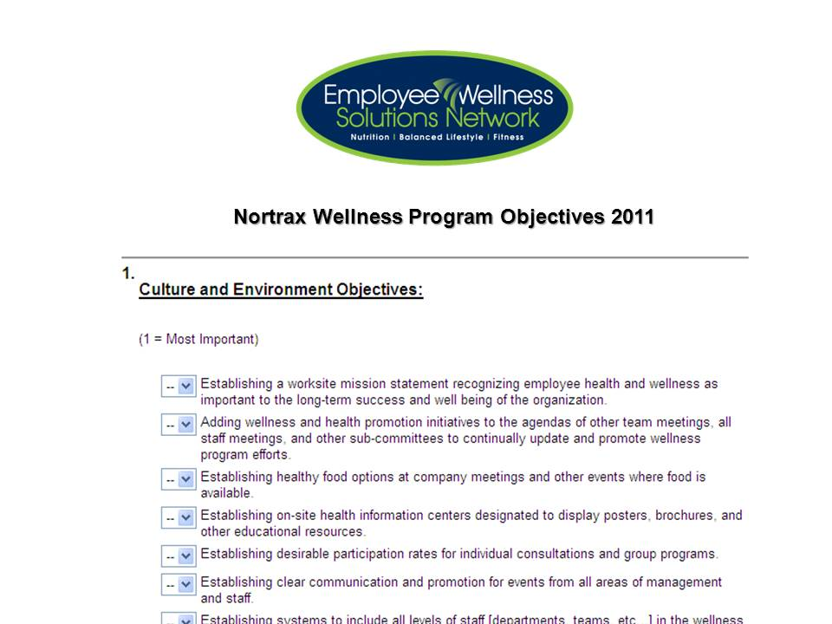
Program Launch Step 3 Analyzing Your Company
Health Risk Assessment
www.EWSNetwork.com/abc
Wellness Committee &
Management Objectives Surveys
First 30-days of
One-on-One Consultations
www.EWSNetwork.com

Slide 23
Enhancing Online Presence
www.EWSNetwork.com
Notes:
60% Obese or Overweight (36 out of 60ppl)
40% High Cholesterol
25% get 35% of calories from fat
23% BMI over 30
16.4% High BP

Slide 24
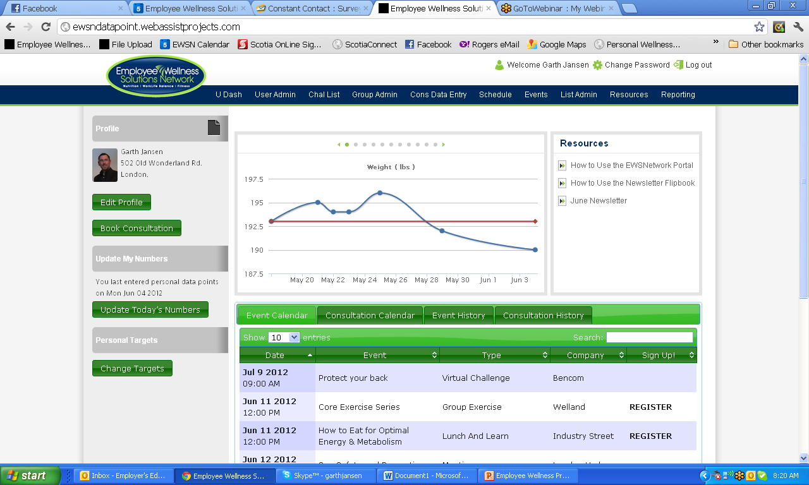
Custom Resource Centre
Data Entry and Graphing
Member/Employee Profile Page
Set Targets / Goals
Current & Past Events & Consultations Calendars

Slide 25
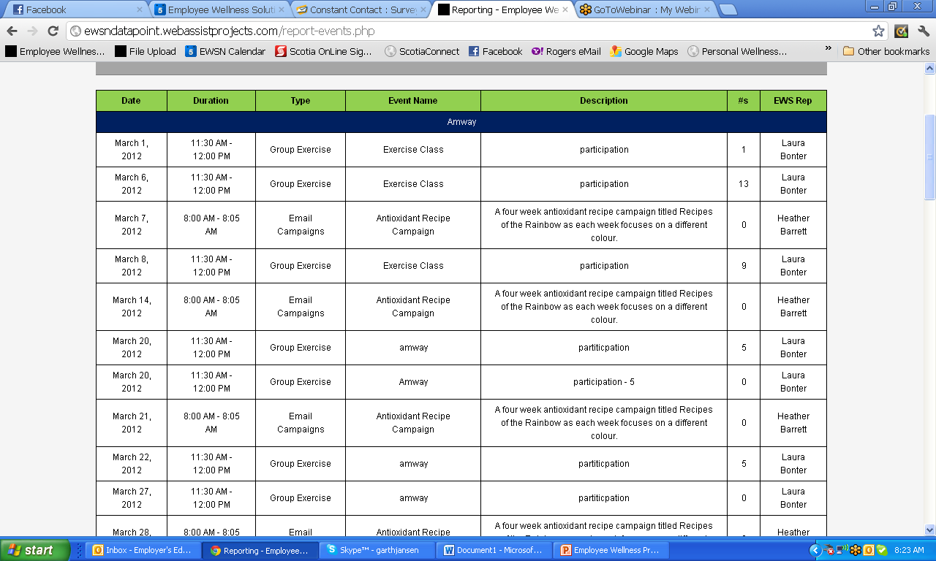
Event Reporting

Slide 26
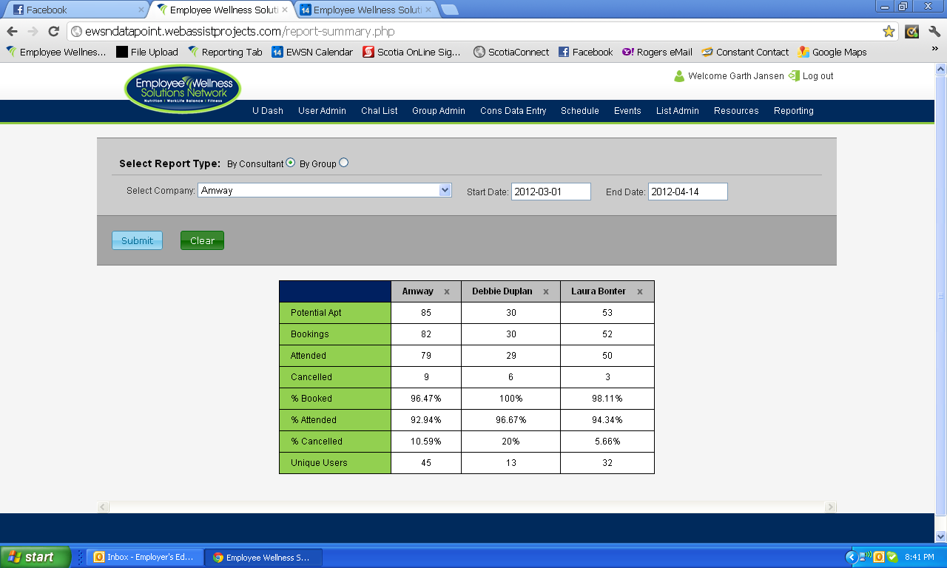
Consultation Reporting

Slide 27
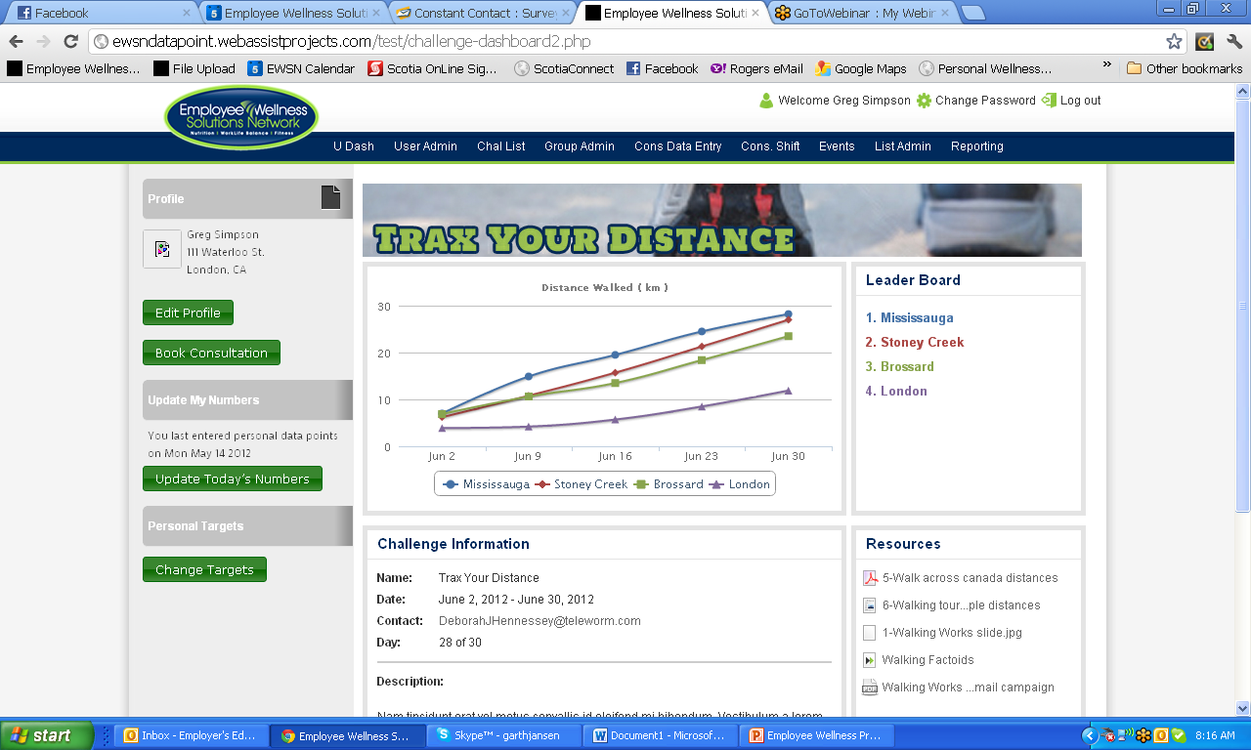
Virtual Challenge Dashboard
www.EWSNetwork.com
Notes:
60% Obese or Overweight (36 out of 60ppl)
40% High Cholesterol
25% get 35% of calories from fat
23% BMI over 30
16.4% High BP

Slide 28
Thank you. Questions now or later?
Garth Jansen, President, Employee Wellness Solutions Network
www.EWSNetwork.com I garth@EWSNetwork.com I 519.860.0502

