Slide 1
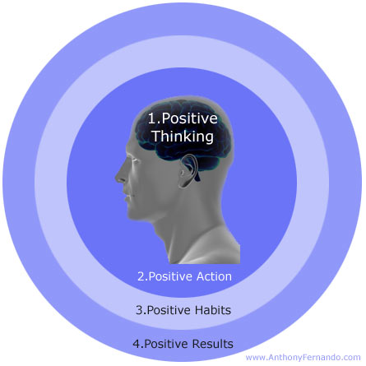
Power of Positive Thinking
www.EWSNetwork.com

Slide 2
The Power of Positive Thinking
The Law of Attraction
Positive Self-Talk
Positive Affirmation
Positive Energy
Healthy Mind = Healthy Body
Gratitude & Letting go of the Past
www.EWSNetwork.com

Slide 3
The Law of Attraction
The law of attraction states that people's thoughts (both conscious and unconscious) dictate the reality of their lives, whether or not they're aware of it. Essentially "if you really want something and truly believe it's possible, you'll get it", but putting a lot of attention and thought onto something you don't want means you'll probably get that too.
Remember when you were learning how to drive and your drivers ed. teacher kept saying “focus on what’s ahead of you and where you want to go and not on the curb”
Just like in life, if you’re always thinking and focusing on where you don’t want to go and what you don’t want to happen then that’s exactly where you’ll go and what will ultimately happen.
www.EWSNetwork.com
Notes:
The law of attraction “what you think about and focus on expands, grows and
multiplies”. Focus on the negative and that’s what you’ll attract and get more of.
Focus on the positive and more good things will come your way.

Slide 4
Positive Self-Talk
77% of the self-talk people use is very negative, counter-productive and self-defeating.
Any time you make a statement about yourself that is negative you are directing your subconscious mind to make you become the person you just described.
The subconscious mind does not know the difference between the statement that we are weak and the statement that we are strong. It accepts our programming just as we give it. It treats everything we tell it with equal indifference. The end result, we end up becoming the result of what we constantly think and say to ourselves and others.
Words of Affirmation and positive self-talk are tools that reverse the damaging affects of negative thinking/programming.
www.EWSNetwork.com

Slide 5
In Class Task
Take a look at your handout. Check off the negative self talk you currently use in column B.
Start exchanging those statements for the positive words of affirmation in column A.
It takes practice!!
www.EWSNetwork.com

Slide 6
Positive Energy
We all have a wide range of concerns - our health, our children, problems at work, the national debt, nuclear war, etc.
Some of these things we have no real control over such as; the past and other people’s behaviour.
- Let’s call these things our circle of concern
Some of these things we can do something about such as; our own behaviour, attitude and thoughts.
- Let’s call these things our circle of influence
What are you focussing your time and energy on?
Are you PROACTI|VE FOCUSSED or REACTIVE FOCUSSED?
www.EWSNetwork.com

Slide 7
Which Circle Relates to Your Focus?
One way to determine which circle you r focus is in is to distinguish between the have’s and the be’s.
The Circle of Concerns is filled with have’s
“If I could just have more time to myself.....”
“I’ll be happy when I have the house paid off…”
“If only I had a more patient husband....”
“If only I had more obedient kids.....”
The Circle of Influence is filled with be’s --- I can be more patient, be wise,
be loving,. It’s the character focus.
The proactive approach is to change from the inside-out: to be different, and by being different, we affect positive change in what’s out there – I can be more resourceful, I can be more diligent, I can be more creative, I can be more cooperative. Anytime we think that the problem is “out there”, that thought is the problem.
www.EWSNetwork.com

Slide 8
Proactive Focus
(Positive energy enlarges the Circle of Influence)
Proactive people focus their efforts in the circle of influence and are driven by their values, not feelings.
The nature of their energy is positive, enlarging, and magnifying, causing their circle of influence to increase.
Circle of Influence
Concern
Reactive Focus
(Negative energy reduces the Circle of Influence)
Reactive people focus their efforts in the Circle of Concern and react based on their feelings.
Their focus results in blaming and accusing attitudes, reactive language, and increased feelings of victimization. The negative energy generated by this type of focus, combined with neglect in the areas they could do something about, causes the Circle of Influence to shrink.
Circle of Concern
Circle of Influence
www.EWSNetwork.com

Slide 9
Positive Affirmation
Affirmation means:
Building yourself and others up and encouraging them
Building people up is more effective than tearing them down!
Finding reasons for praise and applause
Nothing feels better than genuine praise fro m others!
Nurturing and being supportive
We all need recognition and encouragement!
Giving yourself and others reasons to celebrate
It feels good to make someone else feel good!
Affirmation is a win-win situation for everyone.
www.EWSNetwork.com
Notes:
When we do something well and are acknowledged for it, we’re stimulated to do even better the next time.
Just think about how your relationship with yourself and others would change if you started expressing your gratitude and appreciation for the things that people do well and that you appreciate instead of only noticing and nagging about the things you wish they would or wouldn’t do.

Slide 10
Start keeping your eyes open and catch yourself and others doing things right instead of always seeking out and criticizing for what you think is wrong.
When you start focusing on what is good and admirable in yourself and others, life will automatically improve.
Remember that the law of attraction tells us that we will most likely start witnessing more of the things we express gratitude and appreciation for and less of what we don’t.
If you want something from someone, learn to ask for what you want instead of demanding it. We tend to TELL others what to do instead of ASKing them.
www.EWSNetwork.com
Notes:
Most people are much more receptive to a non-demanding request then to an outright order. Demands make people defensive. ASKing someone to do something automatically gives them a sense of control over the situation and allows them to choose to fill your request or not.

Slide 11
Peaks and Valleys
Peaks represent the good times in your life.
Valleys represent the so-called bad times.
Like your heartbeat, your personal peaks and valleys are an essential part of a normal, healthy life.
You can control your own peaks and valleys by what you think and believe.
Valleys should be a time of learning. However, many people fear their valleys and see them as a time of pain, suffering, anger, hurt, frustration and failure.
Once you learn to manage your good and bad times you will gain a sense of healthy balance.
www.EWSNetwork.com
Notes:
Peaks are moments when you appreciate what you have.
Valleys are moments when you long for what is missing.
- You can change a valley into a peak by changing your thinking.
- The path out of a valley opens when you choose to see things differently
- Find and use the good that is hidden in the bad time
Plateaus if you use them as an opportunity to rest and rejuvenate your mind and body.

Slide 12
Healthy Mind = Healthy Body
Psychoneuroimmunolgy (PNI )helps us to understand that our beliefs and thoughts can influence our heart rate, blood pressure, digestion, and immunity and ultimately all of our bodily functions.
Your body’s biochemistry is heavily influenced by what you think, feel, and believe.
Our thoughts can nourish or harm us.
Negative thoughts stem from our beliefs about ourselves and the fears we have as a result of these beliefs.
Ultimately, your body will reflect your mind-set with sluggishness, a suppressed immune system, vulnerability to disease, viruses and lead to illness.
www.EWSNetwork.com
Notes:
What we think or believe can actually affect the biochemical makeup of our bodies and affect our immune system. Negative thoughts and fears can change a healthy alkaline blood system into an unhealthy acidic one.

Slide 13
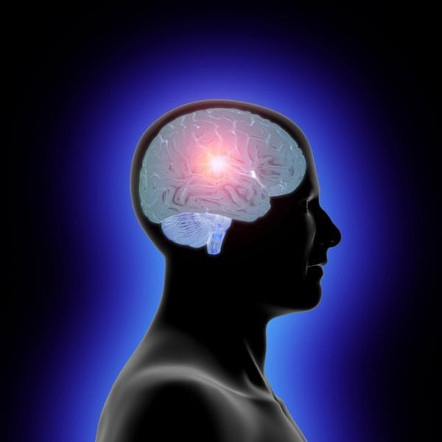
Changing Our Neurotransmitters
98% of the atoms of our bodies are replaced in the course of a year.
If we think enough negative thoughts, we will create unhealthy neurotransmitters and negative energy that will result in poor emotional and physical health. If you think mostly positive thoughts you are likely to produce mood-elevating, healthy neurotransmitters, which will produce a feeling of well-being, safety and positive energy.
Here lies an amazing opportunity for change. We can actually stop acting as if our opinions and perspectives have been carved in stone and can never be altered.
We have complete control over our thoughts
and therefore have the ability to alter our
opinions and perspectives whenever we
choose.
www.EWSNetwork.com
Notes:
Thousands, even millions, of neurons in our brain can fire in a second, each firing creates original and distinct chemistry as well as the possibility for new and different configurations of interconnecting signals.

Slide 14
FEAR
Underneath negative thoughts lie fears, repressed feelings, and issues we haven't dealt with. These take a constant toll on our health. The roots of our fears and beliefs about ourselves are buried in our subconscious minds. Fear is not a real thing. It is a result of our beliefs.
Fear often arises when change appears in our life, whether positive or negative. It is important to recognize the fear as just a reaction, and then let it go.
We need to try and move away from the pessimism to find a more useful and inspiring point of view.
Ask yourself what you would do if you were not afraid and make a plan to start doing exactly that!
www.EWSNetwork.com

Slide 15
Letting go of the Past
• The past has no power to stop you from thinking positive and being happy now. Only your grievance, the baggage of your thoughts and emotions about the past, can do that.
• A grievance is a strong negative emotion connected to an event in the past that is being kept alive by compulsive thinking, by re-telling the story in your head or out loud of what someone did to you or said about you.
• Forgiveness means letting go. We must forgive ourself (let go) for any harm we may have caused our self; forgive all others for any harm they may have caused us; and allow others to forgive us for any harm we may have caused them. Learning to change unhelpful patterns is tough work, but well worth the effort.
A grievance will contaminate not only your mind but many other areas of your life. Let it go!
www.EWSNetwork.com

Slide 16
In Class Task
Write down one or two grievances you currently hold.
Start practicing letting go of the negative emotions that stem from holding onto these past experiences.
www.EWSNetwork.com

Slide 17
An Attitude of Gratitude
Positive people have an unending sense of gratitude.
“When we are happy, we are truly grateful. The reverse also holds true. When we are grateful, we are truly happy.”
In spite of all the catastrophes that might occur we have the ability to cut through all of the misery by simply turning our attention to being grateful for something.
Whenever we notice that joy is absent from our lives, we seem to be complaining, blaming and making excuses for everything, we can look around and find a host of things , events and people to appreciate.
A good habit to get into is to write down at least three things that you are grateful for in your life every day.
www.EWSNetwork.com

Slide 18
Summary
Key points to remember:
Positive thinking improves your mental, physical and spiritual health.
The law of attraction – positive attracts positive and negative attracts negative.
Focus on enlarging your Circle of Influence and your Circle of Concern will be reduced.
Positive thoughts, affirmations, habits and actions equal positive results.
Write down one thing you will start doing today to become more positive!
When you begin to realize and accept that your thoughts will affect your life, positively or negatively, you will have hope, strength and opportunity to create a happier, more positive you.
www.EWSNetwork.com
Notes:
Thinking positive thoughts, using positive self-talk, practicing affirmations and positive habits,
being grateful and letting go of the past are not easy things to do at all times. However, the
more you practice these behaviors the more positive and happier you will become.

Slide 19
Thank you.
Garth Jansen, Employee Wellness Solutions Network
www.EWSNetwork.com I garth@EWSNetwork.com I 519.860.0502

