Slide 1
Employee Wellness Program
www.EWSNetwork.com
Notes:
Rules
Talk about the last 2 years

Slide 2
The Need
Obesity
Almost 60% of adults ages 18 and over, or 14.1 million Canadians, are overweight or obese. (heartandstoke.com)
Obese employees are absent on average 13 times more than non-obese and incur almost 7 times more medical costs. [Ipsos Reid Health Survey 2010]
Physical Activity
Nearly half (49.5%) of Canadians ages 12 and over report being physically inactive. (heartandstoke.com)
Blood Pressure
16.4% of Canadians aged 12 or older reported that they had high blood pressure.
Diabetes
6.6% of the population age 20 and over, have been diagnosed with diabetes. (National Diabetes Surveillance System (2005)
Approximately 80 to 90% of people with type 2 diabetes are overweight or obese. (Canadian Diabetes Association 2008 Clinical Practice Guidelines for the Prevention and Management of Diabetes in Canada)
www.EWSNetwork.com
Notes:
60% Obese or Overweight (36 out of 60ppl)
40% High Cholesterol
25% get 35% of calories from fat
23% BMI over 30
16.4% High BP

Slide 3
The Need
Cholesterol
40% of Canadian adults have high cholesterol. (heartandstoke.com)
Stress
Nearly a quarter (23%) of Canadians report a high degree of life stress.
Employees who experience high stress cost employers almost 50% more in health expenditures. (Canadian Medical Association Journal)
Smoking
$3,396 annually due to increased absenteeism, decreased productivity and the costs of smoking facilities. (Conference Board of Canada 2007)
Health-care costs
Doubling every five years. Joseph Henry (AstraZenece)
More people die of overweight/obesity
issues than of starvation.
(World Health Organization)
www.EWSNetwork.com
Notes:
60% Obese or Overweight (36 out of 60ppl)
40% High Cholesterol
25% get 35% of calories from fat
23% BMI over 30
16.4% High BP

Slide 4
Wellness vs. EAP
Wellness Programs | EAP
Pro-Active | Re-Active
Risk factors are currently a-symptomatic | High and immediate need
Employee is currently present | Employee is presenting with acute symptoms
Productivity may or may not be effected by risk factors | May or may not involve STD or LTD
All who engage will benefit | Required intervention is easily identified
Reaching those who want it and those who need it | Employee seeks assistance
Higher use = higher savings | Higher use = higher cost
www.EWSNetwork.com

Slide 5
Know Your Objectives
Additional benefit
Health concerns
STD/LTD and Workman’s Comp
Retention / Attraction
Marketing (top employer to work for)
Improve the health and wellness of employees
Meet corporate directive
Improved productivity and decreased absenteeism
Decreased cost of health benefits
Educate and motivate staff towards a healthier lifestyle
www.EWSNetwork.com

Slide 6
Return on Investment?
Companies with the most effective health and productivity programs experience superior human capital and financial outcomes.
[Towers Watson, “Staying@Work Report” 2009)
11% higher revenue per employee
1.8 fewer days absent per employee per year
28% higher shareholder return
2010 World Economic Foum report indicates that in organizations perceived as actively promoting health and well-being , 55% of employees reported being engaged compared to 7% in organization without such programs.
Harvard University study found that workplace wellness programs also delivered a significant cost savings for employers. For every $1.00 spend on wellness, medical costs fall by about $3.27 and absenteeism by about $2.73.
www.EWSNetwork.com

Slide 7
Looking at the Business Case Consider the following 3 possibilities.
#1 – The average Health Claims / person / year is $1500 ($125/month).
Reduced this by only 5% that would equal a $6.25 / employee / month savings. ($312.50 based on 50 person company)
#2 – The average Absenteeism in Canada is 7.4 days / employee / year.
Reduce this by only 1 day / year (based on a $50,000 income) and your company will save $16.00 / employee / month . ($800.00 based on 50 person company)
#3 – To recruit, train and manage a new quality employee it may cost your organization an average of $40,000. Reduce this by only 1/2 new employee / year due to STD, LTD or retention and you will save $33 / employee / month . ($1,650.00 based on 50 person company)
Achieve these 3 positive results your organization will save $55.25 / employee / month or $2,762.50 / month.
www.EWSNetwork.com

Slide 8
Employee Wellness Solutions Network
Client Distribution by Company Size
Company Size,
% of overall Clients
www.EWSNetwork.com

Slide 9
Employee Wellness Solutions Network
Client Distribution by Investment
Monthly Investment,
% of overall Clients
www.EWSNetwork.com

Slide 10
Claims Cost Distribution “Disease Costs, Prevention Saves”
“Disease Costs, Prevention Saves”
20% of employees generate 80% of the costs.
Healthy/ At-Risk High Risk Early Active
Low Risk Symptoms Disease
That means, 80% of employees generate only 20% of the costs.
www.EWSNetwork.com

Slide 11
The EWSNetwork System
www.EWSNetwork.com
Notes:
60% Obese or Overweight (36 out of 60ppl)
40% High Cholesterol
25% get 35% of calories from fat
23% BMI over 30
16.4% High BP

Slide 12
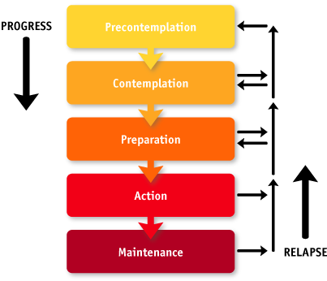
Readiness to Change
Area for Positive Impact and Change
www.EWSNetwork.com

Slide 13
Well Designed Wellness Strategy Links Components Together Giving the Greatest Opportunity for Success
Group
Awareness
Virtual
Individual
www.EWSNetwork.com

Slide 14
Bring YOUR Team together through a comprehensive Employee Wellness Program
www.EWSNetwork.com

Slide 15
The EWSNetwork
Award Winning Program
2011 Health and Wellness Program
(for companies with <1000 employees)
www.EWSNetwork.com

Slide 16
Components of a Successful Wellness Program
Senior Management Support
Pilots the overall direction of the program and cultural objectives.
Helps with scheduling and department support.
www.EWSNetwork.com

Slide 17
Components of a Successful Wellness Program
Wellness Committee
Committee made up of your peers.
Ambassadors of the program.
“Tentacles” of the program. Very valuable source of feedback.
Meet bi-monthly to go over past, present and future initiatives.
Marketing, implementation and feedback from previous events.
www.EWSNetwork.com

Slide 18
Components of a Successful Wellness Program
Health Risk Assessment (HRA/Personal Wellness Profile)
Employee Benefits - Private registration, immediate results highlighting participants’ wellness scores (coronary, cancer, nutrition, fitness, stress/emotional, substance use, safety), health age and recommended health actions. Participants will also be able to access on-line articles that can be accessed from their personal profile . Health recommendations specific to the individual’s results are also shared.
Employer Benefits - Summary and Program Suggestions, Executive Summary Report, Group Summary Report, Productivity and Economic Benefits Report (using company specific income and medical values)
www.EWSNetwork.com/pwp
www.EWSNetwork.com

Slide 19
Components of a Successful Wellness Program Individual Programs
One-on-One Health / Wellness Coaching
The service of a personal trainer, nutrition advisor, stress/time manager and lifestyle coach, “all-in-one”, right at your fingertips!
30 minute one-on-one appointments with a wellness specialist.
Desired turn-around 4-5 weeks.
Help change the individual … they help to change their surroundings
Communicate... Educate... Motivate.
Proven Results – behaviour modification is most effective working with the individual
Personalized Goals – accountability, follow-up, evaluation
www.EWSNetwork.com

Slide 20
Consultation Bookings and Attendance
[January – December 2011]
www.EWSNetwork.com

Slide 21
Components of a Successful Wellness Program
Group Programs
Cross-Canada Challenge
Mountain Climb Pedometer Challenge
World Cup Challenge
Lunch n’ Learns, Workshops
WorkLife Balance Program
Nutrition at Work
4-week Stress and You
6-week Empowered Living
8-week Extreme Lifestyle Makeover
And many others…
Group Exercise Programs
Depending on your facility and surroundings EWSNetwork offers a wide variety of exercise programs.
Walking / Running Programs
Pilates and Yoga Classes
Muscle Toning
Stretching Instruction
Kick-Boxing, Zumba, Step Classes
www.EWSNetwork.com

Slide 22
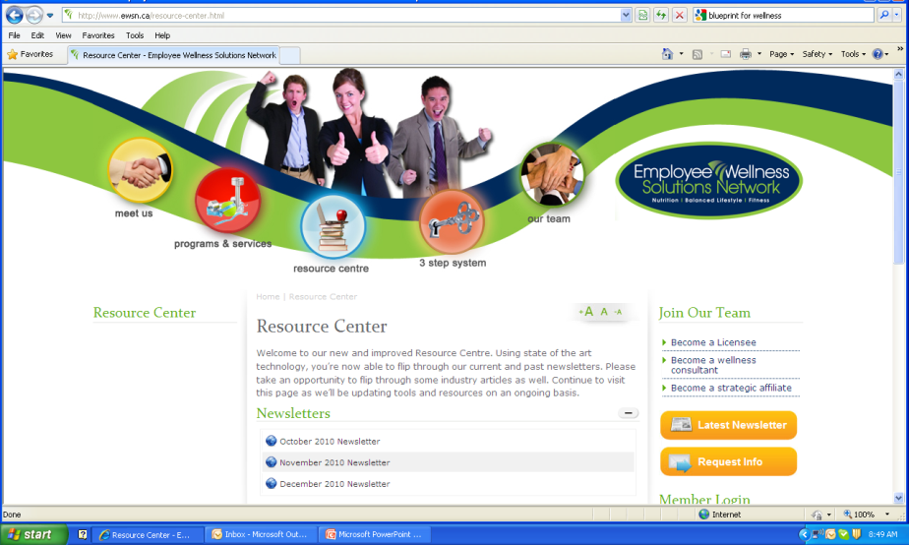
Components of a Successful Wellness Program Awareness Programs
Materials / Campaigns
Wellness Kiosks
Awareness Posters
POD (Point-of-Decision)
Monthly Newsletters
Health Fairs
E-campaigns
Recipe campaigns
EWSNetwork.com Website
Wellness Resource Centre
News / Articles
Walk-arounds
Consultant walks around the worksite to take information to the individual
Spot consultations
Opens up employee to consultant relationship
Increases awareness
Builds engagement within the wellness program
www.EWSNetwork.com

Slide 23
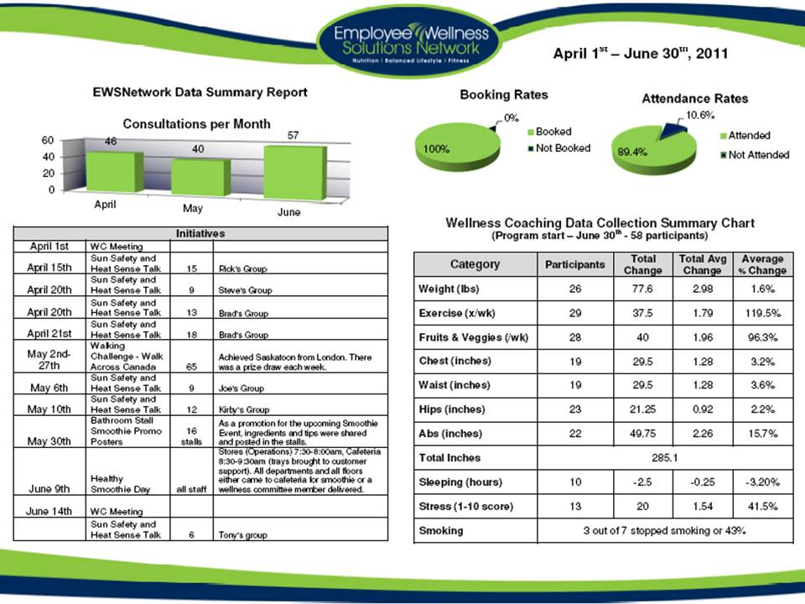
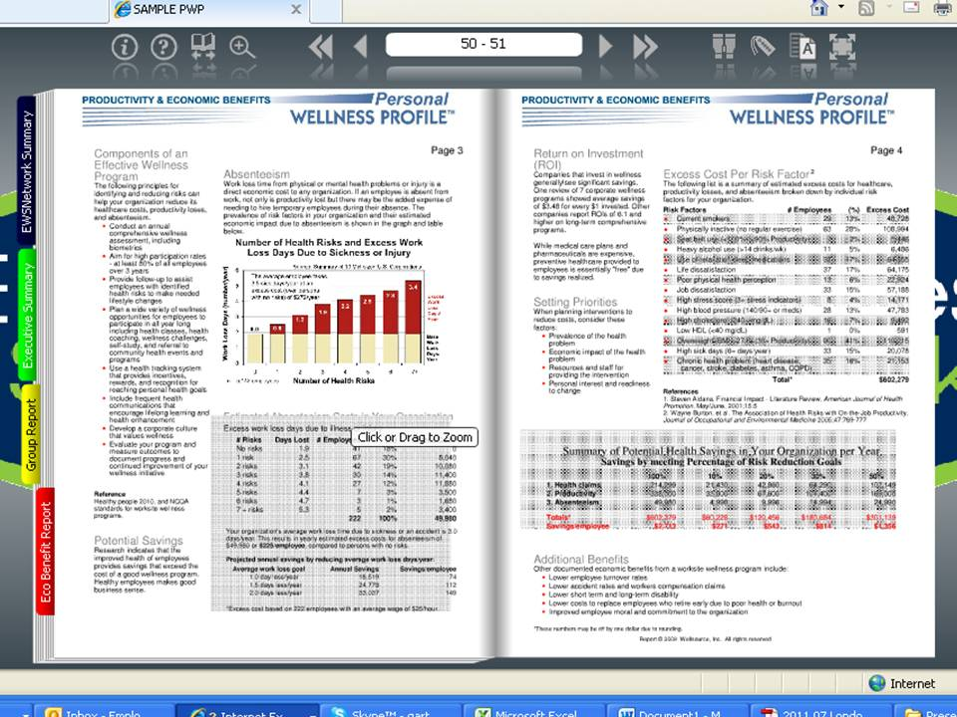
Quarterly Snapshot Reports
Every 3-4 months
Individual Stat Trends
Consultation Numbers
Initiative participation chart
Progression Reports
Every 6 months
Wellness coaching participation rates
Group program participation rates
Past initiative schedule
Wellness committee feedback
Participant feedback
Annual Reporting
Health Risk Assessment / Personal Wellness Profile
Individual participants will receive a comparison report
Corporate reporting will include year to year profile changes and results
Easily shared with other management via pdf, online link, hard copy
www.EWSNetwork.com

Slide 24
Program Launch
www.EWSNetwork.com
Notes:
60% Obese or Overweight (36 out of 60ppl)
40% High Cholesterol
25% get 35% of calories from fat
23% BMI over 30
16.4% High BP

Slide 25
Program Launch Step 1 Decide on the Program
Consider Organizational Set-up
Corporate and Organizational Objectives
Number of locations
Number of employees at each location
Industry
www.EWSNetwork.com

Slide 26
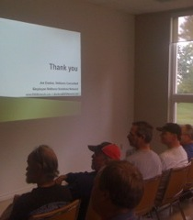
Program Launch Step 2
Marketed with posters, emails, flyers, paystub drops, announcements, memos, intranet and any other mode that is applicable.
An EWSNetwork representative presents the various components of the new employee benefit and introduces the certified wellness consultants who will be working with the organization.
Employees have an opportunity to schedule their first one-on-one consultation at the launch.
Employees have an opportunity to sign up for the wellness committee.
The Health Risk Assessment [Personal Wellness Profile] is launched.
The wellness consultations begin shortly after the launch.
www.EWSNetwork.com

Slide 27
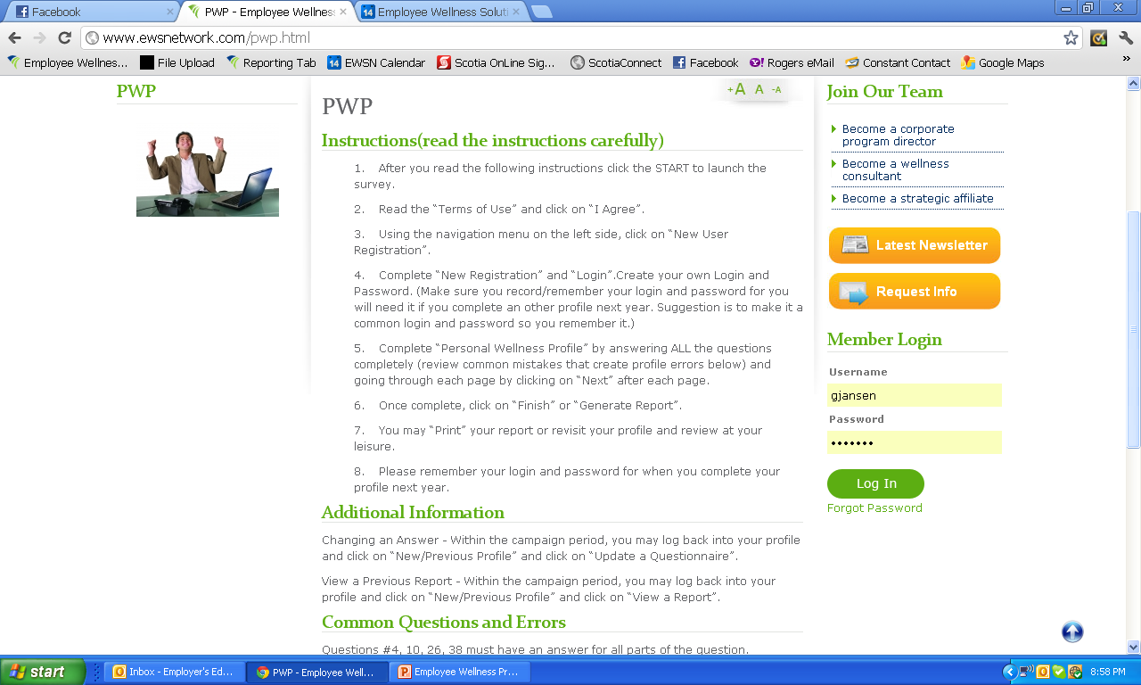
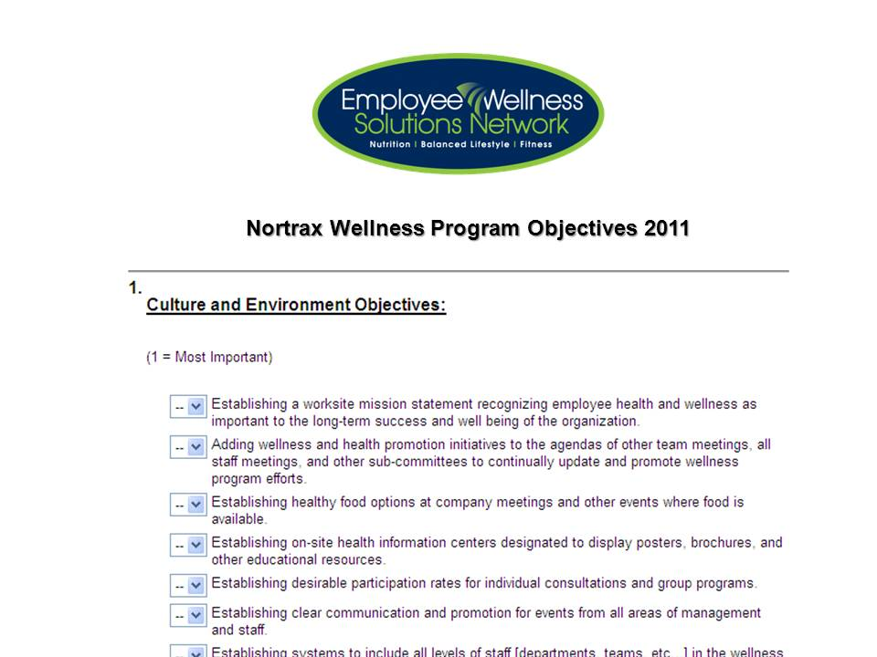
Program Launch Step 3 Analyzing Your Company
Health Risk Assessment
www.EWSNetwork.com/abc
Wellness Committee &
Management Objectives Surveys
First 30-days of
One-on-One Consultations
www.EWSNetwork.com

Slide 28
Enhancing Online Presence
www.EWSNetwork.com
Notes:
60% Obese or Overweight (36 out of 60ppl)
40% High Cholesterol
25% get 35% of calories from fat
23% BMI over 30
16.4% High BP

Slide 29
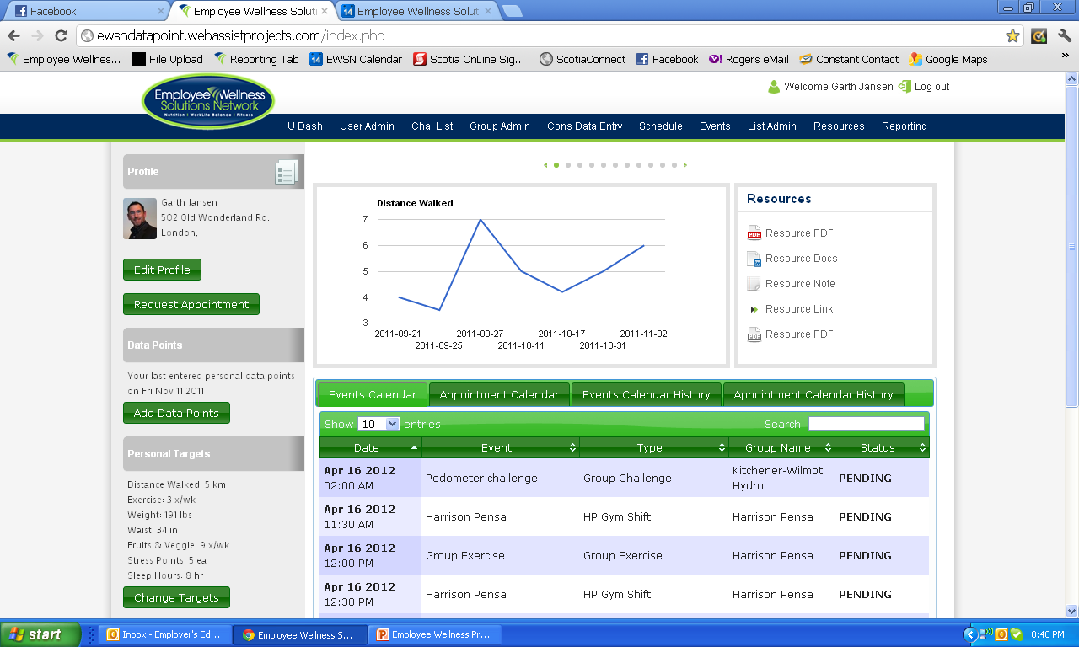
Custom Resource Centre
Data Entry and Graphing
Member/Employee Profile Page
Set Targets / Goals
Current & Past Events & Consultations Calendars

Slide 30
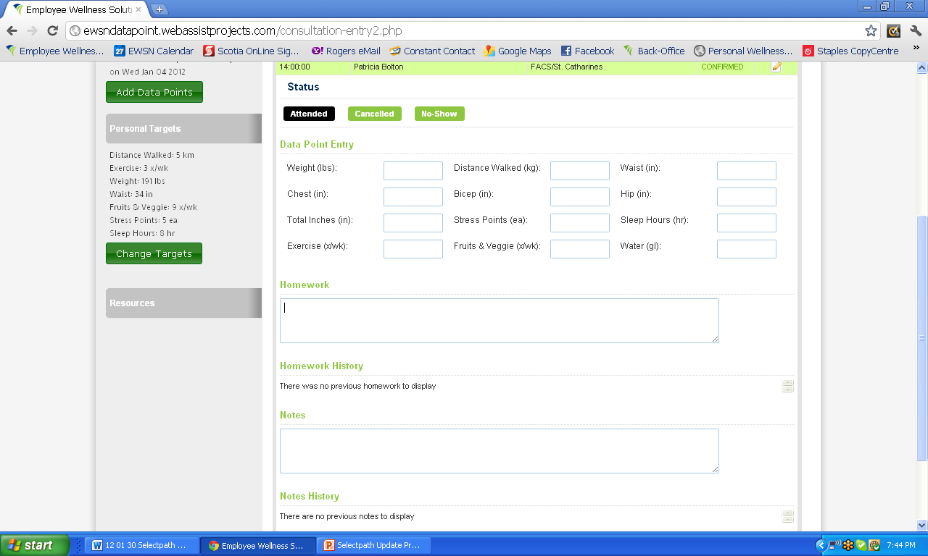
Consultation Data Collection

Slide 31
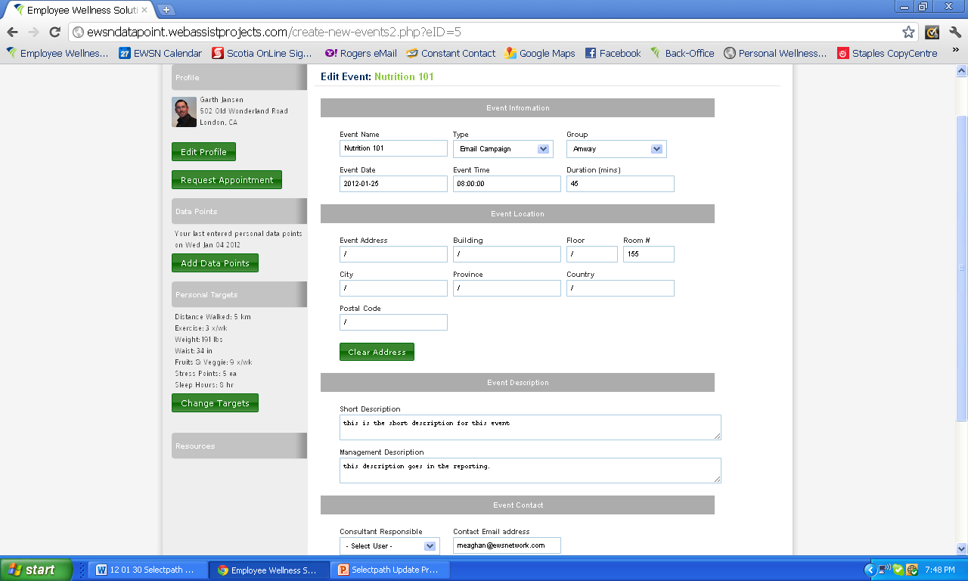
Event Administration

Slide 32
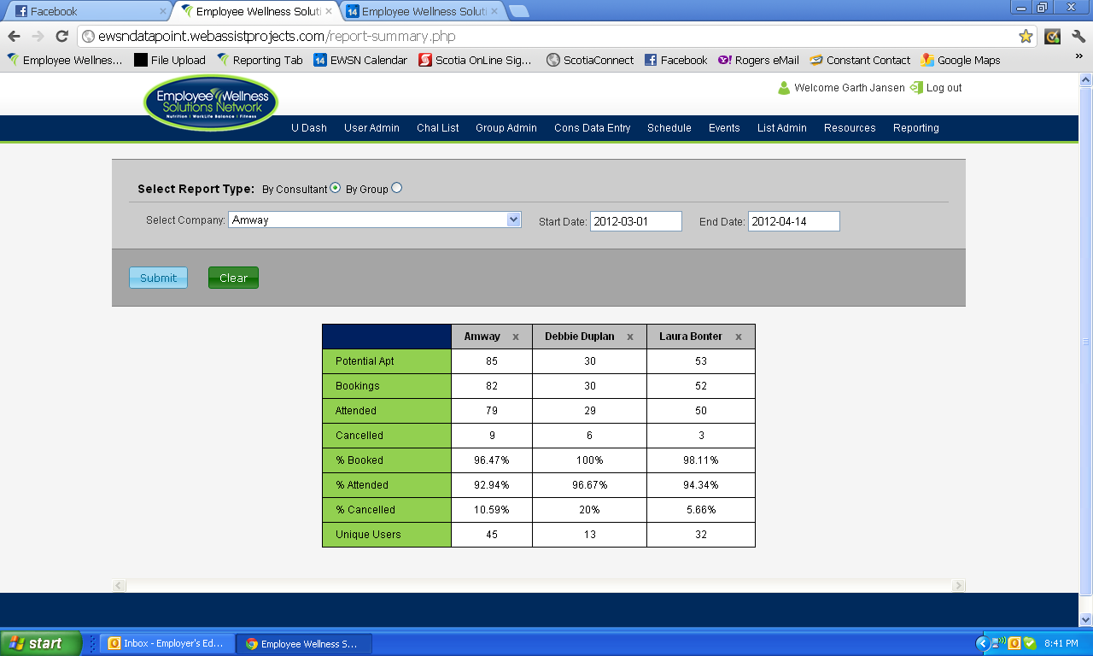
Consultation Reporting

Slide 33
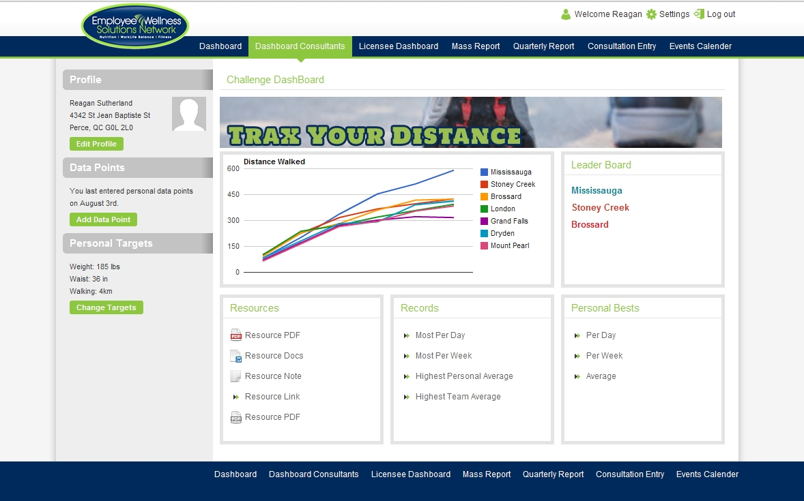
Coming Soon
Virtual Challenge Dashboard
www.EWSNetwork.com
Notes:
60% Obese or Overweight (36 out of 60ppl)
40% High Cholesterol
25% get 35% of calories from fat
23% BMI over 30
16.4% High BP

Slide 34
Summary
Proven results
Proven participation
Hands-on approach
Industry leading consultants
Comprehensive program toolbox
Dominate online presence
Robust real-time reporting
www.EWSNetwork.com
Notes:
60% Obese or Overweight (36 out of 60ppl)
40% High Cholesterol
25% get 35% of calories from fat
23% BMI over 30
16.4% High BP

Slide 35
Thank you. Questions now or later?
Garth Jansen, President, Employee Wellness Solutions Network
www.EWSNetwork.com I garth@EWSNetwork.com I 519.860.0502

