Slide 1
Better Health – Are You Ready?
www.EWSNetwork.com

Slide 2
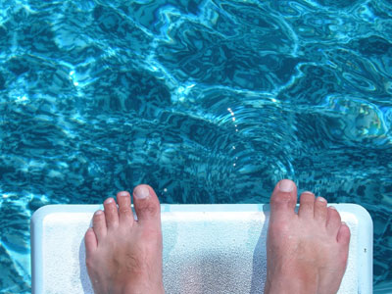
www.EWSNetwork.com

Slide 3
It’s a fact…
W.H.O. states that we now have more people on our planet dying of overweight / obesity issues than we do of starvation.
Obesity - Annual medical expenditures are 36% higher for obese adults vs. those of normal weight.
Blood Pressure - 16.4% of Canadians aged 12 or older reported that they had high blood pressure.
Cholesterol - 40% of Canadian adults have high cholesterol. (heartandstoke.com)
Diabetes - Type II diabetes is 5 times more common among obese people.
Stress and Depression - 30% of all disability recorded at work, 55% of EAP cost and 19% of Absenteeism. (Tangri's research)
www.EWSNetwork.com
Notes:
60% Obese or Overweight (36 out of 60ppl)
40% High Cholesterol
25% get 35% of calories from fat
23% BMI over 30
16.4% High BP

Slide 4
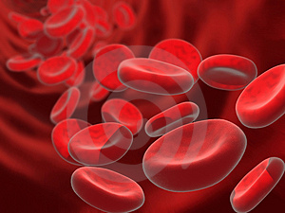
WHO you Are, WHAT you Eat, WHEN you Move, and HOW you Think
The cells in your digestive track are replaced every 3 to 4 days.
Red blood cells are replaced every 120 days.
All of the protein in muscle cells is replaced every 120 days.
All the protein in the brain is replaced twice a year.
Even the protein in bone structure is completely replaced every 3 to 4 years.
10 billion new white blood cells a day.
Source: Well Assured guide to Better Nutrition, Dr. Len Kravitz
www.EWSNetwork.com

Slide 5
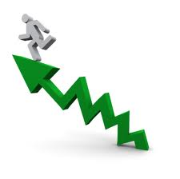
Why Better Health?
We can be worrying about what may happen, or a working on a model about what can happen.
www.EWSNetwork.com
Notes:
Probably talking to the motivated – we know our culture is in a health crisis. We can have a very positive impact on our workplace, social circles, and especially within our families – refer to the network phenomena – friends = 57% Sibling = 40%, spouse = 37%

Slide 6
Self-Evaluation
Abuse
www.EWSNetwork.com
Notes:
Physically – exc 20mins or longer, 3 x week
accumulated physical activity 60mins most days of the week
Mentally – overstressed, stimulated
Emotionally – overstressed, relationships with others

Slide 7
Self-Evaluation
Mis-use
www.EWSNetwork.com

Slide 8
Self-Evaluation
Use
www.EWSNetwork.com

Slide 9
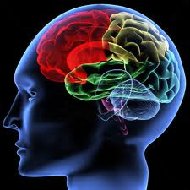
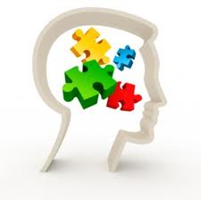
Our-Selves as a Whole
Physical
nutrition, activity, rest
Mental
stimulation, rest
Emotional
stress management,
relationships, rest
www.EWSNetwork.com
Notes:
Refer to body-mind connection, hardwiring and re-wiring of the brain, importance of connection with positive self-talk etc.

Slide 10
Where you are TODAY is a result of decisions made up until NOW.
Where will YOU be…
www.EWSNetwork.com
Notes:
Have them envision making no changes at all, looking down the road at themselves in 2years, 5 years – what will they be doing? Saying? Feeling? Functioning? Level of happiness? Quality of Life?

Slide 11
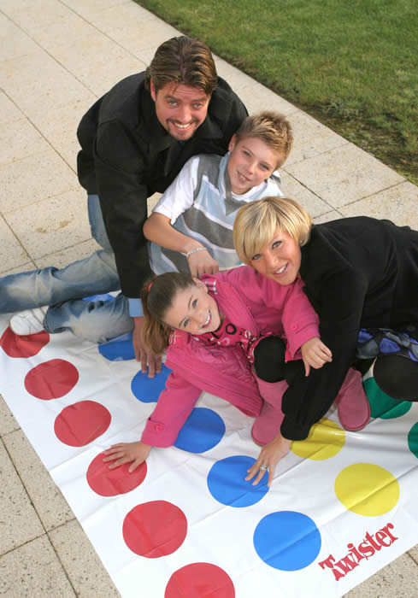
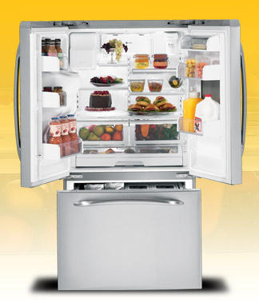
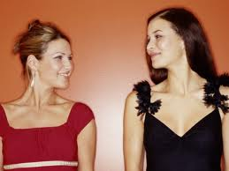
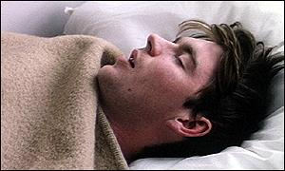
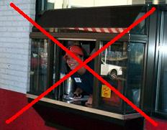
Benefits of small changes
www.EWSNetwork.com
Notes:
Changes don’t have to be monumental, for the benefits to feel monumental

Slide 12
Benefits of small changes
5-10% weight loss will positively impact health profile
Losing 20lbs will decrease the stress on the knee by 40lbs
Improving flexibility through hamstrings and low back can decrease pain/discomfort in the flow back
Increasing water intake to 1.5-2liters/day helps keep joints lubricated
10-12 servings of fruits/vegetables =
10mins daily of meditation can improve mental health
www.EWSNetwork.com

Slide 13
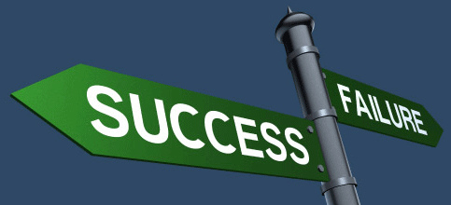
Able doesn’t always mean ready and willing…
www.EWSNetwork.com
Notes:
Focus of today – are you ready? Do you want to move forward? How can you recognize which decisions are right for you? Will see/hear/experience many different options on a myriad of health issues, all of which are good. Which one(s) are best for you? Recognize what is your right fit.

Slide 14
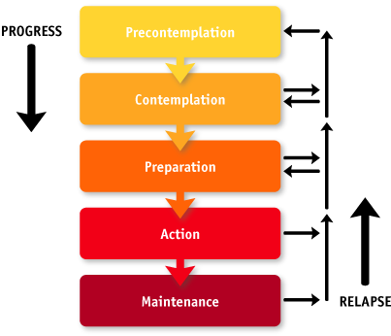
Readiness to Change
www.EWSNetwork.com

Slide 15
Psychology today, Aug 2010 …
Lapse is part of the normal model of change.
The sooner we “forgive” ourselves, the quicker we move forward.
www.EWSNetwork.com
Notes:
Give yourself a break!!

Slide 16
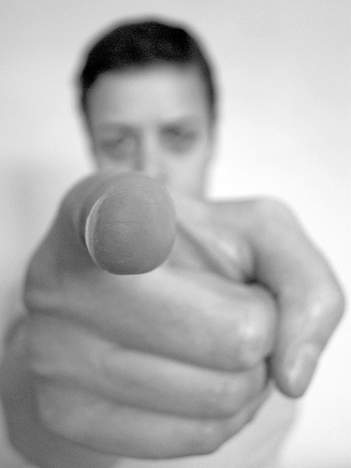
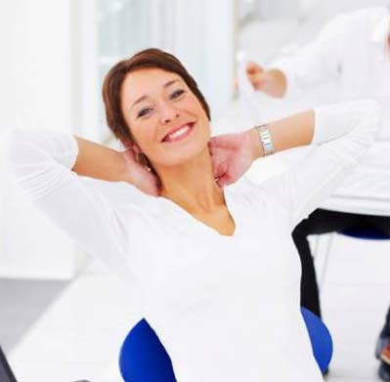
How do you know?
.Pressure Words
Should
Have to
Need
Must
Ready Words
Want
Ready
This feels right
www.EWSNetwork.com

Slide 17
“I should lose weight because I have a family history of heart disease.”
“I have to start exercising.”
“My family said I need to eat better.”
“I don’t want to be tired all the time.”
“I have got to get my stress under control.”
“This just cannot go on any longer.”
Feelings: heaviness, pressure, darkness, foreboding
www.EWSNetwork.com

Slide 18
“That feels right.”
“I’m excited about this.”
“I can do that!”
“This is what I’ve been looking for!”
“I want to make this change.”
“I am ready to get going!”
“Huh!”
Feelings: lightness, excitement, relief, grounding
www.EWSNetwork.com

Slide 19
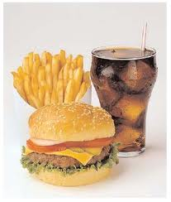
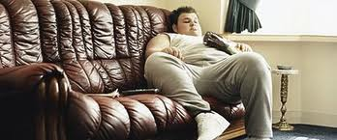
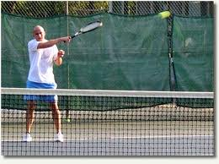
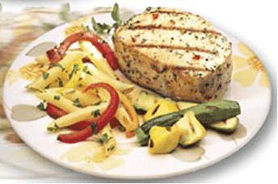
When we say NO to something, we are saying YES to something else!
www.EWSNetwork.com
Notes:
Focus your mind on what you are getting. Not “I’m cutting back on what I am eating” but rather “I eat good portions.”
What do you want that is more fun than this? If you don’t want this, then what do you want?

Slide 20
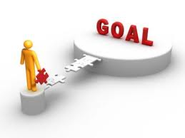
Anchoring yourself in the positive makes it easier to let go of the negative.
www.EWSNetwork.com
Notes:
What do you want, that is more fun that this? Rather than keep stubbing your toe on the coffee table, perhaps it is time to move the coffee table – look after the cause, not the symptom.

Slide 21
If you don’t know where you are going, you’ll end up someplace else.
Yogi Berra
www.EWSNetwork.com
Notes:
Analogy of backing up. Turn around, see what you want and move directly towards it.

Slide 22
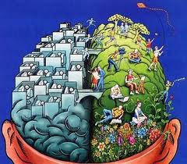
Where your mind goes, the body will follow.
Where the body goes, the mind will follow.
www.EWSNetwork.com
Notes:
Neuroplasticity – what circuits do you run regularly that you would like to change? Frustration? Fatigue? Bitterness? Anger? Replace our thoughts and we change our physical reality.

Slide 23
What do you get out of today?
Where is the best place to start?
www.EWSNetwork.com
Notes:
Make a decision that today is a beginning. Rather than having a great experience, having a great beginning. Use analogy of diving board/pool.

Slide 24
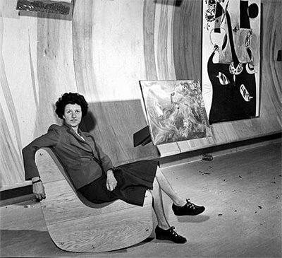
Peggy Guggenheim
“A whim of iron…”
www.EWSNetwork.com
Notes:
The Peggy Guggenheim Collection is one of the most important museums in Italy for European and American art of the first half of the 20th century. Pieces in her collection embrace Cubism, Surrealism and Abstract Expressionism.

Slide 25
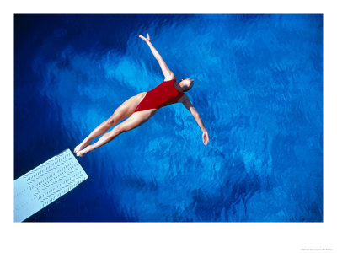
The main thing is
to keep the main thing
the main thing.
Mike Lipkin
www.EWSNetwork.com

Slide 26
Thank you. Questions now or later?
Garth Jansen
Corporate Wellness Specialist, Employee Wellness Solutions Network
www.EWSNetwork.com I garth@EWSNetwork.com I 519.860.0502

