Slide 1
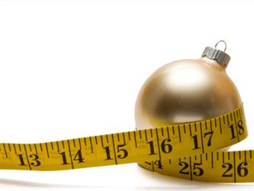
Maintain Don’t Gain
www.EWSNetwork.com

Slide 2
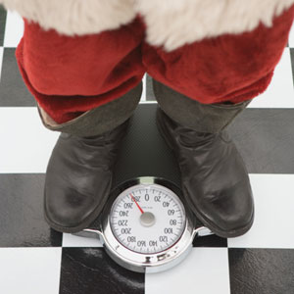
Presentation Outline
Holiday Weight Gain
What is Maintain Don’t Gain?
Week 1: 6 Tips to Maintain
Week 2: Holiday Drinking
Week 3: Staying Active
Week 4: Holiday Nutrition Tips
Week 5: Healthy Cooking Tips
Week 6: Stress Busters
www.EWSNetwork.com

Slide 3
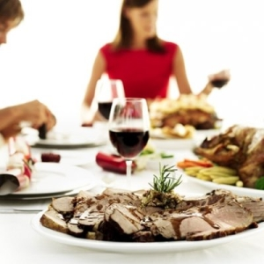
Holiday Weight Gain
“Almost all the weight people had gained over the course of a year could be explained by the pounds they added over the holiday period.”
Holiday Weight Gain Prospective Study
Good News/Bad News Story
2 main factors that influence weight gain
www.EWSNetwork.com
Notes:
Study was conducted by researchers from National Institutes of Health who looked at 195 people over the course of 6 months (during the “holiday weight gain” season – thanksgiving to new years)
Good News/Bad News Story:
Good news is people don’t gain as much weight as they thought over the holidays. They gained avg of 1 pound where most people think they gain 5 – 10lbs. Only less than 10% subjects gained 5 or more pounds.
More importantly in the bad news. Bad News is that weight gained over the winter holidays isn’t lost during the rest of the year. Subjects who came back a year later to be weighed gained an extra 1.5 lbs.
2 main factors:
Subjects who reported being much more active or much less hungry were least likely to gain weight over the holidays
Those who reported being less active or more hungry had the greatest holiday weight gain

Slide 4
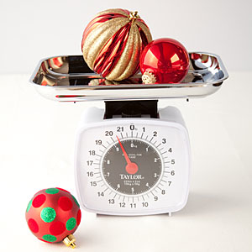
Take home message
“Although an average holiday weight gain of less than a pound may seem unimportant, that weight was not lost over the remainder of the year.” Dr. Yanovski (researcher)
Physical Activity!
www.EWSNetwork.com
Notes:
Take home message:
The cumulative effects of yearly weight gain likely contribute to substantial increase in body weight that frequency occurs across adulthood
Promotion of weight stability during the “holiday weight gain” months is a useful strategy to prevent obesity and overweight individuals.
Exercise!
Subjects who reported more physical activity had LESS holiday weight gain
Suggests that increasing physical activity is an effective method to prevent weight gain during this high-risk time

Slide 5
Why Maintain Don’t Gain?
Best way to manage weight is when you never feel deprived.
Choose foods that you actually enjoy that are also lower in fat, sugar, and calories.
How?
Fill your plate with fresh fruits, salad greens, and filling veggies.
Portion control on the “guilty pleasures”
www.EWSNetwork.com
Notes:
Dieticians agree the best way to manage weight is to modify eating habits so you never feel deprived
We will talk about the half plate rule and more practical ways to maintain your weight.

Slide 6
Week 1: 6 Tips to Maintain
To maintain your weight, you need to balance the energy you take in with the energy you burn.
Focus on friends and family instead of food.
Stay active.
Holiday drinking.
Eat a healthy snack beforehand.
Portion control practically.
If you overindulge, get back on track.
www.EWSNetwork.com
Notes:
Week 1: the holidays are a time to slow down and catch up with your loved ones. Family gatherings may be centered around the dinner table, but it’s certainly not the focus
Week 2: tons of ways to be active outdoors with your family (we’ll talk about this)
Week 3: holiday drinks add a HUGE amount of calories to your holiday intake
Week 4: skipping meals to “save” calories and carbs for your holiday feast is NOT the way to go. This will make it harder for your blood glucose levels to stay leveled and you will almost always over eat.
Snack on lean protein because it burns more calories and it’ll keep you fuller for a longer period of time.
Week 5: eat slowly, use smaller plates, use the half plate rule, and use a tall/skinny glass
Week 6: if you ate more than you intended, don’t think you have failed!! Focus on enjoying the rest of the night with your family. Get back on track but exercising and watching your eating habits starting the next day.

Slide 7
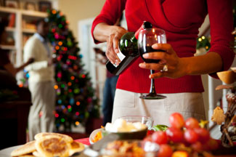
Week 2: Holiday Drinking
#1 Culprit: soft drinks, holiday drinks, and alcoholic cocktails!
Drink | Calories
12 ounce can of soda | 150 calories
16 ounce punch | 200 calories
2 ounces (shot) of liquor | 125 calories
5 ounce glass of wine | 160 calories
12 ounce bottle of beer | 160 calories
8 ounce margarita | 240 calories
1 serving eggnog | 400 calories
www.EWSNetwork.com
Notes:
#1 culprit for excess sugar consumption: soft drinks, holiday drinks (eggnog), alcoholic mixed drinks

Slide 8
Notes:
How much is in a drink
Recommended Serving Size:
12 oz beer
5 oz wine or
1.5 oz liquor

Slide 9
Week 3: 10 Tips to Staying Active
Take time out for yourself.
Stick to your existing routine.
Keep a daily record.
Make New Year’s resolutions early.
Christmas shopping.
Shoveling.
Commit to a brisk 10-15 min walk.
Buy a pedometer.
Get outside!
Family night.
www.EWSNetwork.com
Notes:
Canada’s physical activity guide recommends to be active 2.5 hours a week to obtain health benefits.
When you’re feeling “peopled-out” use this time to be by yourself, relax, and get some exercise.
Don’t let the holidays be a reason to lose your routine
Keeping a record is an easier way to track your progress and to actually see what you accomplshed
Make your new year’s resolution soon. Don’t wait until Jan 1.
Park as far as possible from the mall and briskly walk to your destination.
Shoveling your driveway is a greater way to get exercise and somebody’s gotta do it!
No matter where you eat, before or after dinner, commit to a short, BRISK walk
Buy a pedometer to track how many steps you take each day. Your goal should be 10,000 steps/day
Skating, cross country ski, toboggan, the possibilities are endless
Rather than watching a movie, try doing something different with your family. As long as you’re moving and having fun, that’s already an improvement!

Slide 10
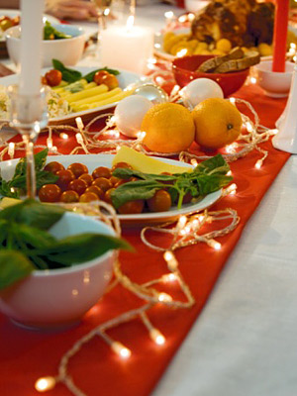
Week 4: Holiday Nutrition Tips
Revising recipes
Planning tips
How much and what will I eat?
Healthy snack beforehand
One healthier option per category
At the party
Share dessert
Start off with salad or soup
White over dark meat
Lay off the booze
Smart portion control
Half plate rule
www.EWSNetwork.com
Notes:
This is the most practical but hardest way to maintain and not gain!
Revising recipes
Cut out half the sugar
Swap mashed bananas or applesauce for oil
Planning tips:
Decide BEFORE the party how much and what you will eat.
Choose a healthy snack that’s a lean protein. Protein takes more energy to burn (so you burn more calories), and it makes you feel fuller longer. Ex. Edamame, hummus, low fat cheese
If you are cooking, provide one healthier option per category. For dessert, bring fresh fruit; for side dishes, bring veggies.
At the party:
Share dessert with another person and scrape off any whipped cream or frosting
Start off with fresh greens. Skip a second helping of stuffing, gravy, mashed potatoes.
Choose white, skinless meat over dark meat. You save about 25 calories and 5 times the amount of fat!!
Stay away from high caloric cocktails (eggnog, mixed drinks). Hold something in your hand like water or keep to one glass of wine for the night.
Smart Portion Control:
Use smaller plates
Use the half plate rule
Use a tall, skinny glass

Slide 11
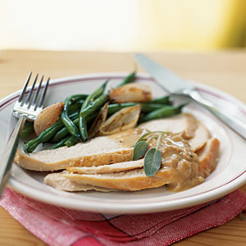
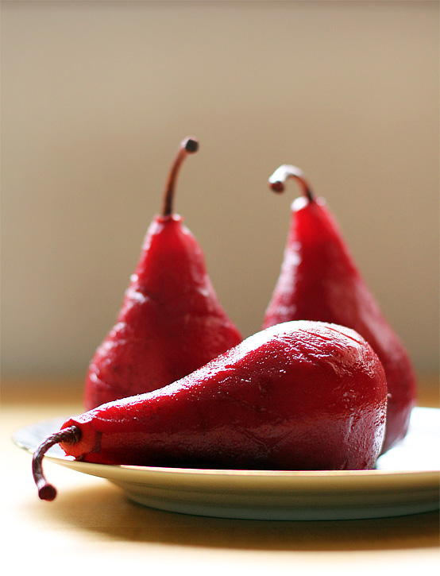
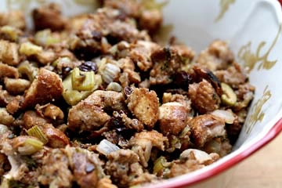
Week 5: Healthy Cooking Tips
Gravy
Stuffing
Turkey
Desserts
www.EWSNetwork.com
Notes:
Practical ways to make your holiday meals healthier:
Gravy: refrigerate it and harden the fat. Skim the fat off to save 56 mg of fat per cup!!
Stuffing: use less bread and add more onions, garlic, veggies. Add fruit like cranberries or apples. Use low sodium chicken broth or applesauce.
Turkey: as mentioned, enjoy skinless turkey breast to save 11 g of saturated fat per 3 oz serving!
Desserts: If you bake, there are tips you can get away with. Substitute 2 egg whites for a whole egg. Replace heavy cream with evaporated skim milk for cheesecakes and cream pies. Top cakes with fresh fruit, or fruit sauce instead of frosting.

Slide 12
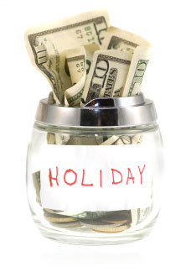
Week 6: Holiday Stress Busters
Cortisol and weight gain
7 tips to fight holiday stress:
Take a breather.
Don’t abandon healthy habits.
Stick to a budget.
Plan ahead.
Don’t give in to the ‘gimmes.’
Learn to say no.
Be realistic about relatives
www.EWSNetwork.com
Notes:
Holiday stress sets in when you try to do it all.
The “stress hormone,” cortisol, is secreted during physical or psychological stress which may alter its normal pattern of secretion. Disruption of cortisol (which controls insulin levels) may not only promote weight gain but also affect WHERE you put on the weight.
Studies show you can redeposit fat in the abdominal area aka “toxic fat.” This area is correlated with development of cardiovascular disease, heart attacks and strokes.
7 tips:
Don't let the holidays become a free-for-all because it only adds to your stress and guilt.
Before you go grocery or gift shopping, decide how much money you can afford to spend. And stick to it!
Plean menus ahead of time. Set specific days to meet friends and family,
Giving into every “I want, I want” can cause financial distress. Focus on holiday traditions that are free i.e skating, volunteer, bake holiday cookies
Saying yes when you should say no can leave you feeling resentful and overwhelmed
Don’t try to solve past issues with family members over the holidays. Have realistic expectations for the short term

Slide 13
Summary
To maintain your weight, you need to balance the energy you take in with the energy you burn.
Watch what you drink because calories can add up really quickly.
Be active by sticking to your existing gym routine and spending time outdoors.
Plan ahead before holiday parties, use the half plate rule, and choose healthy, second helpings.
If preparing your own holiday meal, think about ways to cut sugar and fat.
Fight holiday stress by recognizing stress triggers and make a game plan so you can relax and enjoy the holiday season.

Slide 14
Thank you Questions now or later?
www.EWSNetwork.com

