Slide 1
“How to Eat for Optimal Energy”
Sunshine Building Maintenance Inc.
September 23, 2011

Slide 2
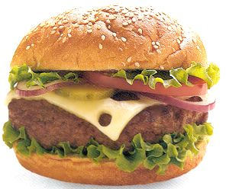
You are what you EAT!
Do you eat breakfast?
Do you bring a lunch to work/buy it?
How many meals/day do you consume?
Do you eat a well-balanced dinner? Eat out?
Do you drink at least 8 glasses of water/day?
How much coffee do you consume/day?

Slide 3
Once upon a time…
“Eat 3 ‘square’ meals a day”.
“Only eat when hungry”.
“Only drink when thirsty”.
“Eat once a day for weight loss”.
The less calories in, the better!

Slide 4
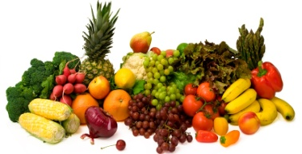
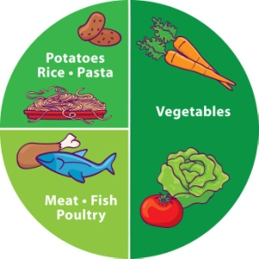
Maintaining energy…nutritionally
Right Times
Right Choices
Right Combinations
Notes:
Three strategies in maintaining energy and a healthy metabolic rate [ability to consume food and use it as energy] we’re going to explore are….
These are the three strategies we’ll be targeting today.

Slide 5
The Right Times
Metabolic environment
Metabolic wheels – are yours turning?
Resting metabolic rate
Blood sugar drops? Fatigue?
Notes:
Eat at the right times will train the body to know it’s going to be fed on a schedule. The more on a schedule the body is trained and knows it will be fed, the less fat storage and subsequent weight gain happens. The less we eat on a schedule, the more apt our bodies are to hold onto the food and calories we consume. Our bodies go into storage mode or starvation mode if it’s not fed frequently. It actually wonders when it will be fed again. The fat storage picks up as a survival mechanism.
Men hold their weight around the mid section, women hold their weight between stomach, hips and thigh – typically [point to your body in these areas].
Go through points.

Slide 6
Ideal timing is every 3 hours
FAVORABLE
UNFAVORABLE
3 hours
3 hours
Blood sugar is consistent
No drops or spikes in energy
Energy is sustained
Blood sugar is NOT consistent
Energy levels drop and peak
which may lead to over-eating
Energy is NOT sustained
Notes:
Again, ideally for the body, eating every three hours is recommended. Again, here’s why…explain the two slides with arm motions for interaction.

Slide 7
Convincing Data
New England Journal Med.
2 weeks
Ate 6 small meals vs 3 large meals (containing the same amount of food)
Reduced LDL by 15%
Reduced cortisol (stress hormone) by 17%
Reduced insulin levels by 28%
European Journal Clinical Nut.
Eating compact, balanced, nutritious meals every 2-3 hours throughout the day:
Increased metabolism
Burned more fat
Lessened chance of becoming overweight

Slide 8
Convincing Data
International Journal of Obesity and Related Metabolic Disorders
Eating frequent meals throughout the day helps control the appetite.
American Journal Clinical Nut.
People are most successful at losing fat and keeping it off when numerous small meals are eaten.
European Journal Clinical Nut.
6 meals/d vs. 2 meals/d
Frequent eating helps blood sugar and insulin levels stay strong and steady.
Insulin levels spike, fat storage starts, blood sugar drops, energy plummets with 2 meals/d.

Slide 9
Energy Slump? Why and How?
1. EAT
2. Stomach
5. Insulin
3. Glucose
4. Blood
Stream
6. Glucose Transporter
7. Cells, Tissues, Organs
Fat Storage
&
Drops in Energy
Notes:
As this slide is sequencing, you can explain it. Say that this slide looks more confusing than it really is. Let me show you [show the audience using your hands and arms….see video for what I mean].
Food goes in, into the stomach, into the bloodstream. Insulin, a hormone, is triggered to send Pac Men to the blood stream to transport the sugar to other areas of the body – cells, tissues, fat storage, liver, heart, lungs, etc… If these pacmen move too quickly, what happens? Our blood sugar drops, we are fatigued and we crave more sugar to make our levels high again. If these pacmen move more slowly and continual, your blood sugars remain even with little drops in sugar and in subsequent energy. The trick is WHAT we consume….and we’ll target that coming up.

Slide 10
To avoid drop in blood sugar… plan your meal times!
Time you get up __________
Breakfast __________
Mid Morning Snack __________
Lunch __________
Mid Afternoon Snack __________
Dinner __________
What are the times that fit your schedule?
Common ‘struggles’…

Slide 11
The Right Food Choices
Strategic eating
3 macronutrients – carbohydrate, protein, fat
DRY and WET carbs
Low vs high glycemic index carbohydrates
Notes:
The second strategy is choosing the right things to eat. We’re going to focus on three of the main macronutrients today – carbohydrates, protein and fats.
To start with, let’s take a look at carbohydrates. Now, I want to keep this as simple as possible. I want you to think about cards as two types – DRY and WET. The DRY carbs would include cereals, breads, wraps, rice, pasta,

Slide 12
Glycemic Index of Food
HIGH GLYCEMIC FOODS (>70):
Food GI
Instant Rice 124
Corn flakes 119
Rice Krispies 117
Jelly Beans 114
French Fries 107
Soda Crackers 106
Potato (boiled, mashed) 104
White Bread 100
Melba Toast 100
Couscous 93
Oatmeal (instant oats) 87
Ice Cream 87
Table Sugar 83
LOW-MED GLYCEMIC FOODS (<55-70):
(Choose these more often)
Food GI
Oatmeal (slow cooked oats) 70
Parboiled Rice 68
Oat Bran Bread 68
Pumpernickel 66
All-Bran 60
Popcorn 58
Sweet Potato 54
Skim Milk 46
Brown Pasta/Rice 40-70
Lentils, Kidney, Baked Beans 40-69
Banana 46
Apple 34
WHY ??
Adapted from: Canadian Diabetes Association
Notes:
Does anyone know about the glycemic index? Take a look at your GI tip sheet. You may take a look at it and feel free to ask us any questions about it. It all comes down to the sugar content of the food and how quickly it appears in the blood and how quickly it escapes to the fat storage cells.
Let me know show you an example….HOLD UP WHEAT AND WHITE PASTA. So, “what’s the difference between these two – white and whole wheat’?? Hopefully they’ll yell some answers out. The main difference is how much sugar and fibre are in these two products. The whole wheat one has much more fibre and protein – which means is has less sugar. Versus, the white one here has less fibre and protein and it has more sugar. The difference is how the pac men react…remember, they LOVE sugar. If we have a diet high in refined carbs, our sugar intake is high which means we’re more prone to fatigue, cravings and weight gain.

Slide 13
The Right Food Choices
Strategic eating
Low vs high glycemic index carbohydrates
Bright colored fruits and vegetables
High fibre foods
Whole grain foods
Lean proteins
Low in saturate and trans fats [unsaturated]
Notes:
The second type of carbohydrate – are the WET ones
Did you know that fruits and vegs are carbohydrates?
The great thing about this type of carbohydrate is they are chalk full of vitamins, minerals, fibre and water.
An analogy I’d like to share with you is I want you to think about why the fibre in fruits and vegs are so important. This type of carbohydrate acts as a Natural Broom in the body. The fibre actually sweeps away [use your hands to show this] the junk, toxins, and fat deposits out of the body….Fruits and Vegs are super foods for keeping your body swept clean of junk that can build up and be harmful.
Let’s talk fats! There are 3 types:
Trans, saturated, and unsaturated – I’m going to start with an analogy…
Think of the difference between the fats like this [I might bring three pliable props for you…]
TRANS – think of a heavy cable. It doesn’t matter how hard I try to break it with my hands, it won’t budge. Think of fat like this. When I consume fat that doesn’t break down, the whole fat globule moves to areas in the body without being broken apart. This is truly dangerous. What types of foods are high in trans fats? ASK THE AUDIENCE…
SATURDATED – think of a highlighter. I might be able to denature this type of fat over time with some work. Again, a not-so-helpful fat for our bodies. When I consume foods high in saturated fats, again, they don’t break down easily thus they wreak havoc on my body, arteries and heart.
UNSATURATED – think of a pencil. Snap, snap, snap…no problem in breaking unsaturated fats apart – or in other word – metabolize this type of fat very easily. The body LOVES unsaturated fat – the fat cells don’t. So, a diet high in unsaturated fats is wise.

Slide 14
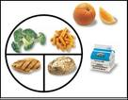
The Right Combinations
Eat a variety of foods
Lessen boredom
Enough vitamins and minerals
Eat a carbohydrate and a protein together
(with every meal)
Not 5 chicken breasts…

Slide 15
The Right Combinations
Notes:
You’ll see there are three columns of food. DRY carbohydrates is on your left, WET carbohydrates is in the middle, and PROTEIN/FAT is on your far right.
The instructions say, for meals, choose one from each column [one dry, one wet, and one protein/fat]. For snacks/smaller meals, choose one food item from either the dry or the wet column plus a protein/fat.
What’s the moral of the story? You’ll consuming protein/healthy fat with every meal. I ask that you put this on your fridge when you get home and track your energy levels doing this! We’ll talk serving sizes/portion control the next time! For a quick reference, you can take a look at the Canadian Food Guide you have in your package for servings of these and other foods.

Slide 16
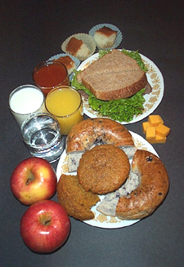
Summary
Eating every 3 hours
Choosing the right foods
Eating the right combinations of foods
(carbohydrate and protein coupled together)
Remember Mr.

Slide 17
Thank you. Questions now or later?
Meaghan Jansen
Certified Corporate Wellness Specialist, Employee Wellness Solutions Network
www.EWSNetwork.com I garth@EWSNetwork.com I 519.860.0502

