Slide 1
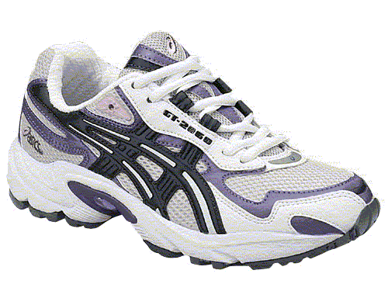
Personal Walking Works Card
For every 5000 steps your pedometer records, cross off a shoe. If you do not have a pedometer, for every 30 minutes you walk, cross off a shoe.
**FULL CARD = 20,000 steps OR 2 hours of walking**
Put full cards in the marked envelope/fish bowl. Don’t forget your name and extension! Prize draws will be done at the end of the campaign. The more completed walking cards, the more chances you have to WIN!
Name: ________________________ Ext.: ______________

