Slide 1

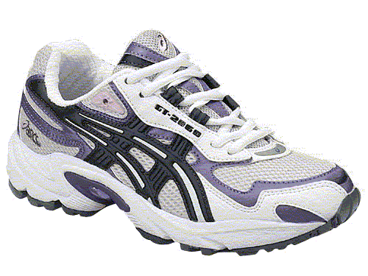
Personal Walking Works Card
For every 1000 steps your pedometer records, cross off a shoe. If you do not have a pedometer, for every 6 minutes you walk, cross off a shoe.
**FULL CARD = 5000 steps OR 30 mins of walking**
Put full cards in the marked envelope/fish bowl. Don’t forget your name and extension! Prize draws will be done at the end of the campaign. The more completed walking cards, the more chances you have to WIN!
Name: ________________________ Ext.: ______________

Slide 2

London Hydro Walk Across Canada
For every 1000 steps your pedometer records, cross off a shoe. If you do not have a pedometer, for every 6 minutes you walk, cross off a shoe.
**FULL CARD = 5000 steps OR 30 minutes of walking**
Put full cards in the marked envelope/fish bowl. Don’t forget your name and extension! Prize draws will be done on each FRIDAY of the month of May. The more completed walking cards, the more chances you have to WIN!
How far across this country will London Hydro walk?
Name: ________________________ Ext.: ______________

