Slide 1



©2023 EMPLOYEE WELLNESS SOLUTIONS NETWORK INC. – ALL RIGHTS RESERVED

Slide 2
TODAY’S FOCUS…
Understand what financial wellness is
Appreciate the link between your finances and your health
Learn the importance of your money mindset
Recognize what you can do to improve your financial well-being
Understand how to prepare for the future
Please note that everyone’s financial situation is unique. The content we are sharing here is for information purposes only. If you are looking for financial advice, we recommend that you consult with a financial advisor who can review your personal finances and provide the appropriate guidance and support.

Slide 3
What is Financial Wellness?

Slide 4
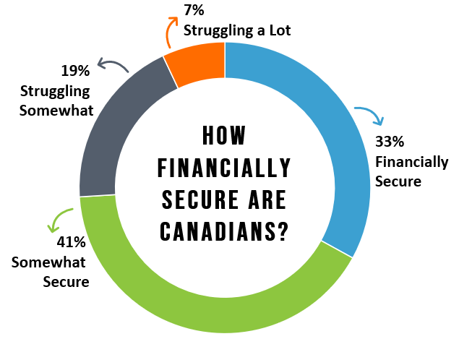
According to a 2018 study, only 33% of Canadians feel financially secure.
That means a lot of us could benefit from investing in our financial well-being!
Notes:
According to a 2018 study, only 33% of Canadians report that they feel financially secure. That means that there is a large population that can benefit from investing in their financial well-being.

Slide 5
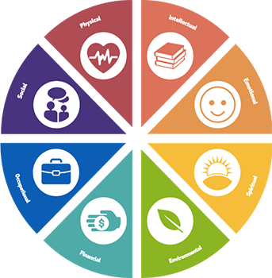

But What is Financial Wellness?
Physical
Intellectual
Social
Emotional
Occupational
Spiritual
It’s an important part of your overall well-being
Financial
environmental

Slide 6
Understanding Financial Wellness
Money and stress often go hand-in-hand, so financial wellness is about effectively managing your economic life to help AVOID this stress.
Financial wellness goes beyond just money… it’s an intentional way to live when it comes to your personal finances so you can enjoy life.
Notes:
For many people, money and stress often go hand-in-hand. Perhaps it’s having difficulty meeting financial commitments or worrying that you’re not saving enough for the future. Money-related concerns can cause all kinds of challenges, so it’s important to learn how to effectively manage your economic life.
But financial wellness isn’t just about money and it’s not an end-state. The goal isn’t simply to have a lot of money. Rather, it’s an intentional practice and way to live when it comes to your personal finances so you can enjoy life. Better financial well-being is associated with less stress overall and greater mental and physical health. Being financially healthy is an important piece of your overall wellness, and there is a dynamic relationship between your finances and the state of your physical, mental and social well-being.

Slide 7
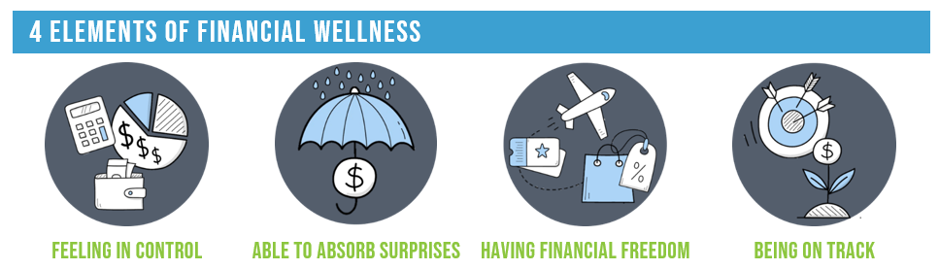
4 Elements of Financial Wellness

Slide 8
4 Elements of Financial Wellness
You feel in control of your daily and monthly finances.
Expenses are covered and bills are paid on time without much worry.
Notes:
Feeling in control
People with high financial well-being feel in control of their daily and monthly finances. Expenses are covered and bills are paid on time without much worry about having enough money to get by.

Slide 9
4 Elements of Financial Wellness
Financial emergencies don’t cause panic and high stress.
You have a safety net (savings, insurance) to prevent unexpected expenses from turning into long-lasting setbacks.
Notes:
Able to absorb surprises
Financial emergencies don’t cause panic and high stress when you have good financial wellness. You have a safety net such as savings or insurance to prevent unexpected expenses from turning into long-lasting setbacks.

Slide 10
4 Elements of Financial Wellness
You have enough money to cover your needs, and extra to do things that make you happy.
You have flexibility: you can take vacations, go out to eat, or willing pass on overtime hours.
Notes:
Having financial freedom
You have flexibility. Not only do you have enough money to cover your needs, but you have extra to do things that make you happy. You take vacations, go out to eat, or can pass on overtime to spend more time with loved ones.

Slide 11
4 Elements of Financial Wellness
You have financial goals: you are identifying what’s important for your future and working towards the goals that will get you there.
Notes:
Being on track
Financial wellness includes goal-setting. You may not yet have a formal financial plan in place, but you are identifying what’s important for your future and working towards the financial goals that will get you there.

Slide 12
Financial Wellness and Your Health

Slide 13
Financial Stress
Money is one of the most common sources of stress.
  48% of Canadians say they’ve lost sleep because of financial worries.
Examples of where financial anxiety comes from:
  Managing household expenses
  Dealing with high levels of debt
  Big purchases
  Unexpected expenses
  Inability to save for financial goals
Notes:
It’s no surprise that money is one of the most common sources of stress. 48% of Canadians say they’ve lost sleep because of financial worries. Financial anxiety may result from ongoing issues like managing household expenses and dealing with high levels of debt, but can also be linked to big purchases, unexpected expenses, or an inability to save for short and long-term goals.
Left unchecked, this stress can become chronic and negatively affect your overall health and well-being. While there is rarely a quick fix for financial concerns, there are steps you can take to minimize the toll that stress takes on your health.

Slide 14









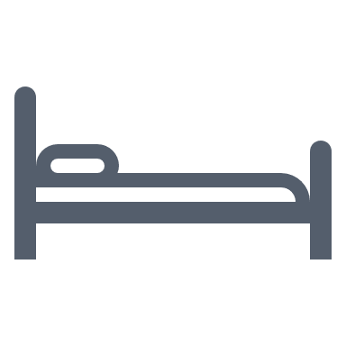
How Financial Stress Impacts Your Health
Changes in physical health
Unhealthy coping behaviours
Poor mental health
Relationship difficulties
Issues with sleep
Notes:
How FINANCIAL STRESS impacts your health
Changes in Physical Health. Stress can quickly manifest into physical problems such as headaches, muscle tension and pain, and gastrointestinal issues. Over time, more serious problems like high blood pressure and heart disease can arise.
Poor Mental Health. Worrying about money increases irritability, nervousness, anxiety, and depression. Those with existing mental health issues are also likely to report worsening symptoms as a result of financial stress.
Issues with Sleep. Fatigue and sleeplessness are common when you’re concerned about your finances. This makes it difficult for you to focus and function at your best during the day. Healthy habits often slip because you’re too tired.
Unhealthy Coping Behaviours. People often lean on unhealthy habits to deal with money-related stress. Examples may include overeating, smoking, using alcohol, or spending excessive periods of time surfing the internet or watching television. These behaviours can lead to additional stress and negative effects on your physical and mental health.
Relationship Difficulties. Money is one of the most common issues couples argue about. Financial stress can make you angry and irritable, cause a loss of interest in sex, and wear away at the foundations of even the strongest relationships. You may also begin to withdraw from friends and social interactions, which will only worsen your stress levels.

Slide 15


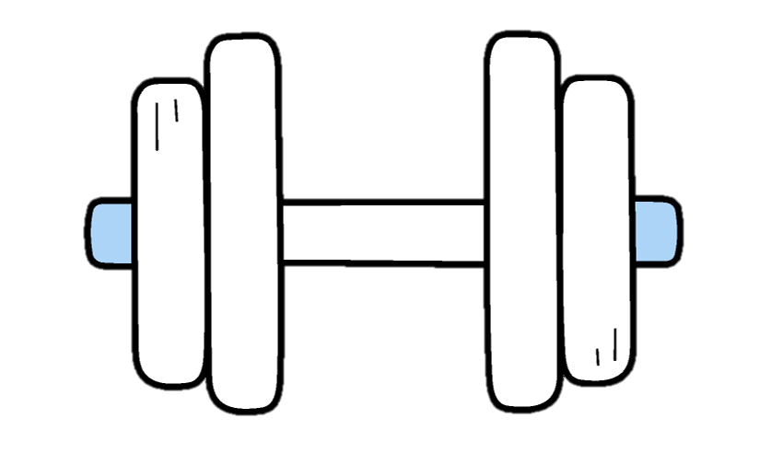

Better Financial Wellness = Better Health!
People who are financially prepared are 2.5 times more likely to have healthy habits like eating fruits and vegetables and exercising regularly.
Notes:
People who are financially prepared are more likely to be healthier. They are 2.5 times more likely to have healthy habits like eating fruits and vegetables and exercising regularly. So, ensuring that you’re supporting your financial wellness is important to other areas of health too!

Slide 16
Coping with Financial Stress
Educate Yourself
Speak with experts, take a class, read books, or listen to podcasts to improve your financial literacy.
Practice Self-Care
Manage stress with proper sleep, regular exercise, a healthy diet, and relaxation techniques.
Get Support
Work with a financial professional to identify priorities and strategies appropriate for your financial situation.
Notes:
Educate yourself
A recent study found that 73% of people want to be more confident in their financial decisions. Invest in yourself by improving your financial literacy. Speak with experts, take a class, read books, or listen to podcasts. While becoming financially savvy requires effort and attention, it’s 100% doable!
Practice self-care
Addressing financial issues can take time, so you need to ensure you find ways to care for your well-being as you go. Proper sleep, regular exercise, a healthy diet, and relaxation techniques can help you manage stress as you work on improving your financial challenges.
Get support
Working with a financial professional can help you make sense of your financial situation, identify priorities and strategies, and start taking steps toward reducing financial stress.

Slide 17
Money Mindset

Slide 18

Your Outlook on Money
Money Mindset: What you believe and how you interact with your money.
Understanding your money mindset is the first step to gaining control over your finances and improving your financial well-being.
Notes:
Your mindset is a powerful thing. It influences how you feel, think, and act. It can hold you back or propel you forward and, therefore, plays a significant role in determining life’s outcomes. A healthy money mindset is at the foundation of a great relationship with your finances. Your money mindset is the set of beliefs you hold regarding money and it shapes all areas of your financial life: earning, spending, saving, and giving. Culture, religion, gender, family, childhood upbringing, and education all play a role in how you relate to money – and sometimes they don’t have the best influence. Understanding your money mindset is the first step to gaining control over your finances and improving your financial well-being.

Slide 19


What’s Your Money Mindset?
Scarcity Mindset
Abundance Mindset
Notes:
There are two types of money mindset: a scarcity mindset and an abundance mindset. It’s important to recognize where your mindset lies and understand how it relates to your relationship with your personal finances.

Slide 20
What’s Your Money Mindset?
Scarcity Mindset
No amount of money is enough.
You may feel stressed or discouraged when spending money or may avoid spending altogether.
You don't believe you’re good with money or smart enough to have a lot of it.
You feel stressed about paying bills and unexpected expenses.
You feel bad about purchases or may overspend.
You avoid sharing the money you have (e.g. gifts, donations).
You avoid spending on things that bring you joy.
Notes:
With a Scarcity mindset, no amount of money is enough. You may feel stressed or discouraged when spending money or may avoid spending altogether. People with a scarcity mindset:
Don’t believe they are good with money or think they aren’t smart enough to have a lot of it.
Often feel that they are struggling financially.
Feel stressed about paying bills and even more so when unexpected expenses arise.
Feel bad about purchases or may overspend because they feel “doomed” to be in dept.
Avoid sharing money (e.g. gifts, donations).
Avoid spending on things that bring them joy.

Slide 21
What’s Your Money Mindset?
Abundance Mindset
You’re focused on opportunity and potential wealth.
You enjoy the financial journey and working towards your goals.
You appreciate the money you have regardless of the amount.
You know there’s plenty of money and you can always make more.
You don’t stress over bills or unexpected expenses.
You enjoy being generous and sharing what you can with others.
You feel confident that you can make money and reach your financial goals.
Notes:
An Abundance mindset is focused on opportunity and potential wealth. You enjoy the financial journey and working towards your goals. People with an abundance mindset:
Appreciate the money they have regardless of the amount.
Know that there’s plenty of money and that they can always make more.
Don’t stress over bills or unexpected expenses.
Enjoy being generous and sharing what they can with others.
Feel confident that they can successfully make money and reach their financial goals.

Slide 22

Changing Your Money Mindset
Stop Negative Comparisons
Know What You Want
Be Intentional With Money
1
3
5
2
4
Practice Gratitude
Write About What You Know
Notes:
If you recognize that you have a money mindset that focused on scarcity, you can work towards changing it! How?
Stop negative comparisons
Comparison fuels your mindset. It can motivate you to achieve what you want, or it can leave you feeling defeated. For example, if a friend shares pictures of their latest vacation, you may question what you’re doing wrong that you can’t afford the same. On the other hand, you can see it as a reminder of what’s possible and what you can work towards. You choose how to respond.
Practice gratitude
It’s okay to want more, but you also have to be thankful for where you are now. Focus on what you already have that makes you feel abundant. Celebrate your accomplishments, the people in your life, and the simple pleasures that you enjoy. A grateful attitude helps shift your mindset and focus on small changes you can make to help improve your situation.
Know what you want
What would you do if $10,000 landed in your account today? Whatever your answer is, the key is understanding that you don’t need the money to start doing it. Determine exactly what you want and develop a plan. No matter how small the first step may be, you can start working toward your goal.
Write about what you know
Set time aside to write about your current relationship with money. Create a list of what you know and where that knowledge came from. Then, you’ll be able to identify which beliefs and ideas are serving you, and which you should let go of.
Be intentional with money
If you take the time to look at where your money is going, you may find that you’re spending on things you don’t need – or perhaps even want. Being intentional with money means identifying what’s most important to you and your family. Spend money on what matters most and cut out the rest.

Slide 23
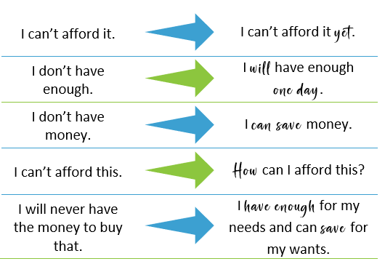
Changing Your Money Mindset
Self-Talk Matters!
Notes:
You also need to understand that your thoughts and what you say to yourself matter – a lot. Making a conscious effort to pay attention to the words you use and adjusting them to be more focused on abundance and financial opportunity can make a big difference in shifting your money mindset. Here are some examples of how you can shift your self-talk.

Slide 24
Building Good Money Habits

Slide 25

Your Actions Make a Difference
Research shows that financial well-being has more to do with behaviours than with how much money you have.
You need to build good money habits to get a better handle on your finances.
Notes:
While your economic situation does play a part, research shows that financial well-being has more to do with behaviours than with how much money is in your bank account. Building good money habits is a must if you want to get a better handle on your finances.

Slide 26
The Big One: Budgeting
The most important action that can help you improve your financial well-being is creating a monthly budget.
Creating and sticking to a spending plan is essential to establish a good relationship with money.
You must understand how much money you have and how it flows in order to manage it appropriately.
Notes:
If you don’t feel like you have control over your finances, chances are you avoid looking at them in detail. Perhaps you tell yourself that debt is normal or that you’ll never make enough money to be able to save as much as you’d like to so there’s not much point in trying to change things. Avoidance is a common reason why people get comfortable with debt or don’t establish and plan for their financial goals. The best (and only) way to change this is to shift your mindset and schedule consistent time to work on your finances. Creating a budget and sticking to your spending plan is one of the most important actions you can take to help establish a good relationship with money. It’s essential to know how much money you have to work with and how that money flows in order to manage it appropriately.

Slide 27

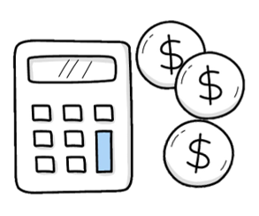

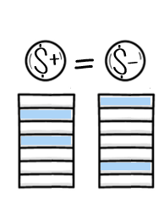

How to Budget
Gather your financial information
Calculate your net income
List your fixed and variable expenses
Repeat!
Calculate the difference
Track your spending
Notes:
So how do you budget your finances?
Gather your financial information including bills, bank statements, credit card statements – anything you currently spend money on.
Calculate your net income. This is the total amount that you have to budget with.
List your expenses. Reference the information in step 1 to create your list of fixed (same amount each month) and variable (can change from month to month) expenses
Calculate the difference. Subtract your expenses from your income to determine where you stand. From here, you can adjust so your expenses do not exceed your income.
Track your spending. Your budget is your reference. Each day, record your actual spending so you can monitor your progress and adjust as you go, if necessary, to stay on budget.

Slide 28

How to Budget
TIPS
Make budgeting a family affair.
Remember that every month is different.
Include debt repayment.
Use tools that work for you.
Maintain it with a weekly financial routine.
Notes:
Make budgeting a family affair. If you have a partner, do your budget together. You need to be on the same page with how you spend and save.
Remember that every month is different. Some months come with specific expenses (e.g. birthdays, car maintenance), so you need to adjust your budget accordingly. If you can, incorporate a savings fund for bigger spends you know are coming (e.g. Christmas shopping in December). Planning ahead will help avoid stress.
Include debt repayment. If you have debt, paying it off needs to be a top priority. No matter how small the contribution, it will help. The sooner you pay it off, the sooner you can reallocate those funds to another category.
Use tools that work for you. If spreadsheets aren’t your thing, there are plenty of online tools and apps that can help you create and manage a budget that will keep you on track.
Create a weekly financial routine. Set time aside each week to review bank accounts, bill due dates, financials goals, and your budget of course. These checks throughout the month will help avoid surprises and missed payments, and they keep your goals top of mind.

Slide 29

What else can you do?
Upgrade your environment
Create an environment that helps you accomplish what you want.
Example:
  To reduce the temptation to spend, delete shopping apps on your phone, leave your credit card at home, or pack your lunch.
Notes:
Budgeting is essential to improving your financial well-being, but it isn’t the only thing you can do. There are other habits you can incorporate into your lifestyle to help improve your financial well-being.
upgrade your environment.
If you’re trying to improve your eating habits, filling your pantry with cookies and treats isn’t a great idea. The same thinking goes for your finances. Identify ways to reduce the temptation to spend: delete shopping apps on your phone, leave your credit card at home, prep the coffee maker and pack a lunch the night before. Setting up your environment with your goals in mind will help set you up for success.

Slide 30
What else can you do?
Reward Achievements
Establish an incentive to keep you motivated.
Monitor your progress and celebrate your success with an inexpensive reward.
Notes:
reward your achievements.
Making changes to your spending habits can be hard. Monitor your progress and celebrate your success with an inexpensive reward like your favourite fancy coffee or a quiet me-time with a new library book. Establishing the incentive beforehand can help keep you motivated.

Slide 31

What else can you do?
Don’t Wait to Start Saving
Include saving in your budget – no matter the amount.
Establish a savings goal, so you know what you’re working toward and can track your progress.
Notes:
don’t wait to start saving.
Even if you can’t contribute a large amount each month, it’s important to make savings part of your monthly budget. You may not be able to allocate the ideal amount right away, but looking at saving as a priority will make a difference in the long run. If you can only budget five dollars on savings, it’s still a start. Establish a savings goal, so you know what you’re working toward and can track your progress. Find more ways to contribute to savings by looking for opportunities to adjust your variable expenses. For example, pull out your coffee maker and brew coffee at home rather than doing a daily coffee run, pass on Friday night take-out, or cancel a monthly subscription you can do without for now. While it may be difficult to give up some small luxuries, it doesn’t have to be forever. What you will gain in the peace of mind that comes from having an emergency fund or savings for your future is worth it.

Slide 32

What else can you do?
Have a Debt Repayment Plan
Leverage your budget to pay more than the minimum if you can.
Adjust variable spending so you pay more towards debt.
Find a process that works for you.
  Examples: Snowball Method, Avalanche Method
Notes:
make a debt repayment plan.
Instead of just paying the minimum and hoping for the best, it’s important to make a plan. Your budget is an ally when it comes to a debt repayment plan. Look for opportunities to adjust variable spending so you pay more towards debt repayment. There are different strategies that you can investigate to find a process that works for you (TIP: Check out the Snowball Method and Avalanche Method).

Slide 33

What else can you do?
Consider a Side Hustle
Boost finances with a fun and rewarding side gig.
Examples:
  Sell crafts you make.
  Clean homes or offices.
  Offer dog-walking services.
Notes:
consider a side hustle.
A side gig can be a fun and rewarding way to boost finances, especially if you monetize a hobby. Get creative with your skills: sell something you make, offer cleaning or dog walking services, or be an Uber driver.

Slide 34

What else can you do?
Leverage Micro Habits
Simple day-to-day actions that can lead to meaningful behaviour changes over time.
Examples:
  Limit coffee purchases by buying a gift card each month.
  Implement a 24-hour waiting period on new purchases.
Notes:
As much as you’d like to be able to budget 20% of your income for savings, that just may not be realistic at this point in your life. That’s ok! There are still meaningful changes you can make to get on track and work towards your financial goals. Micro habits are simple, manageable actions that you can implement into your day, and they can result in meaningful behaviour changes over time. Here are a few examples:
Limit your coffee purchases by buying a gift card from your favourite spot at the beginning of the month. Consider this your monthly budget. Once it’s spent, you brew your own coffee at home.
Implement a 24-hour “cool down” on new purchases to prevent impulse buying. This waiting period will give you time to rethink your purchase and determine if you really need – or even want – an item.
Others:
Plan your shopping. It’s easy to be tempted by new product displays and sales. If you need to visit a store, make a list of what you need and stick to it. Meal plan and hit the grocery store once a week.
Automate your savings. It’s much easier to spend money if you see it in your bank account. You may have allocated funds to savings in your budget, but if it’s simply sitting in your cheque account, you may be tempted to spend it.

Slide 35
Future Finances

Slide 36

Know Where You’re Going
Goals are an important part of your financial wellness journey.
Notes:
Financial goals is important to your financial wellness journey. Goals, in general, benefit your life by creating focus, motivation, and confidence. But, when you include defined financial objectives in your plan, you set yourself up for stability and security as well as successful outcomes that benefit, not only your financial situation but other areas of your life.

Slide 37
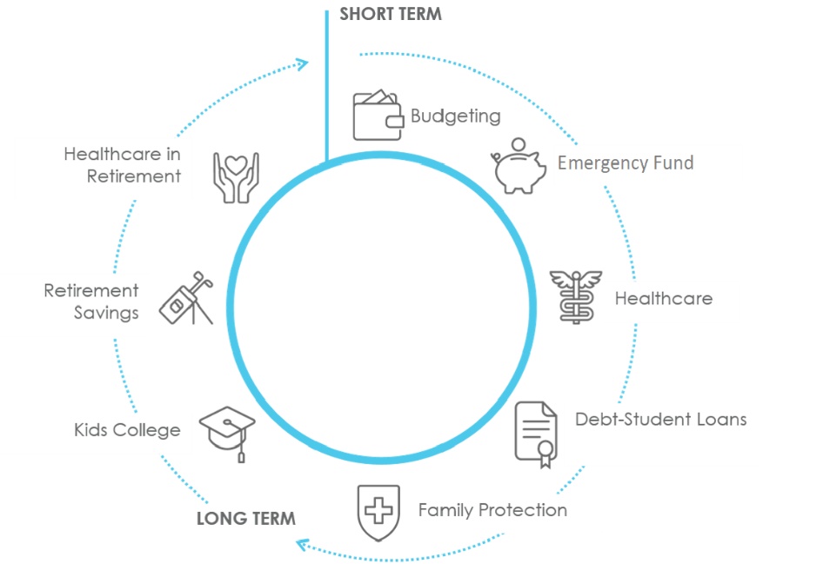
Know Where You’re Going
SHORT-TERM GOALS can be achieved within a year.
Examples:
  Cut monthly spending.
  Start an emergency fund.
  Save for vacation.
MID-TERM GOALS take 1 to 5 years to achieve.
Examples:
  Save for a home down payment.
  Pay off a larger debt.
LONG-TERM GOALS take 5 or more years to achieve.
Examples:
  Start a retirement fund.
  Pay off mortgage.
  Save for children’s tuition.
Notes:
Short-term goals can be accomplished within a year. They tend to be easier to plan and focus on current issues in your life. Some examples are cutting monthly spending, establishing an emergency fund, paying off smaller debts, and saving for a vacation or home improvement project.
Mid-term goals are a gray area since they may overlap with certain short- or long-term goals. They generally take 1 to 5 years to achieve. Perhaps it’s saving for a car or a down payment on a home, or paying off larger debts.
Long-term goals typically take 5 years or more to accomplish and require more time and planning. Perhaps you’d like to have a retirement fund, save for your child’s tuition, or pay off your mortgage. They tend to focus on major life events and may require re-evaluation as circumstances develop and change over time.

Slide 38

Know Where You’re Going
Number-Based Goals
Associated with a specific value amount.
Examples:
  $5000 emergency fund
  Decrease spending by $100
  $10,000 for a 10-year anniversary vacation
Habit-Based Goals
Associated with behaviours.
Examples:
  Pay monthly credit card bill in full
  Automate bill payments
  Plan and stick to weekly grocery lists
Notes:
In addition to the timeline, financial goals can also be categorized as number-based or habit-based.
number-based goals
Naturally, financial goals will have numbers associated with them. A number-based goal has a specific amount associated with it, so you know exactly how much money is required to achieve it. Here are some examples:
Create an emergency fund with $5,000.
Pay off your mortgage before you retire.
Maximize your RRSP contributions this year.
Save $10,000 for a 10-year anniversary vacation.
Decrease your monthly grocery bill by $100.
Find a way to make an extra $150/month.
habit-based goals
Habit-based goals have to do with behaviours - how you interact with money. While they tend to support numbers-based goals, they are valuable in their own right because they help you create a healthy relationship with your finances. Some examples include:
Pay off your credit card entirely each month.
Pay for all vacations in cash.
Start donating to a cause that’s important to you.
Automate your bill payments so they are paid on time.
Create weekly grocery lists and stick to them.

Slide 39


Financial fitness is not a pipe dream or a state of mind. It’s a reality if you are willing to pursue it and embrace it.
- Will Robinson

Slide 40

Thank You for Participating
Questions?

